Slide 1
Team RCD -
Robot Can Dance
by
Memoona Shah
Fabian Vincenzi

Slide 2
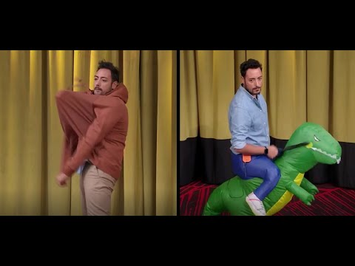
The Choreography
‘Ride it - Regard’
Popular song
Iconic moves from ‘LOL - chi ride è fuori’

Slide 3
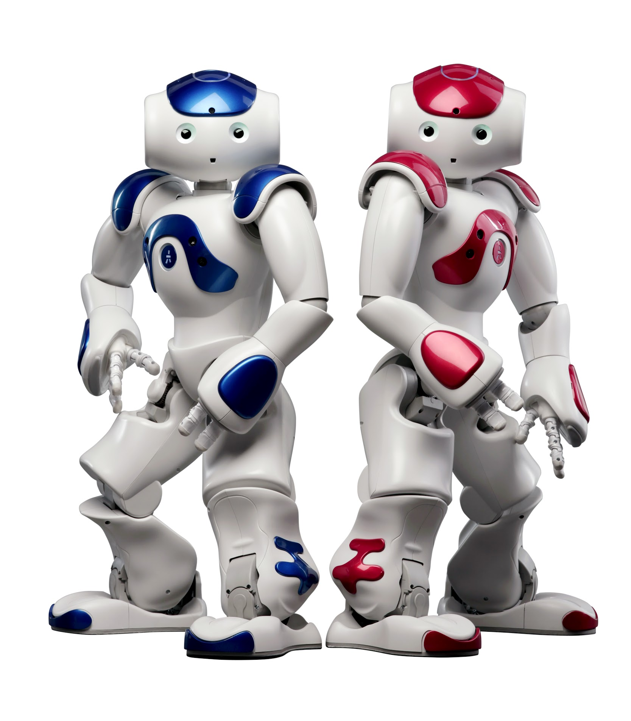
Strategies
We started from the initial state and tried to reach the goal state with robot moves that works with the rhythms of the music
We tried to replicate the human dance for the chorus
We implemented arms and legs movements in parallel
Almost all the moves have time cost zero
Few moves have 1 sec delay to make transitions from one move to another smooth

Slide 4
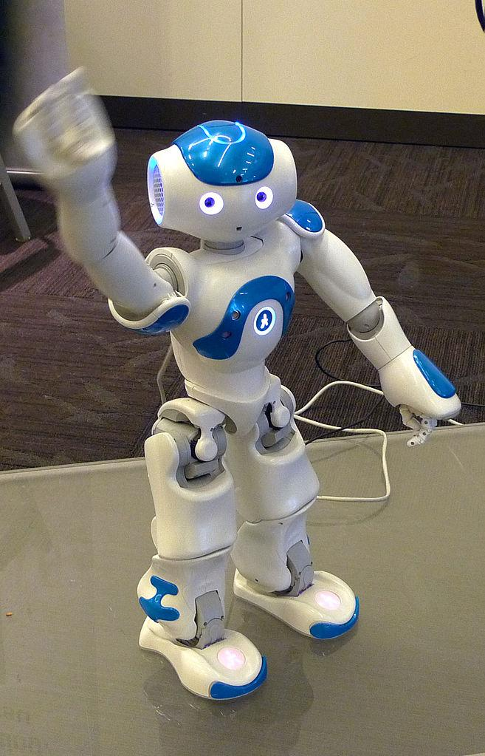
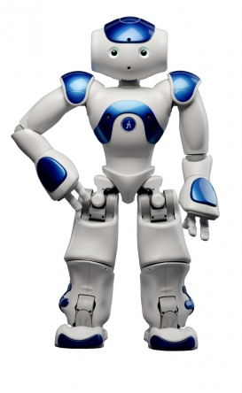
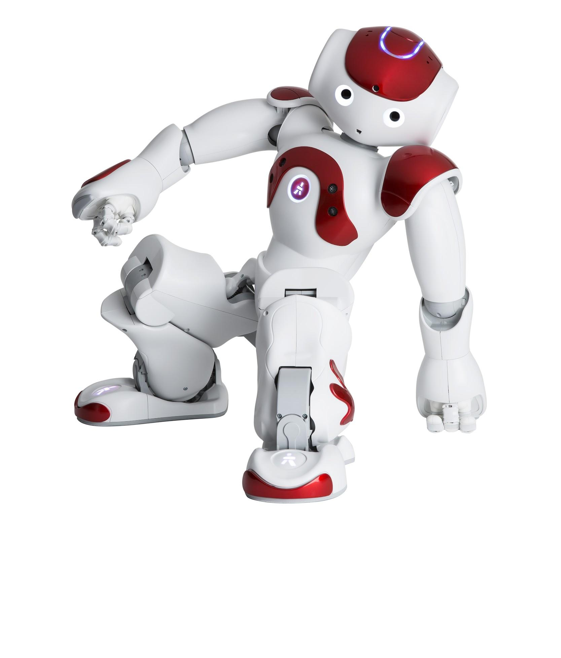
Moves
Mandatory positions [StandInit, Sit, Wipe Forehead, Hello, SitRelax, StandZero, Crouch]
Intermediate positions [Move To, Point At, Lying back, Look At]

Slide 5
Thankyou

