Slide 1

Big Data Lab – insider movies
Robin Kreuzig & Jens Rembe 05.02.2018
Notes:
„
Robin Kreuzig & Jens Rembe

Slide 2
Agenda
Motivation and objective
Data streaming
Data analyse
Searching for insider tipps
Visualization
Robin Kreuzig & Jens Rembe 05.02.2018
Notes:
Richtung = positiv - neutral - negativ
Intensität: je ausgeprägter, desto intensiver
Generalität = bei psychisch Gesunden tendieren alle Selbstkonzepte zur Orientierung an sozial erwünschten Merkmalen (Positivität)
...
Real vs. Ideal: wichtig ist hier die Unterscheidung in Selbstwahrnehmung, Selbstbewertung, Selbstdarstellung gegenüber bewußte Verfälschung (mangelnde Offenheit)
Robin Kreuzig & Jens Rembe

Slide 3

1 Motivation and objective
What movie should we watch next?
  Searching for insider tipps
Research movies, which nobody knows
To find good movies which are not known by everybody.
Robin Kreuzig & Jens Rembe 05.02.2018

Slide 4
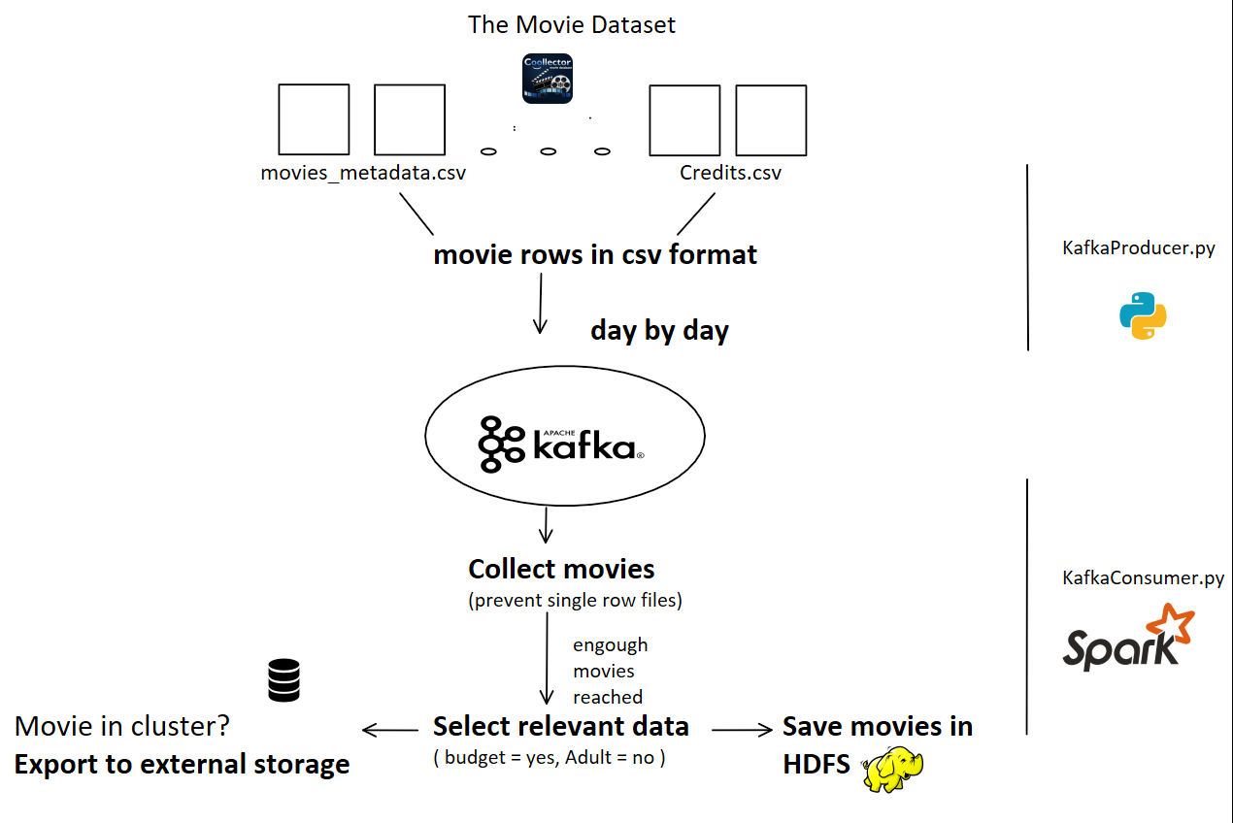


2 Data streaming
Robin Kreuzig & Jens Rembe 05.02.2018

Slide 5
3 Data analyse
Create hive table:
    CREATE EXTERNAL TABLE movies_avro
    (budget DOUBLE, title STRING, genre STRING, month TINYINT, day TINYINT, revenue DOUBLE, vote_average FLOAT, vote_count FLOAT )
    STORED AS AVRO
    PARTIONED BY (year SMALLINT)
    LOCATION ‘‘/movies/‘‘
Robin Kreuzig & Jens Rembe 05.02.2018

Slide 6
3 Data analyse
Discover data:
    SELECT COUNT(*) FROM movies_avro;
    45,294
    SELECT COUNT(*) FROM movies_avro
    WHERE budget > 0;
    8,886
Robin Kreuzig & Jens Rembe 05.02.2018

Slide 7
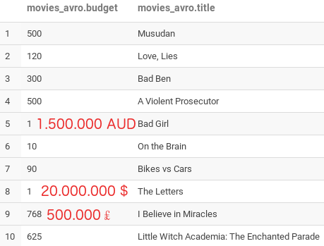
3 Data analyse
Discover data:
    SELECT budget, title FROM movies_avro
    WHERE budget < 999;
Robin Kreuzig & Jens Rembe 05.02.2018

Slide 8
3 Data analyse
Discover data:
    SELECT COUNT(*) FROM movies_avro
    WHERE budget >= 999
    AND revenue >=1
    AND vote_count >=5
    AND vote_average >=7;
    1,241
    Lost many movies bad dataset
Robin Kreuzig & Jens Rembe 05.02.2018

Slide 9
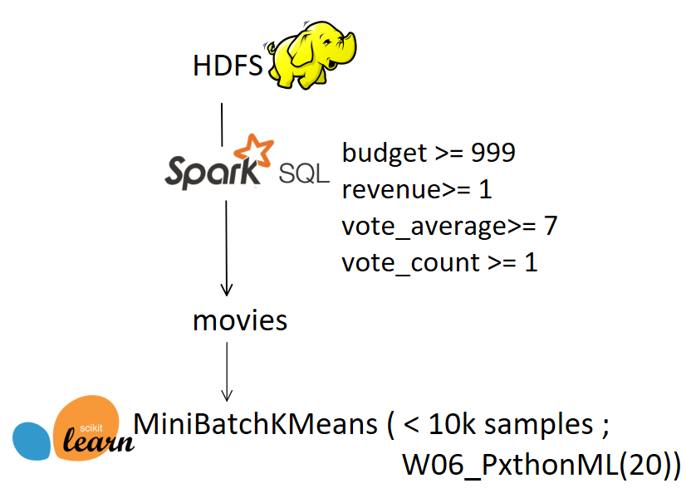
4 Clustering
Clustering.ipynb
Robin Kreuzig & Jens Rembe 05.02.2018

Slide 10
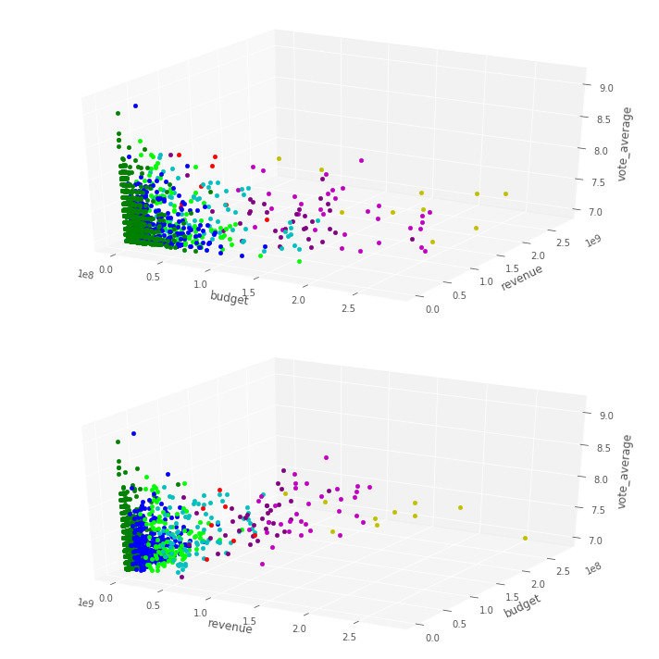
4 Clustering
Insider movies in dark green cluster
  low budget
  low average
Save cluster and model in hdfs
  KafkaConsumer.py
Export insider movies into MySQL DB in external storage
Robin Kreuzig & Jens Rembe 05.02.2018

Slide 11
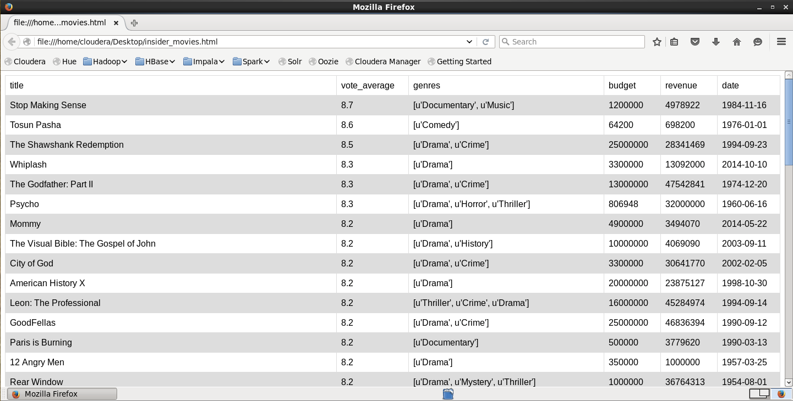
5 Visualization
Robin Kreuzig & Jens Rembe 05.02.2018

Slide 12
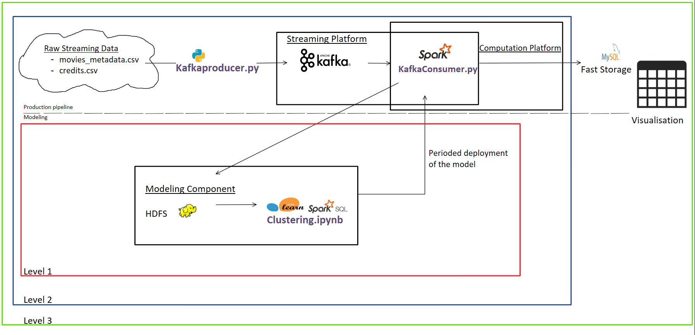
Thank you for your attention
Robin Kreuzig & Jens Rembe 05.02.2018

