Slide 1
Project presentation
COMP2031 - Data Engineering
Semester 1, 2024
Time limit for the duration of the presentation: 5 minutes {so I’m advised to be as concise as possible}
My name: Kory Frankee
My FAN ID: fran0618

Slide 2
Techniques used

Slide 3
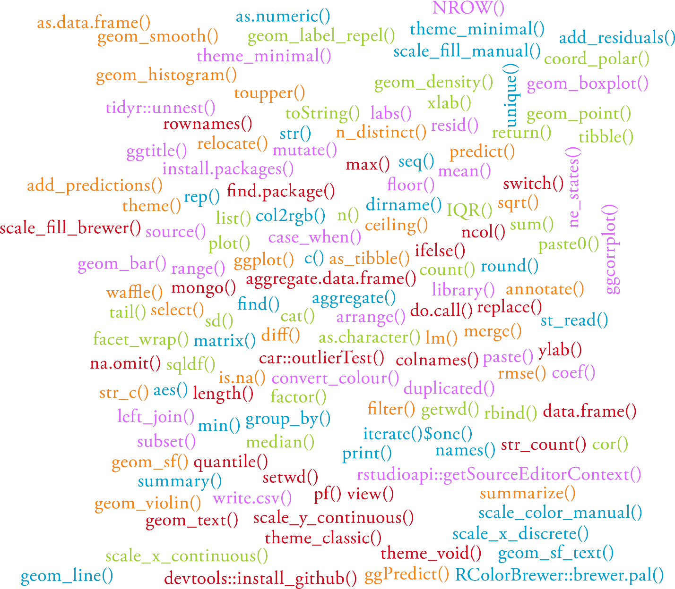
To help me accomplish what I wanted to do, I used all kinds of functions from base R, custom-written functions, as well as functions from over 20 packages

Slide 4
Data wrangling

Slide 5
Loading the data in
Retrieved data from a MongoDB collection and put it into a tibble {MongoDB}
Retrieved data from .csv files and put this data into a tibble {Oulad}

Slide 6
Tidying the data
Checked for redundant data {MongoDB & Oulad}
Clarified the names of the columns {Oulad}
Corrected misspelt values {Oulad}
Corrected the assessment weightings {Oulad}
Filled in missing student scores with zero {Oulad}
Filled in missing exam due dates with the last week of the course value {Oulad}
Filled in missing IMD values with the most common IMD value for that region {Oulad}
Made it so the grade a student receives is based on their score {Oulad}
Either split or merged tables if that made it easier for me to work with the data {Oulad}
Removed columns with a lot of missing data that I didn’t intend on working with such as the columns for when a student used and stopped using VLE materials {Oulad}
Replaced abbreviated terms with their unabbreviated version {Oulad}
Unnested nested columns {MongoDB}
Used “yes”/”no” in place of “1”/”0” where “1”/”0” was used to mean this {Oulad}
Filtered for the data I wanted, which helped me to analyze and visualize the data {Oulad}
Reordering data {Oulad}

Slide 7
Data transformation

Slide 8
New variables created
Created a did the student withdraw from or complete the course column {Oulad}
Created a grades column {MongoDB & Oulad}
Created an assessment weightings column that I used to calculate the weighted score in the case of a student taking an exam with other assessment items (the values of this column consist of a re-scaled version of the existing assessment weightings so that they add up to 100%) {Oulad}
Created a weighted score column {Oulad}
Created a cumulative grade column {Oulad}
Created a difference between when student handed in the assignment and the assignment due date column {Oulad}
Created a has student taken an exam column {Oulad}
Created a sum of the weighted scores column {Oulad}
Created a column where I grouped the module and presentation IDs {Oulad}
Created a column that converts the grade a student received to its numerical equivalent {Oulad}
Created a column works out the grade points {Oulad}
Created a column that works out the total credits a course is worth {Oulad}

Slide 9
Data analysis and visualization

Slide 10
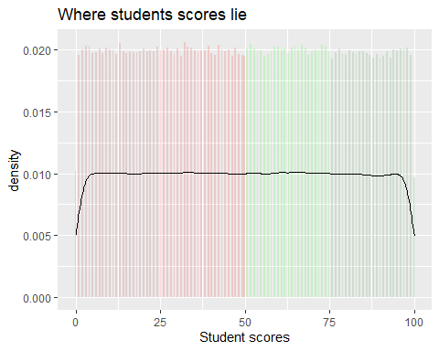
Uncovered findings: Student scores had a uniform distribution, which was one of several indications that the mock data was unrealistic {MongoDB}

Slide 11
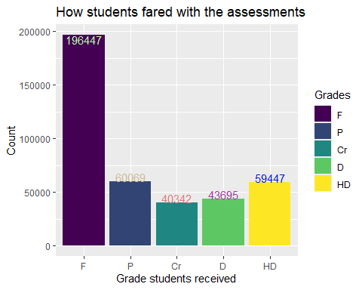
Uncovered findings: Revealed that more students succeed with their assignments than fail at them by a small margin. This means that students are underperforming or that the markers are harsh {MongoDB}

Slide 12
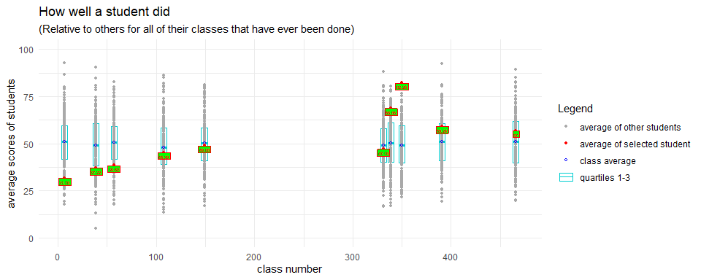
Uncovered findings: Revealed that I could visualize how a student performs and compare their performance to how all other students that share the same class performed {MongoDB}

Slide 13
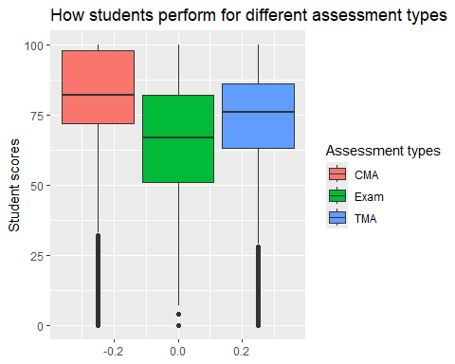
Uncovered findings: Students score the best for ‘CMA” assessments, second best for “TMA assessments”, and worst for “Exam” assessments {Oulad}

Slide 14
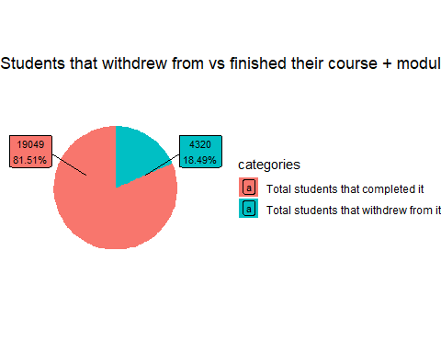
Uncovered findings: Most (~ 81.51% of) students completed their studies but lots of (~ 18.49% of) students withdrew {Oulad}

Slide 15
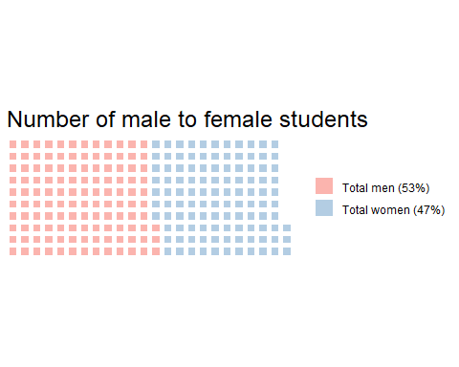
Uncovered findings: The gender balance of the students is near even with ~ 53% of them being men and ~ 47% being women {Oulad}

Slide 16
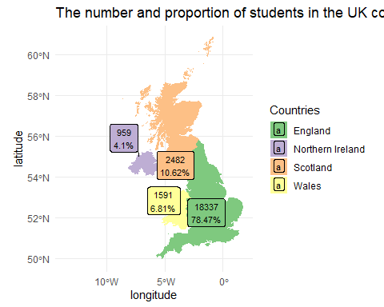
Uncovered findings: Most (~ 78.47% of) students come from England, 2nd most (~ 10.62% of) students come from Scotland, 3rd most (~6.81% of) students come from Wales, and 4th most (~ 4.1% of) students come from Northern Ireland {Oulad}

Slide 17
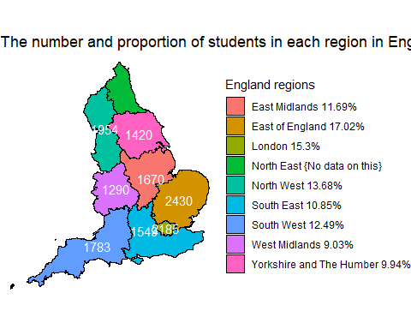
Uncovered findings: Students from almost all over England are taking these courses – there’s still the potential for the institution to reach students from Northeast England {Oulad}

Slide 18
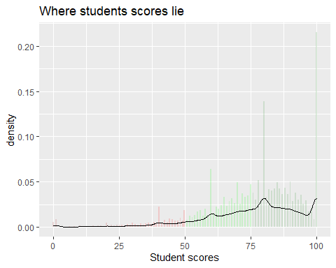
Uncovered findings: Student scores skew positively, which is good as I don’t think students would want to study an institution where scores negatively {Oulad}

Slide 19
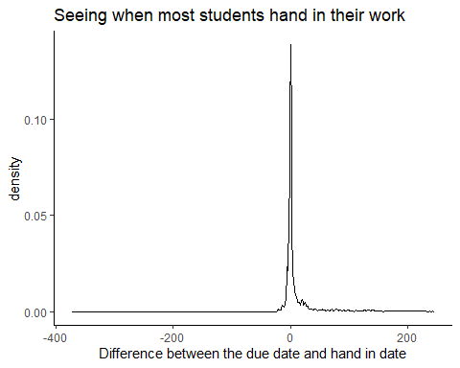
Uncovered findings: Students tended to hand in their assignments within a few days of if not on the day their assignment was due {Oulad}

Slide 20
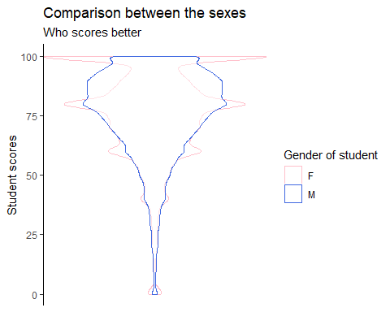
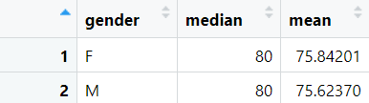
Uncovered findings: Both genders score about as good as each other {Oulad}

Slide 21
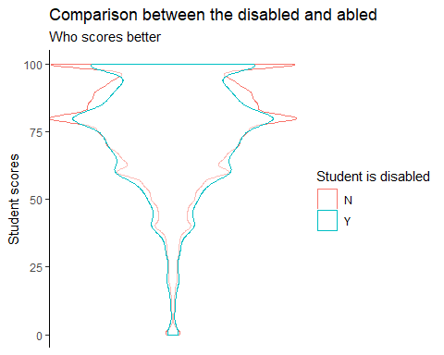
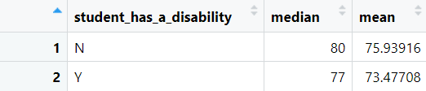
Uncovered findings: Students without a disability have a slight edge over the students that do {Oulad}

Slide 22
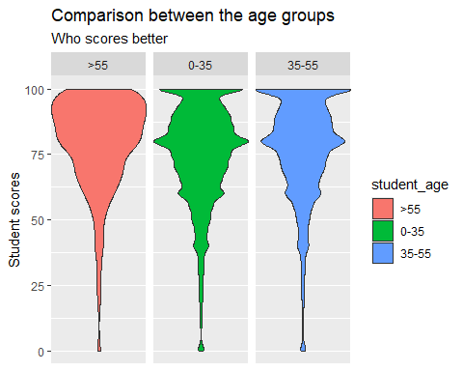
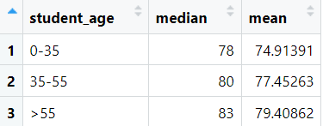
Uncovered findings: Students that are older have a slight edge over students that are younger {Oulad}

Slide 23
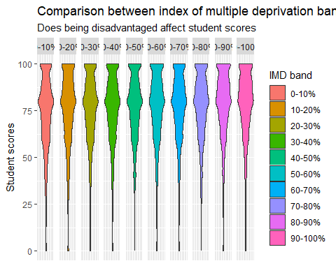
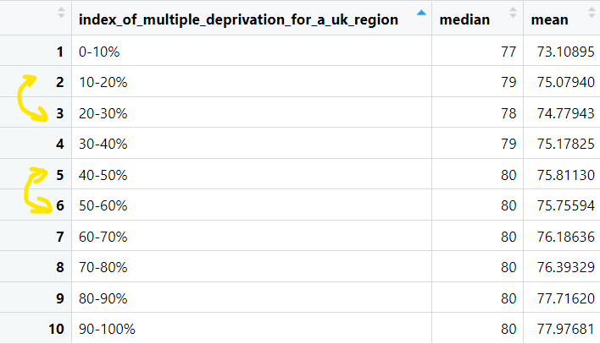
Uncovered findings: Students that are less impoverished generally have a slight edge over students that are more improvised {Oulad}

Slide 24
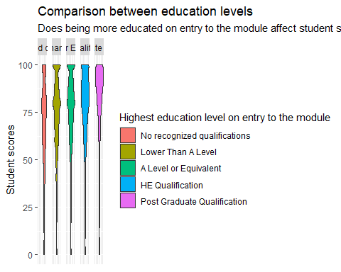
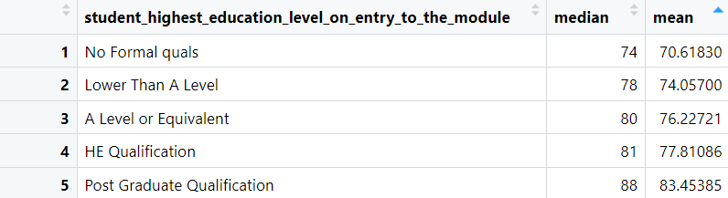
Uncovered findings: Students that are more well educated on entry have an edge over less educated students {Oulad}

Slide 25
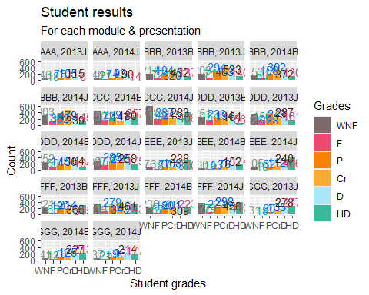


Uncovered findings: Students perform the best in module + presentation combination “EEE, 2014J” and the worst in “DDD, 2013B” {Oulad}

Slide 26
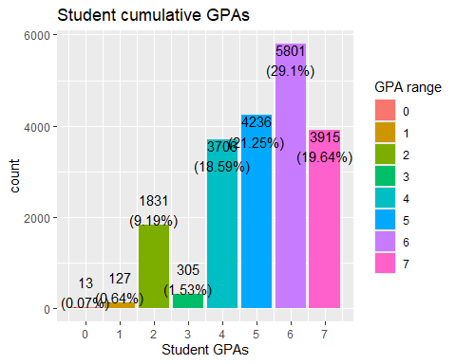
Uncovered findings: Most {~ 59.99%} students have a high enough cumulative GPA (> 4.5) for postgraduate studies

Slide 27
Data modelling

Slide 28
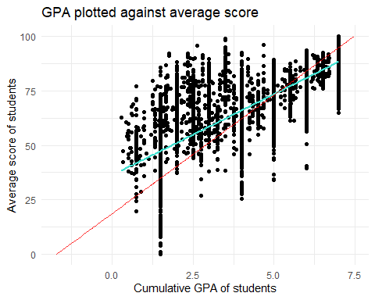

Simple linear model: {Continuous predictor} Linear model 01 – Relationship between cumulative GPA of a student (y) and the average score of a student (x) Model is the best fit I was able to obtain

Slide 29
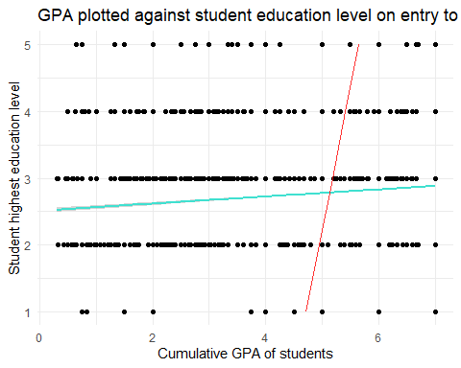
Simple linear model: {Categorical predictor} Linear model 02 – Relationship between cumulative GPA of a student (y) and the education level of the student on entry to the module (x) Model is clearly a poor fit

Slide 30
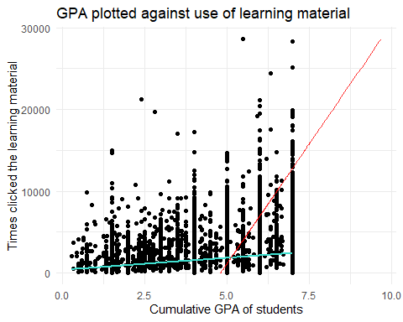
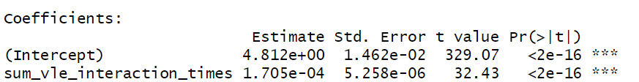
Simple linear model: {Continuous predictor} Linear model 03 – Relationship between cumulative GPA of a student (y) and the total times a student has clicked onto VLE learning material {x} Model is clearly a poor fit

Slide 31
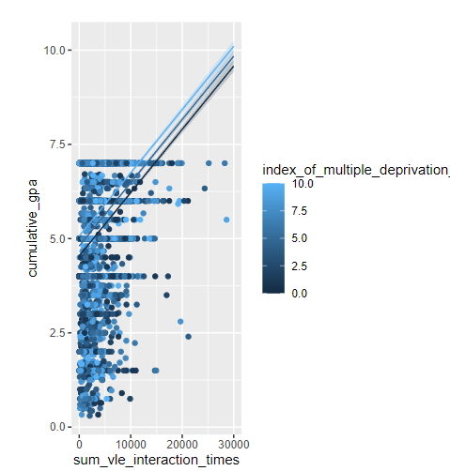
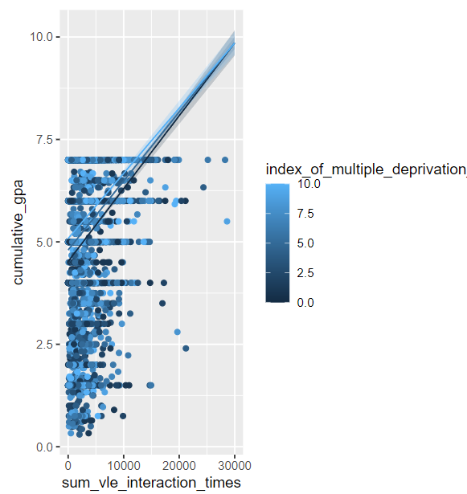
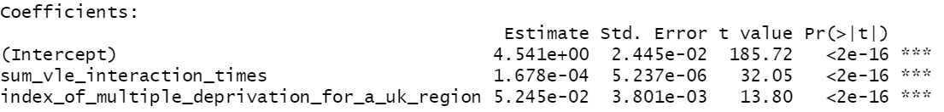
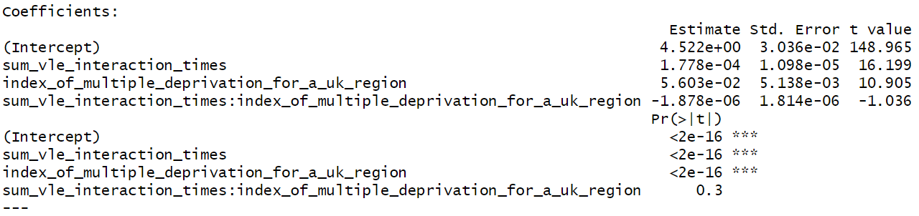
General linear model: {Categorical and continuous predictor} Linear model 04 (+ between terms) & 05 (* between terms) – Relationship between the cumulative GPA of a student (y) and total VLE learning material clicks (x₁) and IMD band (x₂) Model is clearly a poor fit

Slide 32
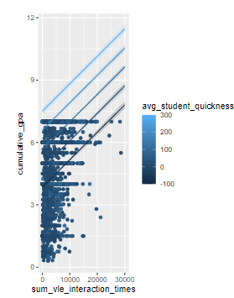
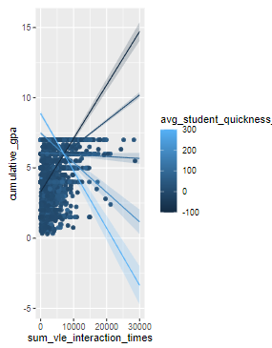
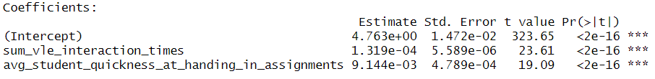
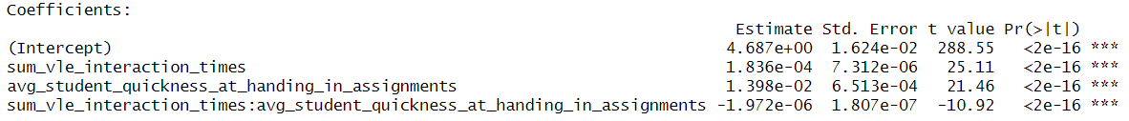
General linear model: {Two continuous predictors} Linear model 06 (+ between terms) & 07 (* between terms) - Relationship between the cumulative GPA of a student (y) and average student quickness at handing in assignments (x₁) and total VLE learning material clicks (x₂) Model is clearly a poor fit

Slide 33
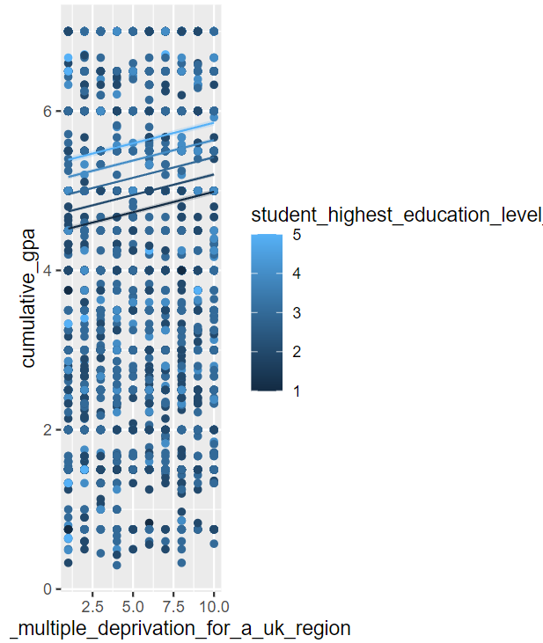
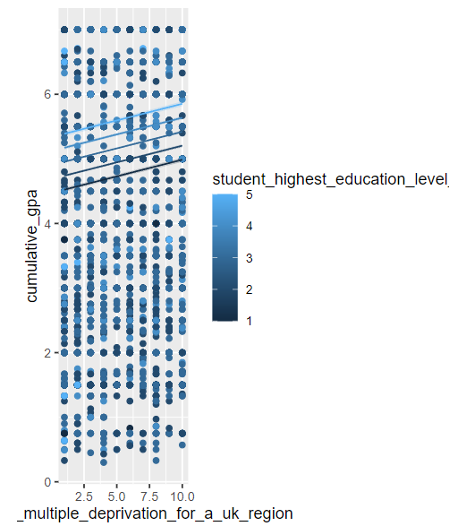
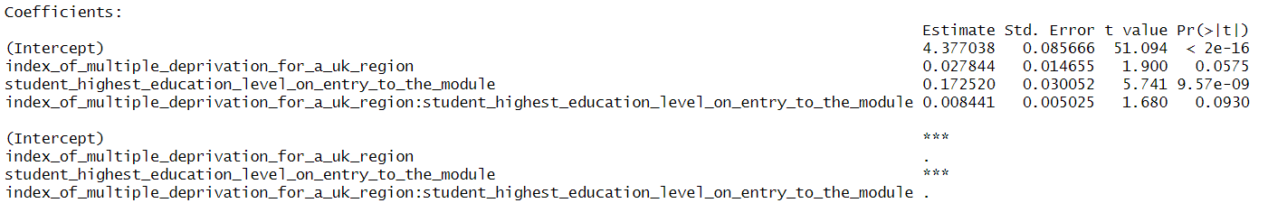
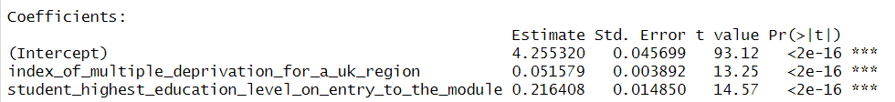
General linear model: {Two categorical predictors} Linear model 08 & 09 - Relationship between the cumulative GPA of a student (y) and IMD band (x₁) and highest education level on entry (x₂) Model is clearly a poor fit

Slide 34
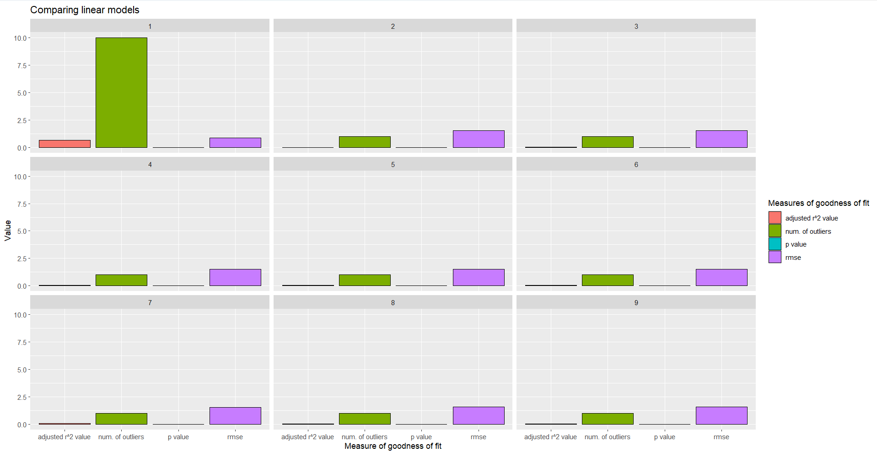
Model evaluation
Linear model 01 (predicting the cumulative GPA based on the average score of a student) performed the best considering its adjusted r^2 value (closest to 1) and rmse (closest to 0) but it did have the most outliers

