Slide 1
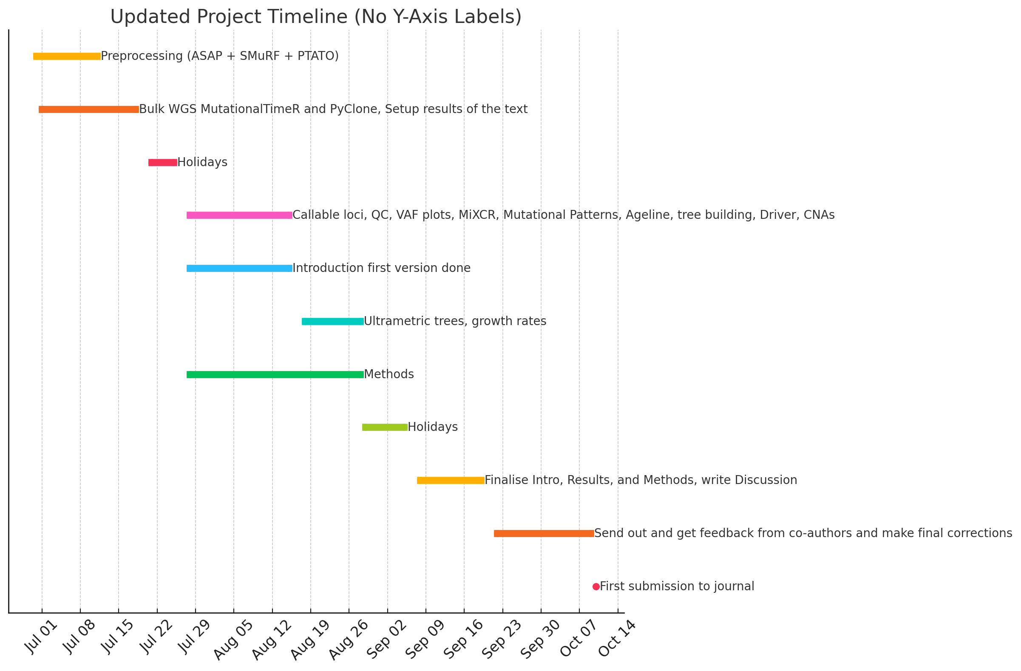
Burkitt Manuscript timeline

Slide 2
Figure 1 Tumor cells have more mutations than expected healthy memory B cells
Overview of experimental pipeline for scWGS
IGV screenshot for myc translocation
Ageline with myc-SBS-, myc-SBS+ and myc+ cells

Slide 3
Figure 2 Intra-tumoral heterogeneity
Absolute tree 28306 ASC with drivers and CNAs
Absolute tree 27774 ASC with drivers and CNAs
Absolute tree 27548 ASC with drivers and CNAs
Absolute tree P3G6 ASC with drivers and CNAs
Mutational sigs early vs (intermediate vs) private
MutationalTimeR to time driver mutations compared to CNAs

Slide 4
Figure 3 Timing tumorigenesis in years
SBSblood or C>T to show that one constant mutation rate in normal and constant? Rate in malignant
Ultrametric tree 27774 with drivers and CNAs
Ultrametric tree 28306 with drivers and CNAs
Ultrametric tree 27548 with drivers and CNAs
Ultrametric tree P3G6 with drivers and CNAs
Ultrametric tree PB08410 with drivers and CNAs
Ultrametric tree PB14458 with drivers and CNAs

Slide 5
Figure 4
Growth rates vs latency period
Doubling time vs latency period

Slide 6
Figure 5 Inter-tumoral heterogeneity
Absolute tree PB08410 LN + BM with drivers and CNAs
Absolute tree PB14458 PL + BM with drivers and CNAs
MIXCR to show clones are same/different
Mutational signatures between sites? If interesting
Ultrametric PB08410
Ultrametric PB14458

Slide 7
Supplementary figures
Sorting strategy example
QC for post-PTATO (callable vs coverage)
Violin plot with bulk
MiXCR
CNA examples
Mutational signatures per sample
Mutational patterns myc vs non-myc
Mutational signatures on absolute trees
Cosine similarity for branches
Oncoplot of diagnostic cohort
GISTIC recurrent amps and deletions of diagnostic cohort
PCR bands for normal B cells to show MYC::IGH translocation
O/E ratio using healthy SBS9+/- reference + bulk diagnostics + bulk samples + single-cell SBS9+/-/myc-t
Distribution of estimated relative timing of CNA events.
Average estimated relative timings of recurrent CNA events.
Schematic overview of the mutation timing groups. CNAs are divided into three timing groups (early, middle, late) and mutations are timed before or after the CNA event, resulting in six groups.
Relative contributions of SBS signatures to SNVs in timing groups.
Timing of driver mutations, grouped by gene.
Timing of hotspot mutations, grouped by sample.

Slide 8
Supp tables
Patient clinical info
Driver mutations before selection
Mutations before and after PTATO filtering

