Slide 1
ISEP · COMPENSATION PROJECT 2025/2026 · 5 ECTS
Gym Buddies
Find a training partner. Train together. Stay motivated.
Joaquim Kéloglanian · 20 min + 30 min Q&A · wiki ab679f9+#71
Notes:
One line: social app to find a gym buddy. Do not start with the stack.

Slide 2
PROBLEM
Athletes train alone.
No partner
No graph
No trust
A session dies when nobody is free at the same hour and gym.
Existing social apps are not built around sport, place, and time.
Public profiles leak; private ones hide the people you need.
Gym Buddies · problem
02
Notes:
Keep it human. No stack yet.

Slide 3
SCOPE
Three modules, one product.
In scope | Out of scope
Feed, posts, likes, nested comments, friends, public/private profiles, events, search, suggestions, DMs, JWT, MinIO, fixtures, admin | Native iOS/Android, payments, ads, wearables, white-label, E2E encryption, group chat
Cadrage with the instructor did not happen (holiday). Specs are not blocked on that meeting.
Gym Buddies · scope
03
Notes:
Point at 01-Scope-and-modules.md. Mention cadrage will not happen.

Slide 4
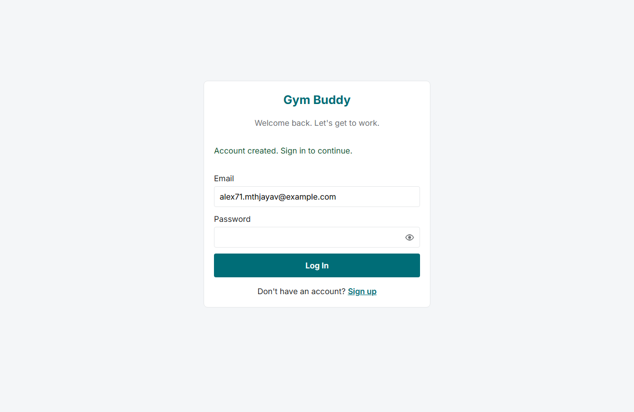
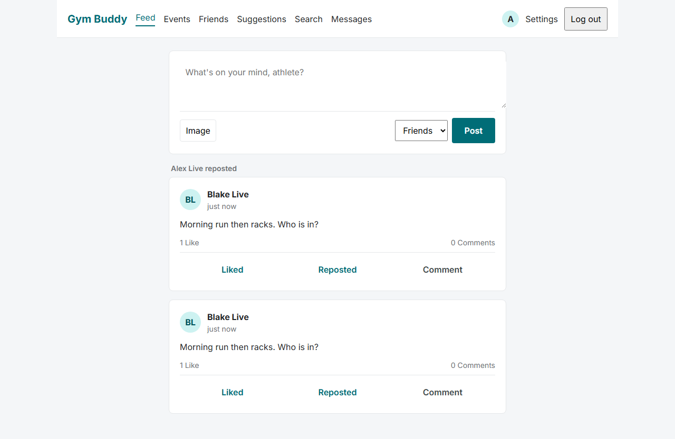
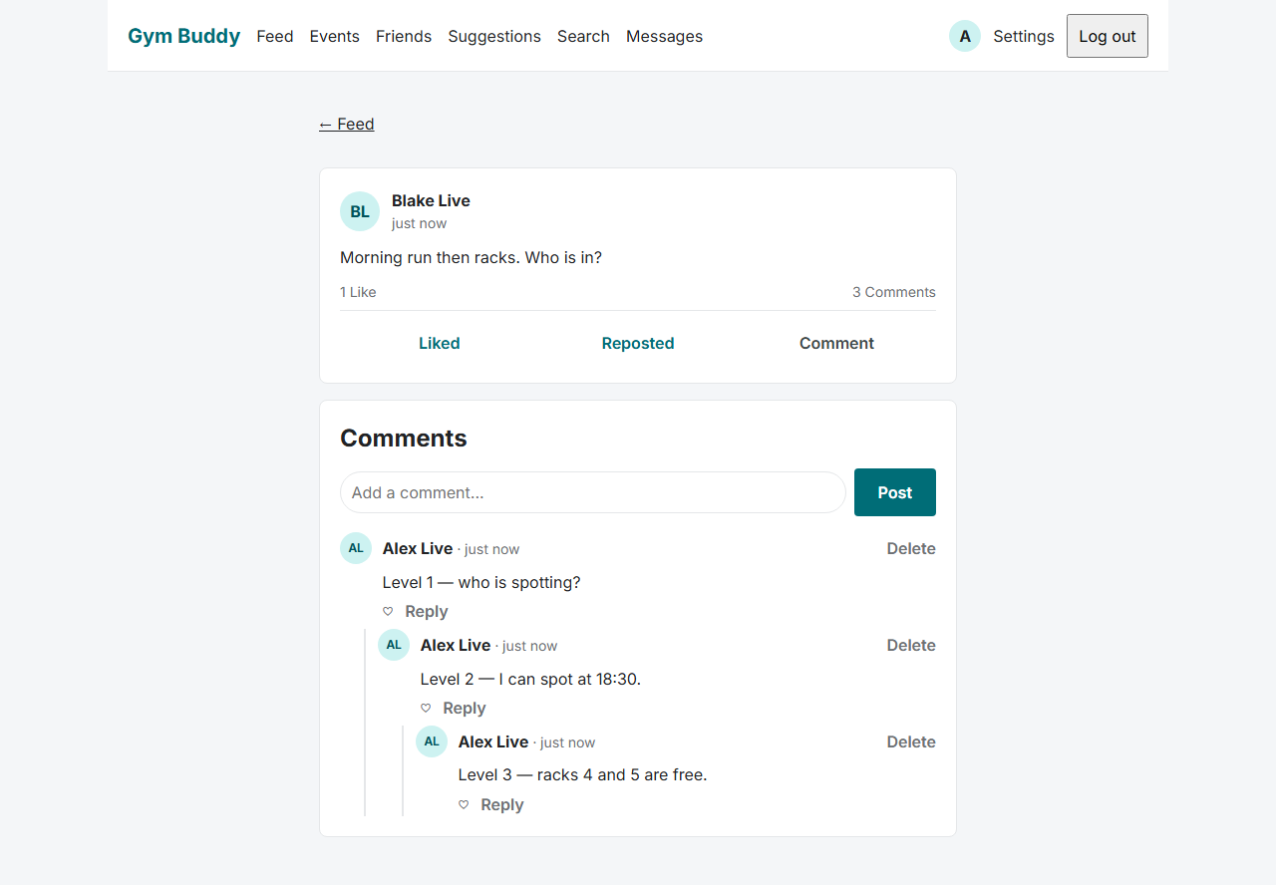
DEMO 1 — SOCIAL · 4 MIN
Feed, post, comment, like, friend.
01
02
03
04
05
Sign in
Feed
Post
Thread
Friend
fresh register on Pages
Friends + own, cursor 20
Text, optional images
Depth cap 4, likes
Request → accept
Live Pages v1.1.0, 2026-08-31 — not mockups.
Demo 1 · social · live v1.1.0
04
Notes:
Live v1.1.0 as registered members; demo.alex password is not in git. FS-FEED, FS-POST, FS-CMT, FS-FRND.

Slide 5
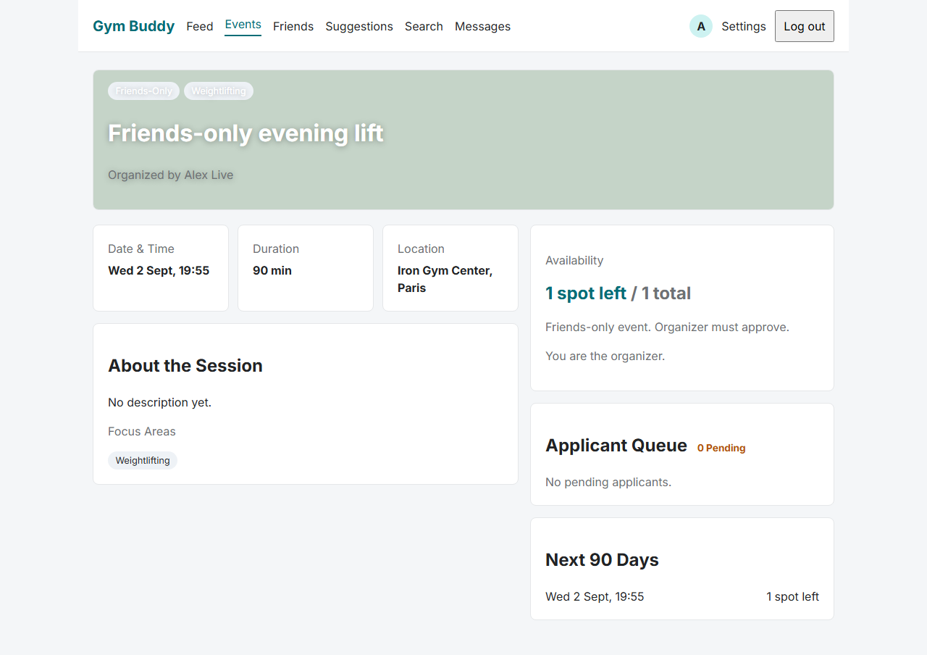
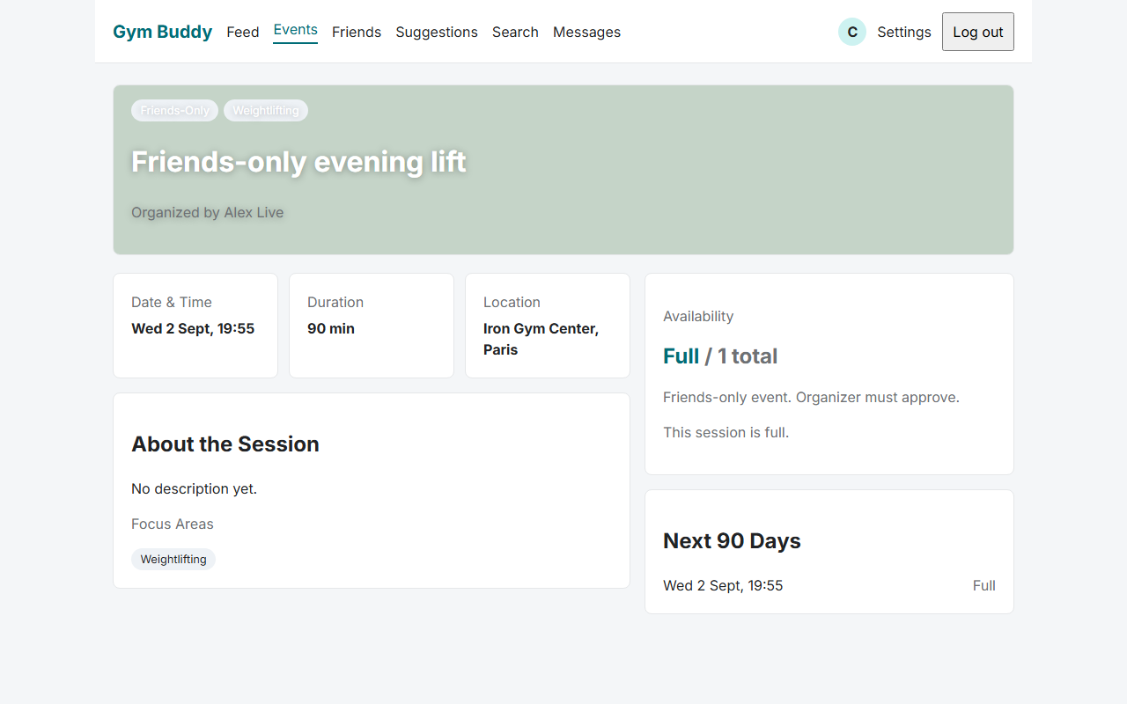
DEMO 2 — SESSION · 4 MIN
Friends-only event. Apply. Last seat.
Rule | FS | What to show
Capacity 1–100 excluding organizer | FS-EVT-01 | Create weightlifting, friends, 3 seats
Apply once per occurrence | FS-EVT-05 | demo.blake applies
Accept is transactional | FS-EVT-07 | Fourth accept → CONFLICT
WEEKLY + BYDAY, 90-day window | FS-EVT-03 | List materialised occurrences
Demo 2 · session
05
Notes:
Show a full event and a rejected extra applicant. SELECT FOR UPDATE. Live capture: capacity 1, Blake pending then Full.

Slide 6
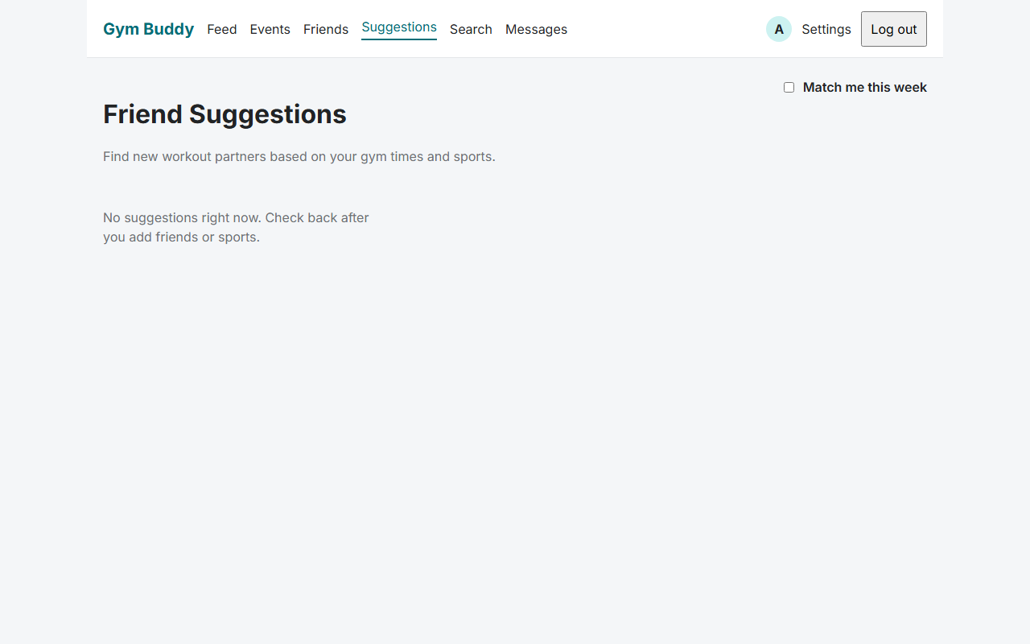
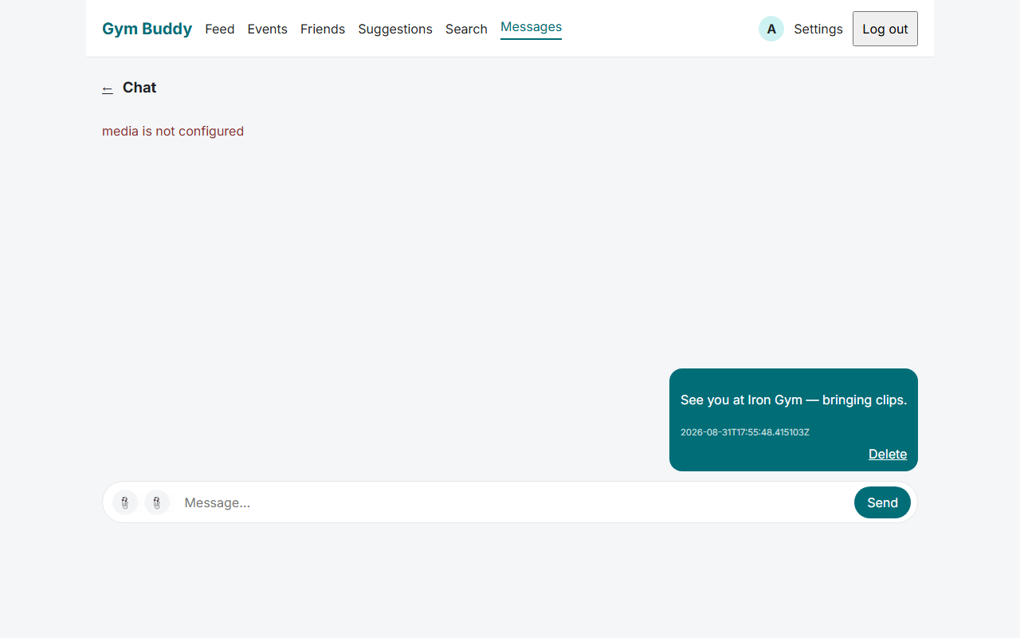
DEMO 3 — BUDDY · 2 MIN
Explainable suggestion, then a DM.
Why this person
Then message
Primary reason = argmax of wi × feature. FoF (Adamic–Adar), sports Jaccard, geo, windows, experience. Not ML.
Friends only. Text, one image, or audio ≤ 120 s. WebSocket + HTTP fallback. Bytes in MinIO.
Demo 3 · buddy
06
Notes:
Read the why line when a card exists. Live prod suggestions were empty (no 3k fixtures). Chat text works; image/audio need object storage. FS-SUGG-03, FS-MSG.

Slide 7
ARCHITECTURE · 2 MIN
Four repos. One modular monolith.
gym-buddy-documentation
Wiki, tickets, Gym Buddy Project
gym-buddy-openapi
HTTP contract. Tagged $ref tree.
gym-buddy-service
Java 25 · Spring · Flyway · VPS
gym-buddy-ui
Angular 22 · Pages · orval client
Architecture
07
Notes:
Wiki + OpenAPI + service + UI. Pages for static; OVH for Java. Postgres, Redis, MinIO.

Slide 8
DATA MODEL · 1 MIN
Eight entities. Not the whole ER.
User
Friendship
Post
Comment
Event
Media
Message
Audit
Data model
08
Notes:
UUIDs, UTC, soft-delete. PostgreSQL 18. Flyway V1–V12 + fixtures.

Slide 9
ALGORITHM · 3 MIN
Suggestions: generate, then score.
S(u,v) = 0.35 m̂ + 0.25 J + 0.15 G + 0.15 T + 0.10 E
Term | Meaning
m̂ | Adamic–Adar on mutual friends, min-max on C(u)
J | Jaccard of sports
G | Geo, D = 25 km, or 0.4 same city
T / E | Window overlap / experience closeness
FoF is O(d²) per user. Nightly all-users ≈ 3k × 64. No all-pairs. Not ML.
Algorithm
09
Notes:
One formula. Complexity on 3k users. Why not ALS: no implicit feedback, opaque why.

Slide 10
SECURITY · 1.5 MIN
Fail closed. No existence leak.
JWT
HS256 access in JSON. Refresh cookie HttpOnly + Secure + SameSite=None; Partitioned. Redis denylist.
Passwords
Argon2id. Never logged. ≥ 10 characters.
canRead
Mint a 60 s signed GET only after ACL. Deny and missing both NOT_FOUND.
Admin
Member calls to /admin/* return NOT_FOUND. Staff JS is a separate bundle.
Security
10
Notes:
Live 1.1.0 cookie is SameSite=None; Partitioned so github.io can send it. SameSite=Lax was the v1.0.0 session-drop. Stranger cannot fetch an object key. TS-JWT, FS-MED-06/07.

Slide 11
TESTS · 1 MIN
Pyramid + a seeded graph.
3 000
12 000
15 000
20260813
users
friendships
posts
seed
JUnit names FS IDs. CI uses tens of rows, never the 3k set. Prod profile cannot reset. GitHub Actions: format, test, HTTP smoke on every PR to develop.
Tests and fixtures
11
Notes:
Datafaker, seed 20260813. demo.alex / demo.blake.

Slide 12
LIMITS AND Q&A
What I would drop with two weeks less.
Weekly matching opt-in — greedy 1/2-approx, not exact.
Audio DMs — text + image would still satisfy the brief.
Recurring events beyond WEEKLY+UNTIL.
Staff bootstrap + MinIO on the VPS (admin 15–16 and signed media).
Ask: Java 25? Stranger image key? Suggestion complexity? Racing accepts? RRULE? How a tag reaches the VPS?
Limits
12
Notes:
Answers point at a spec ID. CI → Release → GHCR → replace.sh → Caddy.

