Slide 1
Projet majeure – TP Alimentation
September 2024
Matisse BOFFY – Analog Field Applications Engineer
( +33 6 86 36 88 47 | * m-boffy@ti.com

Slide 2
Specifications
Maximum Input Voltage | 36V
Nominal Input Voltage | 30V
Output Voltage | 5V
Output Current | 2.5A
Target Efficiency | 92%
Output voltage ripple | < 5%
Output voltage variation during 50% to 100% load steps | < 5%
Switching frequency | 200kHz
Maximum inductor current ripple | 30%
Specifications du projet
Bonnes pratiques

Slide 3

Power Stage – P-MOS selection criteria
Key specifications
Drain-source breakdown voltage $V_{DS}$
Continuous Drain Current $I_{D}$
$\text{Drain}\text{−}\text{source} \text{ON} \text{resistance} R_{DS_{on}}$
Total gate charge$Q_{G}$
Output capacitance $C_{oss}$
Losses : Conduction, switching & gate drive
$P_{cond}={I_{RMS}}^{2}{×R}_{DS_{on}}$
$P_{sw} =\frac{F_{sw}}{2}\left(V_{IN}{×I}_{pk}{×t}_{swON}\right)+\frac{F_{sw}}{2}(V_{IN}{×I}_{pk}{×t}_{swOFF})$
$P_{Gdrive}=V_{G}×F_{SW}×Q_{G}$
Notes:
Output cap Coss effect

Slide 4
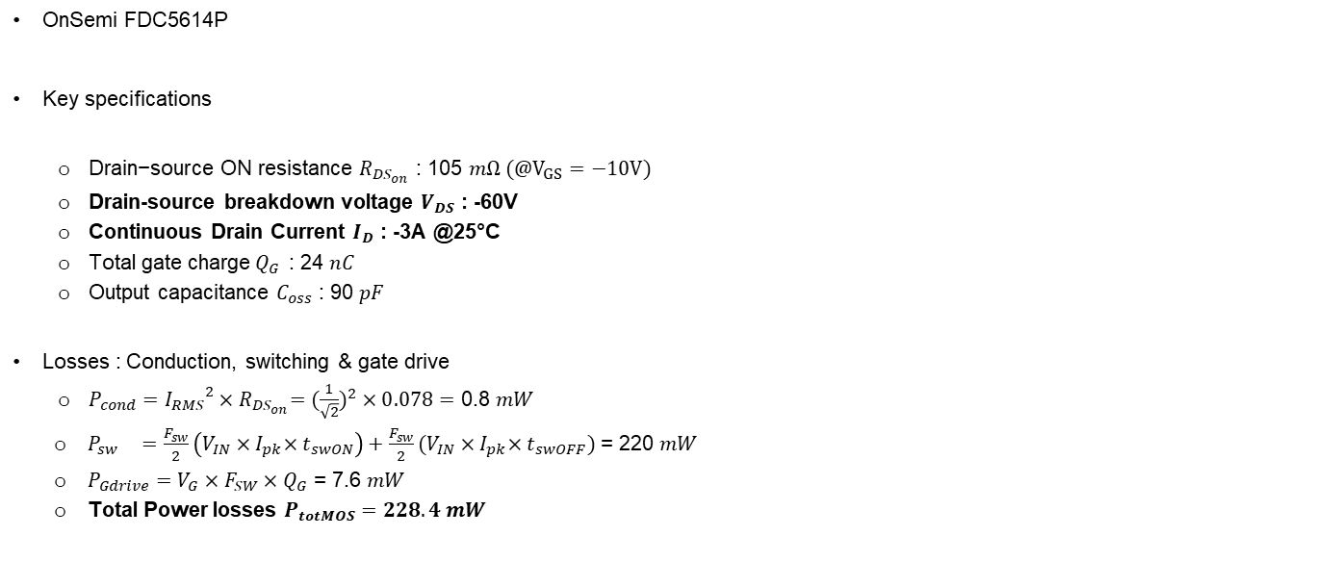
Power Stage – P-MOS selection
OnSemi FDC5614P
Key specifications
$\text{Drain}\text{−}\text{source} \text{ON} \text{resistance} R_{DS_{on}}$ : 105 $mΩ (@V_{GS}=−10V)$
Drain-source breakdown voltage $V_{DS}$ : -60V
Continuous Drain Current $I_{D}$ : -3A @25°C
Total gate charge$Q_{G}$ : 24 $nC$
Output capacitance $C_{oss}$ : 90 $pF$
Losses : Conduction, switching & gate drive
$P_{cond}={I_{RMS}}^{2}{×R}_{DS_{on}}=({\frac{1}{\sqrt{2}})}^{2}×0.078=$ 0.8 $mW$
$P_{sw} =\frac{F_{sw}}{2}\left(V_{IN}{×I}_{pk}{×t}_{swON}\right)+\frac{F_{sw}}{2}(V_{IN}{×I}_{pk}{×t}_{swOFF})$ = 220 $mW$
$P_{Gdrive}=V_{G}×F_{SW}×Q_{G}$ = 7.6 $mW$
Total Power losses $P_{totMOS}=228.4 mW$
Notes:
Output cap Coss effect

Slide 5

Power Stage – Inductor selection criteria
Key specifications
Inductance value
Saturation current 10% $I_{SAT}$
RMS current $I_{RMS}$ (20, 40°C)
Equivalent Series Resistor ESR
Losses : Conduction, core & windings
$P_{cond}={I_{LRMS}}^{2}×ESR$
Cores & windings losses are specified in manufacturer’s datasheet
Notes:
Output cap Coss effect

Slide 6

Power Stage – Inductor selection
Coiltronics DR127-330
Key specifications
Inductance value with 30% current ripple at 30Vin:
$$L=\frac{V_{out}×(V_{in}−V_{out})}{∆I_{L}×f_{SW}×V_{IN}}=\frac{5×(30−5)}{0.3×2.5×200×{10}^{3}×30}=27uH$$
Equivalent Series Resistor ESR : 60 $mΩ$
RMS current $I_{RMS}$ (20, 40°C) : 3.23 A
Losses : Conduction, core & windings
$P_{cond}={I_{LRMS}}^{2}×ESR$ = ${\sqrt{I_{PK}^{2}+\frac{{∆I}^{2}}{12}}}^{2}×ESR=96 mW$
Cores & windings losses : 3 $mW$
Total Power losses $P_{totL}=99 mW$
Notes:
Output cap Coss effect

Slide 7
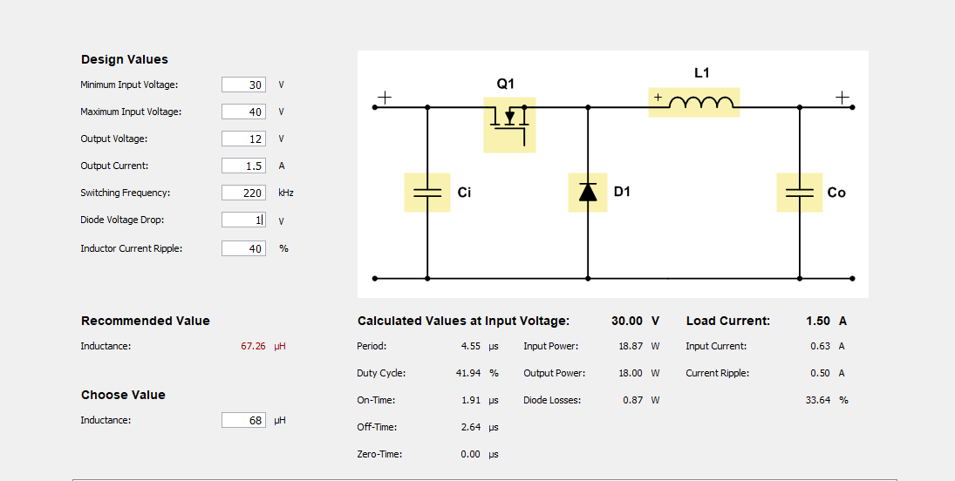
Simulation on power stage designer

Slide 8

Power Stage – Rectifier selection criteria
Key specifications
Breakdown voltage $V_{R}$
Continuous forward current $I_{F}$
Forward voltage $V_{F}$
Diode capacitance $Ct$
Losses : Conduction & AC
$P_{cond}=V_{F}×\left(I_{out}+\frac{∆I}{4}\right){×D}_{utyCycle}$
$P_{AC}=\frac{1}{2}(C_{t}×({V_{IN}+V_{f})}^{2}×f)$
Notes:
Output cap Coss effect

Slide 9

Power Stage – Rectifier selection
OnSemi MBRS360
Key specifications
Breakdown voltage $V_{R}$ : 60V
Forward voltage $V_{F}$ : 0.6V
Continuous forward current $I_{F}$ : 3A
Diode capacitance $Ct$ : 60 pF @30Vr
Losses : Conduction
$P_{cond}=V_{F}×\left(I_{out}+\frac{∆I}{4}\right){×D}_{utyCycle}$
$P_{AC}=\frac{1}{2}(C_{t}×\left({V_{IN}+V_{f})}^{2}×f\right)$
Notes:
Output cap Coss effect

Slide 10

Power Stage – output capacitor selection criteria
Key specifications
Capacitance (F)
Voltage rating (V)
ESR
Losses : Conduction
$P_{cond}={I_{incap}}^{2}×ESR$
Notes:
Output cap Coss effect

Slide 11


Power Stage – output capacitor selection criteria
Panasonic EEVFK0J221P
Key specifications
Capacitance
$C_{out}=\frac{∆I_{Transient}}{2πf_{loopBW}∆V_{Transient}}=\frac{0.5×2.5}{2π×22k×0.05×5}=36 uF$, $this is the effective capacitance$
ESR : 160 $mΩ$
Voltage rating 6.3V
Losses : Conduction
$P_{cond}={I_{incap}}^{2}×ESR$
Can also be used
Notes:
Output cap Coss effect

Slide 12
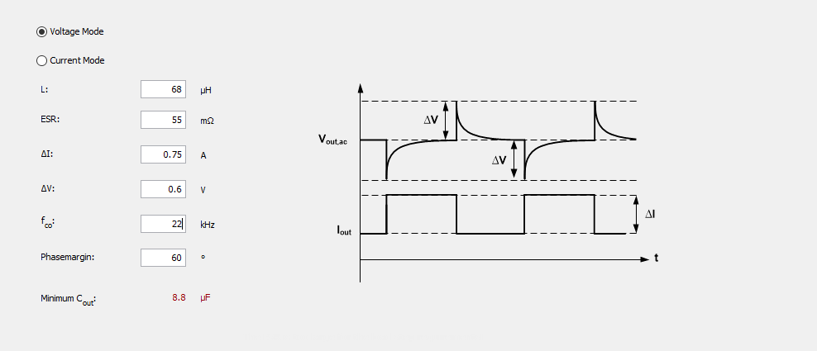
Power Stage – output capacitor selection criteria
Power stage designer lookup
Notes:
Output cap Coss effect

Slide 13
Power Stage – input capacitor selection criteria
Key specifications
Capacitance (F)
Voltage rating (V)
ESR
Losses : Conduction
$P_{cond}={I_{incap}}^{2}×ESR$
Notes:
Output cap Coss effect

Slide 14

Power Stage – input capacitor selection
Panasonic EEUFC1J101
Key specifications
Capacitance
$$C_{in}≥\frac{D\left(1−D\right)∗I_{out}}{∆V_{in_{pp}}∗f_{sw}}≥1.15uF$$
Voltage rating : 50V
Losses : Conduction
$P_{cond}={I_{incap}}^{2}×ESR$
Notes:
Output cap Coss effect

Slide 15
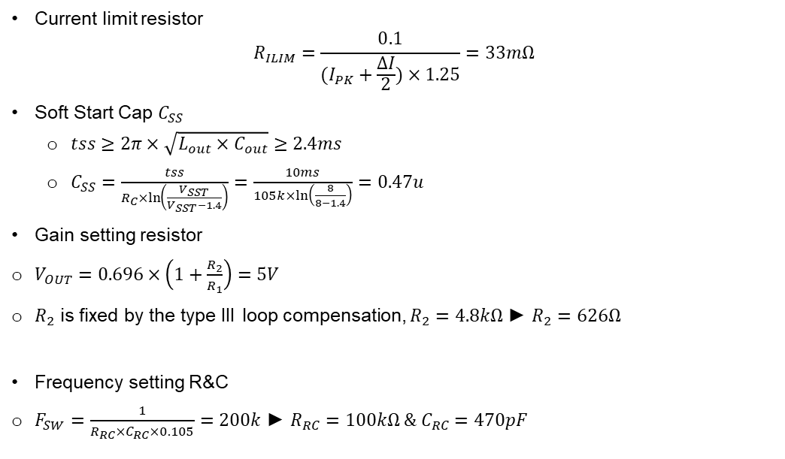
Additional passives
Current limit resistor
$$R_{ILIM}=\frac{0.1}{(I_{PK}+\frac{∆I}{2})×1.25}=33mΩ$$
Soft Start Cap $C_{SS}$
$tss≥2π×\sqrt{L_{out}×C_{out}}$ $≥2.4ms$
$C_{SS}=\frac{tss}{R_{C}×\ln\left(\frac{V_{SST}}{V_{SST}−1.4}\right)}=\frac{10ms}{105k×ln\left(\frac{8}{8−1.4}\right)}=0.47u$
Gain setting resistor
$V_{OUT}=0.696×\left(1+\frac{R_{2}}{R_{1}}\right)=5V$
$R_{2}$ is fixed by the type III loop compensation, $R_{2}=4.8kΩ$ ► $R_{2}=626Ω$
Frequency setting R&C
$F_{SW}=\frac{1}{R_{RC}×C_{RC}×0.105}=200k$ ► $R_{RC}=100kΩ \& C_{RC}=470pF$
Notes:
Output cap Coss effect

Slide 16
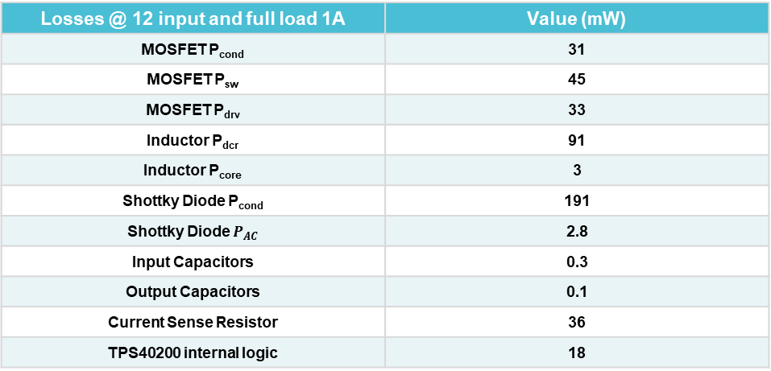
Power Stage - Efficiency
Losses @ 12 input and full load 1A | Value (mW)
MOSFET P_{cond} | 31
MOSFET P_{sw} | 45
MOSFET P_{drv} | 33
Inductor P_{dcr} | 91
Inductor P_{core} | 3
Shottky Diode P_{cond} | 191
Shottky Diode $P_{AC}$ | 2.8
Input Capacitors | 0.3
Output Capacitors | 0.1
Current Sense Resistor | 36
TPS40200 internal logic | 18
Total Losses | 451 mW
Estimated Efficiency | 93%

