Slide 1

evila
bora entender

Slide 2

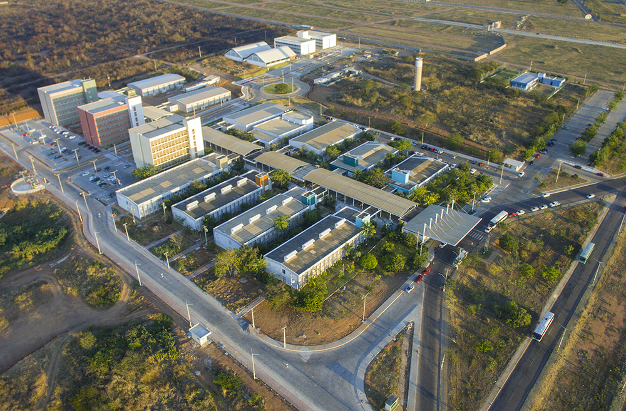

Slide 3
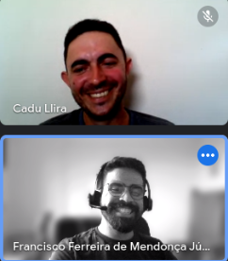


Slide 4



Slide 5


Slide 6


