Slide 1

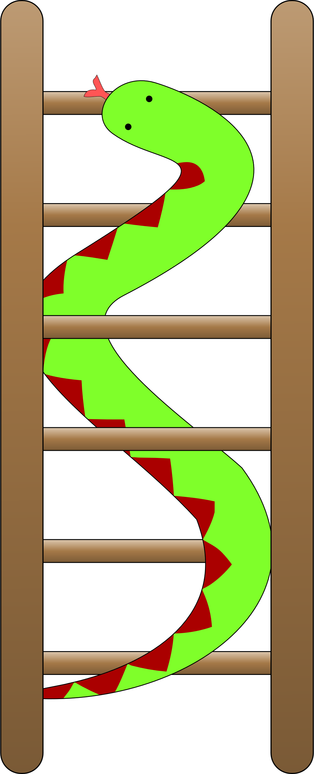
MiniLudu
Aadil Sohail
Mayk Al-Ghrawi

Slide 2
Problems to solve
Representing the dice roll
Representing the board
Various Players
Safe Spaces
Win position
Representing a ‘cut’ event

Slide 3
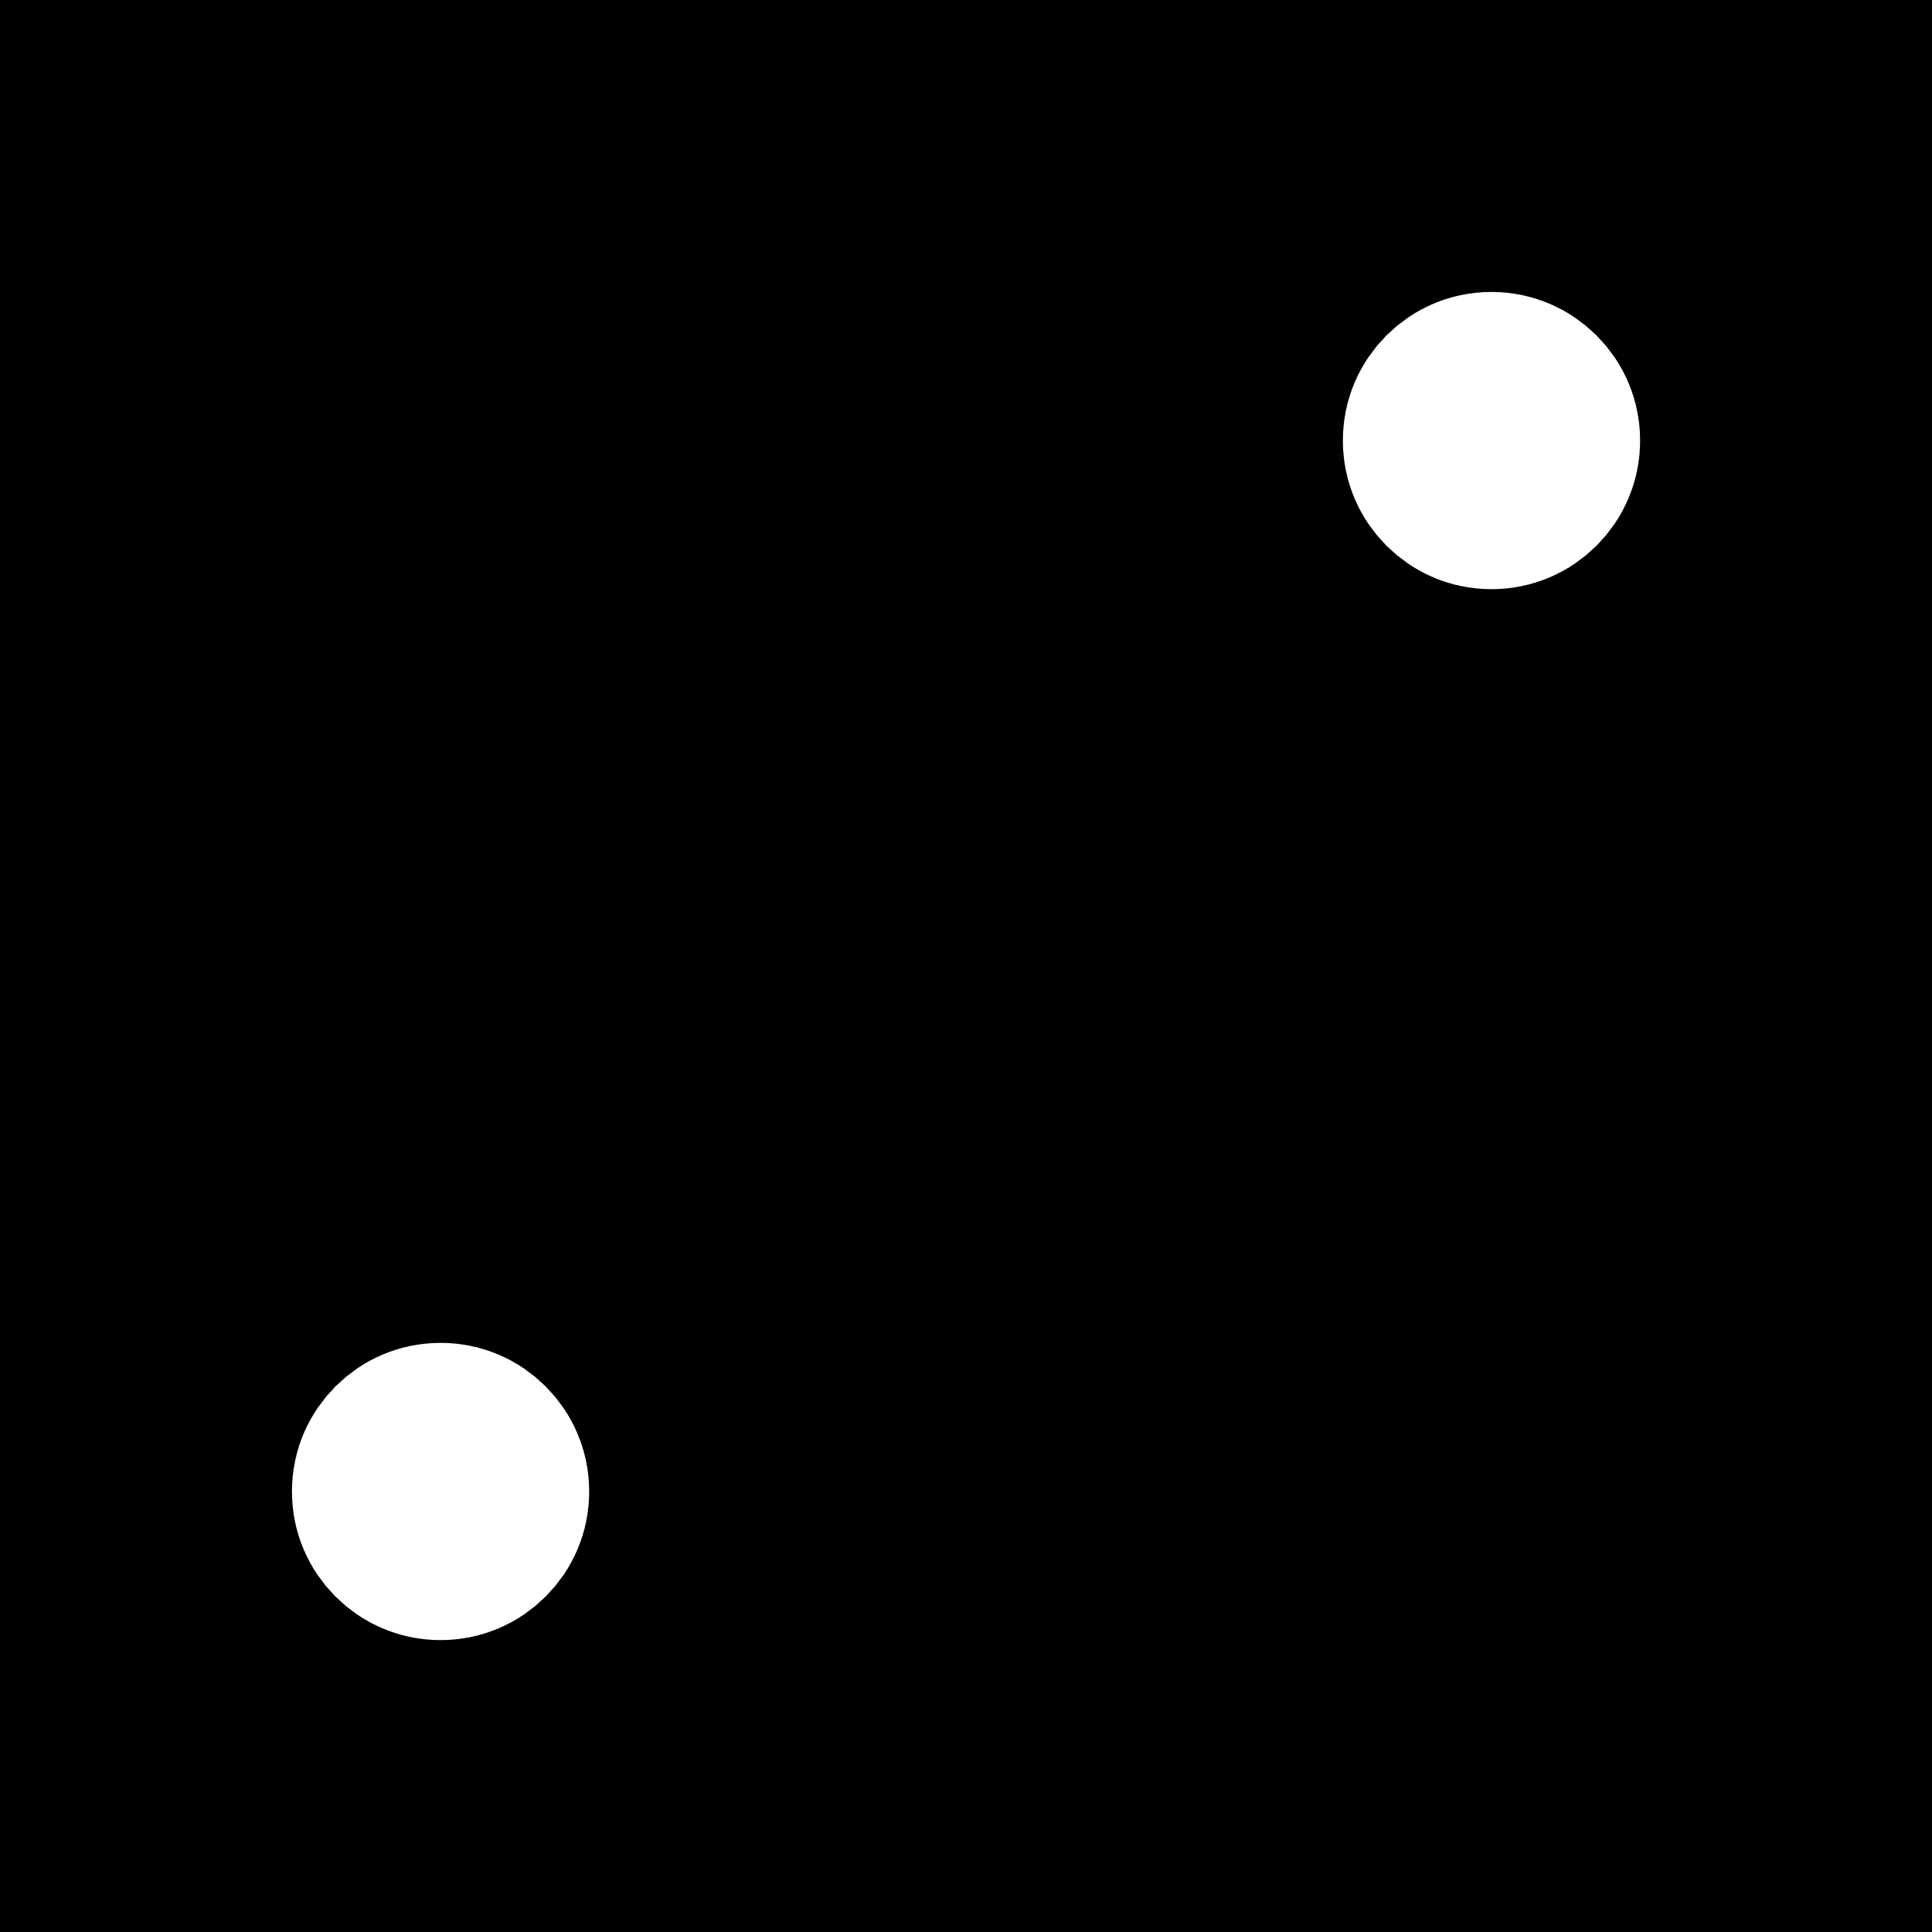
Representing the dice roll
Solution:
Generate random number between 0 and RAND_MAX (essentially max int).
Generated number modulus 4 and add 1. (add 1 because a dice roll can’t be 0).
Save to int variable.
Example:
Generate 4 -> 4%4 = 0 -> 0 +1 = 1
You rolled a 1.

Slide 4
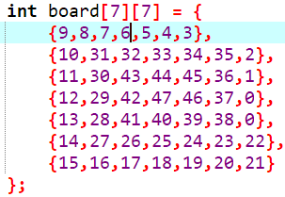
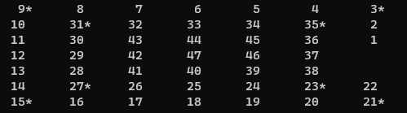
Representing the board
Players asked for their name on initialization of the board.
Board is a 2D array of 7 rows by 7 columns.
A star is printed next to the safe squares
When a player rolls the dice and lands on a square, their names first letter gets appended.

Slide 5
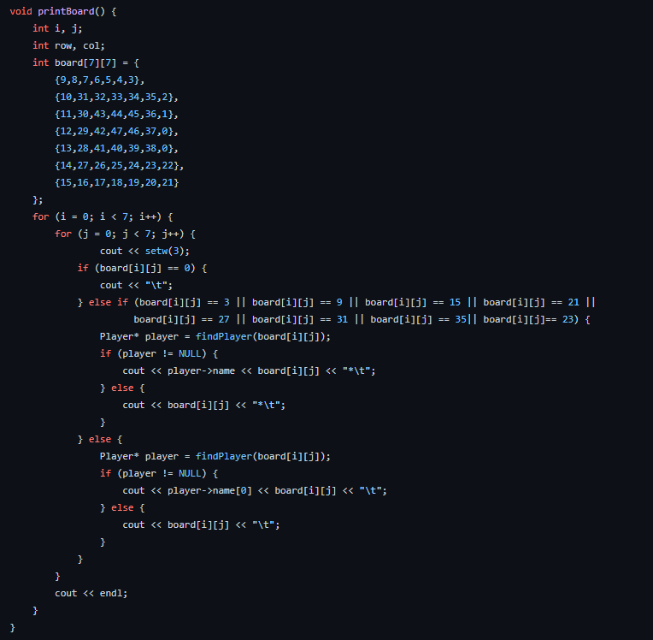
Logic traversal of the board
Firstly, we create the board using a multi-dimensional array; setting the positions in their correct places. Using a nested for loop we then loop through each element in the array.
If we hit any of the safe spaces, we call the findPlayer method to check if a player is at that position, if a player is not at that position, we then print the player's name along with the position followed by a star indicating that it is a safe space.
Entering the else branch would mean that we are at a position which is not safe, we call the findPlayer method to check if a player is at that position. If a player is indeed at that position, we show the current player as the other player would be ‘cut’.

Slide 6
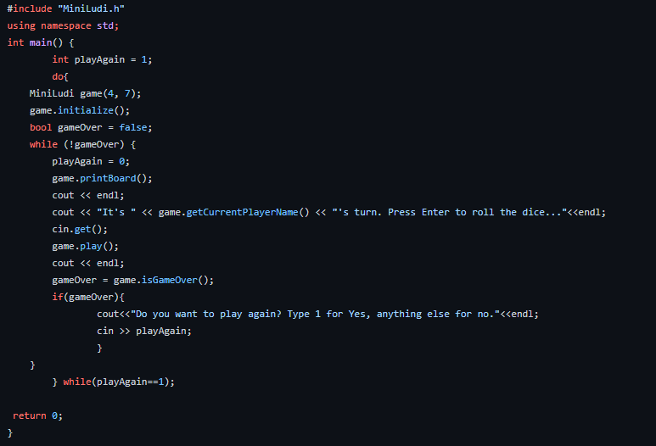
Int Main()
In the main function we create a variable playAgain and initialize it to 0. We then use a do while loop to essentially keep repeating the game until the user no longer wants to play again.
We create a game with 4 players and a 7 by 7 board. We call a initialize method which sets up a game with each player being a node in a doubly linked list.
We then use the play method to play the game. We check if the game is over with the isGameOver function after each call of the play method
If the game is over, we ask the players if they wish to play again if they choose to play again then a new game is initialized , if not then we leave the loop as playAgain would not equal 1 thus ending the program.

