Slide 1
Mobile Computing Laboratory
CSE 3218
Project Title : Furniture Shop App
Presented By:
Farhana Proma (1907041)
Fahim Abrar Wasi (1907044)
Proloy Karmakar (1907051)
Sakib Hasan Topu (1907052)
Md Naieem Islam (1907055)

Slide 2
Objectives
Getting familiar with swift for IOS development.
To learn about Xcode storyboards and interface builder.
To provide Enhanced user experience.
To use API and jason parsing as per need.
To implement Database Connection and store various data dynamically in database.

Slide 3
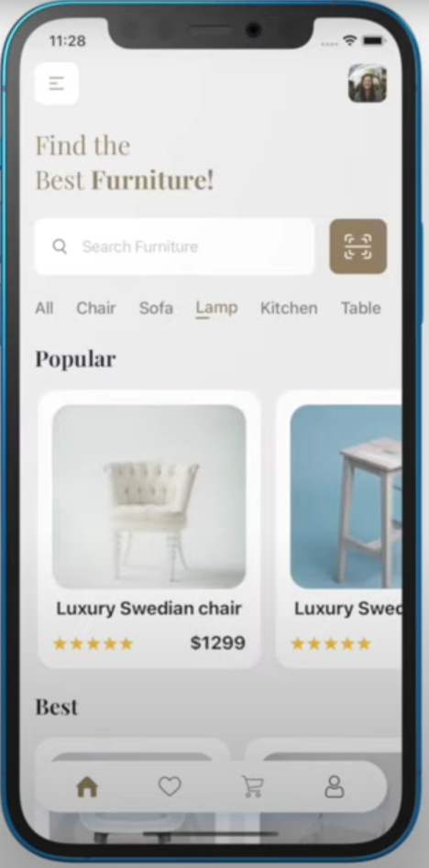
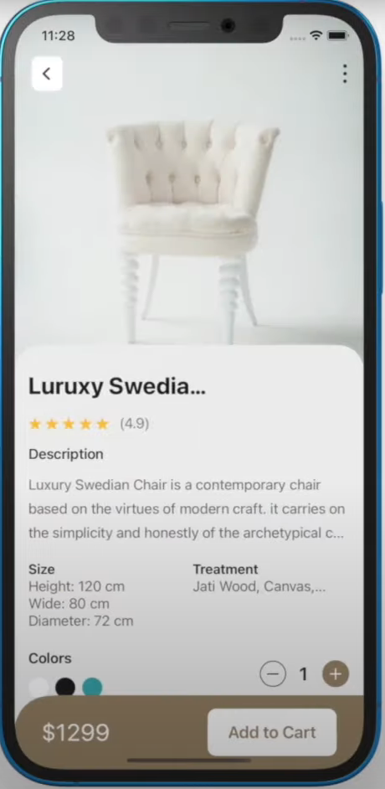
introduction
Our Furniture Shop App for iOS aims to bring the world of furniture shopping to the fingertips of iOS users, offering a seamless and personalized experience.

Slide 4
Key Features
Splash Screen to welcome the user.
A visually appealing welcome screen that greets users when they launch the app, setting a positive tone for their shopping experience.
Users can SignUp and Login to their accounts.
Users can create new accounts (SignUp) or log in to existing ones. This feature ensures a personalized experience and allows users to track their orders and saved items.

Slide 5
Key Features(Continued..)
Users can update their profile.
Users have the ability to update their profiles, including adding or changing their personal information, addresses, and profile pictures.
Products and their description are showed in cards.
The app presents furniture products in a visually appealing card format, making it easy for users to browse and compare different items.

Slide 6
Key Features(Continued..)
Furnitures are divided into categories.
Furniture products are categorized into various categories (e.g., chairs, tables, sofas) to help users find items of interest quickly.
Users can search for specific furniture.
Users can search for specific furniture items using keywords or filters, enhancing their shopping efficiency.

Slide 7
Key Features(Continued..)
Add to favourites for checking out later.
Users can mark their favorite products, creating a personalized wishlist for future reference.
Products can be added to cart for checkout.
Users can add products to their shopping cart for easy checkout. The cart allows users to review and edit their selections before making a purchase.
Order Confirmation Page.
After completing the checkout process, users receive an order confirmation page that summarizes their purchase and provides order details.

Slide 8
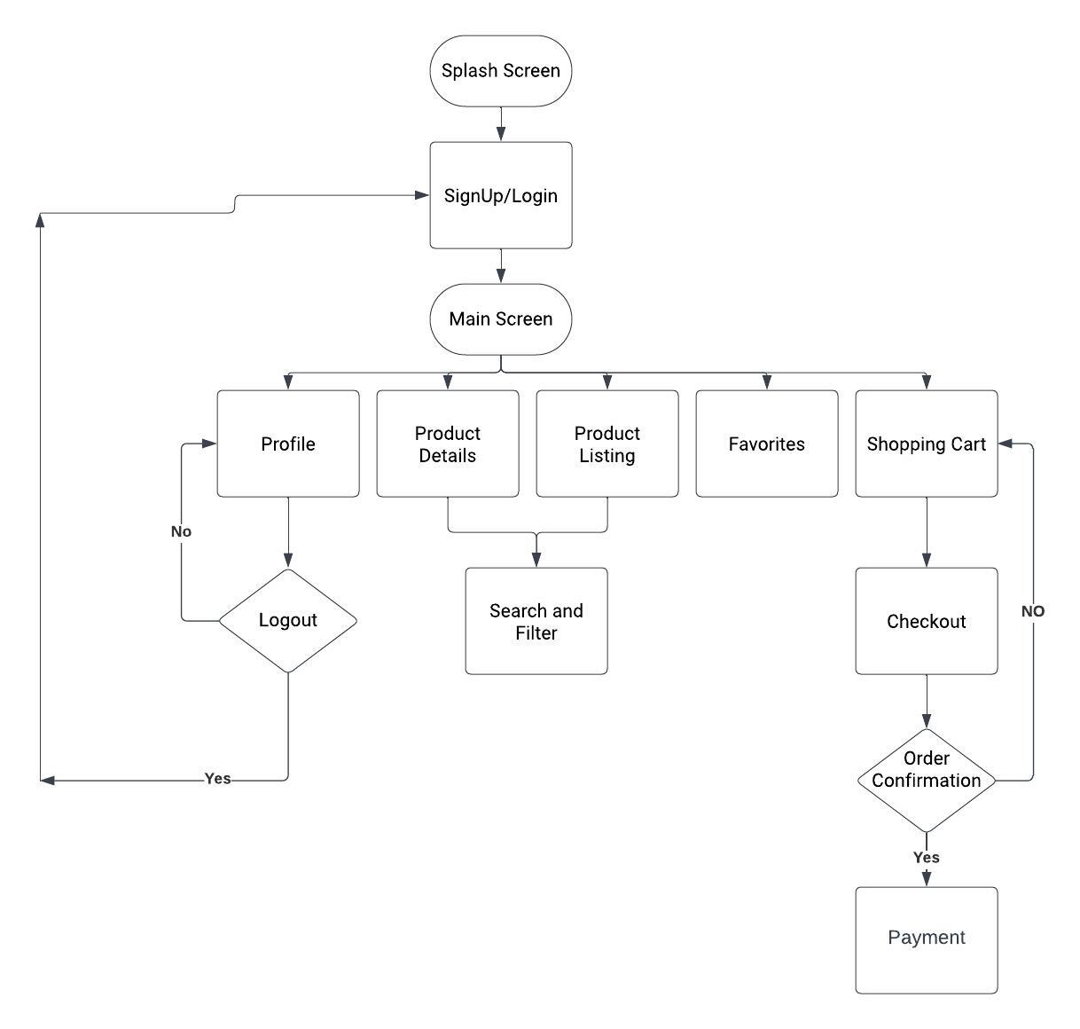
Workflow

Slide 9
Technologies
Xcode IDE for Swift
Firebase Authentication
Realtime Firebase database

Slide 10
Thank You!

