Slide 1
TECHNOLOGIES FOR INTERNET OF THINGS
Name: Farjana Ahmed
Master’s in Automotive Software Engineering
ID:619518
1
5/21/21
Notes:
1

Slide 2
Contents
Introduction
The Basic Properties of Internet of Things
Architecture of Internet of things
Key Technology of Internet of things
Wireless Technologies for IoT
IoT Gateways
The Application Fields
The Key Technologies of IoT in Digital Agriculture
Challenges
Opportunities
Conclusion
2
5/21/21
Notes:
2

Slide 3
Introduction
Highly integration of a variety of new technologies and concepts.
Intelligent network which ties any items to the internet for the purpose of exchange information.
Communication through the information sensing device and in accordance with the agreed protocol.
It achieves the goal of intelligent identify, locating, tracking, monitoring and management.
3
5/21/21
Notes:
3

Slide 4
The Basic Properties of IoT
Its related properties include focus, content, collection, computing, communications and connectivity scenarios.
These properties show the seamless connection that between people and objects or between the objects and objects.
Calculation any time any content
Combination Anything Any device
Content Anything anyone
Network of Things
Connection Anywhere
Collection anyserver any business
Communication any path any network
Figure 1: The Basic properties of IoT
4
5/21/21
Notes:
4

Slide 5
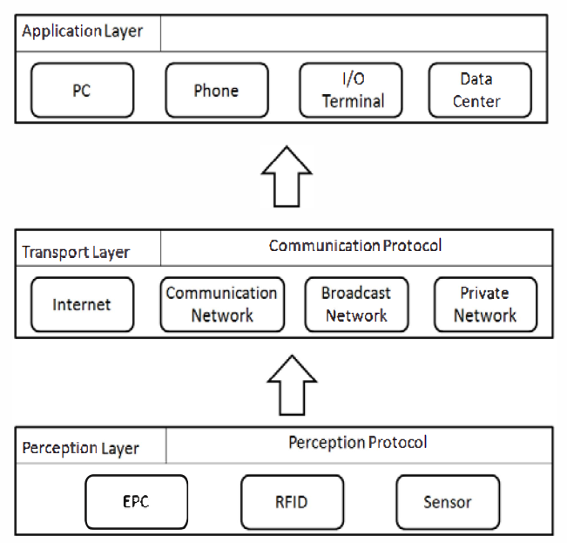
Architecture of Internet of things
The Internet of Things levels are composed of :
Perception Layer
Transport Layer
Application Layer
Figure 2: Architecture of Internet of things
5
5/21/21
Notes:
5

Slide 6
Key Technology of IoT
1. Two-dimensional Code
Use black and white pixels
To laid out on a plane (two-dimensional) to store information.
black represents binary “1” while the white represents binary “0.”
contains many advantages such as high information content, high reliability, as well as the ability to express a variety of information
6
5/21/21
Notes:
6

Slide 7
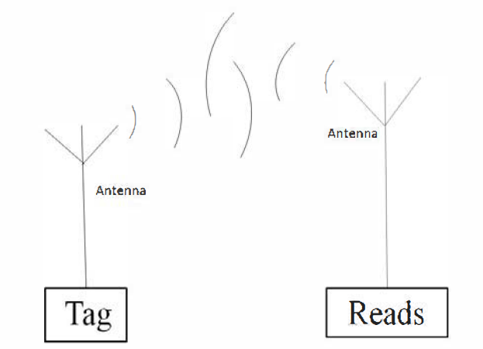
Key Technology of IoT (Cont.)
2. RFID Technology
A non-contact automatic identification technology.
Consists of three parts:
Tag
Reader
Antenna
Major issues :
Collision and anti-collision of RF identification;
RF antenna research;
Choice of frequency;
Security and privacy issues.
Figure 3: Elements of RFID
7
5/21/21
Notes:
7

Slide 8
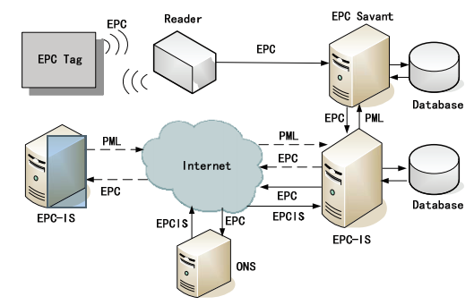
Key Technology of IoT (Cont.)
3. Electronic Product Code
Figure 4: The architecture of EPC network
8
5/21/21
Notes:
8

Slide 9
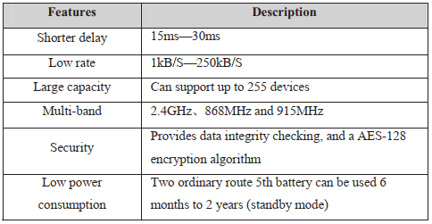
Key Technology of IoT (Cont.)
4. ZigBee
Short-range, low-rate wireless network technology
Three main areas
Hardware platforms
Network communication protocol
Information processing technology
Figure 5: The characteristic of ZigBee Wireless Sensor Network
9
5/21/21
Notes:
9

Slide 10
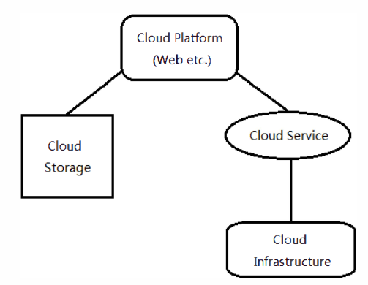
Key Technology of IoT (Cont.)
5. Cloud Computing
Combination of Internet technologies and traditional computer technologies.
Consist grid computing, distributed computing, parallel computing, utility computing, network storage, virtualization and load balancing.
Considered as a powerful function of supercomputers.
User can use these services on-demand measurement.
Figure 6: The architecture of Cloud computing
10
5/21/21
Notes:
10

Slide 11
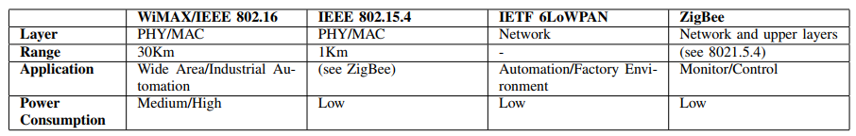
Wireless Technologies for IoT
Table 1: COMPARISON OF WIRELESS TECHNOLOGIES FOR IOT
11
5/21/21
Notes:
11

Slide 12
IoT Gateways
Home Gateway Initiative :
Develops specifications and standards for home gateway equipment.
These address, amongst others, functional and management concerns.
HGI specification addresses the provision of third-party applications on top of the home gateway.
Has considered the Open Services Gateway Initiative (OSGi).
In real-life equipment, an OSGi instrumentation can provide parts of the specified HGI feature set.
12
5/21/21
Notes:
12

Slide 13
IoT Gateways
Open Services Gateway Initiative
Global consortium of industry stakeholders
Defines a software framework to support modular applications for the Java platform.
Defines schemas for essential application metadata
Dynamically assembled during runtime by binding together appropriate bundles registered in the OSGi service registry
13
5/21/21
Notes:
13

Slide 14
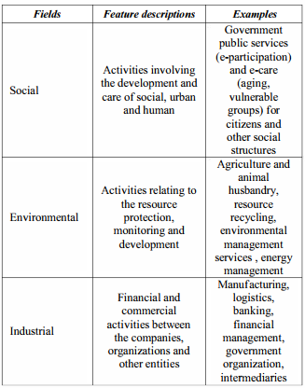
The Application Fields
The new dimension is to increase the added-value of loT.
Extend the capability of traditional localized automatic identification and data acquisition.
Expand the application area of state-of-the-art technology in hardware and software interfaces.
Table 3: Examples of three major Applicable areas
14
5/21/21
Notes:
14

Slide 15
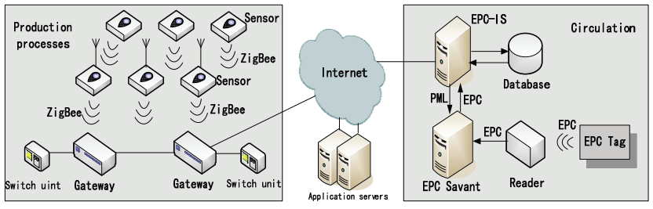
The Key Technologies of IoT in Digital Agriculture
Real time information are collected by various types of sensors.
The information is transmitted to the gateway by ZigBee.
Finally, the gateway controls the switch unit to water, fertilize, ventilate and control temperature automatically with the support of the application servers.
Figure 8:The framework of digital agriculture application based on IOT
15
5/21/21
Notes:
15

Slide 16
Challenges
Cost of battery replacement of enormous numbers of sensors
Low power sensor design
Connecting the growing number of devices
Security and privacy issues
16
5/21/21
Notes:
16

Slide 17
Opportunities
Low power wireless sensors
Better connectivity
‘Zero touch’ management & analysis
Smart service for People
17
5/21/21
Notes:
17

Slide 18
Conclusion
Still in its early stage and far away from mature.
Security problems are still in the conceptual stage
Many problems are still controversial.
The ultimate goal is to have devices connected to the standard Internet.
IoT has a huge room for further development and upgrading
18
5/21/21
Notes:
18

Slide 19
References
[1] Xu Diwei, Cai Jianin, "Analysis on Internet of Things and its application," Computer Engineering and Applications, 20II [2] Khoo B "RFlD as an Enabler of the Internet of Things: Issues ofSecu;ity'and Privacy", Internet of Things (iThings/CPSCom), 2011International Conference on and 4th International Conference on Cyber,Physical and Social Computing, 20II [3] Mason, A., "Intelligent Radio Frequency Identification Positioning usingWireless Sensor Networks," in Antennas and
Propagation Conference,2007 [4] Kalagiakos, P, "Cloud Computing learning," in Application ofInformation and Communication Technologies (AICT), 2011 [5] K. Chunying, “Research on generation algorithm of network twodimensional code,” Journal of Natural Science ofHeilongjiang University, vol. 26, no. 2, pp. 216–219, 2009. [6] H. Xuechen, “The two-dimensional bar code application in bookmanagement,” in Web Information Systems and Mining (WISM), 2010International Conference on, vol. 1. IEEE, 2010, pp. 409–411. [7] T. Sun and D. Zhou, “Automatic identification technologyapplicationof two-dimensional code,” in Automation and Logistics (ICAL), 2011 IEEE International Conference on. IEEE, 2011, pp. 164–168. [8] Dai, Jifeng, Kaiming He, and Jian Sun. "Boxsup: Exploiting bounding boxes to supervise convolutional networks for semantic segmentation." Proceedings of the IEEE International Conference on Computer Vision. 2015.
[9] L. Qiwei, “Research and design on radio frequency identificationreader,” in Anti-counterfeiting, Security, Identification, 2007 IEEE International Workshop on. IEEE, 2007, pp. 356–359. [10] Y. Wang, Y. Wu, Y. Liu, and A. Tang, “The application of radiofrequency identification technology on tires tracking,” in Automation and Logistics, 2007 IEEE International Conference on. IEEE, 2007,pp. 2927–2930. [11] H. G. Initiative, Home Gateway Technical Requirements: ResidentialProfile, Home Gateway Initiative (HGI) TR TRRP, 2008 [12] OMA, OMA Gateway Management Object (GwMO) Architecture,Open Mobile Alliance Std., 2013. [Online]. Available:
http://technical.openmobilealliance.org/Technical/release program/ docs/CopyrightClick.aspx?pck=GwMO&file=V1 1-20130625-C/ OMA-AD-GwMO-V1 1-20130625-C.pdf [13] D. Boswarthick, O. Elloumi, and O. Hersent, M2M Communications: A Systems Approach. Wiley, 2012.
19
5/21/21
Notes:
19

Slide 20
Thank You
20
5/21/21
Notes:
20

