Slide 1

Packet
Analyzer
Name: Proma Chowdhury
Roll: BSSE 1132
Supervisor: Dr. BM Mainul Hossain

Slide 2
MOTIVATION
EXPLORING NETWORK TRACES
NETWORK ANOMALY DETECTION
PENETRATION TESTING

Slide 3
Steps
Packet capture using Wireshark
Analyzing packet headers in C
Live Packet capture using raw socket
Checksum calculation to check if the packet is corrupted
Check if a port is open/close
Detect SYN Flood Attack
Detect the IP addresses of the attacker
Sending ICMP Packet or ping the host
Checking if a host is alive in C

Slide 4
Progression
Packet capture using Wireshark
Packet header analysis using C code
Transport layer protocols TCP/UDP
Socket functions and how to live packet capture using Socket
Detecting whether a specific port of an address is open or closed using C code.
Scanning a network port
SYN flood attack principle

Slide 5

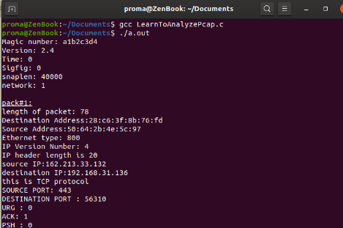
Progression
Packet Capture & Header Analysis
Processing packet…
Packet header
Global header
Packet # 1
Packet # n
… … …
Packet # n
Packet data

Slide 6
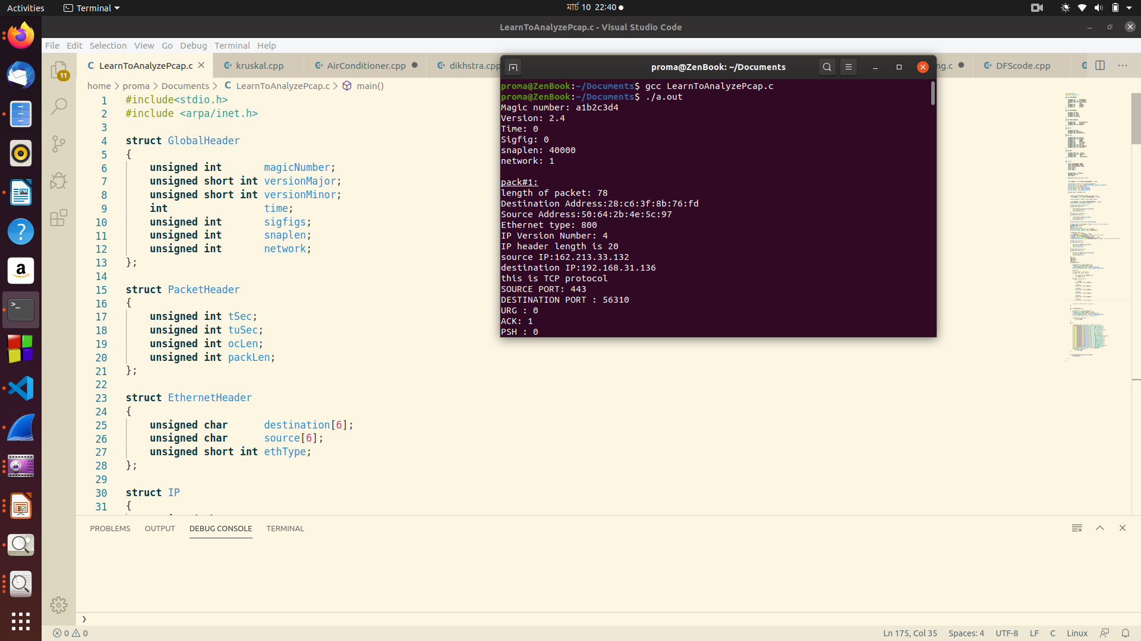
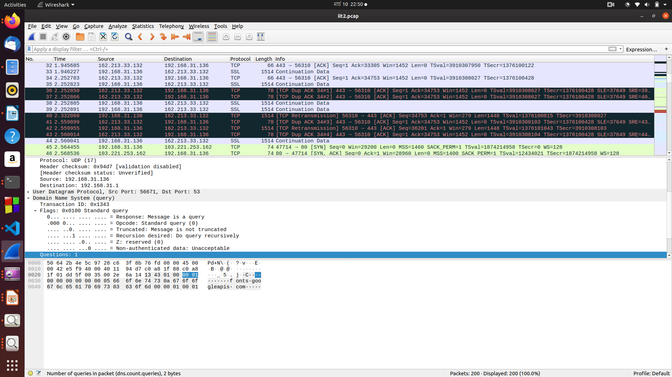
Progression
Packet Capture & Header Analysis
*The following picture shows a C program that analyses a captured packet’s headers:
*The following picture shows a packet captured using wireshark:

Slide 7
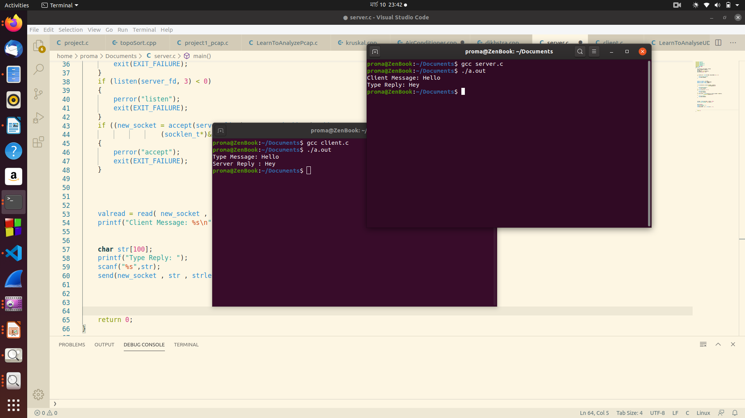
Progression
Raw Socket
Exchanging one message between server and client

Slide 8
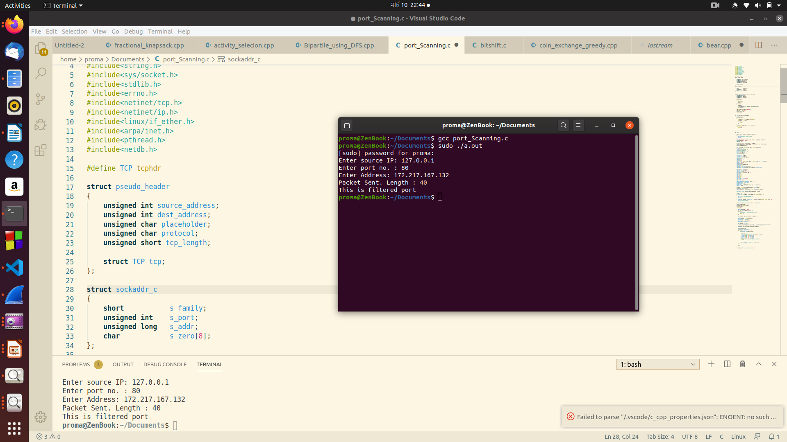
Progression
Detecting Whether a Port is Open or Close
*The following picture a program that detects whether given port of given address is open or not:

Slide 9
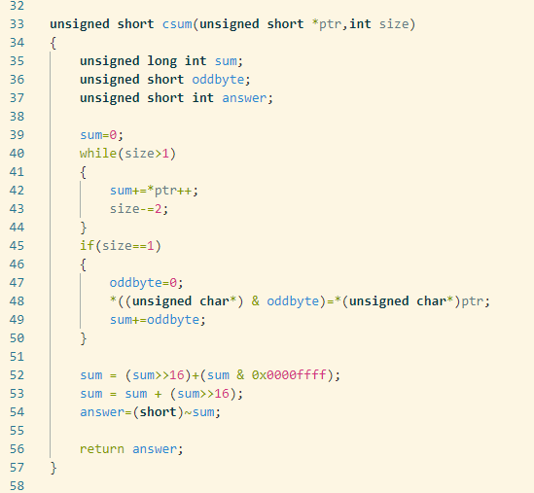
Progression
Port Scanning
TCP/IP checksum
How to calculate checksum
IP CIDR
How to parse CIDR to network format
*Checksum calculation algorithm

Slide 10


Progression
Port Scanning
Packet Received!
Packet
ACK: 1
Packet
SYN : 1
ACK: 1
Packet
SYN : 1

Slide 11
Progression
Port Scanning
SYN
SYN+ACK
ACK
Open Port

Slide 12
Progression
Nevermind!!
Packet Received!
Packet
RST: 1
Packet
SYN : 1
ACK: 1
Packet
SYN : 1

Slide 13
Progression
Port Scanning
SYN
SYN+ACK
RST
Half Open Port

Slide 14
Further Plans
Detecting SYN Flood Attack
Check if a host is alive

Slide 15

SYN FLOOD ATTACK
???
SYN-ACK
Spoofed SYN packet
???
SYN-ACK
Spoofed SYN packet
Spoofed SYN packet
SYN-ACK
Spoofed SYN packet
???
SYN-ACK
Packets received, so now server will send SYN-ACK response with the open ports.
But the SYN_ACK packets won’t find any valid receiver, where the attacker will keep sending SYN packets
This will keep working in a loop, keeping the server busy thus making it deny legitimate user services.
???

