Slide 1

Packet
Analyzer
Name: Proma Chowdhury
Roll: BSSE 1132
Supervisor: Dr. BM Mainul Hossain
Page: 1

Slide 2
MOTIVATION
EXPLORING NETWORK TRACES
NETWORK ANOMALY DETECTION
Page: 2

Slide 3
Steps
Packet capture using Wireshark
Analyzing packet headers in C
Live Packet capture using raw socket
Checksum calculation to check if the packet is corrupted
Check if a port is open/close
Detect SYN Flood Attack
Detect the IP addresses of the attacker
Sending ICMP Packet or ping the host
Checking if a host is alive in C
Page: 3

Slide 4
Progress
Packet capture using Wireshark
Packet header analysis using C code
Transport layer protocols TCP/UDP
Socket functions and how to live packet capture using Socket
Detecting whether a specific port of an address is open or closed using C code.
Scanning a network port
SYN flood attack principle
Page: 4

Slide 5

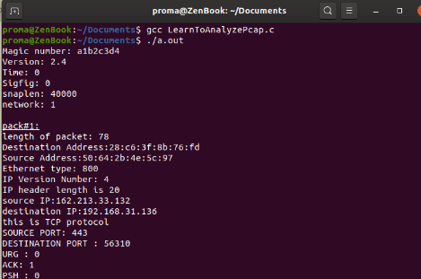
Progress
Packet Capture & Header Analysis
Processing packet…
Packet header
Global header
Packet # 1
Packet # n
… … …
Packet # n
Packet data
Page: 5

Slide 6
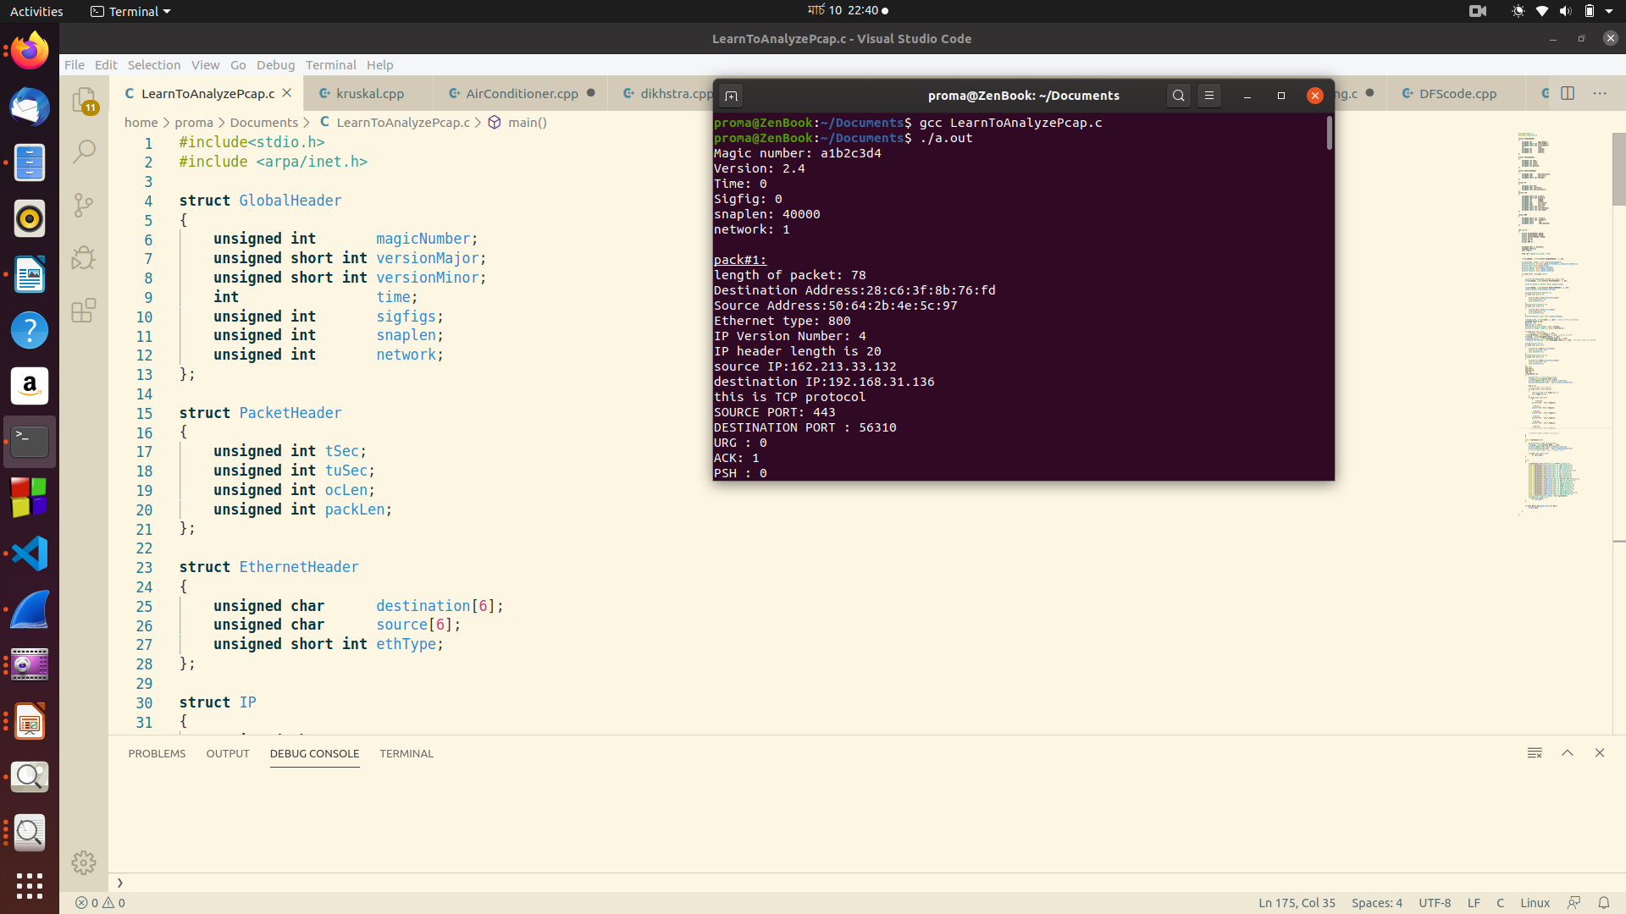
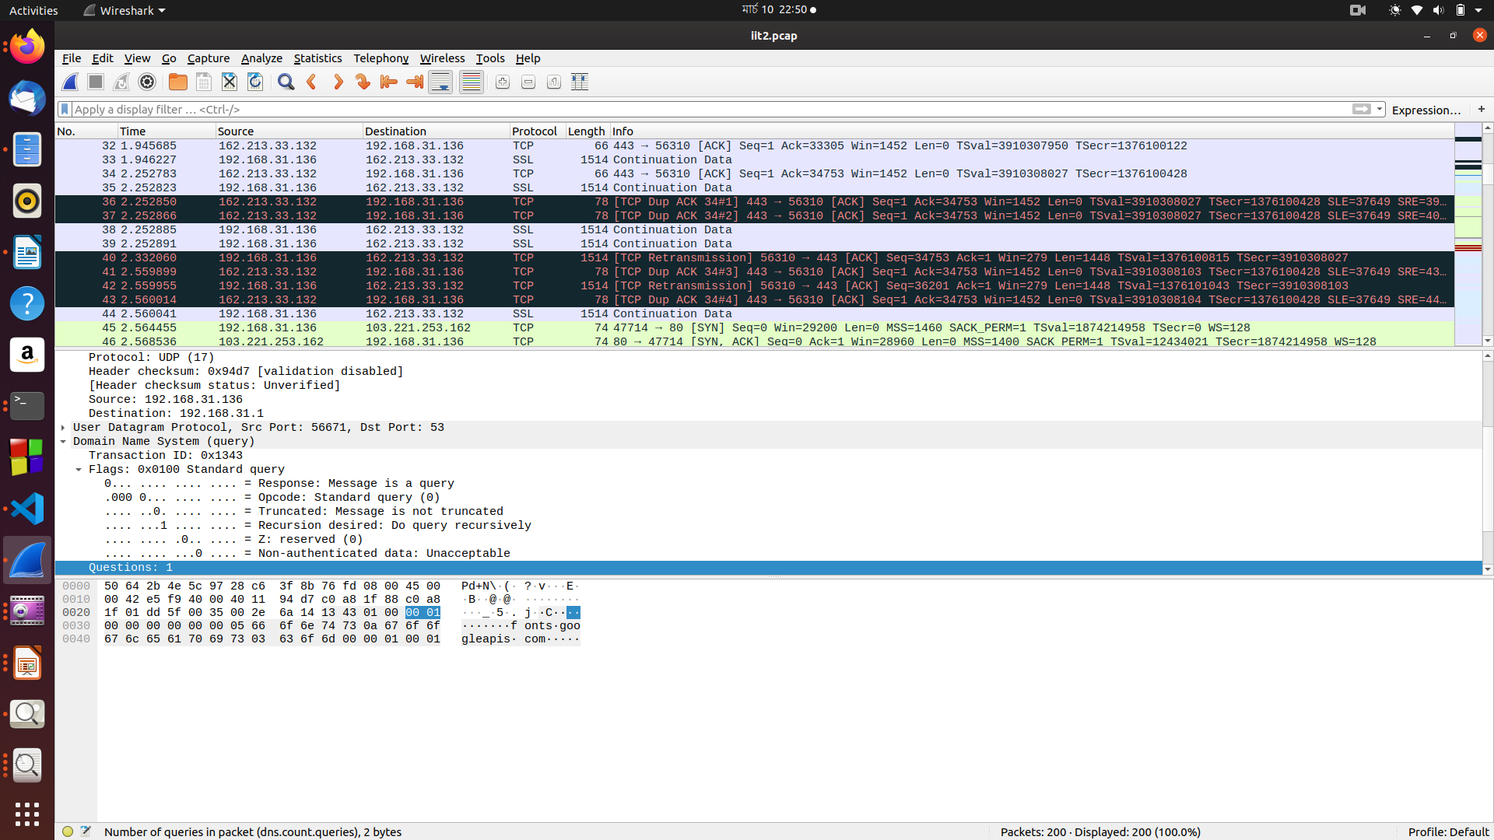
Progress
Packet Capture & Header Analysis
Page: 6

Slide 7
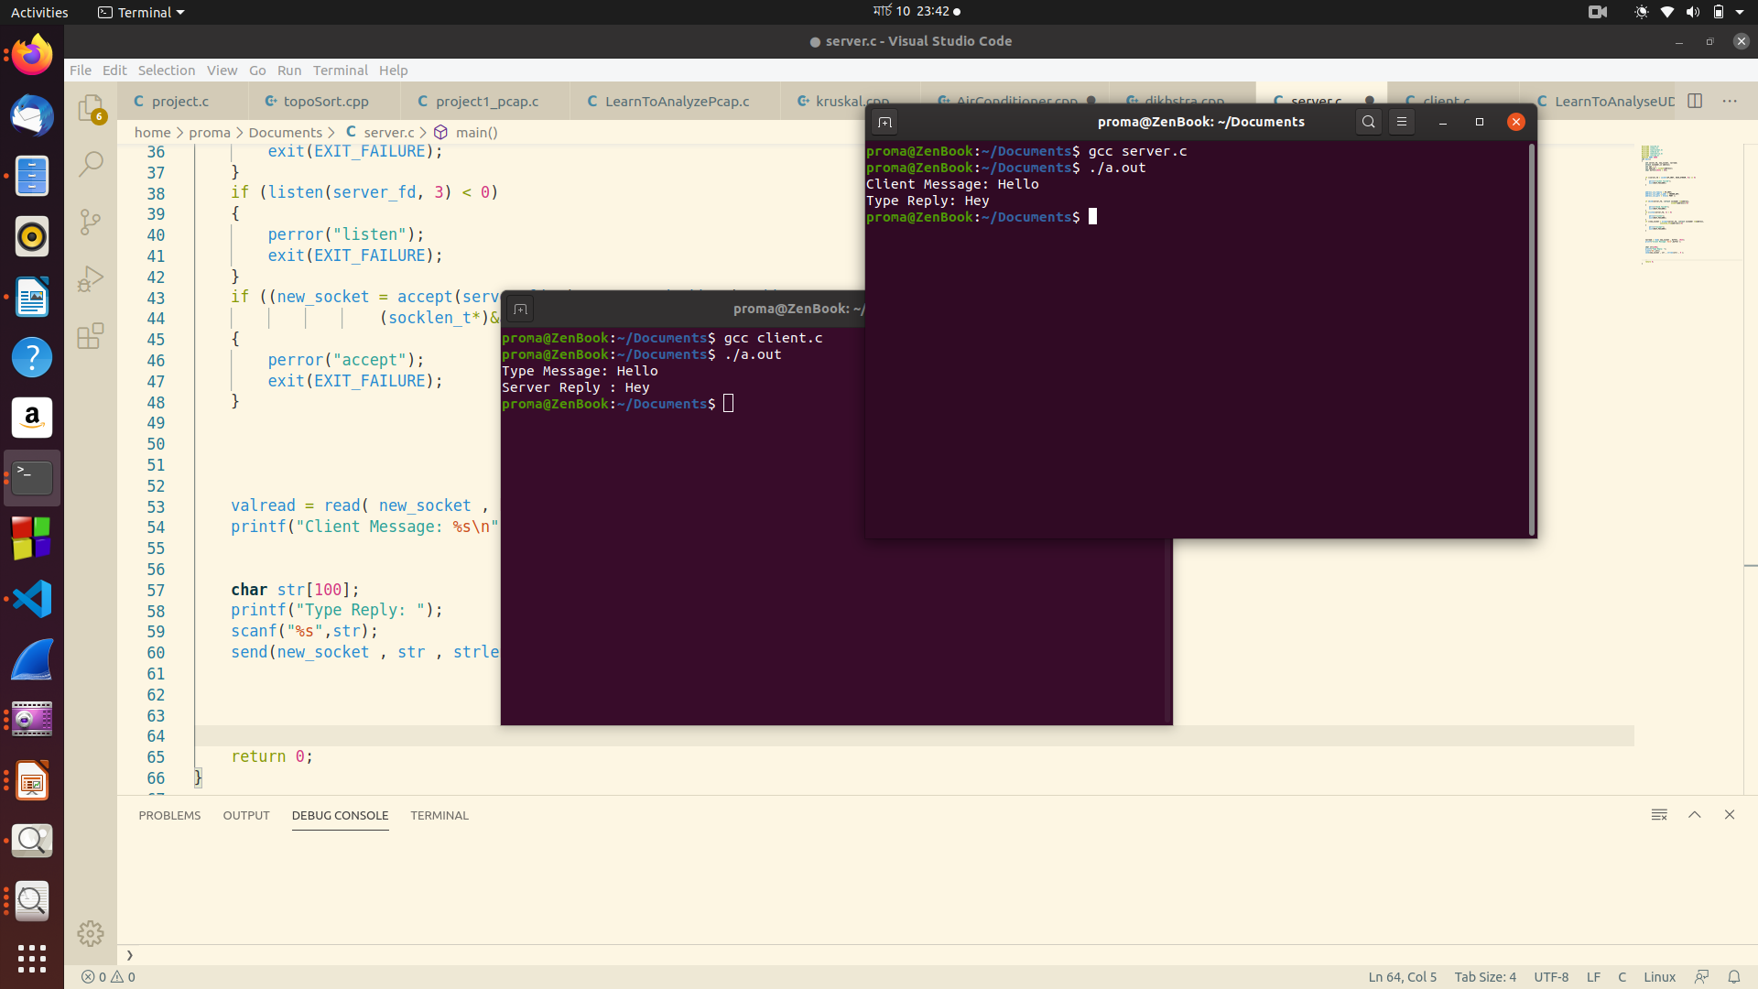
Progress
Raw Socket
Exchanging one message between server and client
Page: 7

Slide 8


Progress
Port Scanning
Packet Received!
Packet
ACK: 1
Packet
SYN : 1
ACK: 1
Packet
SYN : 1
Page: 10

Slide 9
Progress
Port Scanning
SYN
SYN+ACK
ACK
Open Port
Page: 11

Slide 10
Progress
Port Scanning
Nevermind!!
Packet Received!
Packet
RST: 1
Packet
SYN : 1
ACK: 1
Packet
SYN : 1
Page: 12

Slide 11
Progress
Port Scanning
SYN
SYN+ACK
RST
Half Open Port
Page: 13

Slide 12
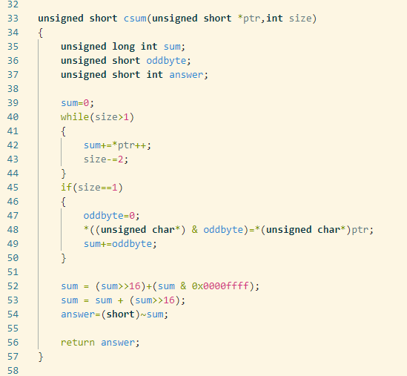
Progress
Port Scanning
TCP/IP checksum
How to calculate checksum
IP CIDR
How to parse CIDR to network format
*Checksum calculation algorithm
Page: 9

Slide 13
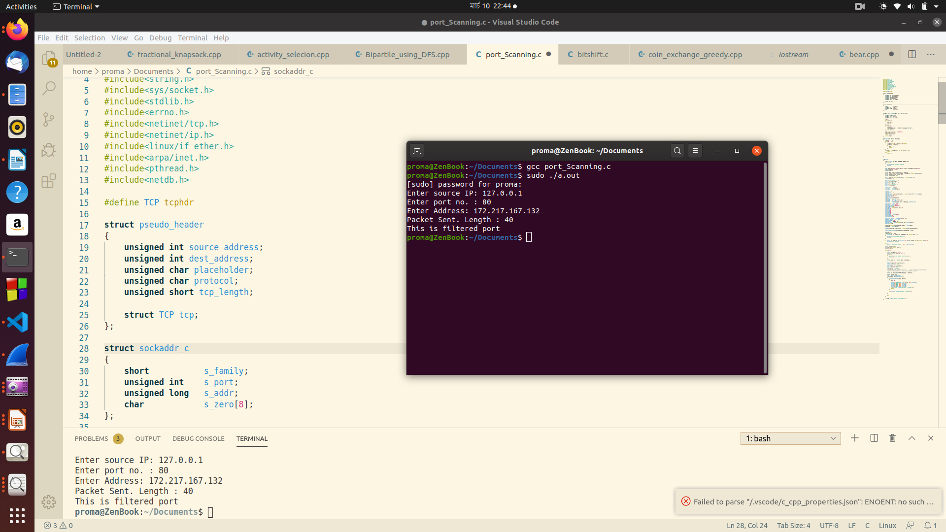
Progress
Detecting Whether a Port is Open or Close
Page: 8

Slide 14
Further Plans
Detecting SYN Flood Attack
Check if a host is alive
Page: 14

Slide 15

SYN FLOOD ATTACK
???
SYN-ACK
Spoofed SYN packet
???
SYN-ACK
Spoofed SYN packet
Spoofed SYN packet
SYN-ACK
Spoofed SYN packet
???
SYN-ACK
Packets received, so now server will send SYN-ACK response with the open ports.
But the SYN_ACK packets won’t find any valid receiver, where the attacker will keep sending SYN packets
This will keep working in a loop, keeping the server busy thus making it deny legitimate user services.
???
Page: 15

Slide 16
Image Sources
Computer cartoon in slide 10, 11, 12, 13 : https://paintingvalley.com/computer-cartoon-drawing#computer-cartoon-drawing-2.jpg
Server cartoon in slide 10, 11, 12, 13 : https://www.vectorstock.com/royalty-free-vector/server-room-on-network-and-telecommunication-vector-21228522
Laptop cartoon in slide 5 : https://www.shutterstock.com/image-vector/laptop-cartoon-vector-illustration-computer-mascot-1292073241
Attacker computer in slide 15 : https://www.123rf.com/photo_62900945_stock-vector-avatar-man-cartoon-hacker-digital-criminal-wearing-gray-hoodie-and-black-glasses-behind-monitor-comp.html
Page: 16

