Slide 1
Product Review Analysis By using Deep Learning Approaches
International Islamic University Chittagong
Presented by
Ayesha Julekha
ID:C163237
Proma Mutsuddi
ID:C163215
Supervised by
Dr. Abdul Kadar Muhammad Masum
Associate Professor
Department of CSE,IIUC

Slide 2
Welcome to Our Presentation

Slide 3
Contents
Introduction
Background of the study
Problem statement
Literature review
Research gap
Objectives
Methodologies
Result and Discussion
Summary of the Findings
Contributions
Conclusions
Limitations
Future work
Reference

Slide 4
Introduction
Beside five basic needs shopping also a mandatory part for our livelihood.
Online shopping plays an important role in our daily life.
Before purchase anything we prefer to check review on the specific item.
About 90% of the consumers read online reviews before making a purchase .After reading the positive reviews 72% consumers will be prompted to take an action.
Product reviews express the people’s perception about the product either it is positive or negative. Positive product reviews attract customers more than negative product reviews. Reviews bring benefits and losses to any business.
Bangla is a language ,around 265 million people used it as a First language and 37 million people used it as a secondary language.

Slide 5
Background of the study
In this digitalize era, People Prefer to reading product reviews before buying the product.
Since many e-commerce websites are available online. So there is a question about the authenticity of the product.
There are many online e-commerce site which sell fake product.
It creates panic situation among the people.

Slide 6
Problem Statement
For pandemic COVID-19 people can’t go out for manual purchase. So, in terms of the previous situation nowadays people much more depend on online shopping, any kind of grocery items, fast food, cloth, shoes, etc. are purchased from an online platform.
Bangla is a kind of language which has so many variations. Bangla texts still have a new field and opportunities for improvement. Because of textual complexity, it is very difficult to identify the intent of Bangla text from the Bangla language.
Less work done in product review with Bangla language and less number of Bangla review datasets being available in the online platform.

Slide 7
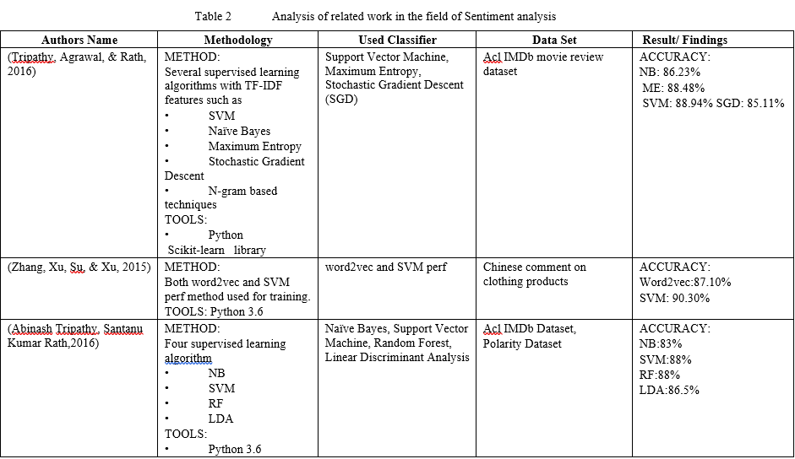
Literature review :Sentiment analysis

Slide 8
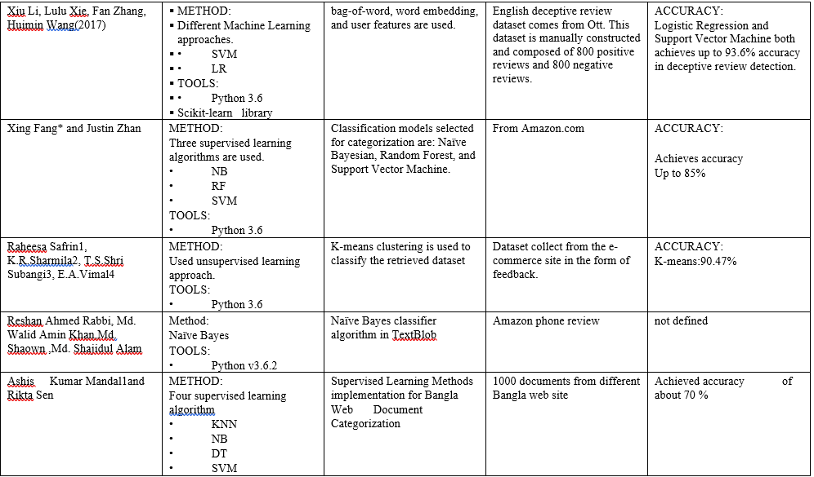
Literature review

Slide 9
Research Gap
Lack of large volume of publicly available Bangla dataset.
Few work has been done on Bangla review dataset with Natural language approach.
Less work has been done bidirectional LSTM.
Few work has been done convolutional neural network with Bidirectional Long short term memory.

Slide 10
Objectives
To build a dataset of Bangla product reviews which is collected from the Amazon platform.
To classify product reviews using deep learning approaches.

Slide 11
Methodologies
Methods we have used-
Convolutional Neural Network (CNN)
Bidirectional Long Short Term Memory(Bi LSTM)
CNN with Bidirectional LSTM

Slide 12
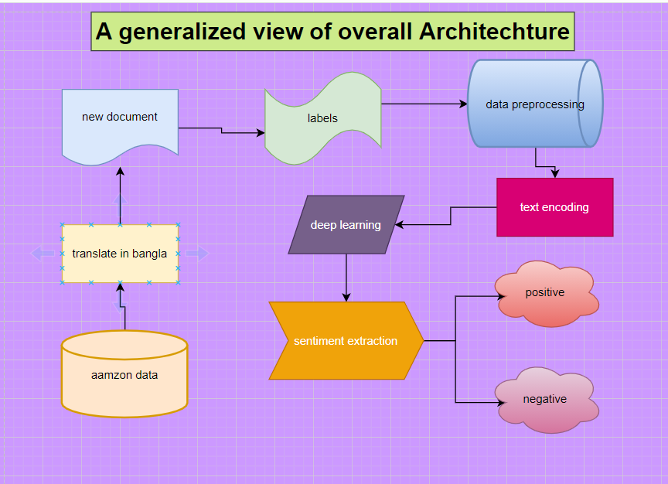
Generalized View Of Overall Architecture

Slide 13
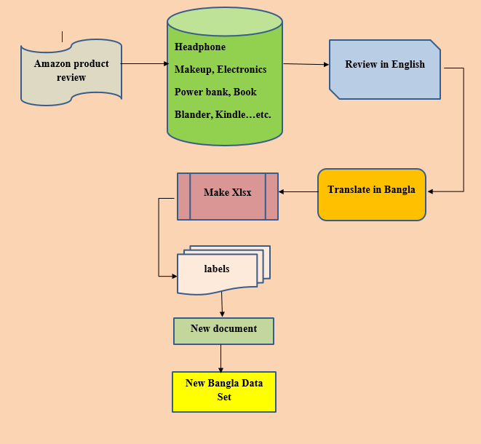
Data Collection
15000 amazon reviews of products.
Translated in Bangla.
Label in positive and negative
7500 positive data
7500 negative data

Slide 14
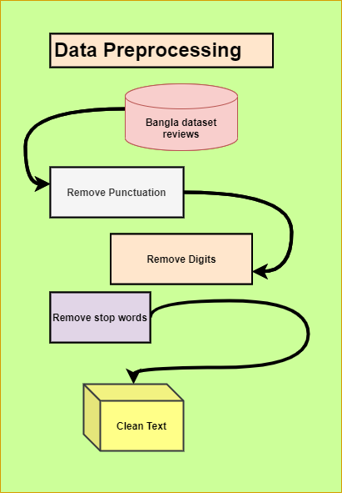
Data Preprocessing
Data preprocessing is a technique of data mining that involved the process of making an understandable data format.
Why data preprocessing
Noisy data
Missing values
Inconvenient form

Slide 15
Tokenization
Tokenization is a technique that splits the text into tokens
there are two kinds of tokenization one is word tokenization and another is sentence tokenization.
Sentence tokenization split the sentence into single words.
Word tokenization split the words into single characters.
Why tokenization
For modeling text
Example of sample text input | Tokenize text
এই ঘড়ির মুখটি খুব ছোট। সাবধান হোন. আমি নিশ্চিত নই যে কেন তারা এটিকে ইউনিসেক্স ঘড়ি বলছে কারণ কোনও লোকই এর চেয়ে ছোট কিছু চাইবে না। | ‘এই’ ‘ঘড়ির’ ‘মুখটি’ ‘খুব’ ‘ছোট’ ‘।‘ ‘সাবধান’ ‘হোন’. ‘আমি’ ‘নিশ্চিত’ ‘নই’ ‘যে’ ‘কেন’ ‘তারা’ ‘এটিকে’ ‘ইউনিসেক্স’ ‘ঘড়ি’ ‘বলছে’ ‘কারণ’ ‘কোনও’ ‘লোকই’ ‘এর’ ‘চেয়ে’ ‘ছোট’ ‘ কিছু’ ‘চাইবে’ ‘না’ ‘।‘
আমি যখন আমার পিএস ভিটা পেয়েছিলাম তখন আমি এটি বিনামূল্যে পেয়েছিলাম এবং এটি খুব ভাল জিনিস যেহেতু এটি অকেজো হওয়ার পাশেই রয়েছে। আমি এই বিষয়ে লোকেদের মোটেই অর্থ ব্যয় করার পরামর্শ দেব না। | ‘আমি’ ‘যখন’ ‘আমার’ ‘পিএস’ ‘ভিটা’ ‘পেয়েছিলাম’ ‘তখন’ ‘আমি’ ‘এটি’ ‘বিনামূল্যে’ ‘পেয়েছিলাম’ ‘এবং’ ‘এটি’ ‘খুব’ ‘ভাল’ ‘জিনিস’ ‘যেহেতু’ ‘এটি’ ‘অকেজো’ ‘হওয়ার’ ‘পাশেই’ ‘রয়েছে’’।‘ ‘আমি’ ‘এই’ ‘বিষয়ে’ ‘লোকেদের’ ‘মোটেই’ ‘অর্থ’ ‘ব্যয়’ ‘করার’ ‘পরামর্শ’ ‘দেব’ ‘না’ ‘।‘

Slide 16
Removing Punctuation
Punctuation marks make a document in a readable format, those punctuation having no importance on text classification.
A clean text is easy to processed
Sample input of text | After remove punctuation
এই ঘড়ির মুখটি খুব ছোট। সাবধান হোন. আমি নিশ্চিত নই যে কেন তারা এটিকে ইউনিসেক্স ঘড়ি বলছে কারণ কোনও লোকই এর চেয়ে ছোট কিছু চাইবে না। | ‘এই’ ‘ঘড়ির’ ‘মুখটি’ ‘খুব’ ‘ছোট’ ‘সাবধান’ ‘হোন’. ‘আমি’ ‘নিশ্চিত’ ‘নই’ ‘যে’ ‘কেন’ ‘তারা’ ‘এটিকে’ ‘ইউনিসেক্স’ ‘ঘড়ি’ ‘বলছে’ ‘কারণ’ ‘কোনও’ ‘লোকই’ ‘এর’ ‘চেয়ে’ ‘ছোট’ ‘ কিছু’ ‘চাইবে’ ‘না’

Slide 17
Remove Digits
The datasets are based on Bangla product review, these reviews contain some English Or Bangla numeric symbol which has no significant meaning in the text. This symbol can make an effect on data redundancy which can make an impact on the negative results, it has to be.

Slide 18
Remove Stop Word
Stop words are a list of those words which are frequently used in a sentence. In-text mining we often worked with removing stop words
Without stop word text can be processed with focused words.
In the Bangla language there are so many stop words, we have listed down 335 Stop words, and we worked throughout it.
Bangla Stop Word | After Removing Stopword
এই ঘড়ির মুখটি খুব ছোট। সাবধান হোন. আমি নিশ্চিত নই যে কেন তারা এটিকে ইউনিসেক্স ঘড়ি বলছে কারণ কোনও লোকই এর চেয়ে ছোট কিছু চাইবে না। | ‘ঘড়ির’ ‘মুখটি’ ‘ছোট’ ‘সাবধান’ ‘হোন’. ‘নিশ্চিত’ ‘এটিকে’ ‘ইউনিসেক্স’ ‘ঘড়ি’ ‘কোনও’ ‘লোকই’ ‘ছোট’ ‘চাইবে’

Slide 19
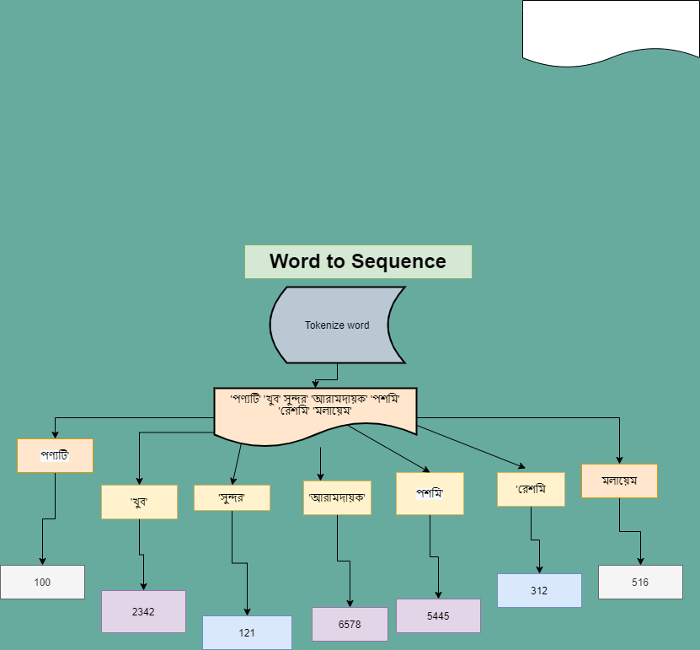
Text to Sequence
Deep learning and machine learning both are worked with numeric values not with texts
In deep learning inputs are represented in vectorize form.
in the class of text to sequence all the unique token get a integer value in term of that word.

Slide 20
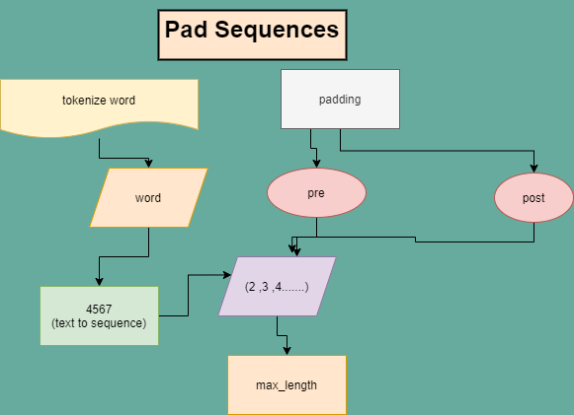
Pad Sequences
Pad sequence is used to make the all sequences in the same length.
By padding we can make the all sequences to same length and get a fine input for neural networks

Slide 21
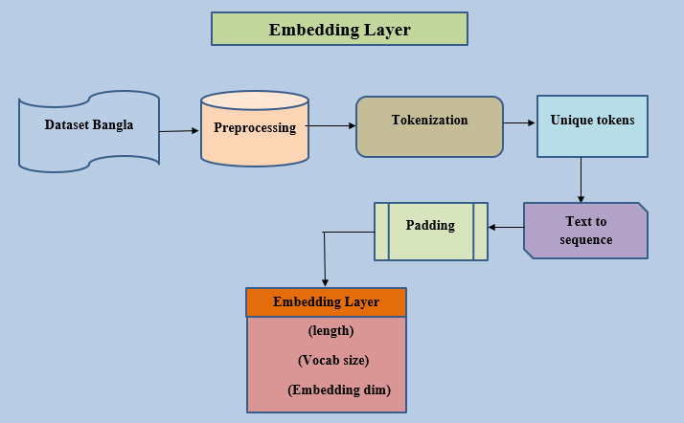
Embedding layer
Embedding layer is a important layer used in deep neural networks when it implement with text classification
Embedding layer used to index a table which is belongs to embedding vector.

Slide 22
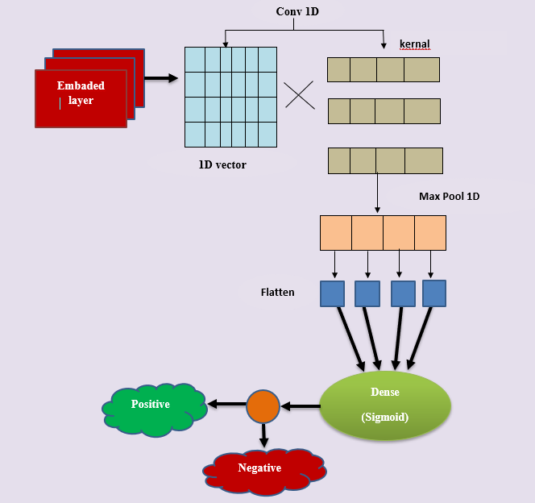
Implement With CNN
Embedding layer with 100 nodes.
Three consecutive layer of conv1D
100 nodes used in each Dense
Relu activation function used on each dense.
MAXpool1d ,Flatten is used.
In output layer sigmoid active function used with 1 node.
Loss function- Binary cross entropy.
Optimizer Adam.
Metrics- Accuracy

Slide 23
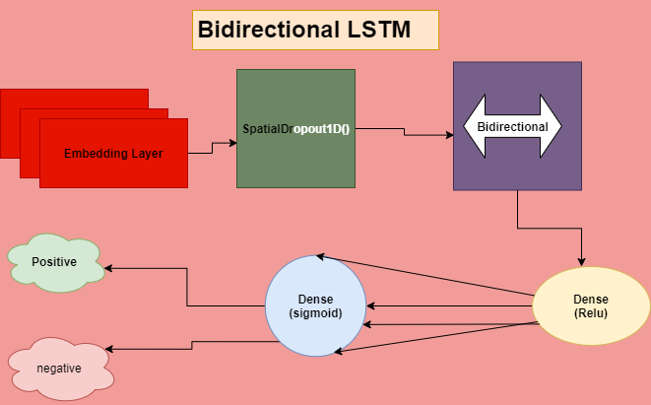
Implement with Bi LSTM
Embedding layer with 100 nodes
Bidirectional LSTM layer with 50 nodes
Activation function – Relu
Output dense with 1 node by using sigmoid function
Loss function – binary cross entropy
Optimizer – Adam
Metrics- Accuracy

Slide 24
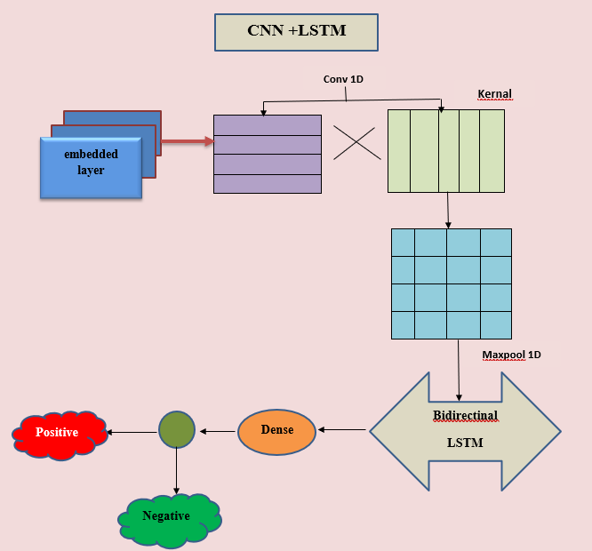
CNN with Bi-LSTM
Embedding layer with 100 nodes.
conv1d layer
maxpool1D layer
Bidirectional LSTM with 100 nodes
In output layer sigmoid active function used with 1 node.
Loss function- Binary cross entropy.
Optimizer Adam.
Metrics- Accuracy

Slide 25
Result

Slide 26
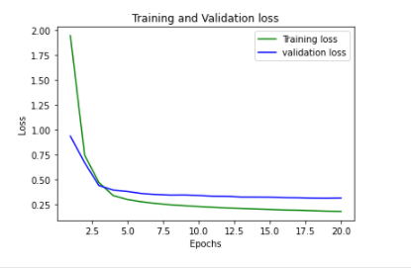
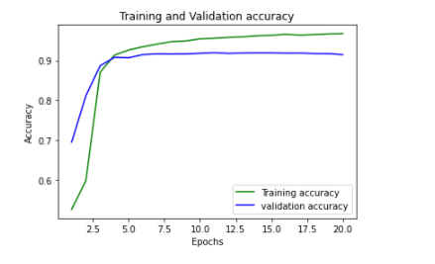
CNN
Loss Curve
Accuracy Curve

Slide 27
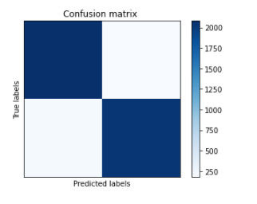
Confusion metrics of CNN
From the confusion metrics
[[2081 179]
[ 204 2036]]
It can be said that the CNN model correctly classify the 4117 data out of 4500 testing data.
Accuracy – 91.49%

Slide 28
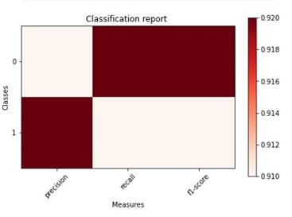
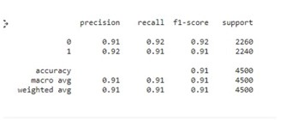
Classification report of CNN
Both negative and positive polarity have different f1 score

Slide 29
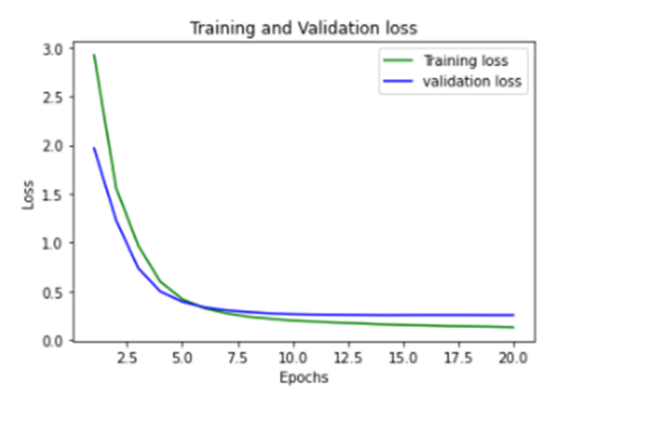
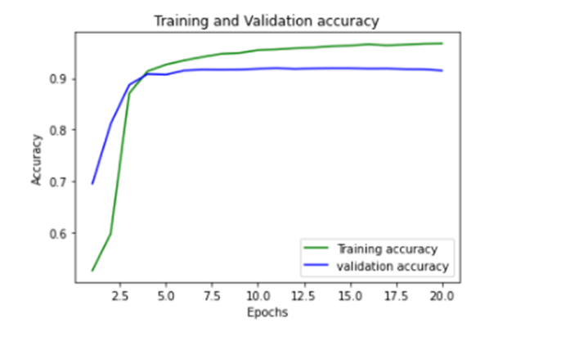
Bidirectional LSTM
Loss curve
Accuracy curve

Slide 30
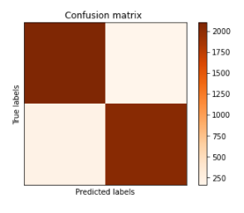
Confusion metrics of Bi- LSTM
From the confusion metrics
[[2100 160]
[ 201 2039]]
It can be said that the bidirectional LSTM model correctly classify the 4136 data out of 4500 testing data.
Accuracy-92.13%

Slide 31
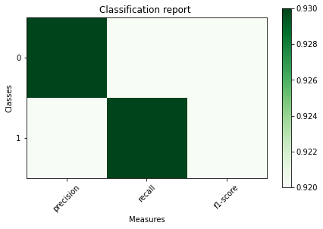
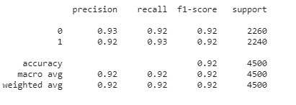
Classification report Of Bi-LSTM
Both negative and positive polarity have same f1 score

Slide 32
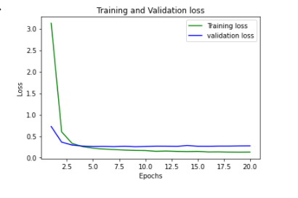
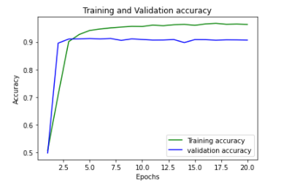
CNN with Bidirectional LSTM
Loss curve
Accuracy curve

Slide 33
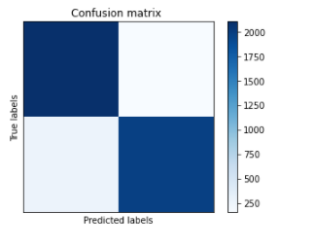
Confusion metrics of CNN with Bi-LSTM
From the confusion metrics
[[2073 187]
[ 209 2031]]
It can be said that the CNN with bidirectional model correctly classify the 4104 data out of 4500 testing data.
Accuracy – 91.01%

Slide 34
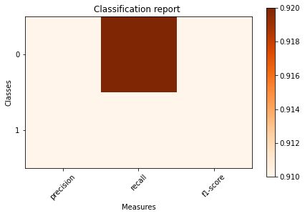
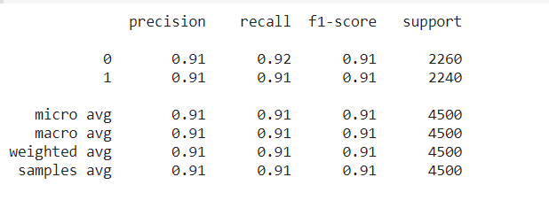
Classification report of CNN with Bi-LSTM
Both positive and negative polarity have same f1 score.

Slide 35
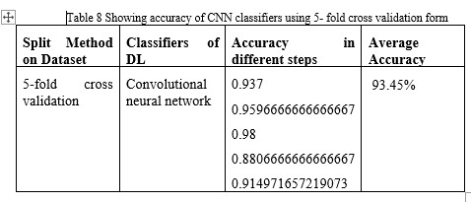
Cross validation with CNN
We have used 5 fold cross-validation approach for our dataset so that the output of the dataset can be utilized in an optimal way. For CNN,
Accuracy:
Percentage split validation approach- 91.49%
Cross validation approach- 93.45%

Slide 36
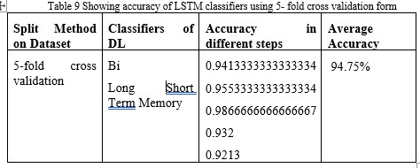
Cross validation with bidirectional LSTM
For Bidirectional LSTM,
Accuracy:
Percentage split validation approach- 92.13%
Cross validation approach- 94.75%

Slide 37
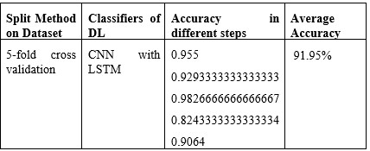
Cross validation with CNN with bidirectional LSTM
For CNN with Bi LSTM,
Accuracy:
Percentage split validation approach- 91.01%
Cross validation approach- 91.95%

Slide 38
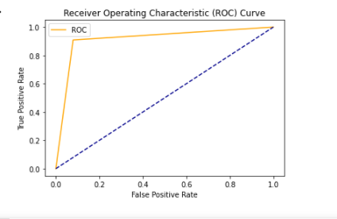
ROC curve of CNN
The AUC score of the CNN is 0.91 which is in the range of 0.5 to 1. That means the model work Pretty well.

Slide 39
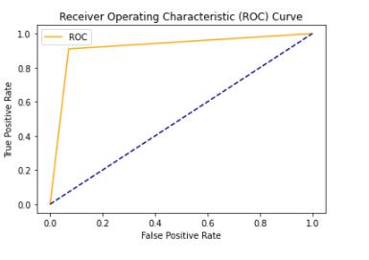
ROC curve of Bidirectional LSTM
The AUC score of the bidirectional LSTM model is 0.92 which is pretty good in term of the range of AUC.

Slide 40
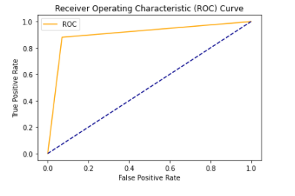
ROC curve of CNN with Bi-LSTM
The AUC score of the CNN with Bidirectional LSTM model is 0.91 which is pretty good in term of the range of AUC.

Slide 41
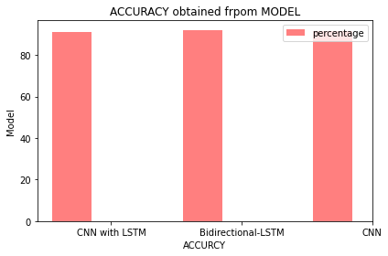
Comparative result of models

Slide 42
Discussion
In the summary of the study, there is no doubt that there is a lot of research work in natural language processing, especially in the English language. Due to textual complexity, review analysis from Bangla language is very hard. Extensive research has been done on social media to analyze the content of English texts, but less one has done this work with Bangla data yet.
With deep learning approach, a good accuracy of 91.49% has been achieved with the CNN approach in the case of sentiment analysis.
Implementation of sentiment analysis yields an accuracy of 91.01% with the deep learning approach convolutional neural network with Bidirectional LSTM.
in case of sentiment analysis using Bidirectional LSTM approach a fair accuracy of 92.13% has been achieved.

Slide 43
Summary of Findings
Developing efficient Bangla text classification is crucial issue, Bengali is a rich language with many variations as well as electronic documents based on Bengali have been published very fast both online and offline. We can say without any doubt that Bangla language is rich enough to work with and apply with various NLP tasks.

Slide 44
Contribution
Data has been collected from the Amazon Platform. Building a huge amount of the Bangla dataset was surely a challenge because there the reviews were present in the English alphabet and labelling two different fields which are positive and negative.
Using bidirectional LSTM.
Using a hybrid model CNN with bidirectional LSTM.

Slide 45
Conclusion
With deep learning approach, a good accuracy of 91.49% has been achieved with the CNN approach in the case of sentiment analysis.
Implementation of sentiment analysis yields an accuracy of 91.01% with the deep learning approach convolutional neural network with Bidirectional LSTM.
In case of sentiment analysis using Bidirectional LSTM approach a fair accuracy of 92.13% has been achieved.

Slide 46
Limitations
In case of sentiment analysis all models cannot show satisfactory performance and in hybrid model CNN with bidirectional LSTM has shown an accuracy less than the highest achieved one in term of deep learning approach.
Dataset for sentiment analysis is comparatively less authentic.

Slide 47
Future Works
Enlarging our dataset.
Making an approach which can detect fake reviews.
Working with neural layer.
Adding neutral polarity in sentiment analysis.
Implement with other deep learning methods including HAN.

Slide 48
Reference
[1] Turney, Peter D., “Thumbs up or thumbs down? Semantic Orientation Applied to Unsupervised Classification of Reviews”, Proceedings of Association for Computational Linguistics, Philadelphia, PA. July 2002, pp. 417-424.
[2] Ji fang, Bi Chen, “Incorporating Lexicon Knowledge into SVM Learning to Improve Sentiment Classification”, Proceedings of the Workshop on Sentiment Analysis where AI meets Psychology (SAAIP), IJCNLP 2011, pp. 94–100.
[3] Xing Fang* and Justin Zhan “Sentiment analysis using product review data” Fang and Zhan Journal of Big Data (2015) 2:5.
[4] Hu M, Liu B (2004) Mining and summarizing customer reviews. In: Proceedings of the tenth ACM SIGKDD international conference on Knowledge discovery and data mining. ACM, New York, NY, USA. pp 168–177.
[5] R. Moraes, J. F. Valiati, and W. P. G. Neto, “Document-level sentiment classification: An empirical comparison between svm and ann,” ExpertSystems with Applications, vol. 40, no. 2, 2013, pp. 621–633.

Slide 49
[6] Han, J. and Kamber, M. ”Data Mining: Concepts and Techniques.” 2nd Edition. Morgan Kaufmann Publishers, San Francisco, USA. (ISBN-55860-901-6), 2006.
[7] R. Duda, P. Hart, and D. stork, ”Pattern Classification.” 2nd Edition, Wiley Interscience, 2001.
[8] E. Frank, and I. Witten, ”Data Mining: Practical Machine Learning Tools and Techniques.” 2nd Edition, Morgan Kaufmann, San Francisco, 2005.
[9] Galathiya, A. S., A. P. Ganatra, and C. K. Bhensdadia. ”Improved Decision Tree Induction Algorithm with Feature Selection, Cross Validation, Model Complexity and Reduced Error Pruning.” International Journal of Computer Science and Information Technologies 3.2 (2012): 3427-3431.
[10] C. Z. Jiajun Zhang, Neural Networks in Machine Translation: An Overview, IEEE Intell. Syst., pp. 17241734, 2015.
[11] Bullinaria, J.A., Recurrent neural networks. Neural Computation: Lecture, 2013. 12.
[12] Olah, C., Understanding LSTM Networks. 2016.
[13] Hochreiter, S. and J. Schmidhuber, Long short-term memory. Neural computation, 1997. 9(8): p. 1735-1780
[14] Gers, F.A., J. Schmidhuber, and F. Cummins, Learning to forget: Continual prediction with LSTM. Neural computation, 2000. 12(10): p. 2451-2471.
[15] Elman, J.L., Finding structure in time. Cognitive science, 1990. 14(2): p. 179-211
[16] Rohit Narayan, Review Spam Detection Using Machine Learning Techniques, 2016 5: p. 769-008.

Slide 50
[17] M.N. Istiaq Ahsan, Tamzid Nahian, Abdullah All Kafi, Md. Ismail Hossain, and Faisal Muhammad Shah. An ensemble approach to detect review spam using hybrid machine learning technique. 19th International Conference on Computer and Information Technology, Dhaka, December 18-20, 2016..
[18] H. M. Ahmed, M. Javed Awan, N. S. Khan, A. Yasin, and H. M. Faisal Shehzad, “Sentiment analysis of online food reviews using Big Data analytics,” 2021.
[19] S. Al Mostakim, F. Ehsan, S. Mahdiea Hasan, S. Islam and S. Shatabda, "Bangla Content Categorization Using Text Based Supervised Learning Methods," 2018 International Conference on Bangla Speech and Language Processing (ICBSLP), 2018, pp. 1-6.
[20] A. Dhar, H. Mukherjee, N. Sekhar Dash, and K. Roy, “Performance of classifiers in Bangla text categorization,” in 2018 International Conference on Innovations in Science, Engineering and Technology (ICISET), 2018, pp. 168–173.
[21] M. Mansur, “Analysis of N-Gram based text categorization for Bangla in a newspaper corpus,” BRAC University, 2006.
[22] A. K. Mandal and R. Sen, “Supervised learning Methods for Bangla Web Document Categorization,” arXiv [cs.CL], 2014.
[23] R. A. Rabbi, M. W. A. Khan, Shaown, and M. S. Alam, “Product rating generation based on public opinion using sentiment analysis,” BRAC University, 2017.

Slide 51
[24] R. Safrin, K. R. Sharmila, T. S. Shri Subangi, and E. A. Vimal, “SENTIMENT ANALYSIS ON ONLINE PRODUCT REVIEW,” Cloudfront.net, 2008.
[25] X. Fang and J. Zhan, “Sentiment analysis using product review data,” J. Big Data, vol. 2, no. 1, 2015.
[26] X. Li, L. Xie, F. Zhang, and H. Wang, “Online deceptive product review detection leveraging word embedding,” in 2017 IEEE 15th Intl Conf on Dependable, Autonomic and Secure Computing, 15th Intl Conf on Pervasive Intelligence and Computing, 3rd Intl Conf on Big Data Intelligence and Computing and Cyber Science and Technology Congress(DASC/PiCom/DataCom/CyberSciTech), 2017, pp. 867–870.
[27] A. Tripathy, A. Agrawal, and S. K. Rath, “Classification of sentiment reviews using n-gram machine learning approach,” Expert Syst. Appl., vol. 57, pp. 117–126, 2016.
[28] D. Zhang, H. Xu, Z. Su, and Y. Xu, “Chinese comments sentiment classification based on word2vec and SVMperf,” Expert Syst. Appl., vol. 42, no. 4, pp. 1857–1863, 2015.
[29] A. Tripathy, A. Agrawal, and S. K. Rath, “Classification of sentiment reviews using n-gram machine learning approach,” Expert Syst. Appl., vol. 57, pp. 117–126, 2016.
[30] Lee, S. Yi, S. Hyun, and C. Kim, “Review on the recent welding research with application of CNN-based deep learning part I: Models and applications,” J. Weld. Join., vol. 39, no. 1, pp. 10–19, 2021.

Slide 52
Thank you

