Slide 1

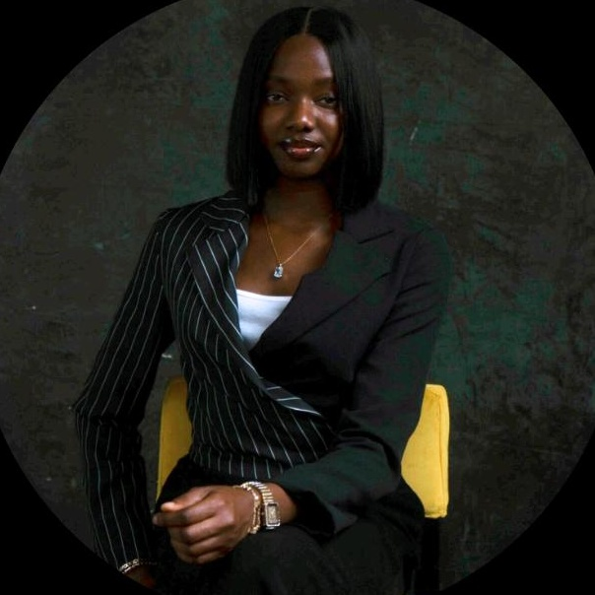

MENTOR
SPOTLIGHT
Umuteme Oghenefego Peace
aka Ms. Fegs · VA Mentor · HNG 14
Presented by: Ayogu Ifunanya
MS. FEGS · VA MENTOR · HNG 14
"A calm in the storm."
Umuteme Oghenefego Peace
Notes:
Open warmly — Ms. Fegs was the first mentor who truly impacted you.

Slide 2
WHO IS SHE?
01 / 10
MEET THE MENTOR
Who is Ms. Fegs?
FULL NAME
CERTIFICATIONS
Umuteme Oghenefego Peace
Project Management
Human Resource Management
Customer Service & Relationship
SLACK ID
Ms. Fegs ⭐
ROLE AT HNG 14
Virtual Assistant Mentor
EDUCATION
Computer Science · Landmark University
"The kind of person you don't forget — not because she was loud, but because she was real."
Notes:
Her background shows she is well-rounded. She brought both technical and human skills to HNG.

Slide 3




MENTORSHIP STYLE
02 / 10
HOW SHE SHOWS UP
Mentorship Style
Four words that define Ms. Fegs — every single time, without exception.
Calm
Encouraging
Detailed
Welcoming
Even in chaos her composure never breaks. She makes you feel like everything will be okay even when it isn't yet. Her voice alone is a stabiliser.
She praises your efforts genuinely and immediately. When you do a good job, she makes sure you know it and you feel it in how she says it.
She doesn't give vague advice. She breaks things down, walks you through every gap, and makes sure you leave with real, actionable clarity.
She listens to your opinion first validates it or doesn't. But she always gives her honest two cents with full respect and no condescension.
Notes:
Each of these words is observable behaviour — not just adjectives.

Slide 4


LEADERSHIP APPROACH
03 / 10
HOW SHE LEADS
Leadership
Approach
She doesn't give you the fish.
She teaches you how to fish
and then tells you about the
times she nearly drowned.
Ms. Fegs leads quietly but powerfully —
through example, storytelling, and empowerment.
Empowers, Doesn't Spoon-feed
She guides you toward the answer rather than handing it to you. She believes in your ability to figure things out and makes you believe it too.
Leadership through story, not just instruction.
Leads Through Storytelling
She shares her own past mistakes openly — what went wrong, what she could have done better. That kind of vulnerability builds trust faster than perfection ever could.
Accessible & Present
She is readily available and quick to help. She doesn't create distance between herself and the interns she mentors. Her DMs are always open.
Notes:
This is what separates Ms. Fegs — she doesn't just guide, she humanises herself in the process.

Slide 5
KEY INTERNSHIP MOMENTS
04 / 10
REAL STORIES FROM THE INTERNSHIP
Key Internship Moments
The Stage 2 Pitch Crisis
Calm in the Channel Storm
Showing Up for the Whole Cohort
I shared my struggle getting a mentor on the Slack channel. Ms. Fegs saw it immediately, stepped in without being asked, and made my problem hers. She guided me on how to pitch calmly and comprehensively. I secured a mentor that same day. That was the moment she made her first impression on me.
When chaos broke out in our Slack channel, Ms. Fegs didn't add to the noise. She quietly went into a colleague's DM to talk things through privately. No drama, no escalation just quiet, intentional care. That's not in any job description. That's character.
I watched how she interacted with fellow interns , always calm, always helpful, always encouraging. Even when I wasn't the one she was speaking to, her presence had a stabilising effect on everyone around her. She made the whole cohort feel safer.
Notes:
Tell the Stage 2 story with emotion. The other two show her consistency across the cohort.

Slide 6
FEEDBACK & COMMUNICATION
05 / 10
HOW SHE COMMUNICATES
Feedback &
Communication Analysis
How Ms. Fegs delivers feedback is as important as what she says.
Goes to Your DM
📩
When situations need sensitivity, she takes it to direct messages. She personally went to a colleague's DM during channel chaos to resolve things privately.
✅
Validates Before Redirecting
She hears your perspective first. Then she either validates it or gently redirects but you never feel dismissed. You always feel heard.
Calm in
the Storm
🌟
Praises Publicly, Coaches Quietly
Good work gets recognised openly. Corrections happen in private. That balance builds confidence without humiliation a skill many professionals never master.
Notes:
The method matters as much as the message. This is what makes her communication style exceptional.

Slide 7
STRENGTHS & GROWTH AREAS
06 / 10
Strengths &
Growth Areas
A respectful, constructive look at what Ms. Fegs does brilliantly and where there's room to grow.
✦ STRENGTHS
✦ GROWTH AREAS
Calm Under Pressure
More Teaching Sessions
Her composure in high-pressure moments sets the tone for the entire cohort. A VA who is calm gives everyone around them permission to stay calm too.
Hosting structured sessions where she teaches concepts or facilitates group opinion-sharing would add immense value. Her insights deserve a bigger stage.
Readily Accessible
More Direct Answers
She is always available and quick to help. Her DMs are open, her presence is consistent, and she never makes you feel like a burden for asking.
At times, questions were redirected to the track lead mentor. Interns would benefit from Ms. Fegs having more solutions at hand her calm delivery makes hard answers easier to receive.
Empathy as a Tool
She moves toward people who are struggling not away. That kind of intentional care is rare in any professional setting and impossible to fake.
Notes:
This is balanced — celebrate her strengths genuinely, then offer growth areas with respect.

Slide 8


LESSONS FOR FUTURE VAs
07 / 10
WHAT VAs CAN LEARN
Lessons Future
VAs Can Learn
From Ms. Fegs' leadership, communication, and operational style.
Lead with Empathy
Specific Feedback Builds Trust
Moving toward people in struggle is a professional skill. Make it intentional not just a personality default.
Name exactly what went right or wrong. Vague feedback helps no one. Precision and intentionality build trust faster than anything.
Celebrate Intentionally
Consistency is Leadership
Recognise effort as it happens. Ms. Fegs' stage write-ups weren't requirements they were choices. Make that choice.
She showed up the same way every time , calm, helpful, encouraging. Reliability maintained consistently is its own kind of leadership.
Notes:
Frame each lesson as something every VA can take into their career.

Slide 9
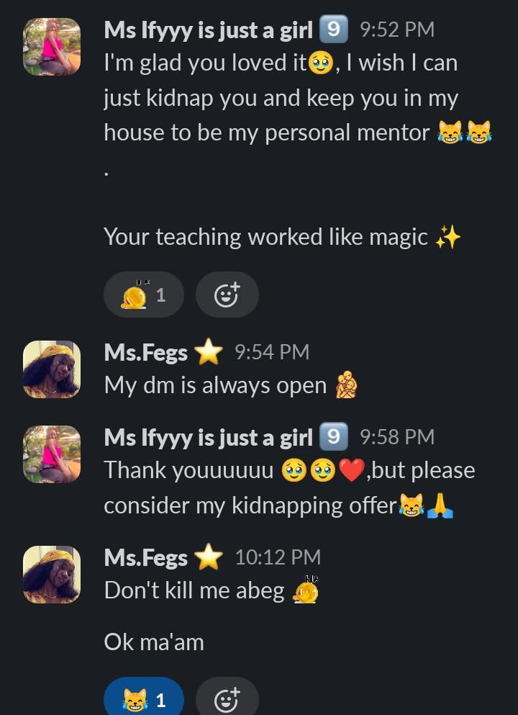
MEMORABLE MOMENTS
08 / 10
BEYOND THE WORK
Memorable Moments
The things that made Ms. Fegs unforgettable — beyond tasks and deliverables.
😂 THE KIDNAPPING OFFER — RECEIPTS ATTACHED
🎤
A Voice to Kill For
Her tone in meetings is so calm and serene it leaves you mesmerized , even when everything around you is chaotic. That voice could end a riot.
Fashion Sense: 10/10
👗
From her Slack display pictures, it's evident her fashion sense is immaculate. Aesthetic, elegant, and always a vibe. A true ten.
Stage Write ups > Everything
📝
Her motivating messages whenever interns were promoted to a new stage were emotional, filled with pride, and genuinely heartfelt. Interns looked forward to them every time.
"Don't kill me abeg" — Ms. Fegs, 10:12 PM
Notes:
Let the audience read the joke. Pause. It humanises everything beautifully.

Slide 10
FINAL TAKEAWAY
09 / 10
IN CLOSING
Final
Takeaway
THE MOMENT
Stage 2 pitch crisis , she stepped in without being asked and changed my trajectory.
THE STYLE
Calm · Encouraging · Detailed · Welcoming
THE IMPACT
A first impression that has lasted far beyond HNG 14.
Thank You,
Ms. Fegs 💛
THE LESSON
What good mentors do is make your problem theirs just long enough for you to find your way.
— Presented by Ayogu Ifunanya | HNG 14 VA Intern
Notes:
End with genuine gratitude. Let the quote sit. You've already shown the journey — this is just the landing.

