Slide 1
SOAP 3.3
By William Simpson

Slide 2
Table of Contents
Overview
What is SOAP?
Envelopes
Headers
Faults and Fault Codes
End-to-end data flow of a SOAP API

Slide 3
Overview
This weeks’ presentation will discuss what the SoapUI is, and provide information on Envelops, Headers, Faults and Fault-codes and End-to-end data flow within a Soap API.

Slide 4
What is SOAP?
SOAP is an acronym for Simple Object Access Protocol.
It is a message protocol that is in some ways similar to REST
It is designed for sending information through computer networks.
It uses XML as its message architecture.
Unlike REST it can be used on protocols other than HTTP, however it can use HTTP.
It is language and system independent so it can communicate between multiple operating systems.

Slide 5
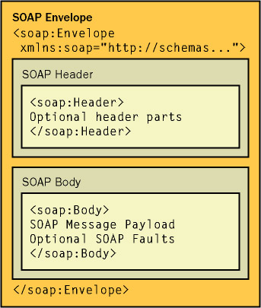
SOAP Structure

Slide 6
Envelopes
An envelope in SOAP defines the start and end of the message, this way it is known when the whole message has been received
The envelope essentially packages the information being sent
The envelope is a mandatory portion in each SOAP exchange
The envelope contains two child elements, the header and body

Slide 7
Headers
Headers are an optional element within a SOAP envelope
If it does exist, it is the first declared child after the envelope element
It has child elements called “header blocks”
Its primary use is to hold information related to its message that can be processed via specific SOAP nodes
This allows greater decentralization of the messages, and does not require point-point contact like REST.
All child elements must be name-space qualified.

Slide 8
Faults and Fault Codes
The fault element is an element that sits within the Body element of a SOAP message.
It is used to define and identify when an error has occurred, primarily for debugging purposes. It has four sub-elements.
It’s sub-elements are the faultcode, faultstring, faultactor and detail.
The faultcode attempts to identify what the fault is through an algorithmic process, and the faultstring turns it into something legible for humans.
The faultactor indicates where the fault happened, and who caused it.
The detail element only carries error information that occurs inside the body element.

Slide 9
End-to-end data flow of a SOAP API
Data is structured inside of the SOAP envelope
The SOAP envelope is sent along a protocol which follows its’ message path.
This could travel directly or bounce around nodes along the way
The receiving application will then identify everything within the message meant for the application
Verify that all mandatory elements are supported and then process them.
If there is an error at some point then a Fault and Fault codes will be generated and sent back.

Slide 10
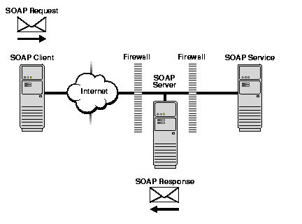
SOAP API Visualization

Slide 11
Resources
Websites:
https://www.tutorialspoint.com/soap/soap_envelope.htm
https://www.soapui.org/learn/api/soap-vs-rest-api.html
https://www.w3schools.com/xml/xml_soap.asp
https://www.w3.org/TR/2000/NOTE-SOAP-20000508/
https://www.ibm.com/support/knowledgecenter/en/SSMKHH_9.0.0/com.ibm.etools.mft.doc/ac55780_.htm
Images
https://flylib.com/books/en/2.439.1.22/1/
https://docs.oracle.com/cd/A97335_02/integrate.102/a90297/overview.htm

