Slide 1
REST 6.2
By William Simpson

Slide 2
Table of Contents
Overview
Business Use Case
Identify the ROI
The 7 step-design

Slide 3
Overview
This weeks’ presentation will go into the process behind designing an API. It will address the business use case, the investment return for creating an API and the classic 7-step design which details a framework to begin designing your own API from scratch.

Slide 4
The API background
The purpose of the API that we will be designing, will be to engage users with books that they might like and haven’t read yet. The API will pull data from the New York Times book list, specifically the most read books section. The purpose of this will be to match users known book preferences with most read books in the same genres, thus introducing them to statistically well received books that they might not yet have read.

Slide 5
The ROI
The Return on Investment with our API will come from generating new book purchases and affiliate revenue by suggesting well liked books to users. The users will have options to access the books through affiliate links only, to maximize profit.

Slide 6
The 7-step design process
1. List what information that the API will need to get or put.
2. Create a diagram that shows the state transitions that will occur within the API
3. Reconcile the data names so that they match
4. Implement or create a media type to be used by the API
5. Document the created application semantics.
6. write and create your API design through an HTTP server
7. Publish the API endpoint

Slide 7
7- step design
1. The Semantic Descriptors (all the information)
List of Books
Book
Book Information
Name of Book
Rank of Book
If-Read Book

Slide 8
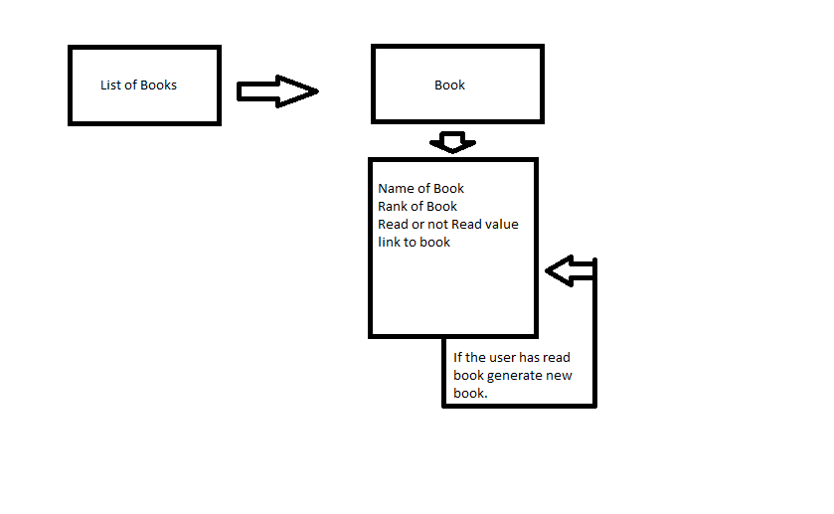
7-step design
2. State Diagram

Slide 9
7-step design
3. Reconcile Names
Here we would reconcile any names with the media type we were going to choose.
4.Media Type
The media type used will be JSON to pass the data.
5.Write the Profile
The profile describes the link relations and semantic descriptors, and where they go.
6. Implementation
In this phase we would actually implement the state diagram and profile and write the code that would get and give the information.
7.Publication
Once you’ve finished up the API, then you’ll get a domain the publish it on with explaining documentation.

Slide 10
Resources
Book:
Amundsen, M. & Richardson, L. (2013). RESTful Web APIs. O’Reilly Media, Inc. Sebastopol, CA.
Websites:
https://restfulapi.net/
https://searchmicroservices.techtarget.com/definition/REST-representational-state-transfer

