Slide 1
The Technology Value Stream
Assignment 1.2
By Will Simpson

Slide 2
Overview – What is the value stream?
Add your first bullet point here
Add your second bullet point here
Add your third bullet point here

Slide 3
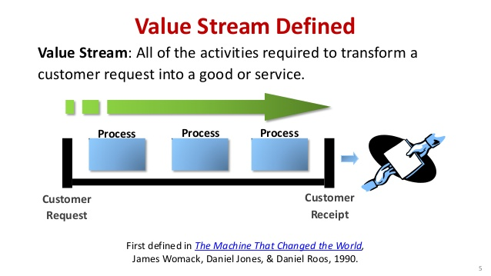
Image
Add your first bullet point here
Add your second bullet point here
Add your third bullet point here

Slide 4
What will be covered?
Lead Time vs. Processing Time
The Common Scenario: Deployment Lead Timers Requiring Months
Our DevOps Ideal: Deployment Lead Times of Minutes

Slide 5
What is Lead Time?
Lead Time is the measurement used to identify how long it takes a task to be completed, from when the request is first received to when the working solution is delivered .
It is an important measuring tool, inside of a customer service industry, the most important factor will always be how long it takes for the customer to get what they want. The faster the better.
It is a normal business practice for companies to have a backlog of work, this is because it is usually better to have more work that still needs to be done, than not enough work. This excess of work, or backlog is why we use lead times.
Lead Time is the most important part of the development process to focus on when looking at improving speed and efficiency.

Slide 6
What is Processing Time?
Processing time is a measurement that rests within Lead Time.
It’s purpose is to measure how long it actually takes to complete a task once work has actually been started.
Processing time is important because it allows a better comparison between development times because not every team or person will have as great of a backlog.
Processing time is also important because it allows you to focus within the creation process itself to make it more efficient which will improve the overall lead time. It however will always be restricted by the speed of development, instead of the amount of backlog.

Slide 7
Time Heavy Lead Requirements
Development doesn’t occur in a vacuum, within a company there are so many factors that must be considered when creating and deploying a solution.
These factors will increase the Lead Time for a solution exponentially, because every team working on the project will have its own backlog of other tasks, and there will have to be discussions and coordination meetings as well as varying levels of approval.
It’s very important for a company to have a well laid out priority system when dealing with heavy lead times, if there is a task that needs to be done that is more crucial than another, each team will have to prioritize accordingly.

Slide 8
Time Heavy Lead Requirements cont.
Without some sort of system it would be detrimental to the production process and would stall all sorts of work.
Not only do you need a priority system in place to determine what gets worked on first, but you also need a well developed approval hierarchy, it would be extremely inefficient if one team was given the approval to work and then passed on what needed to be done next to a team that had not been given approval yet.
Another area of focus is on version control and making sure that each part of the application works. It is far better to take more time up front when getting the pieces to fit together then to rush to create everything and have none of it working at the end.

Slide 9
Moving closer to the Ideal
The Ideal of DevOps is to minimize the time between the request of work and when the developer actually begins.
In a perfect scenario it would only take minutes for a developer to receive and begin work on a solution.
To achieve this sort of efficiency, many of the steps inside of development must be condensed and be able to be completed simultaneously such as testing and quality assurance, should be done in between the micro cycles of actual development to ensure that each little piece of code works as they go along.
This sort of practice is extremely useful since it provides a very clear starting point incase something isn’t working as it should be.

Slide 10
Resources
Website:
http://en.supply-chain-consultant.eu/10/lead-time-supply-chain/
Book:
Antunes, Ricardo; González, Vicente; Walsh, Kenneth (24 October 2017). "Quicker reaction, lower variability: The effect of transient time in flow variability of project-driven production"
Image:
https://www.slideshare.net/KarenMartinGroup/value-stream-mapping-39258406/26-Value_Stream_Performance_Sample_Results

