Slide 1
REST 2.2
By William Simpson

Slide 2
Table of Contents
Overview
What are RESTful APIs?
How are they used?
Website Communication Example
Advantages of RESTful APIs
Disadvantages of RESTful APIs
URI vs URL

Slide 3
Overview
This weeks’ presentation will delve further into RESTful APIs. We will begin to define what they really are, how they are used in the world, what advantages and disadvantages they provide, and what the differences between certain protocols.

Slide 4
What are RESTful APIs?
REST, or Representational State Trasnfer, is a style of development, architecture and even a mindset for use in web applications.
It is a service that lies inbetween servers and web applications, and through the a resource-based architecture, a REST API finds resources on the server and performs an action that could update, request information, or delete.

Slide 5
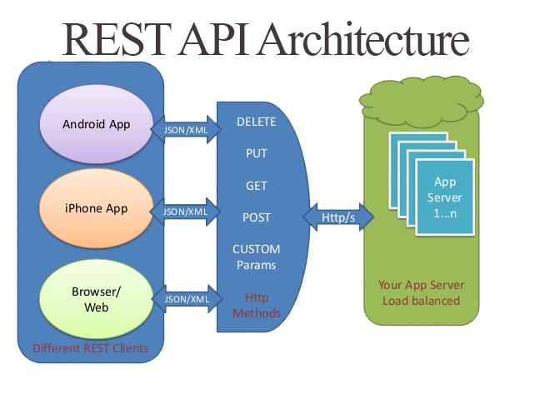
REST API Example

Slide 6
How are they used?
REST is an API that fits between an HTTP request and a server, it takes the commands from an HTTP web application and performs the actions inside of a database on the requested information.
It is often described as the “way HTTP should be used”, meaning that many web applications do not use all of the available HTTP verbs, but a RESTFUL API would.

Slide 7
Website Communication Example
REST Data Transactions
Uniform Interface
Layer System
Hypermedia
Stateless client/server protocol (explained later)

Slide 8
Advantages of RESTful APIs
POST – tells the API to create a resource in the database.
GET – requests read information from the database for the application.
PUT – edits information about a resource inside the database.
DELETE – deletes the selected information or resource.

Slide 9
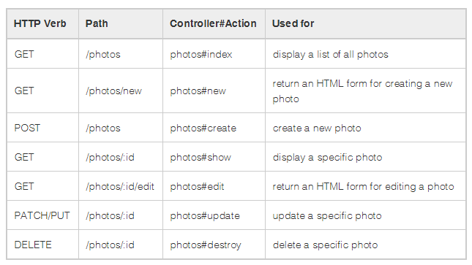
Disadvantages of RESTful APIs

Slide 10
URI vs URL
Stateless – means that every request should be a complete set of instructions, and will not use any previously stored information on the server.
This is what is so powerful about REST APIs, the fact that all of the workload is basically put on the server, which decreases the load on the servers and allows better scalability.

Slide 11
Resources
Websites:
https://restfulapi.net/
https://searchmicroservices.techtarget.com/definition/REST-representational-state-transfer
https://bbvaopen4u.com/en/actualidad/rest-api-what-it-and-what-are-its-advantages-project-develop
Images
HTTP Verb: https://stackoverflow.com/questions/33340539/delete-route-vs-get-methods-for-rails-controllers
https://shareurcodes.com/blog/creating%20a%20simple%20rest%20api%20in%20php

