Slide 1
REST 2.2
By William Simpson

Slide 2
Table of Contents
Overview
What are RESTful APIs?
How are they used?
Website Communication Example
Advantages of RESTful APIs
Disadvantages of RESTful APIs
URI vs URL

Slide 3
Overview
This weeks’ presentation will delve further into RESTful APIs. We will begin to define what they really are, how they are used in the world, what advantages and disadvantages they provide, and what the differences between certain protocols.

Slide 4
What are RESTful APIs?
REST, or Representational State Transfer, is a style of development, architecture and even a mindset for use in web applications.
It is a service that lies in-between servers and web applications, and through the a resource-based architecture, a REST API finds resources on the server and performs an action that could update, request information, or delete.
A RESTful API or Application Program Interface, uses the previously mentioned HTTP verbs to DELETE, GET, POST and PUT data in a server.

Slide 5
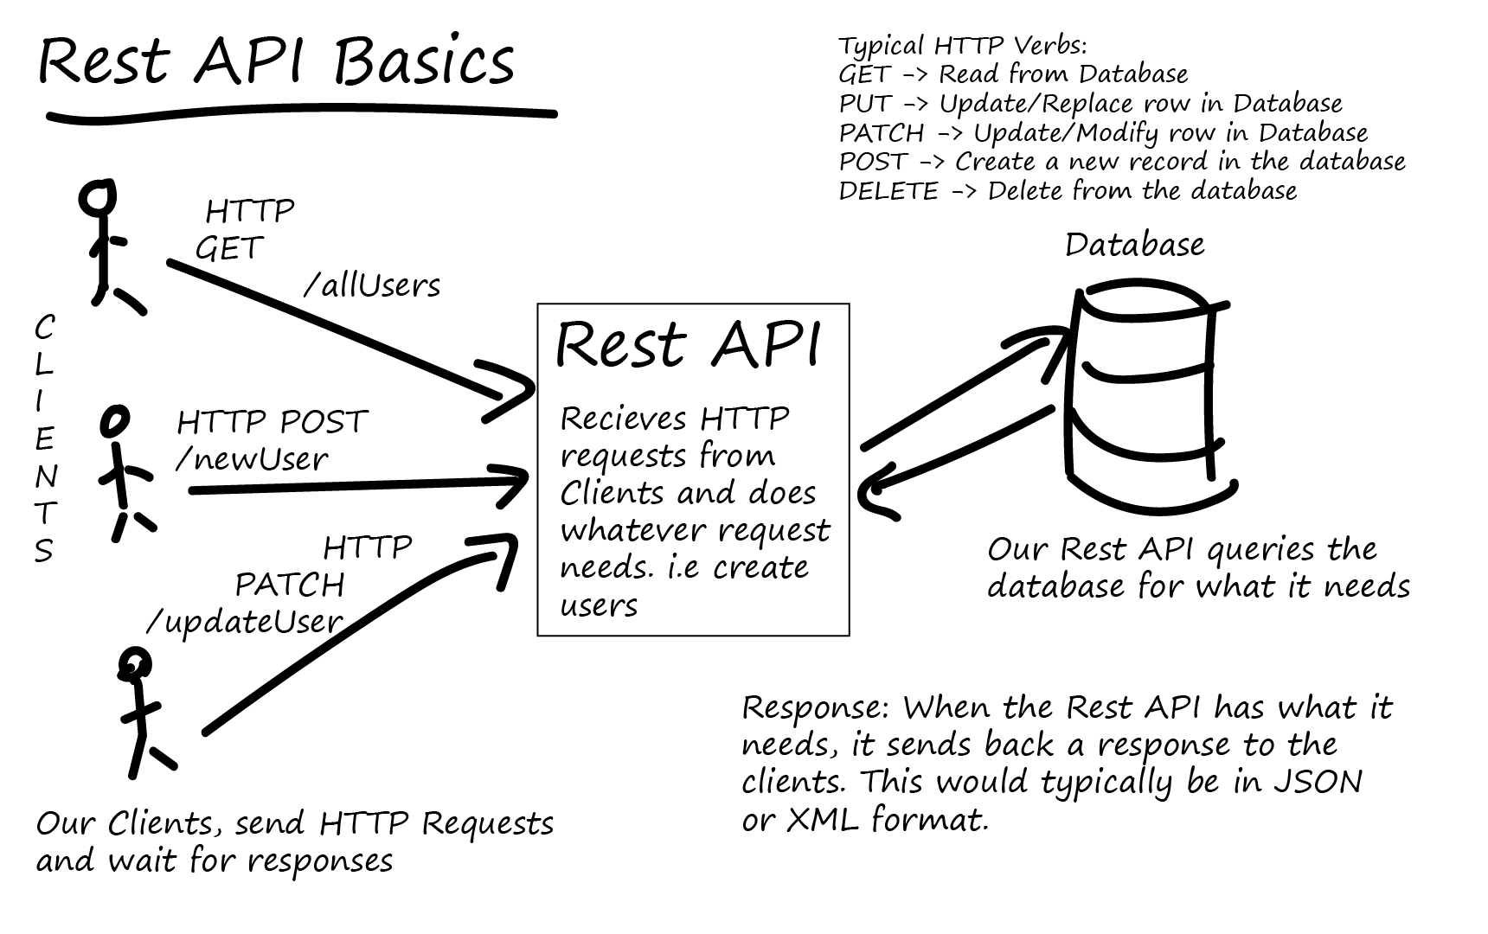
RESTful API Diagram

Slide 6
How are they used?
Simply put, RESTful APIs are used to send or receive data to a client.
What does this mean?
It means that APIs are an application that acts as a go-between clients and servers.
This adds a layer of protection and consistency to data transfer.

Slide 7
Website Communication Example
REST Data Transactions
Uniform Interface
Layer System
Hypermedia
Stateless client/server protocol (explained later)

Slide 8
Advantages of RESTful APIs
Creates a barrier between the client and the server.
As mentioned earlier, this barrier adds a layer of protection, but it also allows the API to be used on different platforms.
RESTful APIs are language neutral.
Just how they can be used on any platform, APIs allow databases to be coded in whatever language makes the most sense, so long as data is transferred from the server in a specific format.
Provides scalability and consistency.
Using an API allows many different groups to access data, and make changes. It also allows the front and back end to be split on different servers.

Slide 9
Disadvantages of RESTful APIs
Since there is a go-between the client and server, the extra step can add latency to the data requests.
Since RESTful requests self contain all necessary instructions, to reduce the load on the server, this increases the amount of data transferred and thus increases bandwidth use.
In rare cases, a network configuration or firewall might not allow the full suite of HTTP verbs, which could affect your application.

Slide 10
URI vs URL
Uniform Resource Identifier
“A Uniform Resource Identifier (URI) is a compact sequence of
characters that identifies an abstract or physical resource.” (2005, T. Berners-Lee)
It isn’t really URI vs URL, because a URI can be an umbrella term for a URL (L for Location)
and URN (N for Name) and is made by combining both.
A URL designates the network location for a web request, such as http://
The URN is the name “google.com”
However, a URI can exist without a URL, because the location doesn’t always need to be specified.

Slide 11
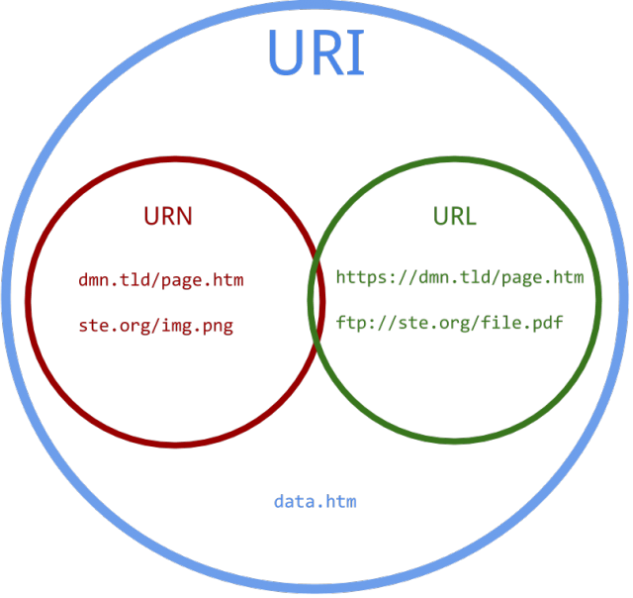
URI vs URL Visualization

Slide 12
Resources
Websites:
https://restfulapi.net/
https://searchmicroservices.techtarget.com/definition/REST-representational-state-transfer
https://bbvaopen4u.com/en/actualidad/rest-api-what-it-and-what-are-its-advantages-project-develop
https://danielmiessler.com/study/url-uri/
https://tools.ietf.org/html/rfc3986
Images
HTTP Verb: https://stackoverflow.com/questions/33340539/delete-route-vs-get-methods-for-rails-controllers
https://shareurcodes.com/blog/creating%20a%20simple%20rest%20api%20in%20php
https://tutorialedge.net/general/what-is-a-rest-api/

