Slide 1
REST
By William Simpson

Slide 2
Table of Contents
Overview
Role in modern web applications
Relationships between HTTP and REST
REST and its key features
HTTP verbs
Stateless client/server protocol.
Resources

Slide 3
Overview
This presentation is meant to give a broad understanding of the role that REST APIs have played in the growth of web development, it will cover what REST is, what it can do, and why it is used.

Slide 4
Role in modern web applications
REST, or Representational State Trasnfer, is a style of development, architecture and even a mindset for use in web applications.
It is a service that lies inbetween servers and web applications, and through the a resource-based architecture, a REST API finds resources on the server and performs an action that could update, request information, or delete.

Slide 5
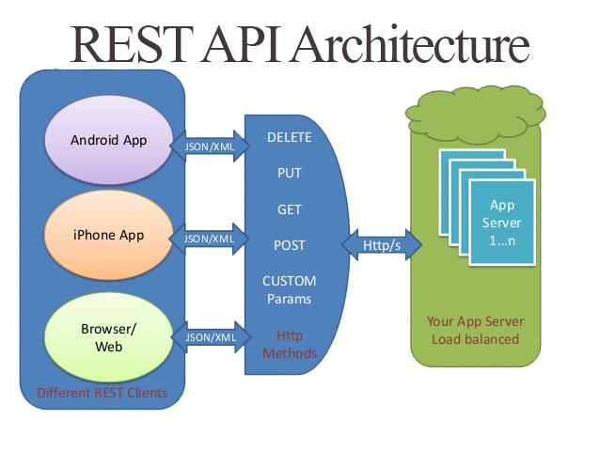
REST API Example

Slide 6
Relationships between HTTP and REST
REST is an API that fits between an HTTP request and a server, it takes the commands from an HTTP web application and performs the actions inside of a database on the requested information.
It is often described as the “way HTTP should be used”, meaning that many web applications do not use all of the available HTTP verbs, but a RESTFUL API would.

Slide 7
REST and its key features
REST Data Transactions
Uniform Interface
Layer System
Hypermedia
Stateless client/server protocol (explained later)

Slide 8
HTTP Verbs
POST – tells the API to create a resource in the database.
GET – requests read information from the database for the application.
PUT – edits information about a resource inside the database.
DELETE – deletes the selected information or resource.

Slide 9
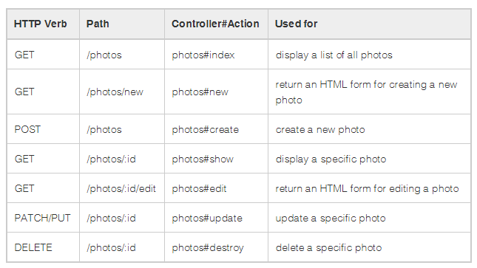
HTTP Verb Example

Slide 10
Stateless client/server protocol.
Stateless – means that every request should be a complete set of instructions, and will not use any previously stored information on the server.
This is what is so powerful about REST APIs, the fact that all of the workload is basically put on the server, which decreases the load on the servers and allows better scalability.

Slide 11
Resources
Websites:
https://restfulapi.net/
https://searchmicroservices.techtarget.com/definition/REST-representational-state-transfer
https://bbvaopen4u.com/en/actualidad/rest-api-what-it-and-what-are-its-advantages-project-develop
Images
HTTP Verb: https://stackoverflow.com/questions/33340539/delete-route-vs-get-methods-for-rails-controllers
https://shareurcodes.com/blog/creating%20a%20simple%20rest%20api%20in%20php

