Slide 1
Open Authentication 9.2
By William Simpson

Slide 2
Table of Contents
Overview
What is OAuth?
How does it work?
Brief History of OAuth.
Why is it popular?
How the data flows.
Resources.

Slide 3
Overview
This weeks’ presentation will cover open-standard authorization, what it is and how it works throughout the web, the history of OAuth its popularity and use and we will follow the data flow throughout the entire process.

Slide 4
What it is.
Open-standard Authorization is a set of protocols that define the idea of servers and known third-parties providing authentication through a single point of entry.
It was originally released in 2010, and was backed by many large companies like Google and Facebook.
It is what allows you to log into various websites using pre-authorized trusted sites like google.

Slide 5
How does it work?
First, you request access to a website, and click the Google Sign-in option
Then, Google will contact that website for you, and provide your identity and essentially vouch for it.
After you’ve been verified, the website sends Google a one-use only token and client secret.
Google then sends the token and client secret to your software.
Your software then gives the token back to gain authorization.

Slide 6
How does it work?
Once that has been confirmed you are given an upgraded approval token.
This is handed off back to Google, who sends it back to the website you are accessing as proof of your authenticity.
Now Google is accessing the website for you, and you see yourself logged in and able to use the service.

Slide 7
Brief History of OAuth
The Oauth discussion group was started in 2007, this group would write the first draft for the protocol.
It was brought before the IETF in 2008 for discussion and further refinement.
Oauth was created in 2010 as the open standard that would define a framework and protocol for unknown services interacting with each other and providing authorization and authentication to 3rd party services.
It was upgraded to version 2.0 in 2012 to mixed reviews.

Slide 8
Why is it popular?
OAuth was created to ease the issues that arose when attempting to access or share information between 3rd party applications.
It accomplished that goal and made sharing information between unknown services more secure by helping limit what information that a service could access.
This allowed information to be shared more easily, which in the age of technology allows for greater and faster growth all around.
It allows services across many different platforms to interact with each other.

Slide 9
Following the Data by Oracle®
“The Authorization Code flow is as follows:
The Web server redirects the user to the API Gateway acting as an Authorization Server to authenticate and authorize the server to access data on their behalf.
After the user approves access, the Web server receives a callback with an authorization code.
After obtaining the authorization code, the Web server passes back the authorization code to obtain an access token response.
After validating the authorization code, the API Gateway passes back a token response to the Web server.
After the token is granted, the Web server accesses their data.”

Slide 10
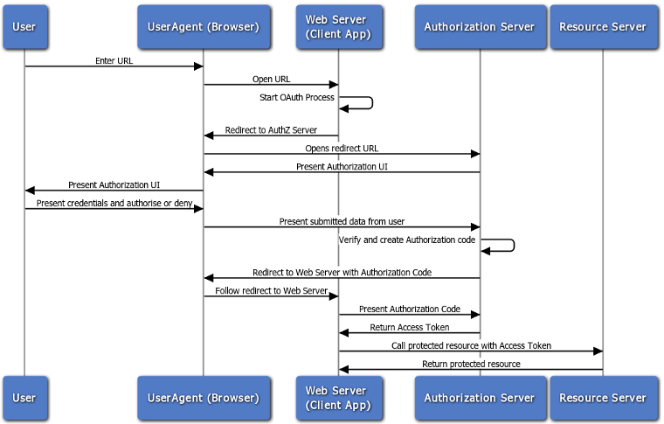
Data Example

Slide 11
Resources
Book:
Amundsen, M. & Richardson, L. (2013). RESTful Web APIs. O’Reilly Media, Inc. Sebastopol, CA.
Image:
https://docs.oracle.com/cd/E39820_01/doc.11121/gateway_docs/content/images/oauth/oauth_web_server_flow.png
Websites:
https://docs.oracle.com/cd/E39820_01/doc.11121/gateway_docs/content/oauth_flows.html
https://www.csoonline.com/article/3216404/authentication/what-is-oauth-how-the-open-authorization-framework-works.html
https://datatracker.ietf.org/wg/oauth/documents/
https://tools.ietf.org/html/rfc6749
https://lifehacker.com/5918086/understanding-oauth-what-happens-when-you-log-into-a-site-with-google-twitter-or-facebook

