Slide 1
ER/EER to Relational Mapping
Chapter 9

Slide 2
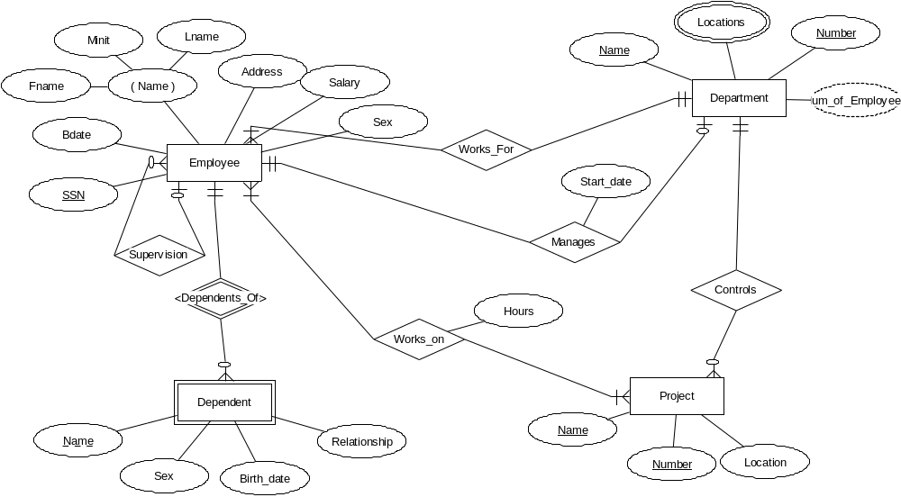

Slide 3
STEP 1
ENTITY TYPE E (non weak) -> NEW RELATION T
RELATION T:
  includes all simple attributes (non composite, single-valued) from E
  includes only simple component attributes of a composite attribute from E (they are on their own now)
  we choose a primary key for T

Slide 4
STEP 2
WEAK ENTITY TYPE W -> NEW RELATION T (with owner E)
RELATION T:
  includes all simple attributes (non composite, single-valued) from W
  includes primary key attributes of the owner E, as foreign key attributes
  primary key of T is a combination of the partial key of W and primary key of E
  Total participation of weak entity in relationship with E

Slide 5
STEP 3
RELATIONSHIP R (1:1) -> EXISTING RELATIONS T & S
RELATIONS S and T:
  relation S includes the primary key from T, as a foreign key
  total participation is a tie-breaker in the decision on which one gets the foreign key (the one with the total participation)
  relation S includes simple relationship attributes from R (if they exist)

Slide 6
Step 3 cont’d
  alternative mapping of R is possible:
    merge the two participating entity sets and the relationship into a single relation
    appropriate when both participations are total
  NOTE: A 1:1 relationship involving a weak entity has already been taken care of by the inclusion of the PK of the owner in the weak entity

Slide 7
STEP 4
RELATIONSHIP R (1:N) -> EXISTING RELATIONS T & S
RELATIONS S and T:
  relation T represents the entity set on 1 side of R and relation S represents the entity set on N side of R
  relation S includes the primary key from T, as a foreign key
  relation S includes simple relationship attributes from R (if they exist)
  NOTE: A 1:N relationship involving a weak entity has already been taken care of by the inclusion of the PK of the owner in the weak entity

Slide 8
STEP 5
RELATIONSHIP R (M:N) -> NEW RELATION T:
  includes primary keys of both entity sets involved in relationship R as foreign and they form the primary key of T
  includes simple relationship attributes from R (if they exist)
  this can be alternative approach for
    1:1 relationships - primary key only from one of the participating entity sets would be included
    1:N relationships - primary key from the entity set from the N side of the relationship

Slide 9
STEP 6
MULTIVALUED ATTRIBUTE A -> NEW RELATION T (from the entity set E)
RELATION T:
  includes attribute A
  includes primary key of E as a foreign key of T
  attribute A and primary key of E form the primary key of T

Slide 10
STEP 7
N-ARY RELATIONSHIP R (N > 2) -> NEW RELATION T
RELATION T:
  includes primary keys of all entity sets involved in relationship R as foreign and they form the primary key of T
  However, if entity involved as a 1 side, do not have to include as part of primary key
  includes simple relationship attributes from R (if they exist)

Slide 11
Company DB using ERD Tool

Slide 12
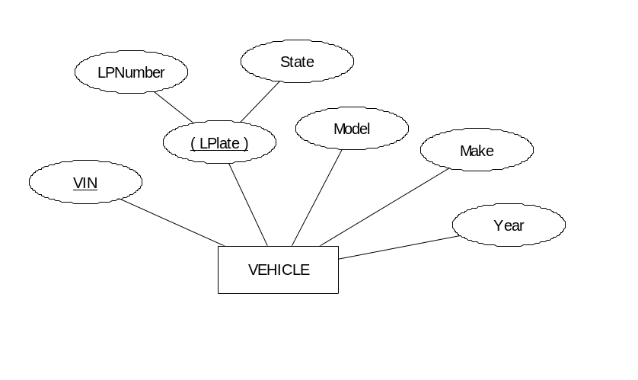
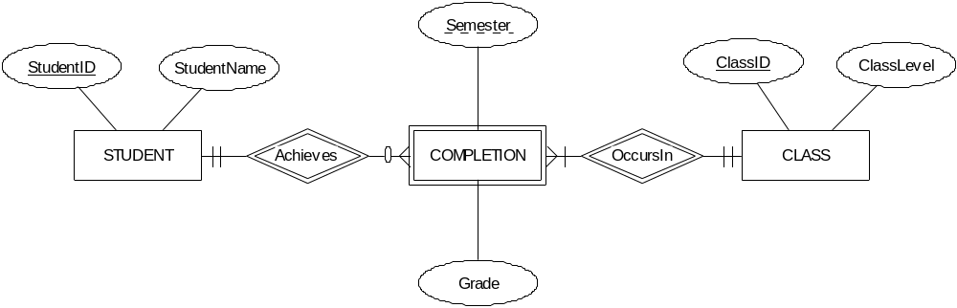
Interesting examples to Map

Slide 13
Is that everything?
Derived attributes?
EER to relational mapping?

Slide 14
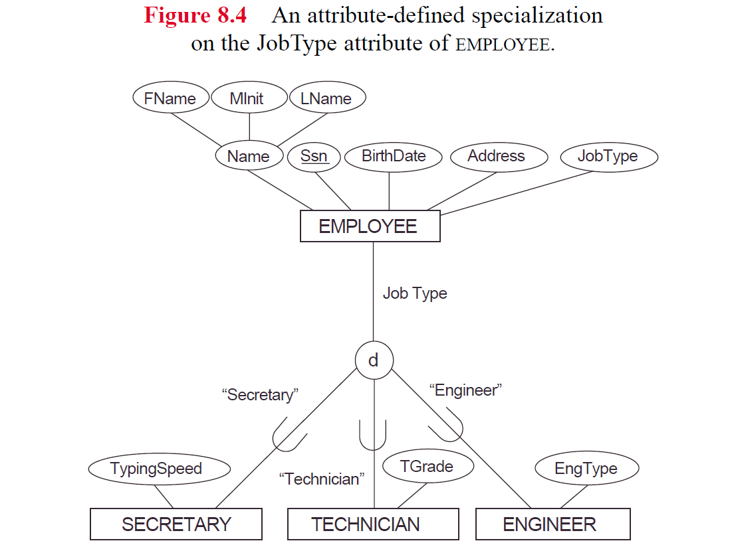

Slide 15

Step 8 - Mapping EER model concepts to Relations
Superclass/Subclass and Specialization/Generalization
  Convert each specialization with m subclasses
    {S1, S2, ..Sm}
  and superclass C where attributes of C are:
    {PK, A1, ...An}
  Using 1 of the following options:

Slide 16
Option A
Create a new relation L with attributes of C
Create new relations Li for each subclass Si with attributes
{PK} U {attr. of Si}

Slide 17
Option B
Create new relations Li for each subclass Si with attributes
(attr. of Si} U {PK, Ai, ..An}

Slide 18
Option C
Create one new relation L with attributes
{PK, Ai, ..An}U {attr. of S1} U{attr. of S2} ...
U{attr. of Sm} U {t}
t indicates subclass to which each tuple belongs

Slide 19
Option D
Create one new relation L with attributes
{PK, Ai, ..An} U (attr. of S1} U{attr. of S2} ... U {attr. of Sm} U {t1, ... tm}
  each ti is a Boolean indicating whether tuple belongs to Si
  Can have one type field t, instead of m type fields

Slide 20
Summary of Options
Option A
  Create one table for superclass, and one table for each subclass
    Include PK of superclass in subclass tables
Option B
  Create one table for each subclass
    include superclass attributes in each subclass table
Option C
  Create one table with attributes from superclass and all subclasses
    Include 1 column to indicate which subclass a member of
Option D
  Create one table with attributes from superclass and all subclasses
    Include m columns, one for each subclass to indicate membership in that subclass

Slide 21
Multiple Inheritance
Any of the options A-D will work

Slide 22
Example Mapping
Map EER Example using these options
Under which constraints do options perform better?
Can mix mapping options for different specializations
Rules to map from UML to relational?

