Slide 1
Functional Dependencies
and Normalization
Chapter 14

Slide 2
Relation Schema Goodness
Logical level - relations and views
Storage level - relations as files
Placing one set of attributes in a table is better than placing them in other tables. Why?

Slide 3
Schema design
Design the schema so it is easy to explain the semantics
  semantics: the meaning associated with the attributes
Want to minimize:
  storage space
  redundant information

Slide 4
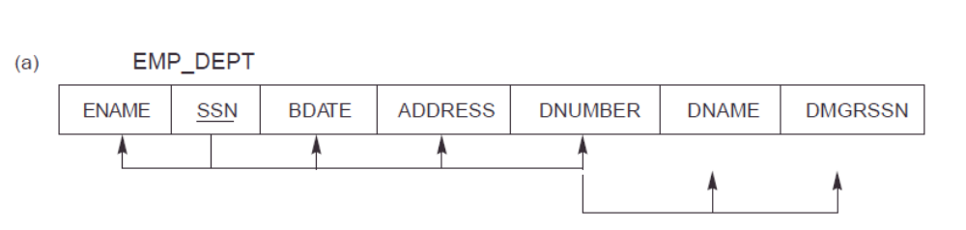
Semantics
Do not combine attributes from > 1 entity/relationship type
Reduce the redundant values
Design schema so no anomalies occur
  Update anomalies: insert, delete, update

Slide 5
Update Anomalies
Insertion
  If add employee in department?
  if insert new employee into EMP_DEPT and no department yet?
  If create a new department and no employee?
Deletion
  If delete last employee of a department?
Modification
  If change the values of a particular department?

Slide 6
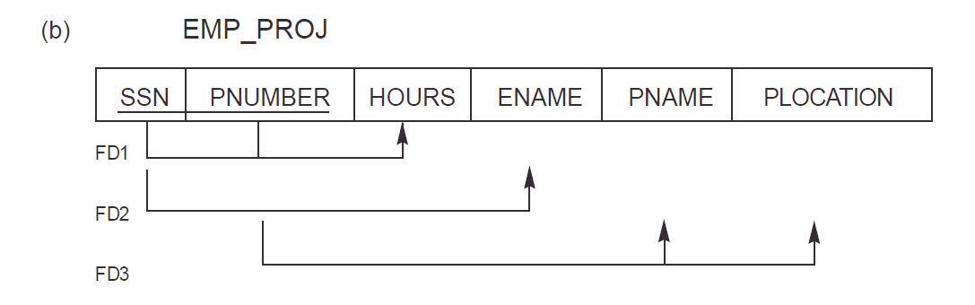
Another example
Emp-Proj(SSN, Pnumber, Hours, Ename, Pname, Plocation)

Slide 7
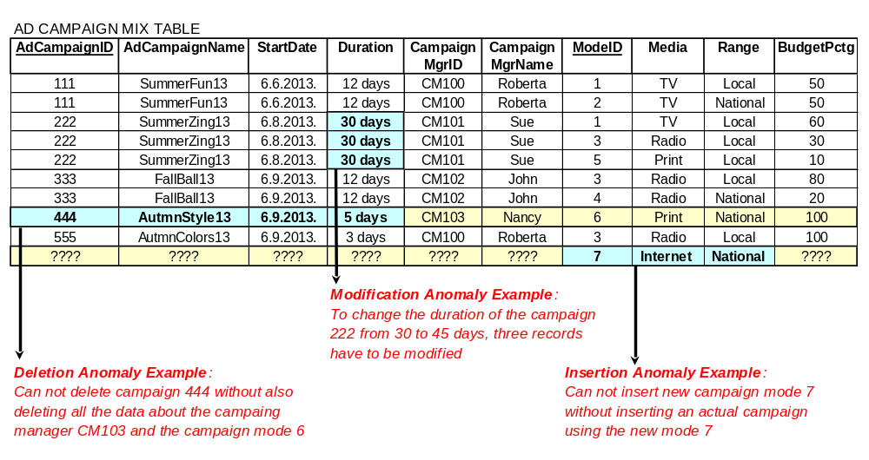

Slide 8
Performance
Design schemas so no anomalies occur but what about performance?
  Must always do join between employee and department
In general it is best if specify joins as views so anomaly free
  If really large tables, may have to rethink this …
  Consider: NoSQL DBs do not have a join

Slide 9
Functional Dependencies
How good is a relational schema?
What is the most importance concept in relational schema design?
Functional Dependencies
Formal concepts and theory to define goodness of relational schemas
Functional dependency FD between 2 sets of attributes as:
X → Y
Constraint on the possible tuples that can form a relation instance

Slide 10
Functional Dependencies
X → Y means:
X functionally determines Y
Y depends on X
Values of Y component depend on, determined by values of X component

Slide 11
Functional Dependencies
Given t1 and t2 where X → Y :
if t1[X] = t2[X] then t1[Y] = t2[Y] (1)
In other words if the values of X are equal, then Y values are equal
Values of X component uniquely (functionally) determine values of Y component iff (1)

Slide 12
Example
for example: address, city → zipcode
ssn → name
if X is a candidate key implies X → Y
if X → Y, does this imply Y → X?
  don’t know - FD is a property of semantics
dependency is a constraint
if satisfy FD, instances are legal relation instances (extension)

Slide 13
FDs - set F
describes a relation instance
constraints must hold at all times
property of relation schema not a particular extension (instance)
therefore, it cannot be automatically deduced, it must be defined explicitly by designer

Slide 14
Normalization to 2nd and 3rd
Normalization of data - method for analyzing schemas based on FDs
Objectives of normalization
  good relation schemas disallowing update anomalies
Unsatisfactory schemas decomposed into smaller ones with desirable properties – This means tables are divided up into smaller tables

Slide 15
Formal framework
database normalized to any degree (1, 2, 3, 4, 5, etc.)
normalization is not done in isolation
need:
  dependency preservation
  additional normal forms meet other desirable criteria
  lossless join – will discuss later

Slide 16
Normal Forms
1st, 2nd, 3rd consider only FD and key constraints
constraints must not be hard to understand or detect
need not normalize to highest form (e.g. for performance reasons)

Slide 17
1NF - 1st normal form
part of the formal definition of a relation
disallow multivalued attributes, composite attributes and their combination
In 1NF single (atomic, indivisible) values

Slide 18
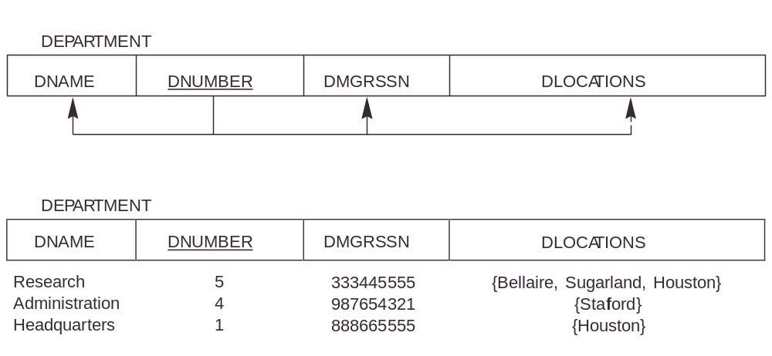
Example:
There are 2 ways to look at dnumber → dlocations, where dlocations is more than one value
dlocations is a set of values
  dnumber → dlocations, but dlocations is not in 1NF
dlocations atomic values
  dnumber does not functionally determine dlocations
  Two different tuples with dnumber=5 can have different values for dlocation= Bellaire or Sugarland or Houston

Slide 19
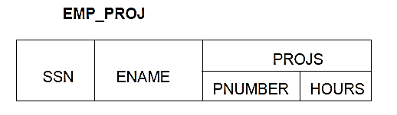
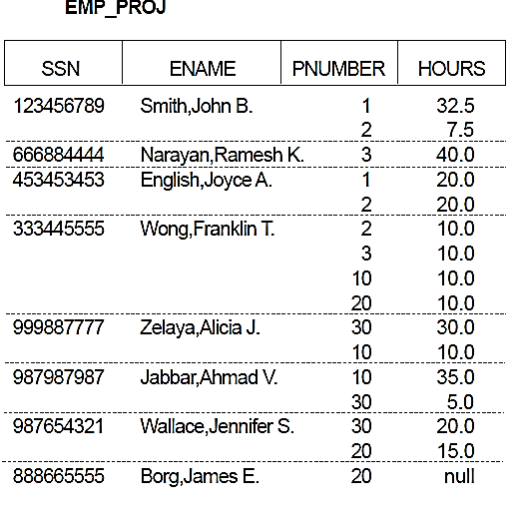
How to resolve this?
What are the choices?
Nested relation – Not 1NF
multivalued composite attributes
Oracle allows it
Normalize it to 1NF

Slide 20
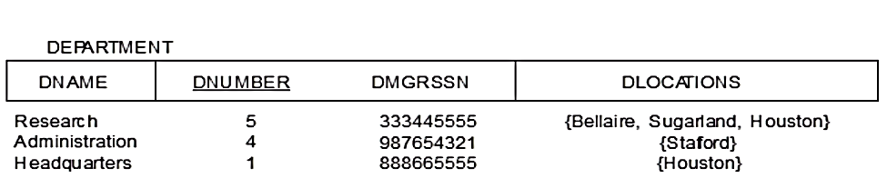
Normalize into 1NF
Algorithm to normalize nested relations into 1NF?
  Replicate tuple for each set value
  New PK: PK and set-valued attribute

Slide 21
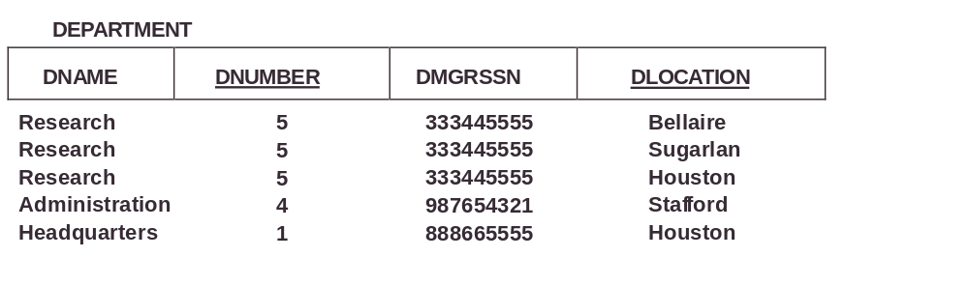

Slide 22
Normalize into 1NF
Can do the same to normalize
nested tables to 1NF
  Replicate tuple in non-nested for each row in nested table
  New PK: PK and key of nested table
  recursively unnest if multilevel nesting
  useful in converting hierarchical schemes into 1NF

Slide 23
Difficulties with 1NF
insert, delete, update
Determine if describe entity identified by PK?
If not, called non-full FDs
We need full FDs for good inserts, deletes, updates

Slide 24
Second Normal Form - 2NF
Uses the concepts of FDs, PKs and this definition:
  An FD is a Full functional dependency if:
  given Y → Z
  Removal of any attribute from Y means the FD does not hold any more
  Obviously Y would be more than 1 column

Slide 25
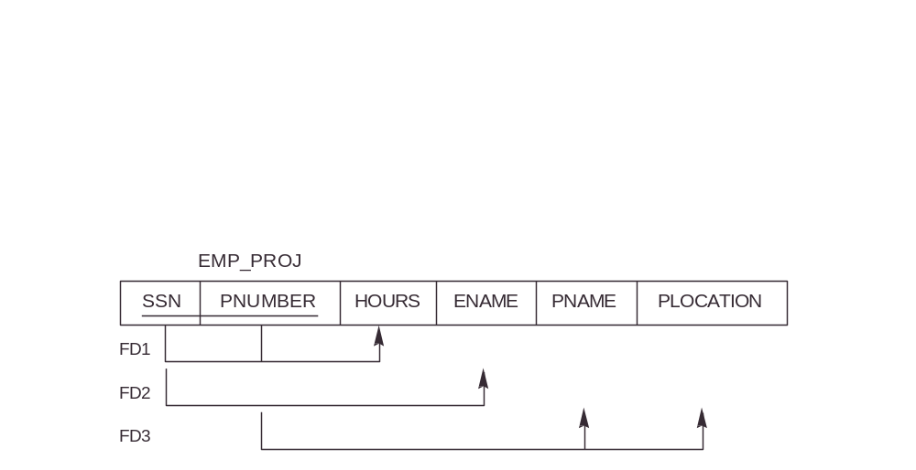
2NF – Partial Dependency
Examples:
{ssn, pnumber} → hours
is a full FD since neither
  ssn → hours nor pnumber → hours holds
Partial Dependency
  {ssn, pnumber} → ename is not a full FD
  it is a partial dependency since
  ssn → ename also holds

Slide 26
2NF
A relation schema R is in 2NF if:
  Relation is in 1NF
  Every non-prime attribute A in R is not partially dependent on any key (primary or candidate)
Definition: Prime attribute - attribute that is a member of the primary (or candidate) key K, so non-prime not in K
In other words – No partial dependencies

Slide 27
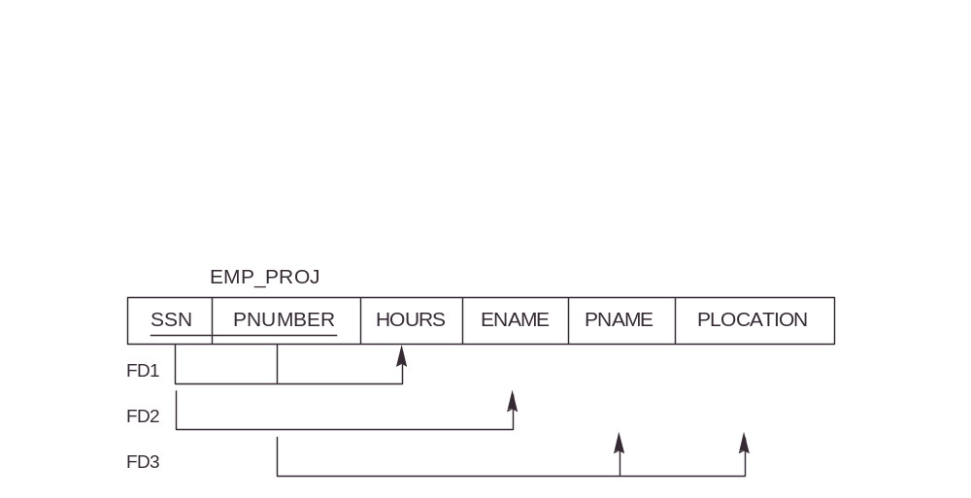
  Remove partial dependencies: How?

Slide 28
Solution
R can be decomposed into 2NF relations via the process of 2NF normalization
  Remove partial dependencies by: How?
    From original table, remove attribute(s) that is partially dependent and place in a new table
    Replicate the part of the primary key on which there is the partial dependency and put in the new table
    Result is 2 relations where partials are now full

Slide 29
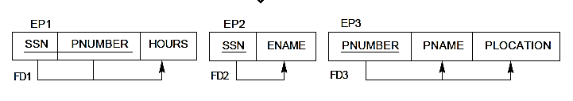

Slide 30
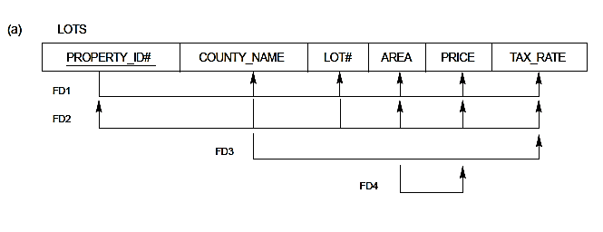
2NF – Formal definition
The above example shows a primary key only (which is > 1 column)
The following example shows relations with multiple candidate keys
  A relation schema R is in 2NF if every non-prime attribute A in R is not partially dependent on any key (including candidate keys of R)
    County_name and lot# are candidate keys

Slide 31

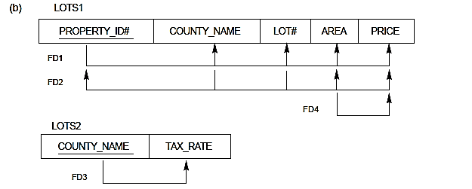

Slide 32
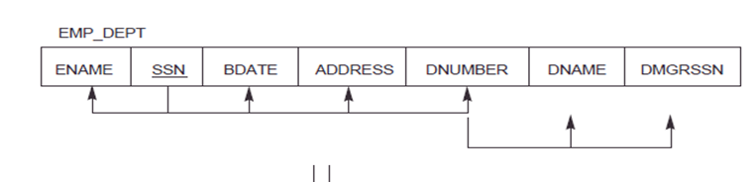
2NF problems:
Even if no partial dependencies problems with insert, delete, modify
Why?
Transitive dependencies
  Given a set of attributes Y, where Y is not a subset of any key and
    X is a key
    Both X → Y and Y → Z
  then we have a transitive dependency
    {X → Y, Y → Z} |= X → Z

Slide 33
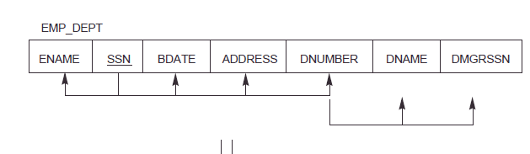
Examples of Transitive FDs
Examples:
ssn → dmgrssn is a transitive FD
since
ssn → dnumber and dnumber → dmgrssn
Also,
ssn → dnumber and dnumber → dname
ssn → ename is non-transitive
since
there is no set of attributes X
where ssn → x and x → ename

Slide 34
3rd Normal Form (3NF)
No non-prime attribute is transitively dependent on a primary key/candidate key and the table is in 2NF
Intuitively, this means we need independent entity facts steps for normalization
Disallow partial and transitive dependency on primary/candidate keys

Slide 35
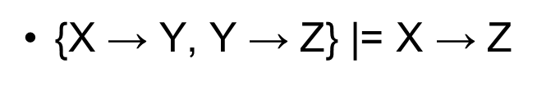
3NF
A relation schema R is in 3NF if:
  it is in 2NF
  no non-prime attribute A in R is transitively dependent on the primary/candidate key
  In other words – no transitive dependencies
R can be decomposed into 3NF relations via the process of 3NF normalization
  Which is?

Slide 36
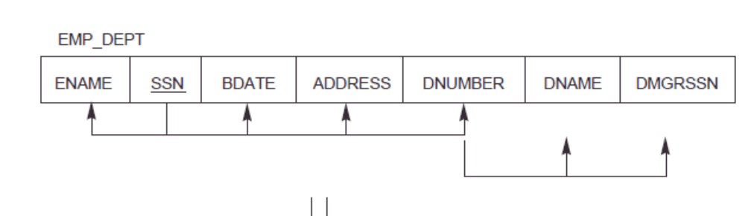
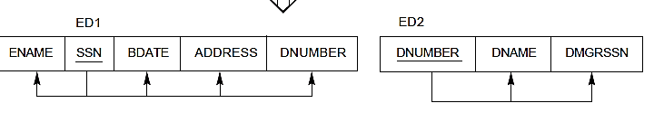

Slide 37
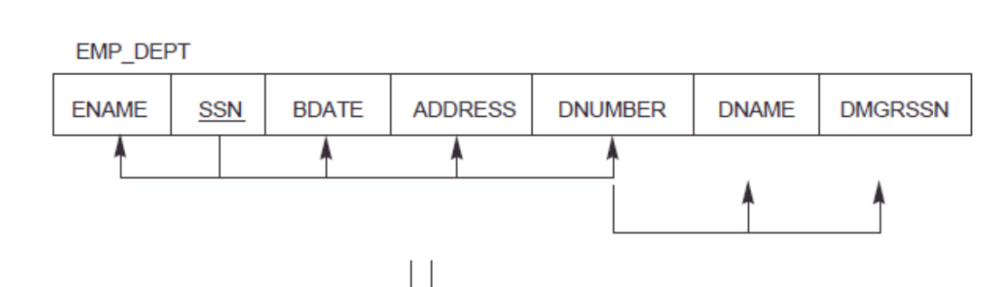
3NF
Formal Definition:
  a superkey of relation schema R - a set of attributes S of R that contains a key of R
A relation schema R is in 3NF if whenever
X -> A holds in R
then either
  a) X is a superkey of R
  or
  b) A is a prime attribute of R
a) means every non-prime attribute is fully functionally dependent on every key
b) means no transitive dependencies on any key

Slide 38
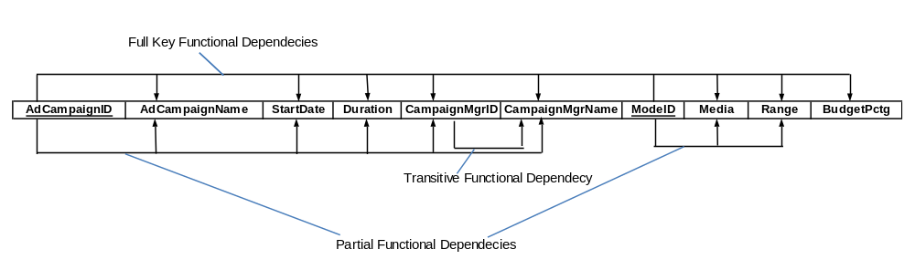

Slide 39
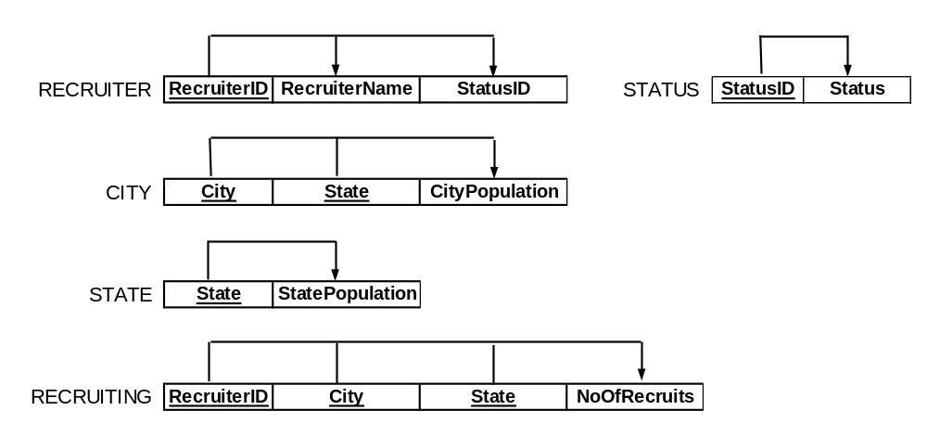

Slide 40
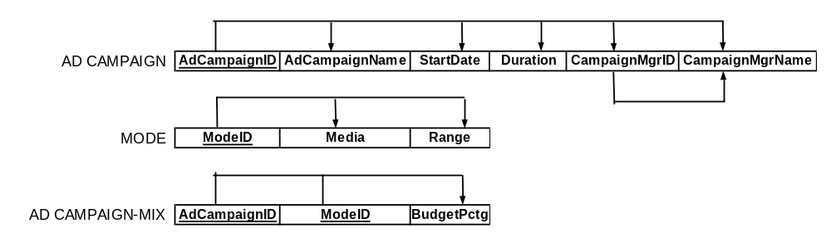

Slide 41
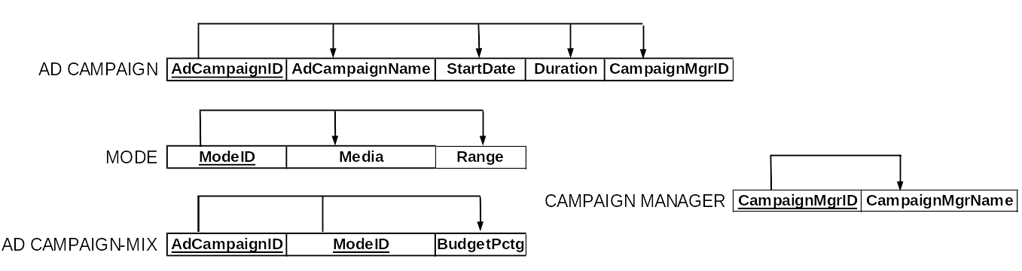

Slide 42
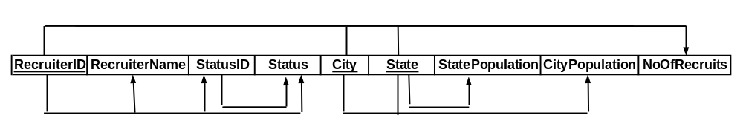
Alternative notation
RecruiterID,City, State → NoOfRecruits
RecruiterID → RecruiterName
RecruiterID → StatusID
RecruiterID → Status
StatusID → Status
City, state → CityPopulation
State → StatePopulation

Slide 43
To Normalize (3NF)
Consider primary and all candidate keys
Make sure in 1st
If any partial dependencies, normalize to 2nd
If transitive dependencies, normalize to 3rd

Slide 44
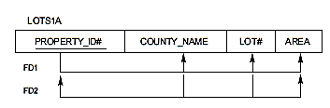
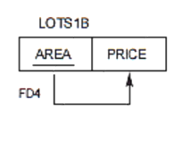
Property_ID# is PK
County_Name, Lot# are CK:
Property_ID# → County_Name
Property_ID# → Lot#
Property_ID# → Area
Property_ID# → Price
Property_ID# → Tax_Rate
County_Name, Lot# → Property_ID#
County_Name, Lot# → Area
County_Name, Lot# → Price
County_Name, Lot# → Tax_Rate
County_Name → Tax_Rate
Area → Price
Final tables

Slide 45
Normal forms:
Each normal form is strictly stronger than the previous one:
  every 2NF relation is in 1NF
  every 3NF relation is in 2NF

Slide 46
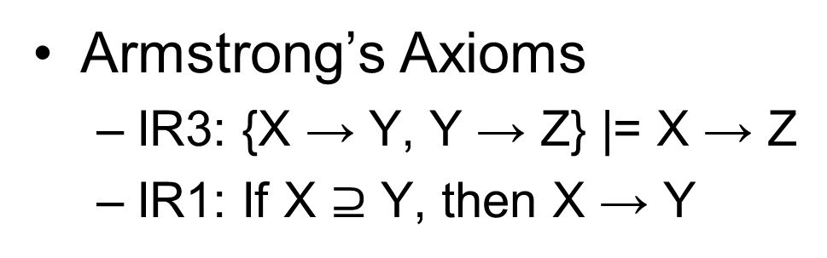
Additional normal forms:
BCNF – 3.5 Normal Form
  Stronger than 3NF
A relation schema R is in BCNF if whenever
X → A holds in R
then either
  a) X is a superkey of R (in 3NF and “A is prime”)
  or
  b) X ⊇ A

Slide 47
Pizza can have toppings, that are of topping type
Your pizza can have exactly three topping types:
one type of cheese
one type of meat
one type of vegetable
PK: Pizza, Topping → Topping Type
CK: Pizza, Topping type → Topping
Topping → Topping Type
Note the Multiple overlapping candidate keys

Slide 48
PK: Pizza, Topping → Topping Type
CK: Pizza, Topping type → Topping
Topping → Topping Type //Does not violate 3NF
Pizza Topping Topping Type
-------- ---------- -------------
1 mozarella cheese
1 pepperoni meat
1 olives vegetable
2 mozarella meat
2 sausage cheese
2 peppers vegetable
Wait a second, mozarella can't be both a cheese and a meat! And sausage isn't a cheese!
The problem is Topping → Topping Type satisfies, 3NF
Needs BCNF, Topping is not a superkey or an improper superset of Topping Type

Slide 49
So how to decompose?
Take out Topping Type and create a new table
Pizza Topping
-------- ----------
1 mozarella
1 pepperoni
1 olives
2 mozarella
2 sausage
2 peppers
Topping Topping Type
---------- -------------
mozarella cheese
pepperoni meat
olives vegetable
sausage meat
peppers vegetable

Slide 50
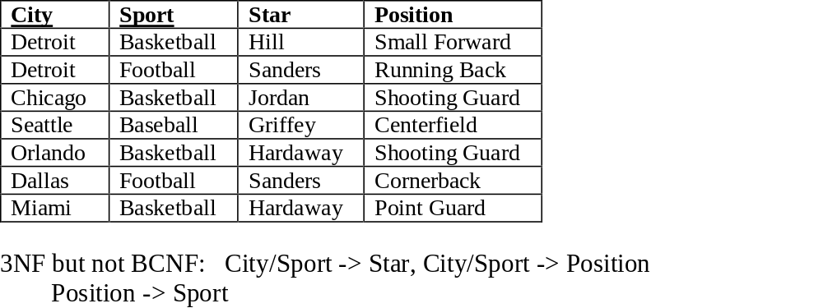

Slide 51
Additional normal forms:
4NF - based on multi-valued dependencies
  No table may contain more than 1 multivalued relationship
  Else, lots of redundancy
  Interesting example:
  http://en.wikipedia.org/wiki/Fourth_normal_form
  States 20% of tables in organizational DBs that were studied violated 4NF

Slide 52
Decomposition
Relational database schema design is synthesis and decomposition
  synthesis - grouping attributes together
  decomposition - avoiding transitive and partial dependencies
strict decomposition - start with a universal relation
OR
ER model mapped to a set of relations using the rules maps to what normal form?
  3NF

Slide 53
Additional aspects
Determine if one set of FDs covers another
Determine if one set of FDs is equivalent to another
  See if they cover each other
Determine if a minimal cover for a given set of dependencies
How to do this?

Slide 54
Armstrong’s Axioms
IR1: If X ⊇ Y, then X → Y
IR2: {X → Y} |=XZ → YZ
IR3: {X → Y, Y → Z} |= X → Z
IR4: {X → ZY} |= X → Y
IR5: {X → Y, X → Z} |= X → YZ
IR6: {X → Y, WY → Z} |= WX → Z

Slide 55
Additional Design Considerations - Reduce nulls
Avoid placing attributes in a base relation whose values may be null for a majority of tuples
If use null values can mean different things
"fat" tuples - if many attributes and lots of nulls wastes space
Aggregate functions are a problem with nulls

Slide 56
Disallow spurious tuples
Spurious tuples represent incorrect information that is not valid
Result of joins with equality conditions on attributes that are not PKs or FKs
Design relations so there can be an equijoin with a PK and a FK or no spurious tuples
Lossless join guarantees no spurious tuples

Slide 57
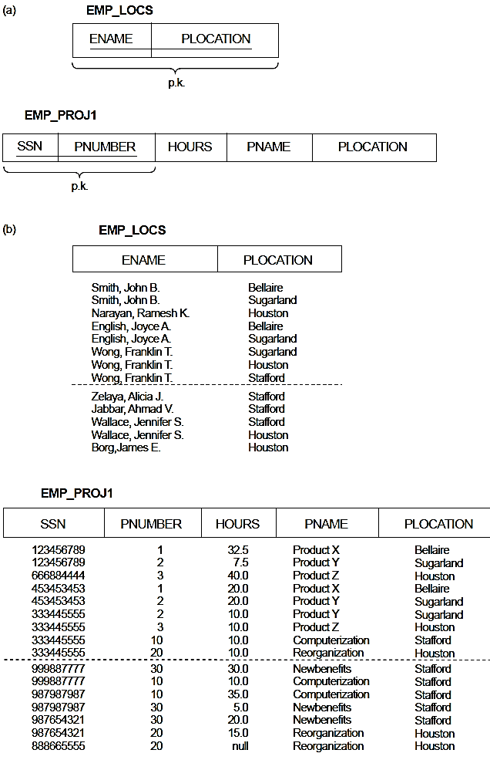
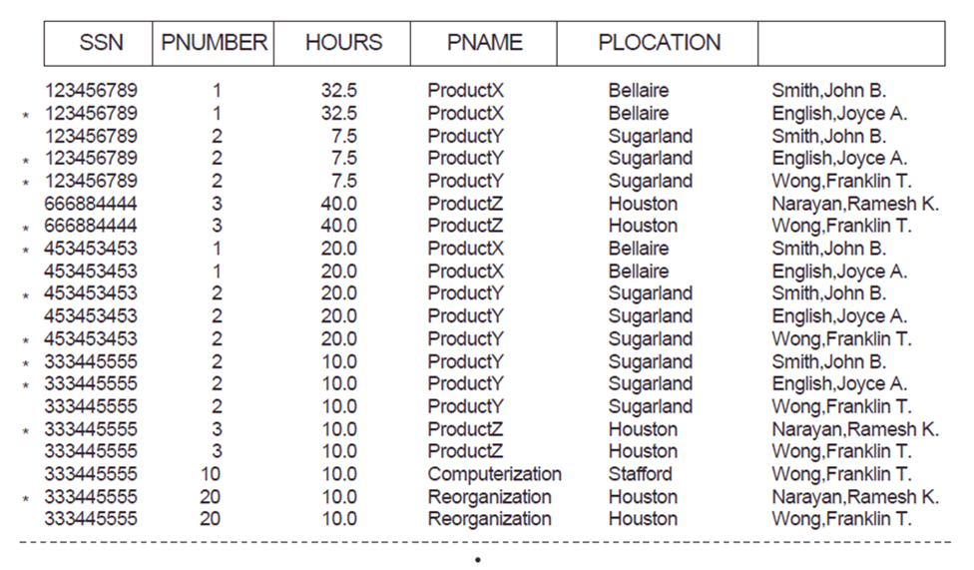
select * from emp_locs l, emp_proj1 p
Where l.plocation=p.plocation

Slide 58
Good design
The goal is to have each relation in 3NF
Semantics should be clear
Reduce the redundant values
Reduce null values
Disallow spurious tuples

Slide 59
Good design
A "good" design is not simple individual relations in a higher normal form
also a set of relations with characteristics such as:
  attribute preservation - each attribute appears once (at least)
  dependency preservation - each dependency is a constraint to enforce a join
    (S T U V) S->T S->V T->U
    is (S V) (T U) a good decomposition?
  union of dependencies holds - does not guarantee a lossless join

Slide 60
But?
Performance vs. normalization
  Denormalization – may have to do this
  useful concept in NoSQL

Slide 61
Normalize to 3rd
(A B C D)
A → B, A → D, D → C
(A B C D)
AB → C, AB → D, C → A
(A B C D) BC form candidate key
A → B, A →C, A → D, BC → A, B → D

