Slide 1
DB storage
Assume tuples are stored in row order on pages
A page can contain one or more tuples
Many databases are still stored on hard drive disks
Pages from a table can be stored anywhere on a disk, e.g. scattered around the disk or hopefully, next to each other
Must perform disk access to get to data

Slide 2
DB Storage Hierarchy
Pages stored on disk and/or memory
  HDD – Hard disk drives: disks with tracks, cylinders, heads, sectors
  SSDs: array of semiconductor memory – read a specific flash SSD location, organized as blocks
  Flash memory – SSD that stores persistent data in flash memory but limited size
  Cache DB in memory

Slide 3
Indexes - Chapter 17.3-17.5

Slide 4
Why use an index
For example:
      If always want to retrieve student records based on CWID
      If I always want to retrieve a record where key = some value
      If I retrieve documents that contain the word “Stormy”
Instead of reading the entire file until value is found, it would be nice if we had a pointer to that employee, record, document
Also useful in relational model for joins
Want a way to improve performance
Want to minimize the amount of data read and the number of disk accesses

Slide 5
Alternatives?
Why not just use a binary search ?
Data file must be sorted - insertions and deletions can be a problem
Binary search requires searching the data file
  Disk access?
Instead use an index so just search the index

Slide 6
What is an index?
An index is itself an ordered file
The index file is physically ordered on disk by the key field
The index file has records of fixed length, containing:
key field, pointer to data
< ki pi >
If key field is not a PK
< ki pi, pj, pm,…pn >

Slide 7
Single level index file
Index can be a single level file listing each value in data file and pointers to data
key field, pointer to data
< ki pi >
Textbook calls this a primary index

Slide 8
PK | Ptr
1
5
34
66
75
PK | Name | Gen | Univ | Major
66 | Bob | M | UA | CS
75 | Carol | F | UAB | EE
1 | Ahmed | M | UA | CS
34 | Nico | M | UAH | EE
5 | Jamal | M | UA | EE

Slide 9
Precursor to modern tree indexes 2-level index files
IBM proposed ISAM (indexed sequential access method)
Contained info about cylinder and track on disk

Slide 10
Limitations
How to search index file?
  Binary search – same issues, sorted, etc.
What happens as the index itself grows?
  Increase levels? (next slide)
How can we improve upon this?
  Tree structured index (B+tree)
  Hash Index

Slide 11
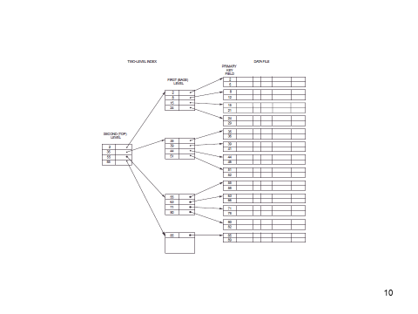
Multi-level index
Possible problems?
  Balanced?

Slide 12
Inverted Index
Used in Information Retrieval
  Searching for web pages that contain a particular word, etc.
  Will discuss later

Slide 13
Current Implementation of indexes
To implement an index use B+ tree
B+ tree is based on a B-tree
B-tree
  balanced tree
  insert, delete is efficient
  nodes are kept half full, a node is split when it is full
  nodes are combined when less than half full

Slide 14
B-tree
Each B-tree has an order p (fan out) which is the maximum number of child nodes for each node
The value of the search field appears once along with a data pointer

Slide 15
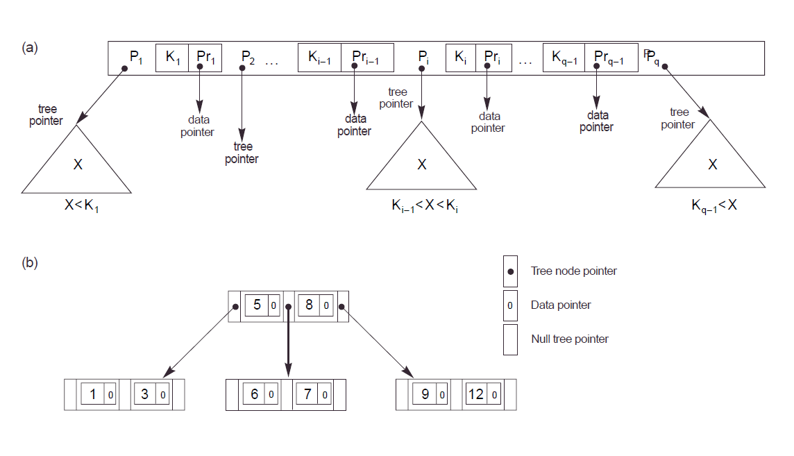

Slide 16
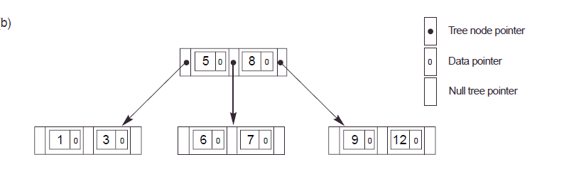
B-tree
Each node contains the following information:
<P1, <K1, Pr1>, P2, <K2, Pr2>, … < > Pq>
  where Pi is a pointer to another node in the tree
  K_{i} is a key field
  Pr_{i} is a data pointer - a pointer to a record (page) whose key field value is equal to K_{i}

Slide 17
B-tree
Within each node K1 < K2 < .. Kq-1
  Each node has at most p tree pointers
  A node with q tree pointers, q <= p, has q-1 field values and q-1 data pointers
  Each node except the root and leaf nodes has at least ceiling(p/2) tree pointers
  Leaf nodes have the same structure as internal nodes except that all of the their tree pointers are null
  Balanced tree – meaning all leaf nodes at same level
  Problems?

Slide 18
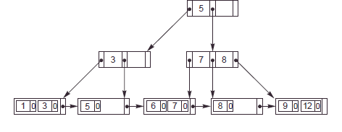
B+ tree
A variation of the B-tree
Data pointers are stored only at the leaf nodes of the tree
A data value can appear in both the upper level and in a leaf level
Leaf nodes different from internal nodes
Leaf nodes have an entry for every value of the search field along with a data pointer
Leaf nodes are linked together to provide ordered access
When using a DB, if say B-tree, usually mean B+-tree

Slide 19
B+ tree
Internal nodes of a B+ tree
<P1, K1, P2, K2, … Pq-1, Kq-1, Pq>
  where each P_{i} is a tree pointer
  Each internal node has at most p tree pointers
    p is called the fanout
  Each internal node (except the root) has at least ceiling(p/2) tree pointers
  An internal node with q pointers has q-1 key field values

Slide 20
B+ tree
The structure of the leaf nodes of a B+ tree:
<<K1, Pr1>, <K2, Pr2>, … <Kq-1, Prq-1>, P_{next}>
  where Pr_{i} is a data pointer and P_{next} points to the next leaf node of the tree
  Each leaf node has a least floor((p-1)/2) or ceiling(p/2)-1 values
  All leaf nodes are at the same level

Slide 21
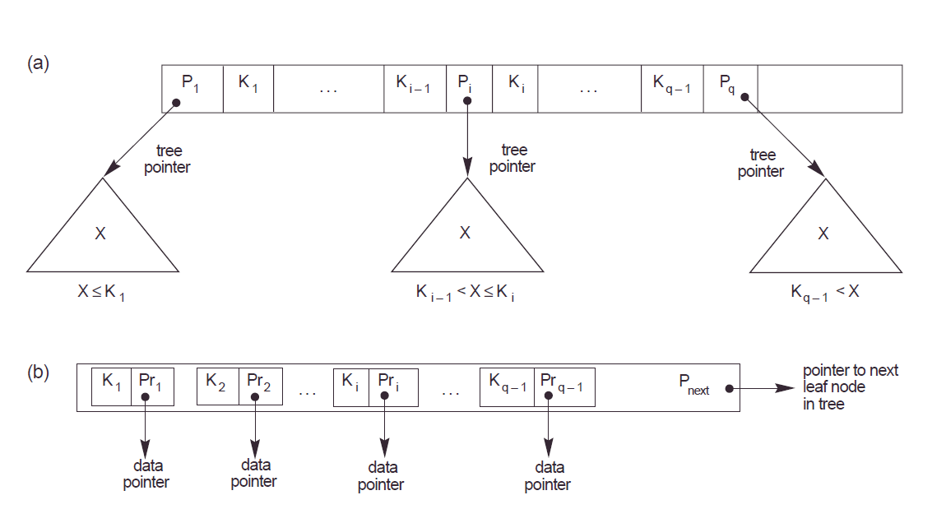

Slide 22
B+ Trees in Practice
Typical order: between 100-200 children
Typical fill-factor: 2/3 full (66.6%)
  Average fanout = 133
Typical capacities:
  Height 4: 133⁴ = 312,900,700 records
  Height 3: 133³ = 2,352,637 records
Can often hold top levels in buffer pool:
  Level 1 = 1 page = 8 Kbytes
  Level 2 = 133 pages = 1 Mbyte
  Level 3 = 17,689 pages = 133 MBytes

Slide 23
Types of B+ indexes
Non-clustered index
(secondary index in textbook)
  key field is a non ordering field
    not used to physically order the data file
  the index itself is still ordered
  How many non-clustered indexes can a table have?

Slide 24
Types of B+ indexes
Clustered/clustering Index
Key field is an ordering field
    Same values for the key on the same pages
    (clustering index in textbook)
    If a candidate key, data sorted by key field
    (primary index in textbook)
  Usually assume disk pages themselves also clustered on the disk
  How many clustered indexes can a table have?

Slide 25
Miscellaneous
Non-dense or sparse index - pointer to first record in page (anchor)
Dense index - pointer to every record
Assume DENSE INDEXES for this class

Slide 26
Performance using index?
Assume you have the query:
Select *
from table
where val = 5
200,000 tuples
10 tuples per page
100 index entries per page
If 1/20 of all val = 5 there are 10,000
tuples with that value

Slide 27
Pages to access – no index
If no index:
  must read the entire file:
200,000/10 = 20,000 pages to read

Slide 28
Pages to access- clustering index
200,000 tuples, 10 per page
100 index entries, 1/20 selectivity
If a clustering index is used:
  all tuples with same value clustered on the same pages
  access the B+ tree internal nodes (suppose 2 levels), leaf nodes and data:
2 + 10,000/100 + 10,000/10 = 1,102 pages

Slide 29
Pages to access – non clustering index
If a nonclustering index is used:
  assume each one of the 10,000 tuples is on a different page (in the worst case)
  access the B+ tree internal nodes (suppose 2 levels), leaf nodes and data:
2 + 10,000/100 + 10,000 = 10,102 pages

Slide 30
Performance – clustered vs. non-clustered
http://www.dba-oracle.com/oracle_tip_hash_index_cluster_table.htm

Slide 31
Why use B+ tree instead of B-tree?
The leaf nodes are linked together to provide ordered access on the key field to records – range queries
Can access all of the data by one pass through the upper levels of the tree
Other reasons?
Is it always faster to search a B+-tree than a B-tree?

Slide 32
B+tree info
  Each internal node has:
    at most p tree pointers
    at least ceiling(p/2) tree pointers
    If q pointers has q-1 key field values
  Each leaf node has:
    a least floor(p/2) values
    All leaf nodes are at the same level

Slide 33
B+ Tree Similar to Multi-Way Search Tree
A B+tree is an ordered tree such that
  Each internal node (except root) has at least ceiling(p/2) children and stores a maximum of p −1 key-element items (k_{i}, ptr_{i}) where p is the number of children
  For a node with children v₁ v₂ … v_{d} storing keys k₁ k₂ … k_{p−1}
    keys in the subtree of v₁ are less than or equal to k₁
    keys in the subtree of v_{i} are between (k_{i−1} and k_{i}] (i = 2, …, p − 1)
    keys in the subtree of v_{p} are greater than k_{p−1}
  The leaves point to the data containing the key value k_{i}
8 15
2o 6o 8o
11o 15o
24o 32o
Input: 11 24 32 15 8 6 2 and p=4 and o is a pointer to the data

Slide 34
Inserting into B+ Tree
Find correct leaf L.
Insert data into L.
  If L has enough space, done!
  Else, must split L (into L and a new node L’)
    Copy up middle key to non-leaf node
      If 2 middle values, choose smallest
    Redistribute entries evenly into 2 nodes
      If odd number of entries, left-most sibling gets the extra
    Insert entry pointing to L’ in parent of L
  Split can happen recursively
    To split non-leaf node, redistribute entries evenly into 2 nodes, but push up middle key to parent node. NO need to copy, just push.
  Splits “grow” tree; root split increases height.
    Tree growth: gets wider or one level taller at top.

Slide 35
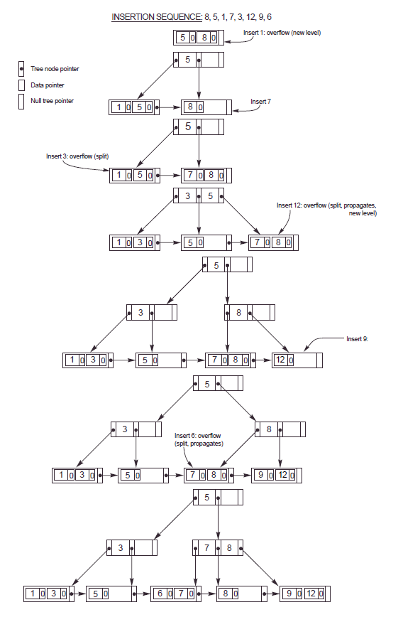

Slide 36
Important points
If you must split a LEAF node, COPY the appropriate value to a parent
If you must split a NON-LEAF node, you move a value up, DO NOT COPY IT
Specific to this class: (for exams and homework)
  If 2 middle values, pick the smallest middle value to copy or move up
  If odd number of values, when split node, leftmost sibling gets the extra value
  Assume the value of a child node is <= value of the parent

Slide 37
Deleting from Tree
If node is less than half full can:
  Borrow from sibling
  If can’t may have to merge with sibling
    Affect parent, merge with cousin
    May propagate up …

Slide 38
Deleting from B+ tree
Start at root, find leaf L where entry belongs.
Remove the entry in L.
  If key of deleted entry is in parent, use next key to replace it
If L is at least half-full, done!
If L has < floor(p/2) entries,
  Try to re-distribute, borrowing from sibling (adjacent node with same parent as L). Change parent to reflect change.
  If re-distribution fails, merge L and sibling. Change parent to reflect change. Merge parent with sibling or a cousin – see last bullet.
  Merge could propagate to root, decreasing height.
  Deletion is much more complicated than described here!

Slide 39
Definitions
Create index index_name
on table_name (col_list) [options];

Slide 40
Definitions
Can have multiple indexes - more than 1 index on table
  How to create?
    Create index Idx1 on Table (c1);
    Create index Idx2 on Table (c2);
Can have composite indexes - more than 1 key field, 1 index
      Create index I1 on Table (c1, c2);
  What does it look like if B+-tree?

Slide 41
Clustering Index Info
Can only cluster table by 1 clustering index at a time
In DB2 –
  Use cluster clause in create index statement
  if the table is empty, rows sorted as placed on disk
  subsequent insertions not clustered, must use REORG
In SQL server
  creates clustered index on PK automatically if no other clustered index on table and PK nonclustered index not specified
In Oracle-
  No clustered index – instead Index-organized table (as opposed to unordered collection)
    Stores entire table in B+ tree
      Instead of storing just key, store all columns from table
      index is the table
    Claims more efficient than regular clustered index

Slide 42
Other types of indexes
Can also have hash indexes based on hashing - hash search algorithm based on K
<K, P>
apply hash function to K to get to correct entry in index, index gives pointer to actual tuple(s)

Slide 43
Hash Indexes
Hash terminology
  Bucket – unit of storage for one or more tuples, typically a disk block
  K – set of all search-key values
  B- set of all bucket addresses
  h - hash function from K to B
    Bi = h(Ki)
    Hash function returns bucket number to use

Slide 44
Hash index challenges
Skew
  Multiple records same search key
  Hash function may result in nonuniform distribution of search keys
Insufficient buckets
Overflow buckets, overflow chaining

Slide 45
PK | Name | Dept. | Loc
666 | Jones | CS | UA
66662 | Lee | ECE | UAH
6661 | Liu | CS | AU
36365 | Ahmed | CS | UAB
24245 | Dolf | CS | AU
12125 | Sky | EE | UAB
12121 | Jukic | MIS | UA
Use mod 6 for hash function
Assume 2 values per bucket

Slide 46
Bucket 0
Mod 6 hash function, Bucket holds 2, assume chaining if overflow
666
PK | Name | Dept. | Loc
666 | Jones | CS | UA
66662 | Lee | ECE | UAH
6661 | Liu | CS | AU
36365 | Ahmed | CS | UAB
24245 | Dolf | CS | AU
12125 | Sky | EE | UAB
12121 | Jukic | MIS | UA
Bucket 1
6661
12121
Bucket 2
66662
…
Bucket 5
36365
24245
12125
Overflow Bucket

Slide 47
Static and Dynamic Hashing
Static hashing – DBs grow large over time
  Choose hash function based on anticipated size
  Buckets created for each value
  Reorganize hash structure as file grows
    New function, recompute function, new buckets
Dynamic hashing – extendable
  Hash function generates value over large range
  Do not create bucket for each value
  Create buckets on demand
  Add additional table – bucket address table

Slide 48
B+-tree vs. Hashing – pros/cons
B+-tree must access index to locate data
Hashing requires potential cost of reorganization
Which is better depends on types of queries

Slide 49
B+-tree vs. Hashing
      Select A1, A2, … An
      From R
      Where Ai = c
  B+-tree Requires time
    proportional to log of fanout/number of values in R for Ai
  In hash, average lookup time is
    constant, independent of size of DB
  However, in worst case, hashing
    proportional to number of values in R for Ai

Slide 50
B+-tree vs. Hashing
      Select A1, A2, … An
      From R
      Where Ai <= c₂ and Ai >= c₁
B+-tree
  Easy, why?
hash function
  If good function, buckets assigned values randomly
  is this good for range queries?

Slide 51
Bitmap indexes
Bitmap index
  Create 1 index for each value in domain of attribute
  Bitmap=1 for value, 0 for others
    E.g. (N, S, E, W requires 4 indexes)
    When would this be useful?
Name | Sex
Bob | 1
Sue | 0
Lee | 1
Joe | 1
Name | Sex
Bob | 0
Sue | 1
Lee | 0
Joe | 0

Slide 52
Index Usage
May not always use index
Query optimizer decides when to use index
Doesn’t use index if would access a large percentage of rows in the table

Slide 53
Oracle
Can create:
  Normal index – B+-tree
    Cluster index
      Must create a cluster first (one or more table)
      Stores together all rows from the tables that share the same cluster key
    Index-organized table
      Sounds like a Primary index
      Data sorted by PK, table does not have a stable physical location
      Leaves of B+-tree have PK and actual row data
  Bitmap
  Function-based
  Hash – must create a hash cluster
  Application domain

Slide 54
Oracle guidelines
Oracle automatically creates indexes, or uses existing indexes, for attributes defined with unique and primary keys.

Slide 55
Oracle guidelines
When to create an index?
  Index keys with high selectivity – this means selects small number
    use ANALYZE to obtain selectivity
  If low selectivity helpful if the data distribution skewed
    Several values occur more frequently
  Do not index columns that are frequently modified
  Keys that are frequently used in WHERE clauses.
  Keys that are frequently used to join tables in SQL statements.

Slide 56
Oracle guidelines
When choosing to index a key
  performance gain for queries
  performance loss for INSERTs, UPDATEs, and DELETEs
  space required to store the index
    Use SQL trace facility to measure

Slide 57
Definitions
Create index index_name
on table_name (col_list) [options];
Details

Slide 58
MySQL
SQL
CREATE [UNIQUE|FULLTEXT|SPATIAL] INDEX index_name [index_type] ON tbl_name (index_col_name,...)
[index_type]index_col_name: col_name [(length)] [ASC | DESC]index_type: USING {BTREE | HASH}

Slide 59
MySQL
Hash Indexes
  Used for equality comparisons, not for range of values
  Cannot use to speed up order by

Slide 60
Traditional Index vs
Inverted Index
Traditional index – key (1 or more columns)
  points to all data that contains the specified values for the key
Inverted index – all of the values in the DB (or documents)
  pointers to all data (documents) that contain each of the values

Slide 61
Representing Documents
Document 1
Term
Document 1
Document 2
The quick brown
fox jumped over
the lazy dog’s
back.
aid
0
1
all
0
1
Stopword
List
back
1
0
brown
1
0
come
0
1
for
dog
1
0
is
fox
1
0
of
Document 2
good
0
1
the
jump
1
0
to
lazy
1
0
Now is the time
for all good men
to come to the
aid of their party.
men
0
1
now
0
1
over
1
0
party
0
1
quick
1
0
their
0
1
time
0
1
Notes:
9

Slide 62
Representing Documents
Term
Doc 2
Term
Postings
Doc 3
Doc 1
Doc 4
Doc 5
Doc 6
Doc 7
Doc 8
aid
0
0
0
1
0
0
0
1
aid
4
8
all
0
1
0
1
0
1
0
0
all
2
4
6
back
1
0
1
0
0
0
1
0
back
1
3
7
brown
1
0
1
0
1
0
1
0
brown
1
3
5
7
come
0
1
0
1
0
1
0
1
come
2
4
6
8
dog
0
0
1
0
1
0
0
0
dog
3
5
fox
0
0
1
0
1
0
1
0
fox
3
5
7
good
0
1
0
1
0
1
0
1
good
2
4
6
8
jump
0
0
1
0
0
0
0
0
jump
3
lazy
1
0
1
0
1
0
1
0
lazy
1
3
5
7
men
0
1
0
1
0
0
0
1
men
2
4
8
now
0
1
0
0
0
1
0
1
now
2
6
8
over
1
0
1
0
1
0
1
1
over
1
3
5
7
8
party
0
0
0
0
0
1
0
1
party
6
8
quick
1
0
1
0
0
0
0
0
quick
1
3
their
1
0
0
0
1
0
1
0
their
1
5
7
time
0
1
0
1
0
1
0
0
time
2
4
6
Notes:
12

Slide 63
Inverted Index
Inverted indexing is fundamental to all IR models, also used sometimes in DBs
Consists of postings lists, one with each term in the collection
Posting list – document id (d) and payload (p)
  Payload can be term frequency or number of times occurs on document, position of occurrence, properties, etc.
  Can be ordered by document id, page rank, etc.
  Data structure necessary to map from document id to e.g. URL

Slide 64
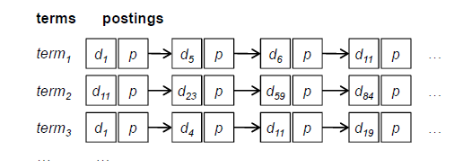

Slide 65
Process query - retrieval
Given a query:
  fetch posting lists associated with query
  traverse postings to compute result set
  Top k documents extracted

