Slide 1
NoSQL DBs

Slide 2
What are the positives of relational DBs?

Slide 3
Relational Positives
Historical positives of RDBMS:
Can represent relationships in data
Easy to understand relational model/SQL
Disk-oriented storage
Indexing structures
Consistent values in DB (locking)

Slide 4
What are the negatives of relational DBs?

Slide 5
Relational Negatives
RDBS strict, can be complex (?really)
Want more freedom, simplicity
RDBS limited in throughput
Want higher throughput
With RDBS must scale up (expensive servers)
Want to scale out (wide – cheap servers)
With RDBS overhead of object to relational mapping
Want to store data as is
Cannot always partition/distribute from single DB server
Want to distribute data
RDBS providers were slow to move to the cloud
Everyone wants to use the cloud

Slide 6
DBs today
Things have changed
Data no longer just in relational DBs
Different constraints on information
For example:
Placing items in shopping carts
Searching for answers in Wikipedia
Retrieving Web pages
Face book info
Large amounts of data!!!

Slide 7
SQL Not Good For:
Text
Data warehouses
Stream processing
Scientific and intelligence databases
Interactive transactions
Direct SQL interfaces are rare
Big Data ??!!

Slide 8
Data Today
Different types of data:
Structured, semi-structured, unstructured
Structured - Info in databases
Data organized into chunks, similar entities grouped together
Descriptions for entities in groups – same format, length, etc.

Slide 9
Data Today
Semi-structured – data has certain structure, but not all items identical
Similar entities grouped together – may have different attributes
Schema info may be mixed in with data values
Self-describing data, e.g. XML
May be displayed as a graph

Slide 10
Data Today
Unstructured data
Data can be of any type, may have no format or sequence
cannot be represented by any type of schema
Web pages in HTML
Video, sound, images
Big data – much of it is unstructured, but some is semi-structured

Slide 11
Big Data - What is it?
Massive volumes of rapidly growing data:
Smartphones broadcasting location (few secs)
Chips in cars diagnostic tests (1000s per sec)
Cameras recording public/private spaces
RFID tags read at as travel through supply-chain

Slide 12
Characteristics of Big Data
Unstructured
Heterogeneous
Grows at a fast pace
Diverse
Not formally modeled
Data is valuable (just cause it’s big is it important?)
Standard databases and data warehouses cannot capture diversity and heterogeneity
Cannot achieve satisfactory performance

Slide 13
How to deal with such data
NoSQL – do not use a relational structure
MapReduce – from Google

Slide 14

NoSQL
NoSQL – do not use a relational structure
NoSQL used to stand for NO to SQL 1998
but now it is Not Only SQL 2009

Slide 15


NoSQL
“NoSQL is not about any one feature of any of the projects. NoSQL is not about scaling, NoSQL is not about performance, NoSQL is not about hating SQL, NoSQL is not about ease of use, …, NoSQL is not about is not about throughput, NoSQL is not about about speed, …, NoSQL is not about open standards, NoSQL is not about Open Source and NoSQL is most likely not about whatever else you want NoSQL to be about. NoSQL is about choice.”
Lehnardt of CouchDB

Slide 16
NoSQL
Many applications with data structures of low complexity – do not need relational features
NoSQL DBs designed to store data structures simpler or similar to OOPL
No expensive Object-Relational mapping needed

Slide 17
Types of NoSQL DBs
Classification
Key-value stores (Dynamo, Voldemort)
Document stores (MongoDB, CouchDB, SimpleDB)
Column stores (BigTable, Hbase, Cassandra, CARE)
Graph-based stores (Neo4j)

Slide 18
Key-Value Store

Slide 19
Key-value store
Key–value (k, v) stores allow the application to store its data in a schema-less way
Keys k – can be ?
Values v – objects not interpreted by the system
v can be an arbitrarily complex structure with its own semantics or a simple word
Good for unstructured data
Data could be stored in a datatype of a programming language or an object
No meta data (except version#)

Slide 20
Key-Value Stores
Simple data model
a.k.a. Map or dictionary
Put/request values per key
Length of keys limited, few limitations on value
High scalability over consistency
No complex ad-hoc querying and analytics
No joins, aggregate operations

Slide 21
Dynamo
Amazon’s Dynamo – is a db plus distributed hash table
Highly distributed
Only store and retrieve data by primary key
Simple key/value interface, store values as BLOBs
Operations limited to k,v at a time
Get(key) returns list of objects and a context
Put(key, context, object) no return values
Context is metadata, e.g. version number
Can also delete

Slide 22
Dynamo
Is that all?
Versioning
Efficient ways of storing based on hash of key
Replication

Slide 23
Voldemort
Why is it called Voldemort? This is why (distributed)
Voldemort (slides 1-5.5, 13-17)

Slide 24
DynamoDB
Precursor to Document Store
Based on Dynamo
Can create tables, define attributes, etc.
Have 2 APIs to query data
Query
Scan

Slide 25
DynamoDB - Query
A Query operation
searches only primary key attribute values
Can Query indexes in the same way as tables
supports a subset of comparison operators on key attributes
returns all of the item’s data for the matching keys (all of each item's attributes)
up to 1 MB of data per query operation
Always returns results, but can return empty results
Query results are always sorted by the range key
http://blog.grio.com/2012/03/getting-started-with-amazon-dynamodb.html

Slide 26
DynamoDB - Scan
Scan Similar to Query except:
examines every item in the table
User specifies filters to apply to the results to refine the values returned after scan has finished

Slide 27
DynamoDB - Scan
A Scan operation
A 1 MB limit on the scan (the limit applies before the results are filtered)
Scan can result in no table data meeting the filter criteria.
Scan supports a specific set of comparison operators

Slide 28
Sample Query and Scan
http://docs.aws.amazon.com/amazondynamodb/latest/developerguide/QueryScanORMModelExample.html
This seems rather complex …
https://www.youtube.com/watch?v=4xIeZdk8br8

Slide 29
Document Store

Slide 30
Document Store
Notion of a document
Documents encapsulate and encode data in some standard formats or encodings
Encodings include:
JSON and XML
binary forms like BSON, PDF and Microsoft Office documents
Good for semi-structured data, but OK for unstructured, structured

Slide 31
Document Store
More functionality than key-value
More appropriate for semi-structured data
Recognizes structure of objects stored
Objects are documents that may have attributes of various types
Objects grouped into collections
Simple query mechanisms to search collections for attribute values

Slide 32
Document Store
Typically (e.g. MongoDB)
Collections correspond to tables in RDBS
Document corresponds to rows in RDBS
Fields correspond to attributes in RDBS
But not all documents in a collection have same fields
Documents are addressed in the database via a unique key
Allows beyond the simple key-document (or key–value) lookup
API or query language allows retrieval of documents based on their contents

Slide 33
MongoDB Specifics

Slide 34
MongoDB
huMONGOus
MongoDB – document-oriented organized around collections of documents
Each document has an ID (key-value pair)
Collections can be created at run-time
Documents’ structure not required to be the same, although it may be

Slide 35
To issue a command in MongoDB
First must specify the Database to use
use DatabaseName
Then start querying
DatabaseName.CollectionName.Method();

Slide 36
Create a collection
Create a collection (optional)
db.collection.createCollection()
Can specify the size, index, max#
If capped collection, fixed size and writes over
OR just use it in an insert and it will be created

Slide 37
MongoDB
Can build incrementally without modifying schema (since no schema)
Each document automatically gets an _id
Example of hotel info – creating 3 documents:
d1 = {name: "Metro Blu", address: "Chicago, IL", rating: 3.5}
db.hotels.insert(d1)
d2 = {name: "Experiential", rating: 4, type: “New Age”}
db.hotels.insert(d2)
d3 = {name: "Zazu Hotel", address: "San Francisco, CA", rating: 4.5}
db.hotels.insert(d3)
db.hotels.insert({name: "Motel 6", options: {smoking: "yes", pet: "yes"}});

Slide 38
MongoDB
DB contains collection called ‘hotels’ with 4 documents
To list all hotels:
db.hotels.find()
Did not have to declare or define the collection
Hotels each have a unique key
Not every hotel has the same type of information

Slide 39
MongoDB
Queries DO NOT look like SQL
To query all hotels in CA (searches for regular expression CA in string)
db.hotels.find( { rating: 4.5} );
db.hotels.find( { address : { $regex : "CA" } } );

Slide 40
Data types
A field in Mongodb can be any BSON data type including:
Nested (embedded) documents
Arrays
Arrays of documents
{
name: {first: “Sue”, last: “Sky”},
age: 39,
classes: [“database”, “cloud”]
}

Slide 41
MongoDB
Operations in queries are limited – must implement in a programming language (JavaScript for MongoDB)
No Join
Can use mongo shell scripts
Many performance optimizations must be implemented by developer
MongoDB does have indexes
Single field indexes – at top level and in sub-documents
Text indexes – search of string content in document
Hashed indexes – hashes of values of indexed field
Geospatial indexes and queries

Slide 42
Collection Methods
Collection methods
CRUD
insert(), update(), remove()
Also
find(), count(), aggregate(), etc.

Slide 43
CRUD
Write – insert/update/remove
Insert
db.collection.insert({name: ‘Sue’, age: 39})
Remove
db.collection.remove({} ) //removes all docs
db.collection.remove({status: “D”}) //some docs

Slide 44
CRUD
Update
db.collection.update({age: {$gt: 21}}, // criteria {$set: {status: “A”}}, //action {multi: True} ) //updates multiple docs
Can change the value of a field, replace fields, etc.
https://docs.mongodb.com/v3.2/reference/method/db.collection.update/#examples

Slide 45
FYI
Case sensitive to field names, collection names, e.g. Title will not match title

Slide 46
CRUD
Read – a query returns a cursor that you can use in subsequent cursor methods
db.collection.find( ..)

Slide 47
Find() Query
db.collection.find(<criteria>, <projection>)
db.collection.find{{select conditions}, {project columns})
Select conditions:
To match the value of a field:
db.collection.find({c1: 5})
Everything for select ops must be inside of { }
For multiple ‘and’ conditions can list:
db.collection.find({c1:5, c2: “Sue”})

Slide 48
Find() Query
Selection conditions
Can use other comparators, e.g. $gt, $lt, $regex, etc.
db.collection.find ({c1: {$gt: 5}})
Can connect with $and or $or and place inside brackets []
db.collection.find({$and: [{c1: {$gt: 5}}, {c2: {$lt: 2}}] })

Slide 49
Find() to Query
Projection:
If want to specify a subset of fields
1 to include, 0 to not include (_id:1 is default)
Cannot mix 1s and 0s, except for _id
db.collection.find({Name: “Sue”}, {Name:1, Address:1, _id:0})
If you don’t have any select conditions, but want to specify a set of columns:
db.collection.find({},{Name:1, Address:1, _id:0})

Slide 50
Querying Fields
When you reference a field within an embedded document
Use dot notation
Must use quotes around the dotted name
“address.zipcode”
Quotes around a top-level field are optional
Use curly braces when includes an operation, e.g. {name: “Sue”}

Slide 51
Cursor functions
The result of a query (find() ) is a cursor object
Pointer to the result set of a query
Iterable object (forward only)
Cursor function applies a function to the result of a query
E.g. limit(), etc.
For example, can execute a find(…) followed by one of these cursor functions
db.collection.find().limit(10)

Slide 52
Cursor Methods
cursor.count()
db.collection.find().count()
cursor.pretty()
cursor.sort()
cursor.toArray()
cursor.hasNext(), cursor.next()
Look at the documentation to see other methods

Slide 53
Cursor Method Info
if the cursor returned from the a command such as db.collection.find() is not assigned to a variable using the var keyword, then the mongo shell automatically iterates the cursor up to 20 times
You have to indicate if you want it to iterate 20 more times, e.g. ‘it’

Slide 54
Cursor iterate example
Cursor returned from the find()
var myCursor = db.users.find({type:2})
Iterates 20 times with
myCursor
Or can use next() to iterate over cursor
Can specify a while from command line in the mongo shell
Or can use forEach()
See next slide

Slide 55
Cursors
To print using mongo shell script in the command line:
First set a variable equal to a cursor
var c = db.testData.find()
Print the full result set by using a while loop to iterate over the cursor variable c:
while ( c.hasNext() ) printjson( c.next() )

Slide 56
Cursor Iteration
You can use the toArray to iterate the cursor and return the documents in an array
toArray loads into RAM all documents returned by cursor
Can use an index- array [3]

Slide 57
Cursors
I don’t have to use var when creating a variable that is a string
E.g. t1 = {name: “Lee”, “age” 19}
I can use t1 in insert command
However, if I want to set a variable equal to a cursor, I must use var or the cursor is exhausted – meaning empty (pointing to spot past last item?)

Slide 58
Cursor Example
Likewise, I can do this var c2 = db.HW4.find() c2.toArray()
But I cannot do this var c2 = db.HW4.find() c2.sort() c2.toArray() //is empty because the cursor is exhausted

Slide 59
Cursor Iteration
Cursors time out after 10 minutes of inactivity but can override this cursor.noCursorTimeout()
Then you must closes the cursor manually cursor.close()

Slide 60
Arrays
Arrays are denoted with [ ]
Some fields can contain arrays
Using a find() to query a field that contains an array
If a field contains an array and your query has multiple conditional operators, the field as a whole will match if either a single array element meets the conditions or a combination of array elements meet the conditions.

Slide 61
Arrays
Various operations on arrays using find()
Returns all documents that contain specified string as one if its element unless
[val1, val2] only 2 element in array with val1, val2
$all: [val1, val2] any order or other elements
$elemMatch - can specify conditions, e.g. $le
$size – number of elements in array

Slide 62
Cursor Iteration – Reminder
You can use the toArray to iterate the cursor and return the documents in an array
toArray loads into RAM all documents returned by cursor
Can use an index- array [3]

Slide 63
Aggregation
CRUD Read operation
Collection method find()
Aggregation
Three ways to perform aggregation
Single purpose
Pipeline
MapReduce

Slide 64
Single Purpose Aggregation
Single access to aggregation, lack capability of pipeline
Aggregate documents from a single collection
Operations
Count
Distinct
Group – see example below for HW6
https://docs.mongodb.com/v3.0/core/single-purpose-aggregation/
Examples
db.collection.distinct(“type”)
db.collection.count({type: “MemberEvent”})

Slide 65
Pipeline Aggregation
Modeled after data processing pipelines
Basic --filters that operate like queries
Operations to group and sort documents, arrays or arrays of documents
Grouping/aggregate operations preceded by $

Slide 66
Pipeline Aggregation
Operators
Stage operators: $project, $match, $limit, $group, $sort
Boolean: $and, $or, $not
Set: $setEquals, $setUnion, etc.
Comparison: $eq, $gt, etc.
Arithmetic: $add, $mod, etc.
String: $concat, $substr, etc.
Text Search: $meta
Date, Variable, Literal, Conditional
Accumulators: $sum, $max, etc.

Slide 67
Pipeline Aggregation
Basic operations
Can use $project in a similar manner to find
db.books.aggregate( [ { $project : { title : 1 , author : 1 } } ] )
$project is useful for HW6, when using arrays
Array operators: $size, etc. https://docs.mongodb.com/v3.2/reference/operator/aggregation-array/

Slide 68
More Complex examples
The first step (optional) is a match, followed by grouping and then an operation such as sum
$match, $group, $sum (etc.)
Grouping/aggregate operations preceded by $
New fields resulting from grouping also preceded by $
Note you must use $ to get the value of the key

Slide 69
Pipeline Aggregation
Assume a collection with 3 fields: CustID, status, amount
db.orders.aggregate({$match: { status: “A”}}
{$group: {_id: “$cust_id”, total: {$sum: “$amount”}}})
Select cust_id as _id, sum(amount) as total
From orders
Where status=‘A’
Group by cust_id
https://docs.mongodb.org/manual/core/aggregation-introduction/

Slide 70
Sort
Cursor sort, aggregation
If use cursor sort, can apply after a find( )
If use aggregation simple collection sort
db.collection.aggregate($sort: {sort_key})
Does the above when complete other ops in pipeline
Order doesn’t matter

Slide 71
Text Search
You can create an Index for a text field
db.collection.creatIndex({field: “text”});
Then search for documents that closely match a specified string using find() and $meta

Slide 72
Count the number of documents in NYC
List the documents with RequestID = 14
List the documents with RequestID < 14, list the StartDate
For all documents, list just the StartDate, no _id
Count number of documents with FIRE DEPARTMENT as the AgencyName

Slide 73
https://stackoverflow.com/questions/23418134/cannot-connect-to-mongodb-errno61-connection-refused
Mention field1 of field2 means field2.field1

Slide 74
What I hate about MongoDB
I am confused by syntax – too many { }’s
db.lit.find({$or: [{{$or: [{$and: [{NOVL: {$exists: true}}, {BOOK: {$exists: true}}]}, {$and: [{NOVL: {$exists: true}}, {ADPT: {$exists: true}}]}]}},{$and: [{ADPT: {$exists: true}}, {BOOK: {$exists: true}}]}]}, {MOVI:1, _id:0})
No error messages, or bad error messages
If I list a non-existent field?
no message (because no schemas to check it with!)
Official MongoDB lacking - not enough examples
Lots of other websites about MongoDB, but mostly people posting question and I don’t trust answers people post

Slide 75
What I learned about mongodb
I don’t have to use var when creating a variable that is a string
E.g. t1 = {name: “Lee”, “age” 19}
I can use t1 in insert command
However, if I want to set a variable equal to a cursor, I must use var or the cursor is exhausted – meaning empty (pointing to spot past last item?)

Slide 76
At CAPS use some type of GUI that makes using MongoDB much easier
Robomongo
Umongo, etc.

Slide 77
MongoDB
Hybrid approach
Use MongoDB to handle online shopping
SQL to handle payment/processing of orders

Slide 78
Further Reading
http://blog.mongodb.org/
https://blog.serverdensity.com/mongodb/
http://blog.mongolab.com/
http://docs.mongodb.org/manual/reference/

Slide 79
Row vs Column Storage

Slide 80
Row-based storage
A relational table is serialized as rows are appended and flushed to disk
Whole datasets can be R/W in a single I/O operation
Good locality of access on disk and in cache of different columns
Negative?
Operations on columns expensive, must read extra data

Slide 81
Column Storage
Serializes tables by appending columns and flushing to disk
Operations on columns – fast, cheap
Negative?
Operations on rows costly, seeks in many or all columns
Good for?
aggregations

Slide 82
Column storage with locality groups
Like column storage but groups columns expected to be accessed together
Store groups together and physically separated from other column groups
Google’s Bigtable
Started as column families

Slide 83
(a) Row-based (b) Columnar (c) Columnar with locality groups
Storage Layout – Row-based, Columnar with/out Locality Groups

Slide 84
Column Store NoSQL DBs

Slide 85
Column Store
Stores data as tables
Advantages for data warehouses, customer relationship management (CRM) systems
More efficient for:
Aggregates, many columns of same row required
Update rows in same column
Easier to compress, all values same per column

Slide 86
Concept of keys
Most NoSQL DBs utilize the concept of keys
In column store – called key or row key
Each column/column family data stored along with key

Slide 87
HBase
HBase is an open-source, distributed, versioned, non-relational, column-oriented data store
It is an Apache project whose goal is to provide storage for the Hadoop Distributed Computing
Facebook has chosen HBase to implement its message platform
Data is logically organized into tables, rows and columns

Slide 88
Hbase - Apache
Based on BigTable –Google
Hadoop Database
Basic operations – CRUD
Create, read, update, delete

Slide 89
Operations
Create()/Disable()/Drop()/Enable()
Create/Disable/Drop/Enable a table
Must disable a table before can change it or delete, then enable it
Put()
Insert a new record with a new key
Insert a record for an existing key
Get()
Select value from table by a key
Scan()
used to view a table, can scan a table with a filter, compareTo, etc.
No Join!

Slide 90
Querying
Scans and queries can select a subset of available columns, perhaps by using a filter
There are three types of lookups:
Fast lookup using row key and optional timestamp
Full table scan
Range scan from region start to end
Tables have one primary index: the row key

Slide 91
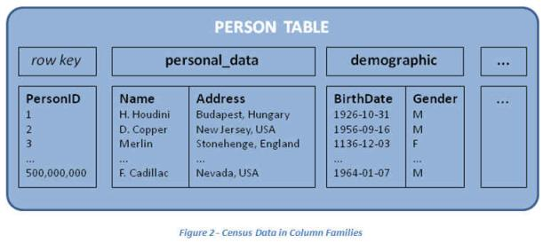
HBase Data Model (Apache) – based on BigTable (Google)
Each record is divided into Column Families
Each row has a Key
Each column family consists of one or more Columns

Slide 92
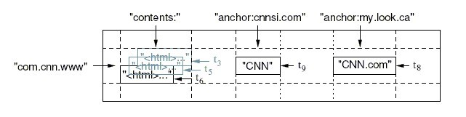
HBase Data Model Example
Column Family
Column
Row Key
Timestamp
Value
Row Key | Time Stamp | ColumnFamily contents | ColumnFamily anchor
"com.cnn.www" | t9 |  | anchor:cnnsi.com = "CNN"
"com.cnn.www" | t8 |  | anchor:my.look.ca = "CNN.com"
"com.cnn.www" | t6 | contents:html = "<html>..."
"com.cnn.www" | t5 | contents:html = "<html>..."
"com.cnn.www" | t3 | contents:html = "<html>..."
Anchor link – takes visitors to specific areas on a page
Backlink anchor text – used by other websites to link to your website helps search engines determine the most relevant keywords for ranking
Notes:
Tables are sorted by Row
Table schema only define it’s column families .
Each family consists of any number of columns
Each column consists of any number of versions
Columns only exist when inserted, NULLs are free.
Columns within a family are sorted and stored together
Everything except table names are byte[]
(Row, Family: Column, Timestamp) → Value

Slide 93
Is that all?
Versioning
Efficient ways of storing based on hash of key
Replication
Voldemort
Why is it called Voldemort? This is why
Slide 75

Slide 94
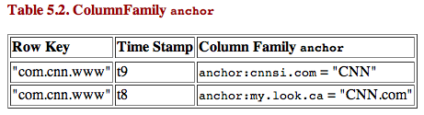
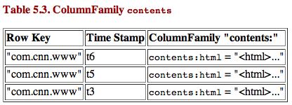
HBase Physical Model
Each column family is stored in a separate file
Different sets of column families may have different properties and access patterns
Keys & version numbers are replicated with each column family
Empty cells are not stored
Row Key | Time Stamp | ColumnFamily contents | ColumnFamily anchor
"com.cnn.www" | t9 |  | anchor:cnnsi.com = "CNN"
"com.cnn.www" | t8 |  | anchor:my.look.ca = "CNN.com"
"com.cnn.www" | t6 | contents:html = "<html>..."
"com.cnn.www" | t5 | contents:html = "<html>..."
"com.cnn.www" | t3 | contents:html = "<html>..."

Slide 95
HBase
Tables are sorted by Row Key
Table schema only defines its column families .
Each family consists of any number of columns
Each column consists of any number of versions
Columns only exist when inserted, NULLs are free.
Columns within a family are sorted and stored together
Everything except table names are byte[]
(Row, Family: Column, Timestamp) → Value
Allows to store any kind of data without “fuss”

Slide 96
Hbase and SQL
I looked up Hbase and SQL and found Phoenix:
http://www.slideshare.net/Hadoop_Summit/w-145p230-ataylorv2
Check out slide 33

Slide 97
Cassandra
Open Source, Apache
Schema optional
Need to design column families to support queries
Start with queries and work back from there
CQL (Cassandra Query Language)
Select, From Where
Insert, Update, Delete
Create ColumnFamily
http://cassandra.apache.org/doc/latest/cql/dml.html
Has primary and secondary indexes

Slide 98
Cassandra
Keyspace is container (like DB)
Contains column family objects (like tables)
Contain columns, set of related columns identified by application supplied row keys
Each row does not have to have same set of columns
Has PKs, but no FKs
Join not supported
Stores data in different clusters – uses hash key for placement
http://cassandra.apache.org/

Slide 99
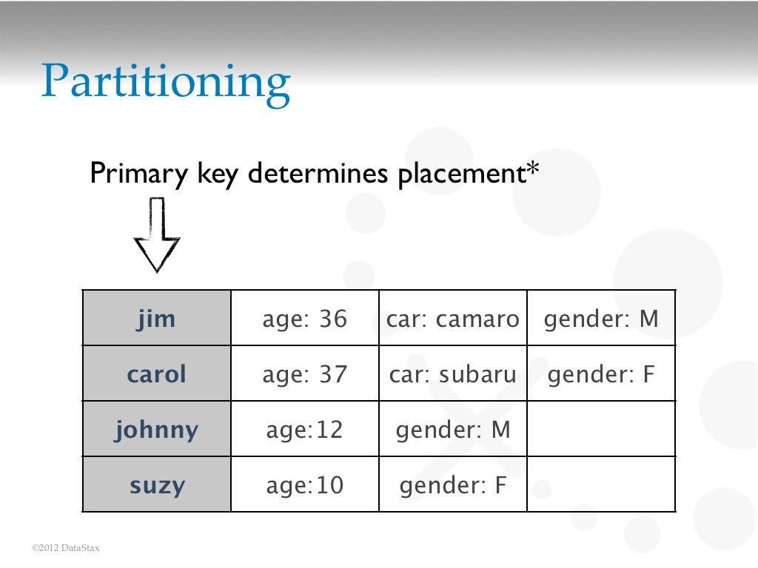

Slide 100
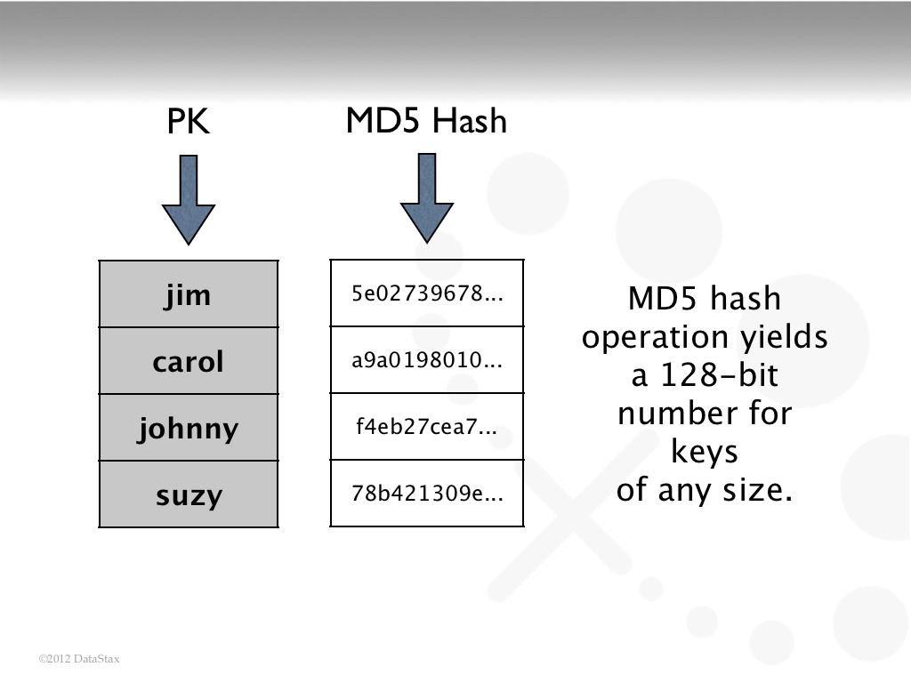

Slide 101
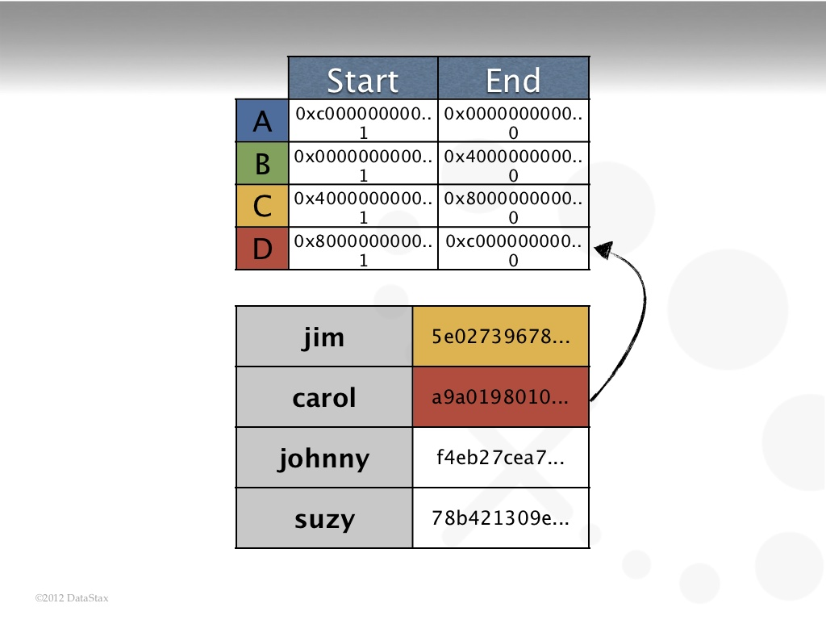

Slide 102
Graph Databases

Slide 103
Graph Databases
Data is represented as a graph
Nodes and edges indicate types of entities and relationships
Instead of computing relationships at query time (meaning no joins)
graph DB stores connections readily available for “join-like” navigation – constant time operation

Slide 104
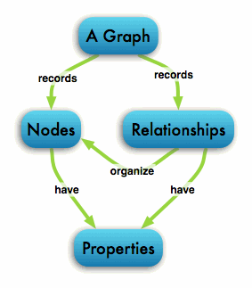
Graph contains connected entities (nodes) – hold (k,v)
Labels used to represent different roles in domain
Relationship – start node and end node
Can have properties
Nodes can have any number/type of relationship without affecting performance

Slide 105
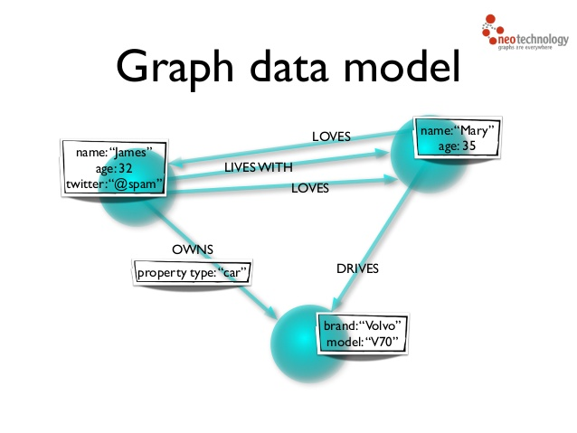

Slide 106
No broken links
If delete a node, must delete its relationships

Slide 107
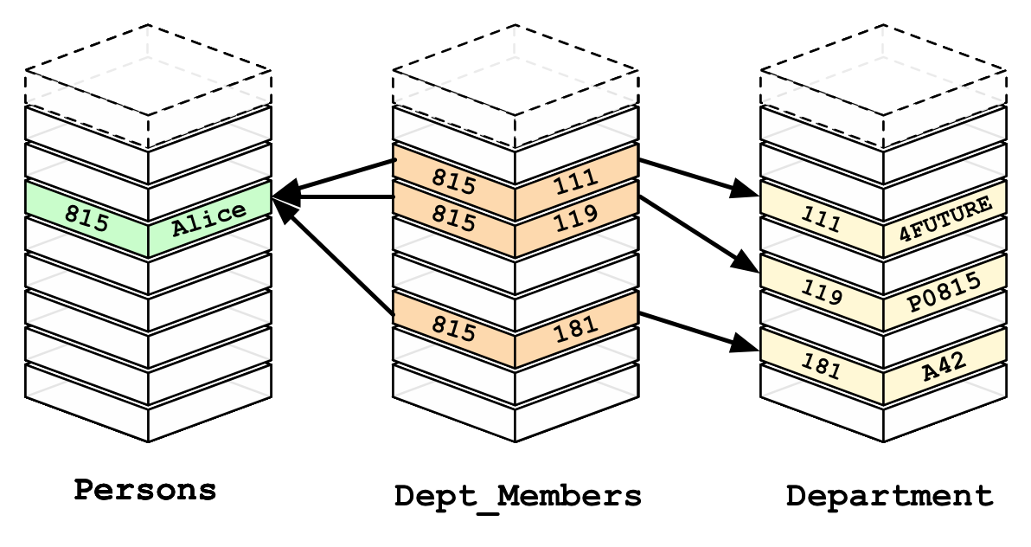
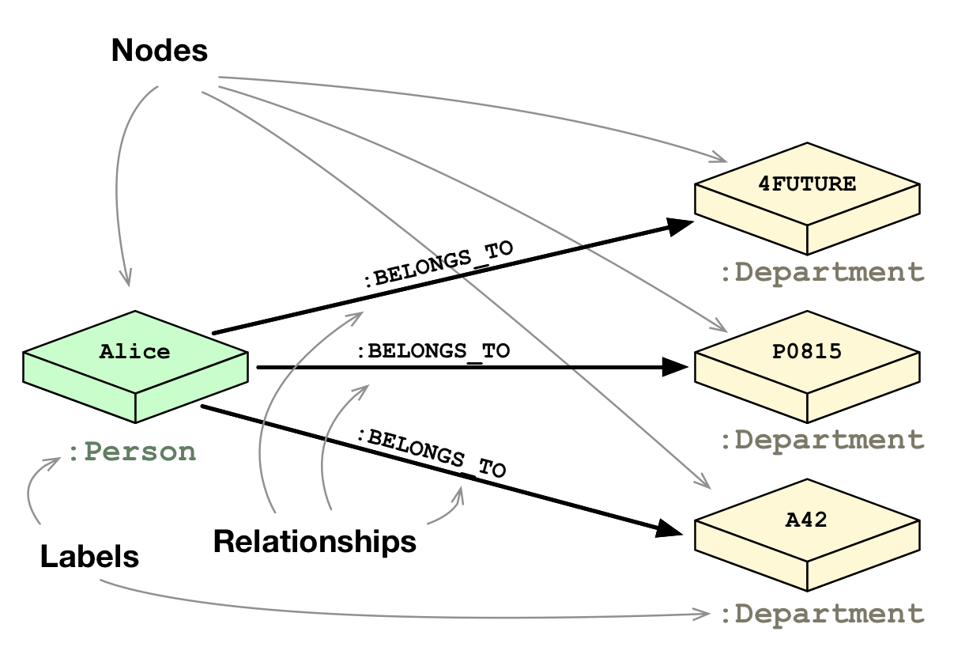

Slide 108
Graph DB is actually stored as a graph
Textbooks on graph DBs
Graph DBs considered faster for some types of databases, map more directly to OO apps
Relational faster if performing same operation on large numbers of data elements

Slide 109
Query Language
MATCH
WHERE
RETURN
http://neo4j.com/docs/stable/query-general.html

Slide 110
Query Language
CREATE (nodes)
Create relationships between nodes)
MATCH, WHERE, CREATE, RETURN
http://neo4j.com/docs/stable/query-create.html
Also:
CREATE, DELETE, SET, REMOVE, MERGE

Slide 111
Importing csv files into neo4j
http://neo4j.com/docs/stable/cypherdoc-importing-csv-files-with-cypher.html

Slide 112
http://neo4j.com/developer/graph-db-vs-rdbms/
http://console.neo4j.org/

Slide 113
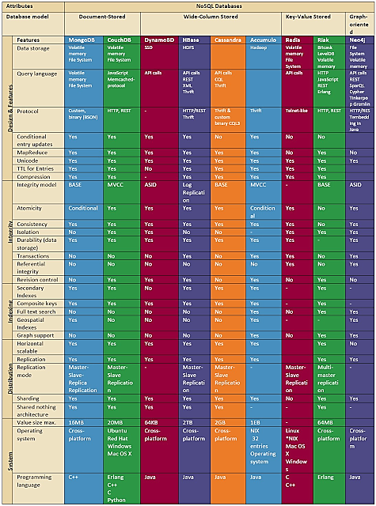

Slide 115
NoSQL Oracle
An Oxymoron?

Slide 116
Oracle NoSQL DB
Key-value – horizontally scaled
Records version # for k,v pairs
Hashes keys for good distribution
Map from user defined key (string) to opaque data items
data type whose concrete data structure is not defined in an interface

Slide 117
Oracle NoSQL DB
CRUD APIs
Create, Retrieve, Update, Delete
Create, Update provided by put methods
Retrieve data items with get

Slide 118
CRUD Examples
// Put a new key/value pair in the database, if key not already present.
Key key = Key.createKey("Katana");
String valString = "sword";
store.putIfAbsent(key, Value.createValue(valString.getBytes()));
// Read the value back from the database.
ValueVersion retValue = store.get(key);
// Update this item, only if the current version matches the version I read.
// In conjunction with the previous get, this implements a read-modify-write
String newvalString = "Really nice sword";
Value newval = Value.createValue(newvalString.getBytes());
store.putIfVersion(key, newval, retValue.getVersion());
// Finally, (unconditionally) delete this key/value pair from the database.
store.delete(key);

Slide 119
NoSQL DBs
Are they here to stay?

Slide 120
NoSQL DBs
NoSQL DBs
Good for business intelligence
Flexible and extensible data model
No fixed schema
Development of queries is more complex
Limits to operations (no join ...), but suited to simple tasks, e.g. storage and retrieval of text files such as tweets
Processing simpler and more affordable
No standard or uniform query language such as SQL

Slide 121
NoSQL DBs Cont’d
Distributed and horizontally scalable (SQL is not)
Run on large number of inexpensive (commodity) servers – add more servers as needed
Differs from vertical scalability of RDBs where add more power to a central server

Slide 122
But
90% of people using DBs do not have to worry about any of the major scalability problems that can occur within DBs

Slide 123
Criticisms of NoSQL
Open source scares business people
Lots of hype, little promise
If RDBMS works, don’t fix it
Questions as to how popular NoSQL is in production today

Slide 124
CompanyDB and MongoDB
Denormalization
Use references https://docs.mongodb.com/manual/reference/database-references/#manual-references
Manual reference – requires 2 queries
One query to get the object_id
Second query to get object associated with _id
DBRefs – need driver support for it (not in C/C++ but in Java, Python, etc.)

Slide 125
Office hours today??? Tuesday???

Slide 126
Will not cover MapReduce in class :>(

Slide 127
MapReduce
Programming model for distributed computations on massive amounts of data
Execution framework for large-scale data processing on clusters of commodity servers
Developed by Google – built on old, principles of parallel and distributed processing
Hadoop – adoption of open-source implementation by Yahoo (now Apache project)
level of abstraction and beneficial division of labor
Programming model – powerful abstraction separates what from how of data intensive processing

Slide 128
Big Ideas behind MapReduce
Scale out not up
Assume failures are common
Divide and conquer – parallel then combine
Move processing to the data

Slide 129
Functional Programming Roots
MR Based on Functional Programming
Different from usual flow of control
Two important concepts in functional programming
Map: do something to everything in a list
Reduce (Fold): combine results of a list in some way
Concept of key-value important

Slide 130
Map/Fold(Reduce) in Action
Simple map example – can do in parallel:
Reduce examples:
(map -> (* x x)) [1 2 3 4 5]) → [1 4 9 16 25]
(Reduce/Fold –> + 0 [1 2 3 4 5]) → 15
(Reduce/Fold -> * 1 [1 2 3 4 5]) → 120

Slide 131
Mappers/Reducers
Key-value pair (k,v) – basic data structure in MR
Keys, values – int, strings, etc., user defined
e.g. keys – URLs, values – HTML content
e.g. keys – node ids, values – adjacency lists of nodes
Map: (Docid, doc) -> [(k2, val)]
Reduce: (k2, [v2]) -> [(k2, v3)]
Where […] denotes a list

Slide 132
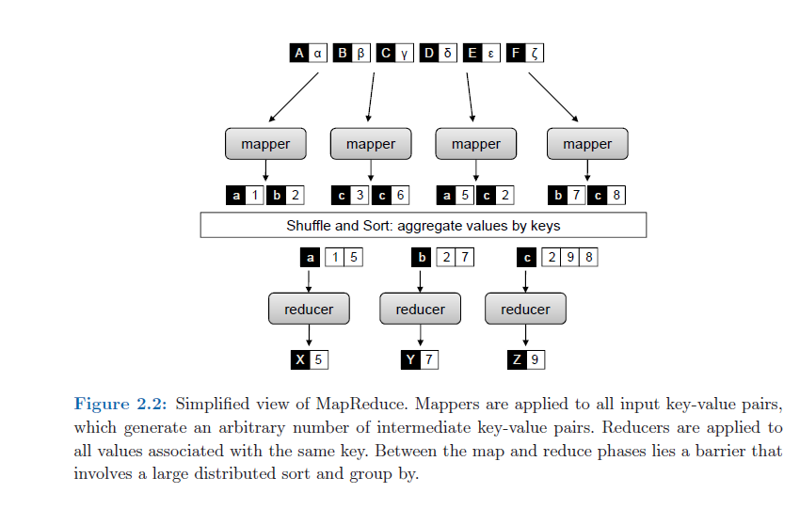

Slide 133
Example: unigram (word count)
(docid, doc) on DFS, doc is text
Mapper tokenizes (docid, doc), emits (k,v) for every word – (word, 1)
Execution framework all same keys brought together in reducer
Reducer – sums all counts (of 1) for word
Each reduce writes to one file
Words within file sorted, file same # words
Can use output as input to another MR

Slide 134
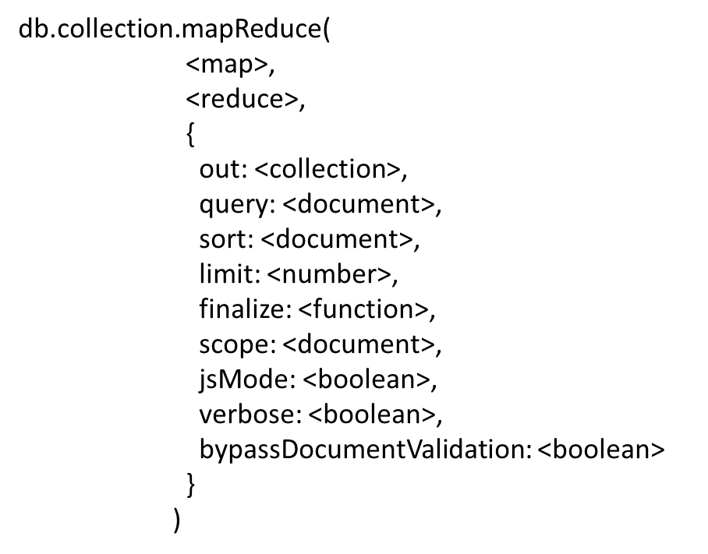
Mongodb mapReduce
Format is:

Slide 135
mapReduce additional arguments
out – specified the location of the result
query – selection criteria
sort – useful for optimization

Slide 136
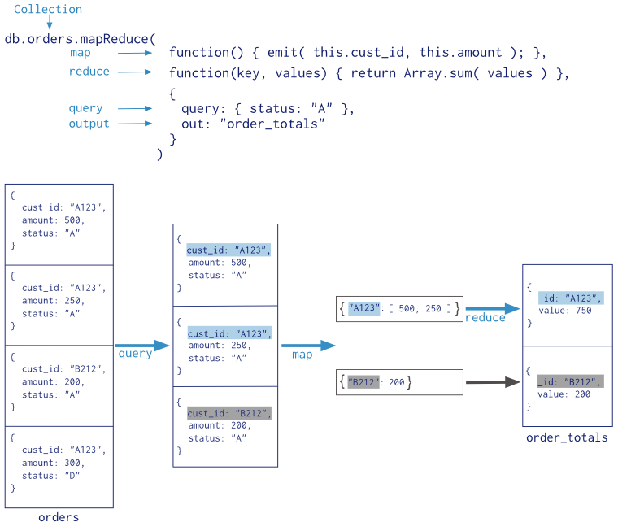
Mongodb MapReduce

Slide 137
var mapFunction1 = function() {
emit(this.cust_id, this.price);
};
In the function, this refers to the document that the map-reduce operation is processing.
The function maps the price to the cust_id for each document and emits the cust_id and price pair.

Slide 138
var reduceFunction1 = function(keyCustId, valuesPrices) {
return Array.sum(valuesPrices);
};
The valuesPrices is an array whose elements are the price values emitted by the map function and grouped by keyCustId.
The function reduces the valuesPrice array to the sum of its elements.

Slide 139
If the map_reduce_example collection already exists, the operation will replace the contents with the results of this map-reduce operation.
There is a way to append new results to an existing collection.

Slide 140
db.orders.mapReduce(
mapFunction1,
reduceFunction1,
{ out: "map_reduce_example" }
)

