Slide 1
Database Security Chapter 24.1-24.3

Slide 2
Terms
Security – all the processes and mechanisms by which computer-based equipment, information and services are protected from unintended or unauthorized access, change or destruction
Authorization – function of specifying access rights to resources
To authorize – to define access policy
Authentication – verifying identity of user
Privacy and confidentiality guaranteed by security
Privacy – individuals right to control access to personal info/body
Confidentiality – how private data is protected by ____

Slide 3
Terms
Privacy – right of retaining control over personal data, what information is shared with whom
Personal data
Any information which relating to an identified or identifiable person
Personal identifiers – user identity or other credential used to access a service allows to identify the user
Personal data – when processed generated information that allows to profile the user (habits, movements, options) and to infer additional knowledge that the user would like to keep personal (location, work related data, network of contacts)

Slide 4
Database Security
Different aspects of database security
data encryption - encoding, transmission, decoding
retrieval of statistical information
protect individual information (could be deduced by smart queries)

Slide 5
Access Control
Access control for a whole DBMS - account numbers and passwords
login procedure, login session, database audit and audit trail
Access control for portions of a database
in a multiuse DBMS different users may be entitled access to different portions of the same DB

Slide 6
Access Control for portions of DB
Secure portions of a DB against unauthorized access
4 approaches:
Discretionary Access Control (DAC)
Role Based Access Control (RBAC)
Mandatory Access Control (MAC)
Attribute-Based Access Control (ABAC)

Slide 7
DBA
DBA is responsible for the overall security of the DB system.
In particular:
Account creation - access to the whole DBMS
Privilege granting – DAC, RBAC
Privilege revocation – DAC, RBAC
Security level assignment – MAC, RBAC

Slide 8
Discretionary Access Control
Based on granting and revoking privileges
Assign privileges
account level (subject)
independent of the relations
create schema, create table, create view
relation level (object)
on a particular base relation or view

Slide 9
Access (authorization) matrix model
row - subject
column - object
M(i,j) -> read, write, update
for example M(a,B) = read means that subject a holds a read privilege on object B
Owner of the relation (typically the creator) is assigned the owner account for that relation and is given all privileges on that relation

Slide 10
Grant/Revoke
Grant the following privileges to other accounts (relation level) – system and object privileges
Select
Modify (update, delete, insert tuples)
References (can reference the relation or specific attributes of the relation when specifying integrity constraints)

Slide 11
Grant SQL statement
Grant {privileges} on {table | view} to {user | public | role}
Where privileges are:
Select, alter, delete, update, index, references, insert, all
Can specify list of (columns) after privileges only for insert, update
Cannot specify list of columns for select privileges
Grant select, delete on Employee, Department
to rsmith

Slide 12
To access tables granted permission
User granted access to table must qualify name of that table with owner
Select *
from svrbsky.Employee
where dno = 4

Slide 13
Grant/Revoke
Revoking privileges
Revoke {privilege} on {table | view} from {user | public | role}
Revoke delete on Department from rsmith

Slide 14
Example of grant/revoke
Example: U1 issues
Create table Employee(SSN, Fname, Lname, Salary)
Propagating/Revoking privileges - horizontal and vertical
Use WITH GRANT OPTION
U1 can issue the following statements:
Grant select on Employee to Xiaoyan;
Grant select on Employee to Jeff with grant option;
Revoke select on Employee from Jeff;

Slide 15
Using views
Create view EMP5
as (select Fname, Lname
from Employee
where dno=5);
Grant select on EMP5 to Bob;

Slide 16
Roles - RBAC
Role-based access control (RBAC)
Sandhu, R., Coyne, Feinstein, Youman: “Role-Based Access Control Models,” 1996
Semantic construct
System administrator creates roles according to job functions

Slide 17
Motivation
Many organizations:
Base access control in role of individual users
Want to centrally control and maintain access rights
Access control needs are unique

Slide 18
RBAC
Role
Specific task competency
duty assignments
Embody authority and responsibility
define individuals and extent of resource access
Grant permissions to users in these roles
Roles & permissions
Users & roles

Slide 19
Motivation
Administration of roles rather than permissions
Role permission predefined
Easier to add/remove users membership than create new roles/permissions
Roles part of SQL3
Supported by many software products
Roles used in Windows NT, XP (system admin)

Slide 20
RBAC basics
Access control in RBAC exists in:
Role-permission (stable)
Role-role relationships (stable)
User-role (dynamic)
RBAC supports principles:
Least privilege
Separation of duties- mutually exclusive roles, combinations of roles prohibited, cardinality, prereq
Data abstraction- abstract permissions (not just R/W)
Limitations
RBAC cannot enforce way principles applied – system admin could configure to violate

Slide 21
In Oracle
Rather than grant privileges to individual users, can grant them to groups using roles
Create role role_name [identified by pw]
Grant {privilege} [on {table}] to role_name
Grant role_name to user
The user must enable the role if a pw is specified with the command:
Set role role_name identified by pw

Slide 22
In Mongodb
db.createRole()
Give it a name and specify privileges
Built in privileges: read, readWrite
https://docs.mongodb.com/v3.0/reference/method/#role-management-methods

Slide 23
Mandatory Access Control- MAC
Motivated by government in late 1980’s/early 1990’s
Utilize security classifications

Slide 24
Mandatory Access Control
Security classes: TS(Top Secret), S (Secret), C(Classified), U (Unclassified)
TS > S > C > U
each subject and object are classified into one of the security classifications (TS, S, etc.)
Bell-LaPadulla properties (restrictions on data access)
simple property: No READ UP
star (*) property: No WRITE DOWN (write at own level)

Slide 25
MLS
multilevel relation (MLS) schema
classification attribute C
tuple classification TC
R(A1, C1, A2, C2, ...An, Cn, TC) Jajodia-Sandhu

Slide 26
MLS Relation Example
Vessel (PK) Objective Destination TC
Micra U Shipping U Moon U U
Vision U Spying U Saturn U U
Avenger C Spying C Mars C C
Logos S Shipping S Venus S S

Slide 27
MLS Relation Example
Vessel (PK) Objective Destination TC
Micra U Shipping U Moon U U
Vision U Spying U Saturn U U
Avenger C Spying C Mars C C
Logos S Shipping S Venus S S

Slide 28
MLS
Level U sees first 2 tuples
Level C sees first 3 tuples
Level S sees all tuples

Slide 29
Vessel (PK) | Objective | Destination
Micra | Shipping | Moon | U
Vision | Spying | Saturn | U
Avenger | Spying | Mars | C
Logos | Shipping | Venus | S

Slide 30
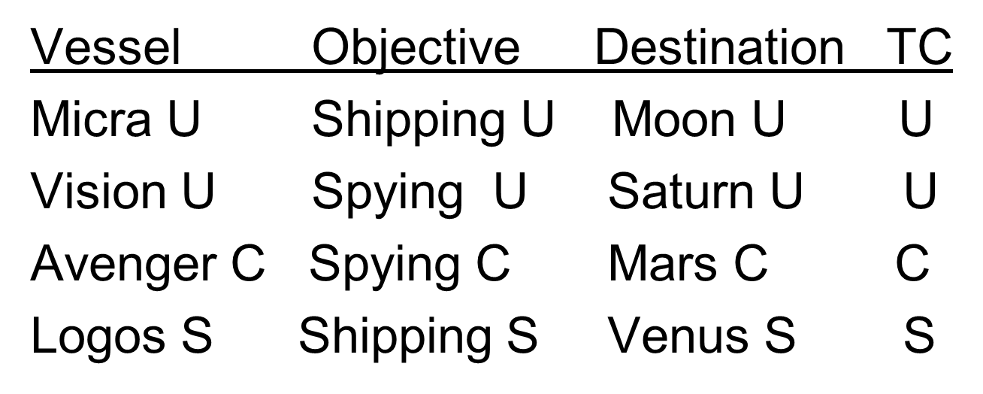
MLS Insert
What if a U user wants to insert a tuple with vessel = Avenger?
If reject the insert – what will happen?
Covert channel

Slide 31
Covert Chanel
Indirect downward flow of information
must be avoided since it allows downward flow of information
Can occur if reject update
Can be used maliciously (higher level user can signal lower level user)
So what to do instead?

Slide 32
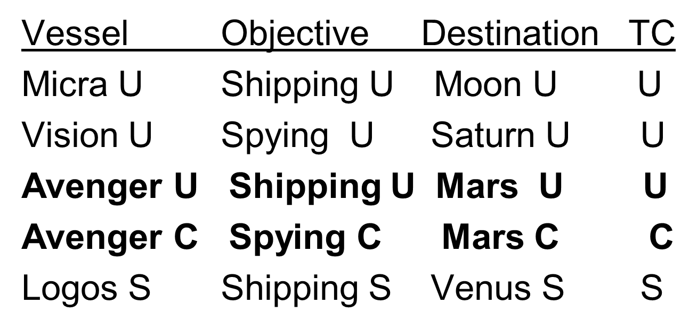
MLS Insert
If insert another Avenger, what about the primary key? Will have 2 Avengers
PK + Classification

Slide 33
MLS Relation
Vessel Objective Destination TC
Micra U Shipping U Moon U U
Vision U Spying U Saturn U U
Avenger U Shipping U Mars U U
Avenger C Spying C Mars C C
Logos S Shipping S Venus S S

Slide 34
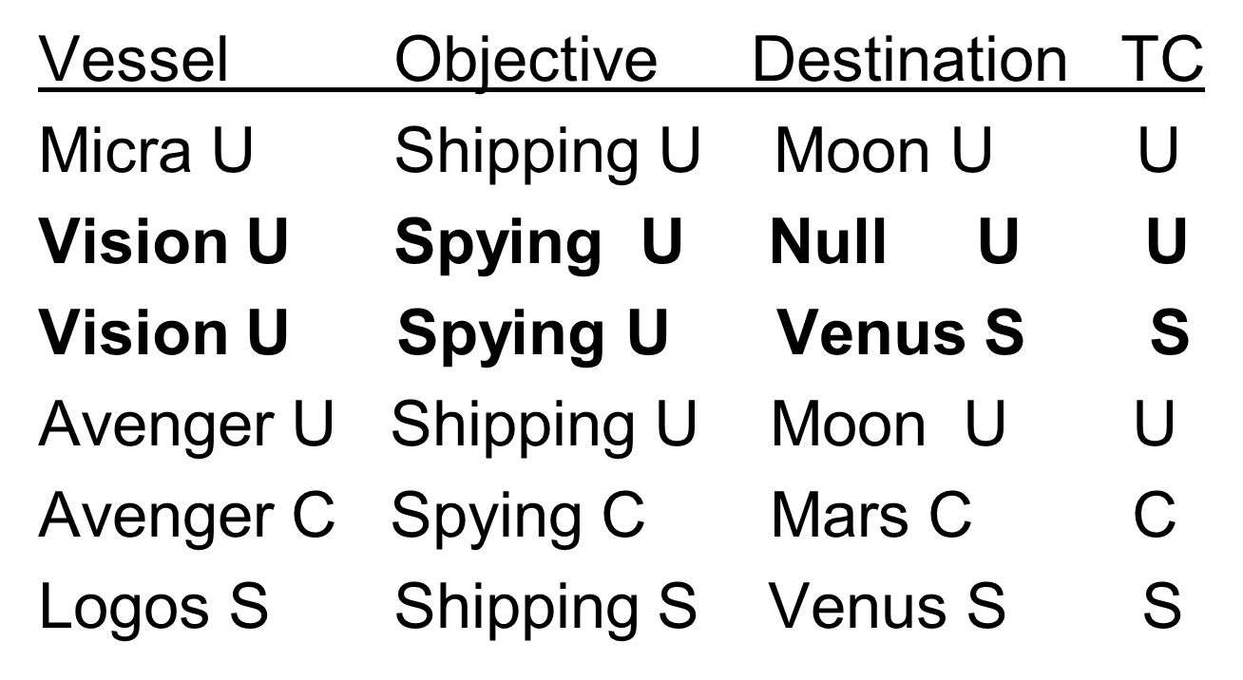
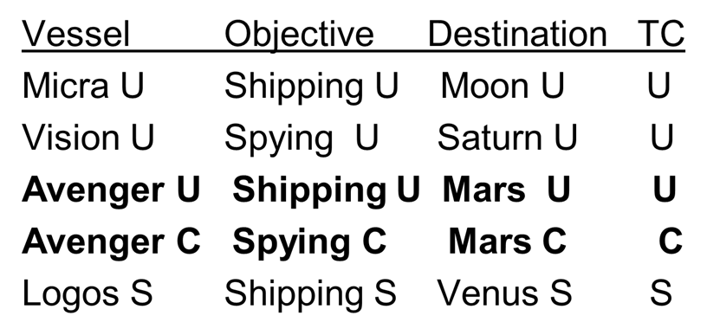
MLS Update
What if the S level wants to update one of the tuples at the U level - update Vision so Destination is Venus
U should not see the update
Null?
Replicate the tuple
PK + Classification + TC (instead?)

Slide 35
Jajodia Sandhu MLS Model
Vessel Objective Destination TC
Micra U Shipping U Moon U U
Vision U Spying U Null U U
Vision U Spying U Venus S S
Avenger U Shipping U Moon U U
Avenger C Spying C Mars C C
Logos S Shipping S Venus S S

Slide 36
MLS Relation – Better Solution
Vessel Objective Destination TC
Micra U Shipping U Moon U U
Vision U Spying U Saturn U U
Vision U Spying U Venus S S
Avenger U Shipping U Moon U U
Avenger C Spying C Mars C C
Logos S Shipping S Venus S S

Slide 37
Extensions to MLS model
Winslett-Smith Model
Tuples at user’s level believe info
See info at lower levels
R(K, KC, A1, A2, ... An, TC) Smith-Winslett
Every tuple has a base tuple – level at which first inserted

Slide 38
Extensions to MLS model
MLR – Sandu-Chen
Relational operations still messy in Winslett/Smith
Try to eliminate semantic ambiguity
Borrowing to indicate belief in lower level tuples
Does it mean T or F?
Cannot indicate disbelief

Slide 39
Extensions to MLS model
Belief consistent model (Jukic-Vrbsky)
Can easily see what others believe at lower levels
Can assert if one level believes lower level belief is false
Reduces tuple propagation
Can even have a cover story for a PK

Slide 40
Why do you think MAC never became popular??
But
Can have MLS database by using:
Oracle Label Security in 12c
Sensitivity labels and security clearances

Slide 41
DAC, MAC vs. RBAC
DAC vs. MAC emerged from defense security research
RBAC independent of access control
RBAC can be used to implement DAC, MAC

Slide 42
HW#7
http://cs457.cs.ua.edu/2018S/HW7.htm
Implement program to identify Normal Form
Use server cs457.ua.edu
Login/password same as mybama
Can ssh to it but must VPN even on campus
Make sure input file has no weird characters use dos2unix

Slide 43
Attribute-Based Access Control
ABAC
Mid 2000’s

Slide 44
Why ABAC? – web sharing
Trend: collaboration and info sharing
Must balance accessibility with protection
Currently
Need set of known users
Simple, static, coarse grained (roles)
doesn’t take into account current threat level, community of interest
Firewall, intrusion detection (HTTP)
can have potential attacks not detectable

Slide 45
ABAC
Attribute-Based Access Control
Motivation – web-based services technologies and service-oriented architectures
Dynamic and adhoc
Based on subject, object and environment attributes
Supports MAC and DAC needs
Can implement ABAC with XML Access Control Markup Language (XACML) defined architecture and policy language for access control
Slides based on: “Attribute Based Access Control ABAC for Web Services,” E. Yuan, J. Tong, ICWS’05.

Slide 46
ABAC
Rule-based approach:
Access granted based on attributes of user not permission of subject associated with user
Evaluates rules or policies against attributes of entities and environment

Slide 47
Definition of ABAC
Attributes
Subject – entity (user, application, process) that acts on a resource
Resource (object) – entity acted upon by subject
Environment conditions
Evaluation of policy rules – first order logic, forward chaining

Slide 48
Example: Alcoholic Beverage Control Store
Attributes:
ATTR(s) SA₁ X SA₂ X … X SA_{k}
ATTR(r) RA₁ X RA₂ X … X RA_{k}
ATTR(e) EA₁ X EA₂ X … X EA_{k}
Assign attributes to s, r, e for ABC store
Subject(s) = (Customer, address, credit rating), (Manager, store, ssn, security_code)
Resource(r) = (Previous purchases, NewPurchase, ApprovePurchase), (Store_info, store_location)
Environment(e) = (state rules, subject location)

Slide 49
Rules
Rule : can_access (s, r, E) ← f(ATTR(s), ATTR(r), ATTR(e))
Policy rules
Rule1: can_access(s, r, e) ← (Role(s)=‘Manager’) ^ (Resource(r)=‘ApprovePurchase’) //enforcing roles
Rule2: can_access(s, r, e) ← (UserID(s) = ResourceOwner(r))
// resource can be accessed by ABC owner
Rule3: can_access(s, r, e) ← (Age(s) >= MinAge(e) ^ Location(s) = Location(r)) ^ (day/time(s) > stateDayTime(e))
// resource can only be purchased by subject on Sunday after 12pm

Slide 50
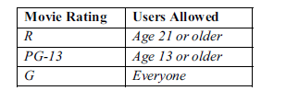
Movie Rating Example: ABAC vs RBAC:
Example
RBAC
Create 3 roles: adult, juvenile, child
Create 3 permissions:
Adult can access R-rated movies, PG-13 movies, G-rated movies
Juvenile can access PG-13 and G
Child can access G movies
Assign users to roles

Slide 51
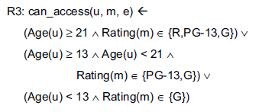
Example
ABAC
Age is s attribute, rating r attribute
Eliminates definition/management of static roles

Slide 52
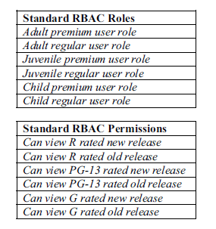
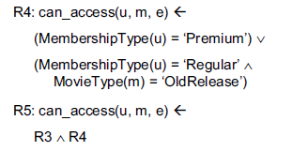
Expand example
Suppose expand to include new (Premium), old release (Regular)
Changes to RBAC Changes to ABAC
R6: (Country(e)= “France” ^ Rating(m) ∈ {R, PG-13, G})

Slide 53
Architectural model
User logs in and has authorization/access information associated with their login
System has to authorize login, access info associated with login
Useful for environment attributes, e.g. location
Allows users to login from anywhere – uses a centralized site to authorize instead of associated within each DB
Can allow access to more than one DB with single login
CAPS – lots of DBs may have access to, don’t want to have to login to each DB

Slide 54
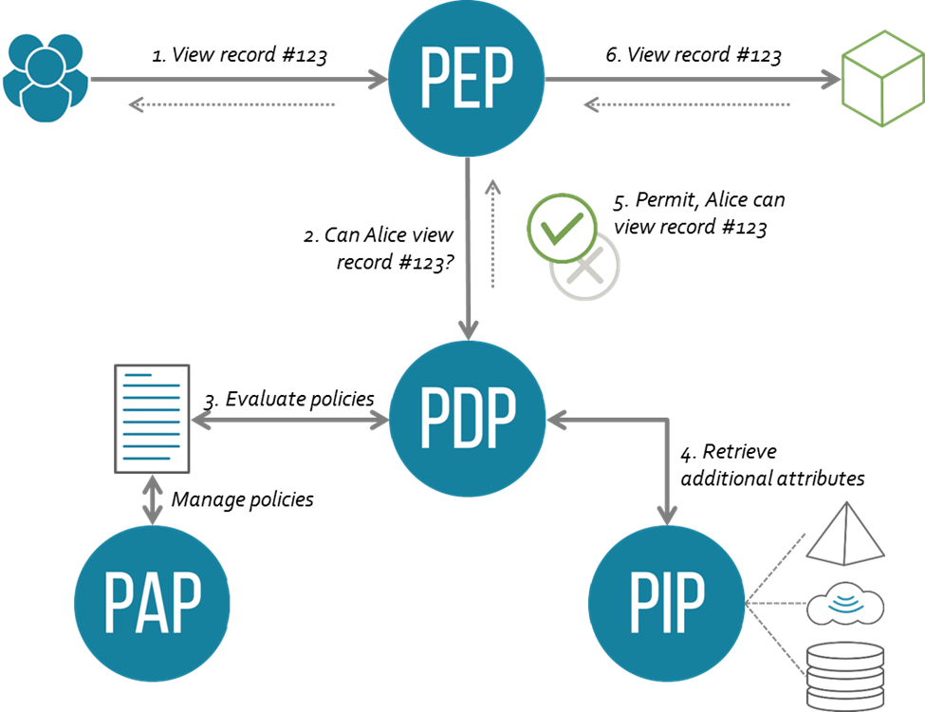
Authorization Architecture
Policy Enforcement Point PEP
Intercepts user request for access
Makes request to PDP for decision to access
Policy Decision Point PDP
Evaluate request against policies
makes authorization decisions
Policy Administration Point PAP
Create/manages access control policies
Policy Information Point PIP
Source of attribute values r, s, e

Slide 56
Advantages/Disadvantages
Advantages?
Users carry their security info (access control, etc.), by way of authorization
Focus for security shifts from DB to PDP
Any disadvantages?
Bottleneck at PDP, PEP
Solution?
Distributed
Extensions?
Can allow users access to multiple DBs through PDP, as long as DB agreements and set in rules

Slide 57
Advantages of ABAC
Benefits
More flexible and powerful
Management of security can be distributed over network
Can implement DAC, MAC, RBAC in ABAC
Drawbacks
User must prove identity for authorization?
No standard model for federal government

Slide 58
SQL Injection
Application security weakness allowing attacker to control a DB
Most common application layer attack
Tricks application by sending SQL commands, e.g. into web form fields
Asks DB to execute commands, e.g. login without PW, delete records, etc.
Attacker submits unexpected values for arguments to see how application responds
Then inputs value that is interpreted as SQL command

Slide 59
txtUserId = getRequestString("UserId");
txtSQL = "SELECT * FROM Users WHERE UserId = " + txtUserId;
User types in: 105 OR 1=1
SELECT * FROM Users WHERE UserId = 105 or 1=1;

Slide 60
Solutions
Prepared statements (have placeholders instead of values and must prepare each time execute)
Instead of allowing user to input: “105 or 1=1” make sure input an integer
Get rid of ‘;’ so can’t add several statements
SELECT email, passwd, login_id, full_name
FROM members
WHERE email = 'x'; DROP TABLE members; --'; -- Boom!
Stored procedures – platform specific, PL/SQL
Avoid all user-supplied input

Slide 61
NoSQL Injection
MongoDB – can pass javascript code snippet to the DB using $where
Cannot change the DB content, but can retrieve unintended results

Slide 62
NoSQL/SQL security?
“The state of NoSQL security is about as abysmal as the state of security in RDBMS systems.” unknown source
Role based
MongoDB, neo4j
Grant/Revoke
HBase

