Slide 2
Design Stage
How the player interacts with the game (UI – information displayed, navigating different screens and character controls), How different entities spawn and function as well as how the camera works.

Slide 3
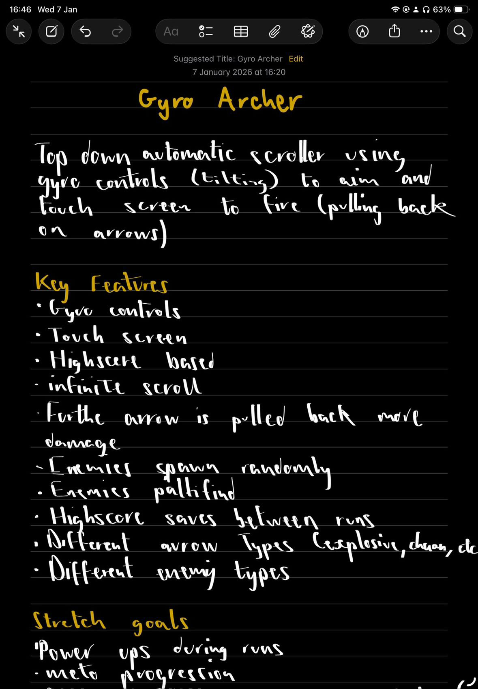
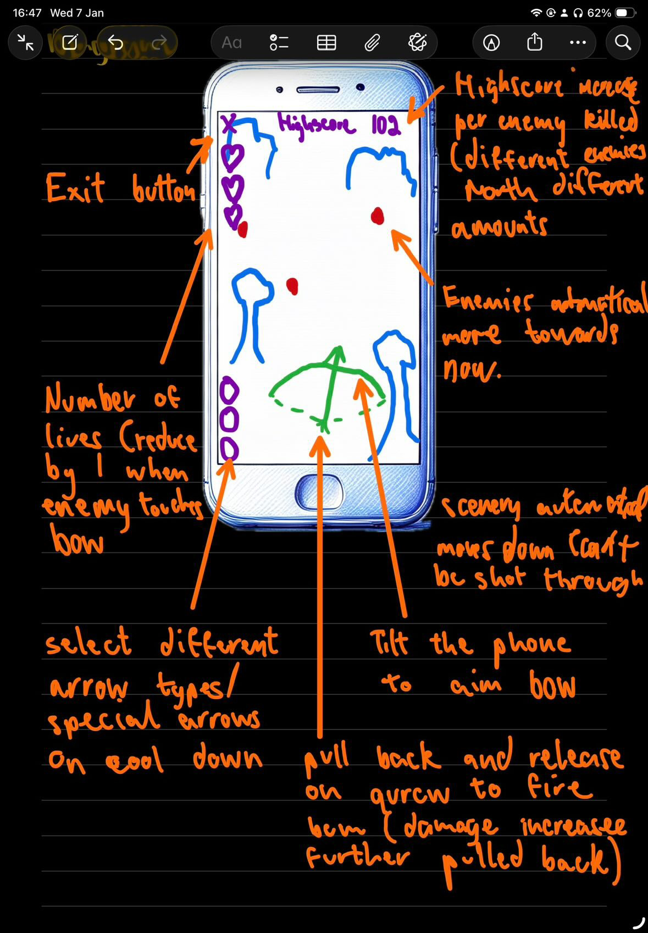
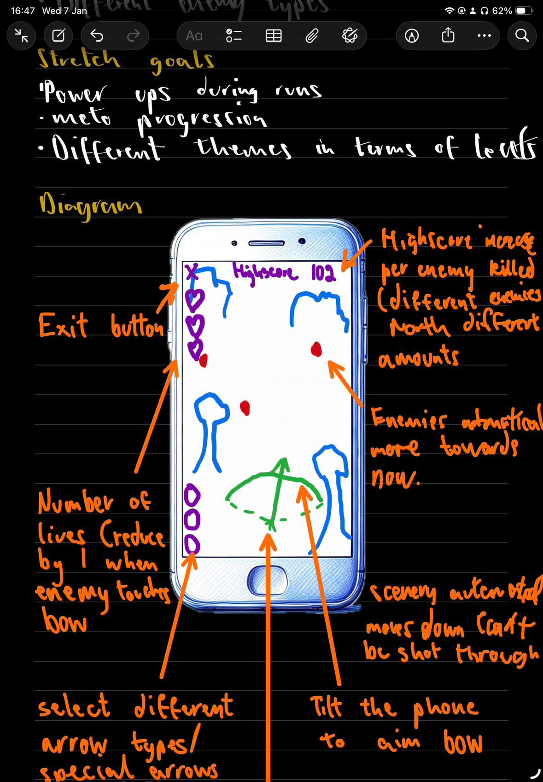
Development 07.01
Started with basic concept
Decided on 2D for better appearance
Started on making sprites and background
Decided on theme – mix of fantasy and
robots

Slide 4
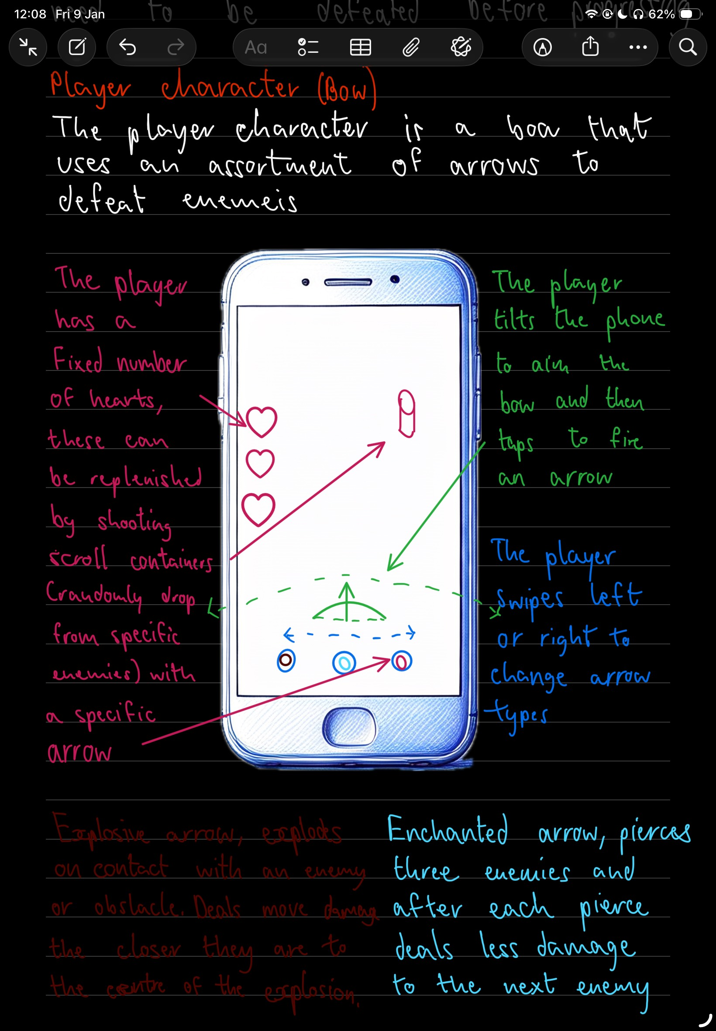
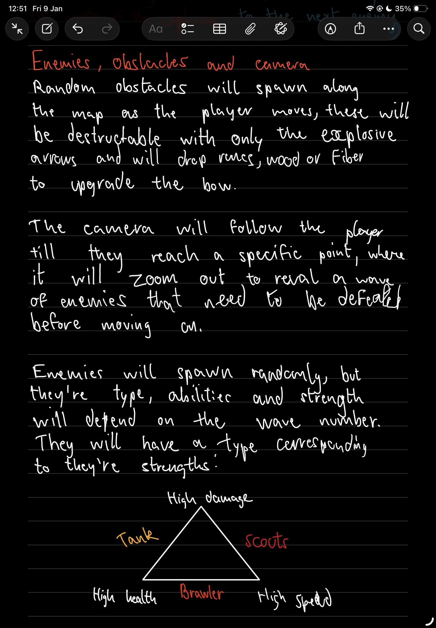
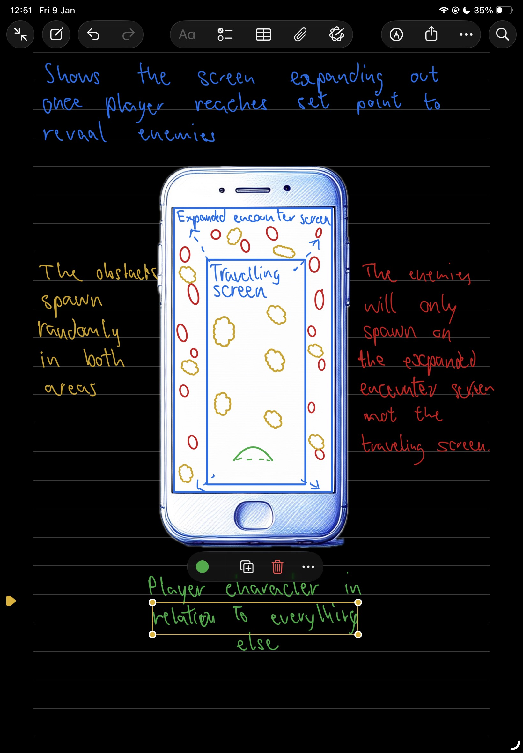
Development 09.01
Refined basic concepts
Decided to use hearts instead of health bar
Decided to include meta progression in the form of upgrading the player character
Decided on having 3 main enemy types, with sub types within them.
Decided how the camera will function
Enemies will drop a scroll containers that can be shot to heal
Obstacles will drop resources used in the meta progression

