Slide 1
GRASP Principles

Slide 2
How to Design Objects
The hard step: moving from analysis to design
How to do it?
  Design principles (Larman: “patterns”) – an attempt at a methodical way to do object design

Slide 3
Object Oriented Design
Larman:
“After identifying your requirements and creating a domain model, then add methods to the appropriate classes, and define the messaging between the objects to fulfill the requirements.”

Slide 4
Object Oriented Design
Larman (continued):
“Ouch! Such vague advice doesn’t help us, because deep principles and issues are involved. Deciding what methods belong where and how objects should interact carries consequences and should be undertaken seriously. Mastering OOD – and this is its intricate charm – involves a large set of soft principles, with many degrees of freedom. It isn’t magic – the patterns can be named (important!), explained, and applied. Examples help. Practice helps. . . .” (p. 271)

Slide 5
Object Oriented Design
Fundamental activity in OOD:
Assigning responsibilities to objects!
Responsibility – an obligation required of an object
Two types of responsibilities:
  Doing
  Knowing

Slide 6
Responsibilities
Two types of responsibilities:
Doing:
  creating an object
  doing a calculation
  initiating action in other objects
Knowing:
  knowing about private encapsulated data
  knowing about related objects
  knowing about things it can derive or calculate
Note: “knowing” often found in domain model, e.g. attributes and associations

Slide 7
Responsibilities
Responsibilities are more general than methods
Methods are implemented to fulfill responsibilities
Example: Sale class may have a method to know its total but may require interaction with other objects

Slide 8
Responsibilities
What are the principles for assigning responsibilities to objects?
Assigning responsibilities initially arises when drawing interaction diagrams . . .

Slide 9
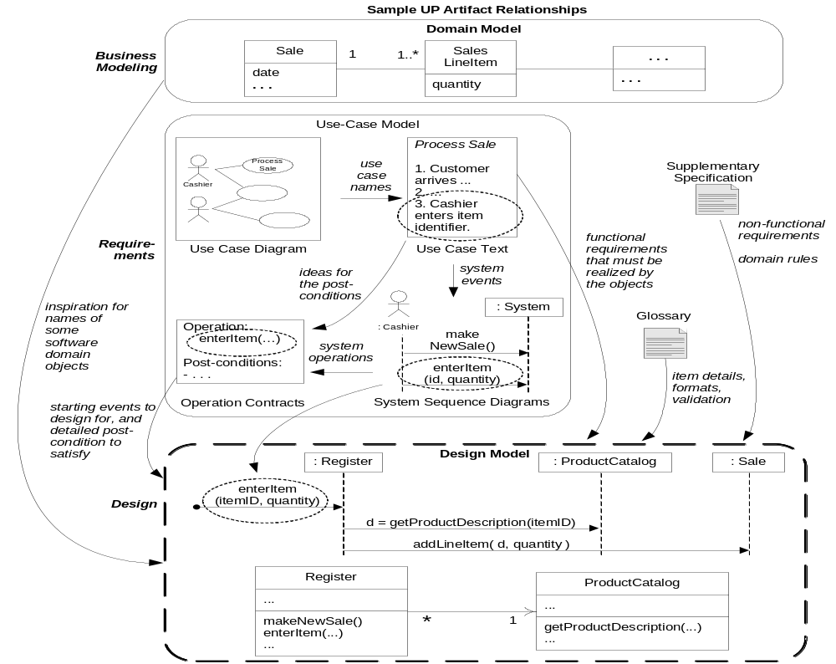
Fig. 17.1

Slide 10
Responsibility-Driven Design (RDD)
RDD is a metaphor for thinking about OO software design.
Metaphor – software objects thought of as people with responsibilities who collaborate to get work done
An OO design as a community of collaborating responsible objects

Slide 11
GRASP Principles
GRASP principles – a learning aid for OO design with responsibilities
Pattern – a named and well-known problem/solution pair that can be applied in new contexts, with advice on how to apply it in new situations and discussion of its trade-offs, implementations, variations, etc.

Slide 12
GRASP Principles
9 GRASP principles:
  Information Expert
  Creator
  Low Coupling
  Controller
  High Cohesion
  Polymorphism
  Pure Fabrication
  Indirection
  Protected Variations

Slide 13
Summary of OOD
Assigning responsibilities is important
First becomes important in interaction diagrams then in programming
Patterns are named problem/solution pairs for identifying principles to be used in assigning responsibilities

Slide 14
Information Expert (17.11)
Problem: What is a general principle for assigning responsibilities to objects?
Solution: Assign a responsibility to the information expert, that is, the class that has the information necessary to fulfill the responsibility.
Example: (from POS system) Who should be responsible for knowing the grand total of a sale?

Slide 15
Information Expert
Example: (from POS system) Who should be responsible for knowing the grand total of a sale?
Start with domain model and look for associations with Sale (Fig. 17.14)
What information is necessary to calculate grand total and which objects have the information?

Slide 16
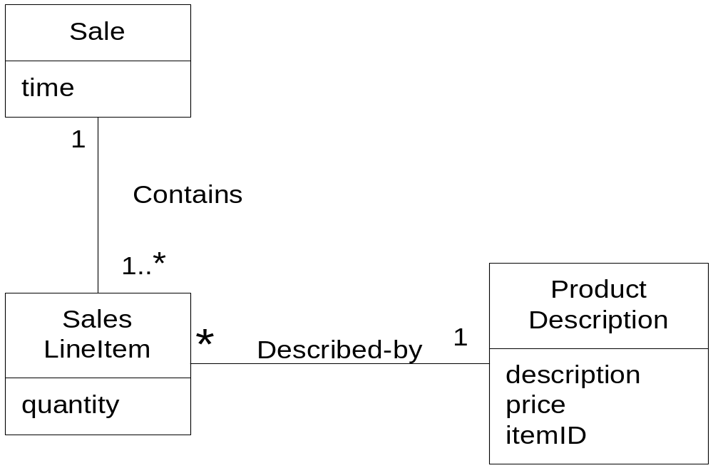
Fig. 17.14

Slide 17
Information Expert
Example (cont.):
From domain model:
“Sale Contains SalesLineItems” so it has the information necessary for total . . .

Slide 18
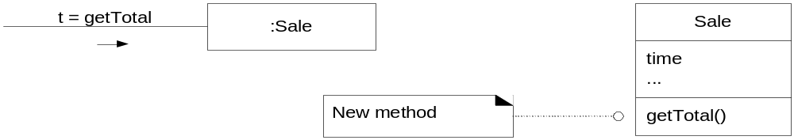
Fig. 17.15

Slide 19
Information Expert
Example (cont.):
How is line item subtotal determined?
quantity – an attribute of SalesLineItem
price – stored in ProductDescription . . .

Slide 20
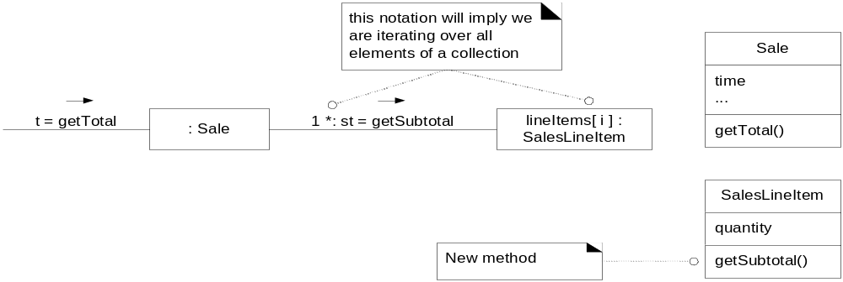
Fig. 17.16

Slide 21
Information Expert
Example (cont.): Who should be responsible for knowing the grand total of a sale?
Summary of responsibilities:
Design Class | Responsibility
Sale | knows sale total
SalesLineItem | knows line item subtotal
ProductDescription | knows product price

Slide 22
Information Expert
Information Expert => “objects do things related to the information they have”
Information necessary may be spread across several classes => objects interact via messages

Slide 23
Information Expert
Animation principle – in real world a sale is inanimate – it just stores data, it is not active
In object-oriented world these objects become animated
Instead of having something done to them they do it themselves

Slide 24
Information Expert
Information Expert is not the only pattern so just because an object has information necessary doesn’t mean it will have responsibility for action related to the information
Example: who is responsible for saving a sale in a database
Problems if it is given to Sale (will violate other principles: cohesion, coupling)

Slide 25
Creator (17.10)
Problem: Who should be responsible for creating a new instance of a class?
Solution: Assign class B the responsibility to create an instance of class A if one or more of the following is true:
  B contains A objects
  B records instances of A objects
  B closely uses A objects
  B has the initializing data that will be passed to A when it is created.
Example: (from POS system) Who should be responsible for creating a new SalesLineItem instance?

Slide 26
Creator
Example: (from POS system) Who should be responsible for creating a new SalesLineItem instance?
Start with domain model:

Slide 27
Creator
Example: (from POS system) Who should be responsible for creating a new SalesLineItem instance?
Since a Sale contains SalesLineItem objects it should be responsible according to the Creator pattern (Fig. 17.13)
Note: there is a related design pattern called Factory for more complex creation situations

Slide 28
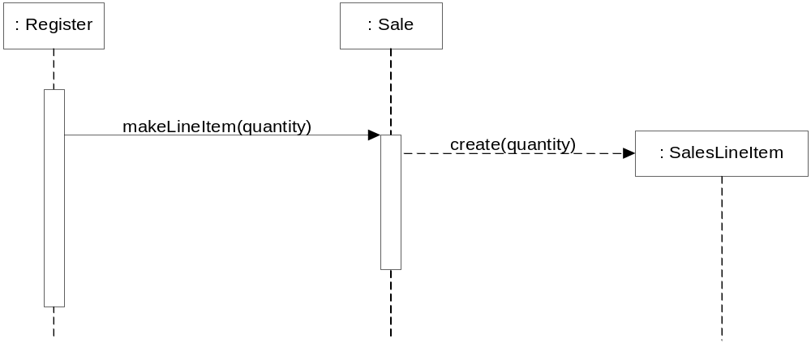
Fig. 17.13

Slide 29
Low Coupling (17.12)
Problem: How to support low dependency, low change impact, increased reuse?
Solution: Assign a responsibility so coupling is low.
Coupling – a measure of how strongly one element is connected to, has knowledge of, or relies on other elements

Slide 30
Low Coupling
A class with high coupling relies on many other classes – leads to problems:
  Changes in related classes force local changes
  Harder to understand in isolation
  Harder to reuse

Slide 31
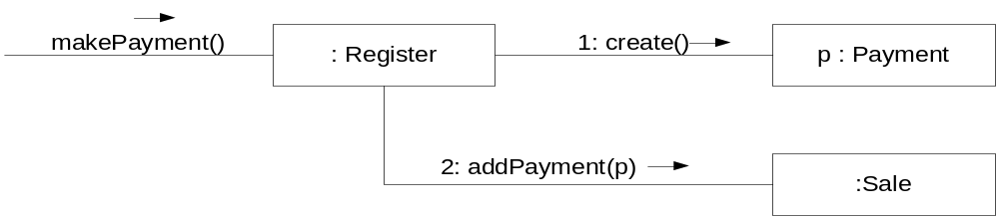
Low Coupling
Example (from POS system):
Consider Payment, Register, Sale
Need to create a Payment and associate it with a Sale, who is responsible?
Creator => since a Register “records” a Payment it should have this responsibility
Register creates Payment p then sends p to a Sale => coupling of Register class to Payment class

Slide 32
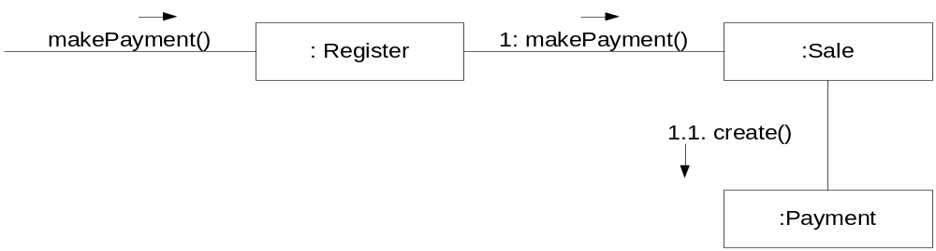
Low Coupling
Example (from POS system):
Consider Payment, Register, Sale
Need to create a Payment and associate it with a Sale, who is responsible?
Alternate approach:
Register requests Sale to create the Payment

Slide 33
Low Coupling
Consider coupling in two approaches:
In both cases a Sale needs to know about a Payment
However a Register needs to know about a Payment in first but not in second
Second approach has lower coupling

Slide 34
Low Coupling

Slide 35
Low Coupling
Low coupling is an evaluative principle, i.e. keep it in mind when evaluating designs
Examples of coupling in Java (think “dependencies”):
  TypeX has an attribute of TypeY
  TypeX calls on services of a TypeY object
  TypeX has a method that references an instance of TypeY
  TypeX is a subclass of TypeY
  TypeY is an interface and TypeX implements the interface
Note: subclassing => high coupling
Note: extreme of low coupling is unreasonable

Slide 36
Controller (17.13)
Problem: Who should be responsible for handling a system event? (Or, what object receives and coordinates a system operation?)
Solution: Assign the responsibility for receiving and/or handling a system event to one of following choices:
  Object that represents overall system, device or subsystem (façade controller)
  Object that represents a use case scenario within which the system event occurs (a <UseCase>Handler)

Slide 37
Controller
Input system event – event generated by an external actor associated with a system operation
Controller – a non-UI object responsible for receiving or handling a system event

Slide 38
Controller
During analysis can assign system operations to a class System
That doesn’t mean there will be a System class at time of design
During design a controller class is given responsibility for system operations
A façade controller (Fig. 17.21)

Slide 39
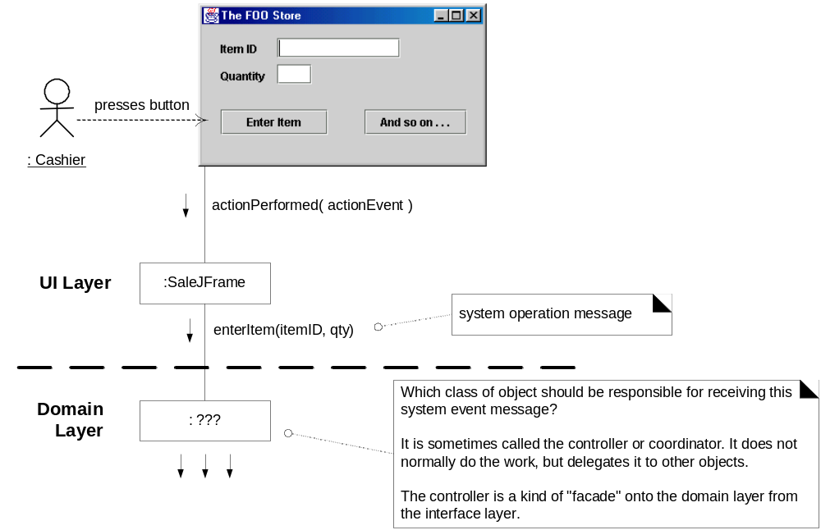
Fig. 17.21

Slide 40
Controller
Controller is a façade into domain layer from interface layer
Often use same controller class for all system events of one use case so that one can maintain state information, e.g. events must occur in a certain order
Normally controller coordinates activity but delegates work to other objects rather than doing work itself

Slide 41
Controller
Façade controller representing overall system – use when there aren’t many system events
Use case controllers – different controller for each use case

Slide 42
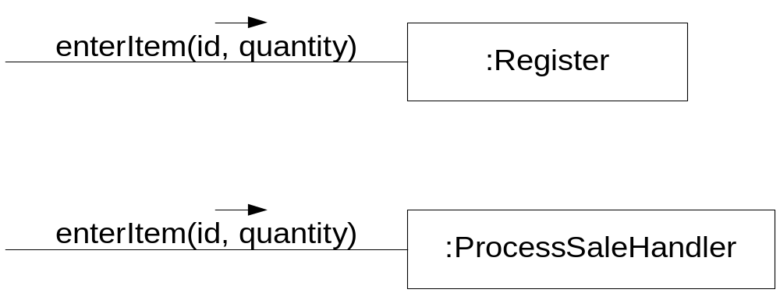
Fig. 17.22

Slide 43
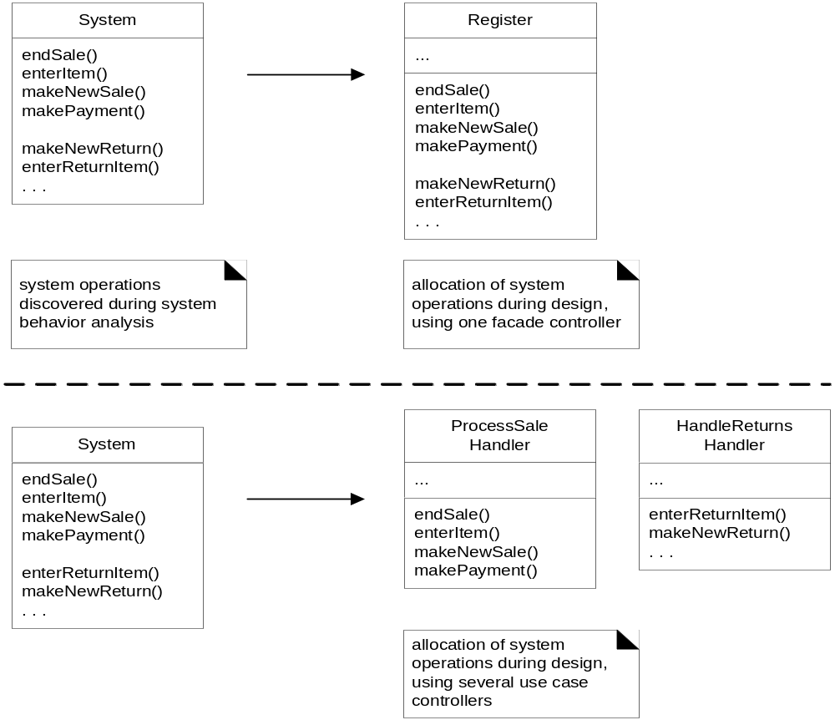
Fig. 17.23

Slide 44
Controller
Bloated controller
  Single class receiving all system events and there are many of them
  Controller performs many tasks rather than delegating them
  Controller has many attributes and maintains significant information about system which should have been distributed among other objects

Slide 45
Controller
Important note: interface objects should not have responsibility to fulfill system events (recall model-view separation principle)
Contrast Fig. 17.24 with 17.25 . . .

Slide 46
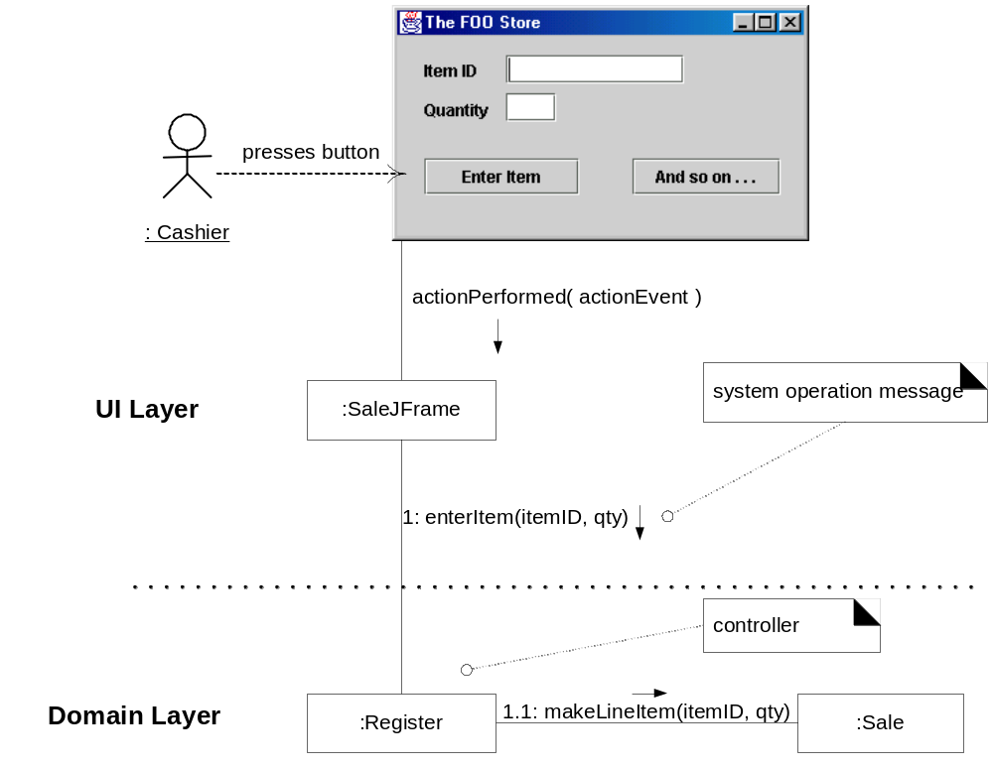
Fig. 17.24

Slide 47
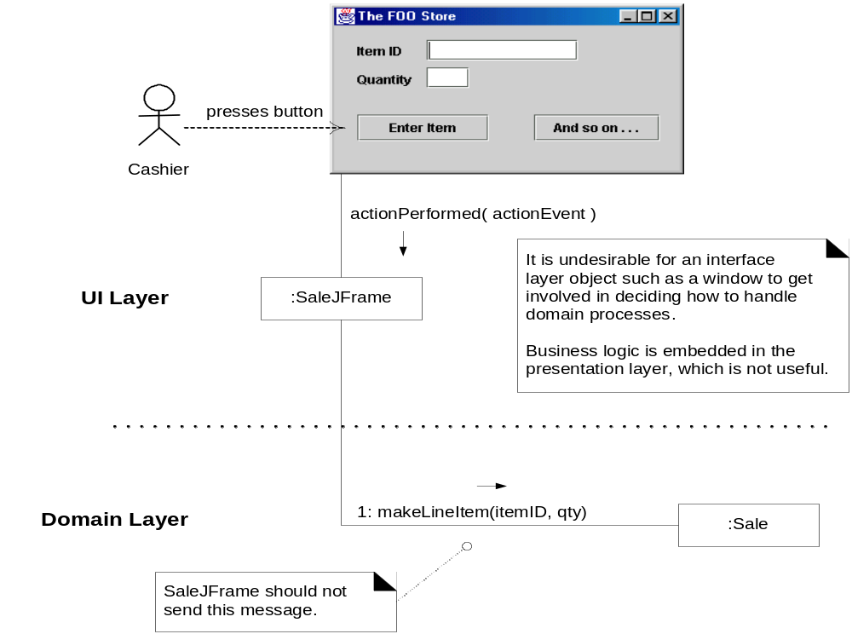
Fig. 17.25

Slide 48
High Cohesion (17.14)
Problem: How to keep complexity manageable?
Solution: Assign the responsibility so that cohesion remains high.
Cohesion – a measure of how strongly related and focused the responsibilities of an element (class, subsystem, etc.) are

Slide 49
High Cohesion
Problems from low cohesion (does many unrelated things or does too much work):
  Hard to understand/comprehend
  Hard to reuse
  Hard to maintain
  Brittle – easily affected by change

Slide 50
High Cohesion
Example: (from POS system) Who should be responsible for creating a Payment instance and associate it with a Sale?
Register creates a Payment p then sends addPayment(p) message to the Sale

Slide 51
High Cohesion
Register is taking on responsibility for system operation makePayment()
  In isolation no problem
  But if we start assigning additional system operations to Register then will violate high cohesion

Slide 52
High Cohesion
Example: (from POS system) Who should be responsible for creating a Payment instance and associate it with a Sale?
Register delegates Payment creation to the Sale

Slide 53
High Cohesion
This second approach will lead to higher cohesion for Register class.
Note: this design supports both low coupling and high cohesion
High cohesion, like low coupling, is an evaluative principle

Slide 54
High Cohesion
Consider:
  Very low cohesion – a class is responsible for many things in different functional areas
  Low cohesion – a class has sole responsibility for a complex task in one functional area
  Moderate cohesion – a class has lightweight and sole responsibilities in a few different areas that are logically related to the class concept but not to each other
  High cohesion – a class has moderate responsibilities in one functional area and collaborates with other classes to fulfill tasks

Slide 55
High Cohesion
Typically high cohesion => few methods with highly related functionality
Benefits of high cohesion:
  Easy to maintain
  Easy to understand
  Easy to reuse

Slide 56
High Cohesion & Low Coupling
High cohesion and low coupling pre-date object-oriented design (“modular design” – Liskov)
Two principles are closely related – the “yin and yang” of software engineering
Often low cohesion leads to high coupling and vice versa
There are situations where low cohesion may be acceptable (read p. 318), e.g. distributed server objects

