Slide 1
Domain Models
9.1 Introduction
The problem domain is modelled using a UML domain model:
  This is the first OO model that we will see (Use Cases are very useful but are not OO);
  The basic notation is trivial to learn but the necessary skill to create domain models is subtle;
  Figure 9.1 illustrates a domain model;
  Identifying a rich set of conceptual classes is at the heart of OO analysis;
  A domain model gives a conceptual visualisation of the problem, it shows:
    domain objects or conceptual classes
    associations between conceptual classes
    attributes of conceptual classes
  A domain model does not represent software classes : no methods, no artificial, programming-related (e.g. interface classes), classes.

Slide 2
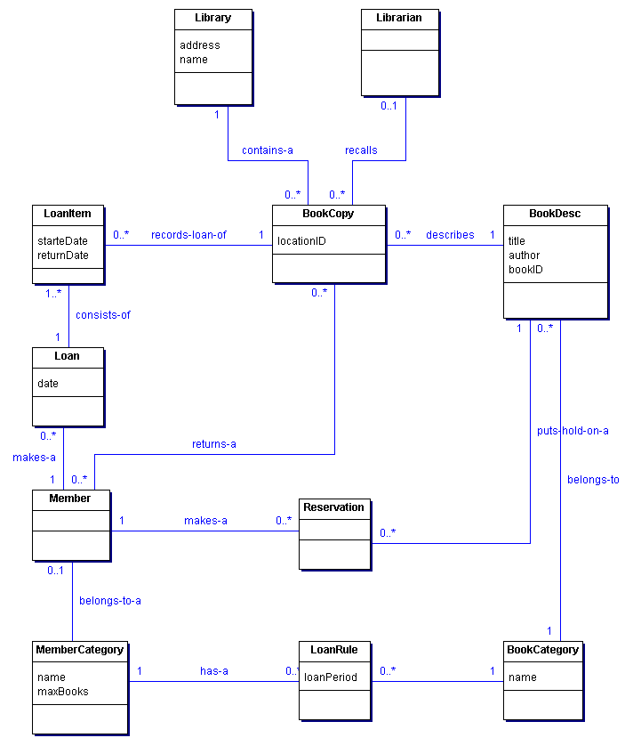
Figure 9.1 Domain Model Example

Slide 3
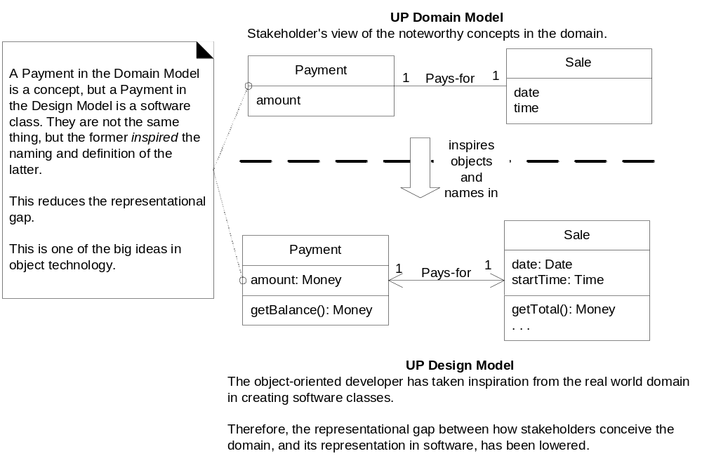
Domain models are a stepping step to design:
Figure 9.2 : From Analysis to Design

Slide 4
The investigation of the domain model is bounded (restricted to) the current iteration requirements under consideration.
9.2 How to create a Domain Model?
Given the current requirements under consideration:
  Find the conceptual classes.
  Draw them as classes in a UML class diagram.
  Add associations and attributes.
9.3 How to Find Conceptual Classes?
3 main strategies:
  Reuse or modify existing models! (do this as much as possible!);
  Think hard and use a category list;
  Identify noun phrases in requirements;
All 3 strategies should be used initially :
  even if that leads to much overlapping;
  it should not take too long anyway;
  best way to arrive at a rich set of conceptual classes;

Slide 5
9.3.1 Using a Category List
Use a list of categories and see if they apply within your problem domain : this yields candidate conceptual classes.
Conceptual Class Category | Examples
business transactions Guideline: These are critical (they involve money), so start with transactions. | Sale, Payment Reservation
transaction line items Guideline: Transactions often come with related line items, so consider these next. | SalesLineItem
product or service related to a transaction or transaction line item Guideline: Transactions are for something (a product or service). | Item Flight, Seat, Meal
where is the transaction recorded? Guideline: Important. | Register, Ledger
roles of people or organizations related to the transaction; actors in the use case Guideline: We usually need to know about the parties involved in a transaction. | Cashier, Customer, Store MonopolyPlayer Passenger, Airline

Slide 6
Continued …
Conceptual Class Category | Examples
place of transaction; place of service | Store Airport, Plane, Seat
noteworthy events, often with a time or place we need to remember | Sale, Payment MonopolyGame Flight
physical objects Guideline: This is especially relevant when creating device-control software, or simulations. | Item, Register Board, Piece, Die Airplane
descriptions of things | ProductDescription FlightDescription
catalogs Guideline: Descriptions are often in a catalog. | ProductCatalog FlightCatalog
containers of things (physical or information) | Store, Bin Board Airplane
things in a container | Item Square (in a Board) Passenger
other collaborating systems | CreditAuthorizationSystem AirTrafficControl

Slide 7
Continued …
Conceptual Class Category | Examples
records of finance, work, contracts, legal matters | Receipt, Ledger MaintenanceLog
financial instruments | Cash, Check, LineOfCredit TicketCredit
schedules, manuals, documents that are regularly referred to in order to perform work | DailyPriceChangeList RepairSchedule
9.3.2 Using a Noun Phrases Identification
Requirements must be read very closely (especially fully-dressed use cases) and nouns or sequences of nouns identified:
  This yields candidate conceptual classes.
Example from the Process Sale fully dressed use case (see previous separate document): note that we restrict ourselves to current requirements (e.g. cash payment only)

Slide 8
Main Success Scenario (or Basic Flow):
1. Customer arrives at POS checkout with goods and/or services to purchase.
2. Cashier starts a new sale.
3. Cashier enters item identifier.
4. System records sale line item and presents item description, price, and running total. Price calculated from a set of price rules.
Cashier repeats steps 3-4 until indicates done.
5. System presents total with taxes calculated.
6. Cashier tells Customer the total, and asks for payment.
7. Customer pays and System handles payment.
8. System logs completed sale and sends sale and payment information to the external Accounting system (for accounting and commissions) and Inventory system (to update inventory).
9. System presents receipt.
10. Customer leaves with receipt and goods (if any).
Extensions (or Alternative Flows): […]
7a. Paying by cash:
Cashier enters the cash amount tendered.
System presents the balance due, and releases the cash drawer.
Cashier deposits cash tendered and returns balance in cash to Customer.
System records the cash payment

Slide 9
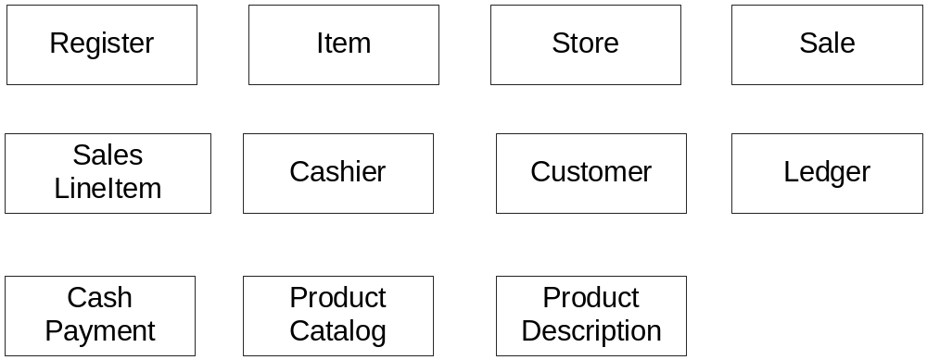
Using these approaches we end up with candidate conceptual classes:
  Some will be outside the current requirements (e.g. price rules);
  Some will be redundant (e.g. goods is better described by item);
  Some will be attributes of concepts rather than concepts themselves (e.g. price);
9.3.3 POS Conceptual Classes
There is no correct list of conceptual classes! (but see Figure 9.3 anyway)
Figure 9.3 Initial POS Domain Model

Slide 10
We can also model un-real world problems: E.g. in a telecommunication domain: Message, Connection, Port, Dialog, Route, Protocol would be candidate conceptual classes.
In the POS application should Receipt be a conceptual class?
  A receipt is certainly noteworthy (allows refunds) : FOR;
  All the information (? Sure ? E.g. receipt number; or should that be Sale number) on the receipt is however derived from other conceptual classes (from Sale) : AGAINST;
  Returns are not being considering in this iteration : AGAINST;
  So we won’t include it now: it may be needed when considering the Handle Returns use case (Make a note to that effect)
Use terminology (e.g. names of concepts, descriptions of use cases) that make sense in the application context.

Slide 11
Common mistake in a domain model; representing something as an attribute when it should be a concept:
  Guideline: if something is not a number or a string then it is probably a conceptual class, not an attribute.
  E.g.
Sale
Sale
Store
Or …
store
phoneNumber
  Here, since a store can have many interesting attributes (it is not a simple string) it should be made a separate concept.

Slide 12
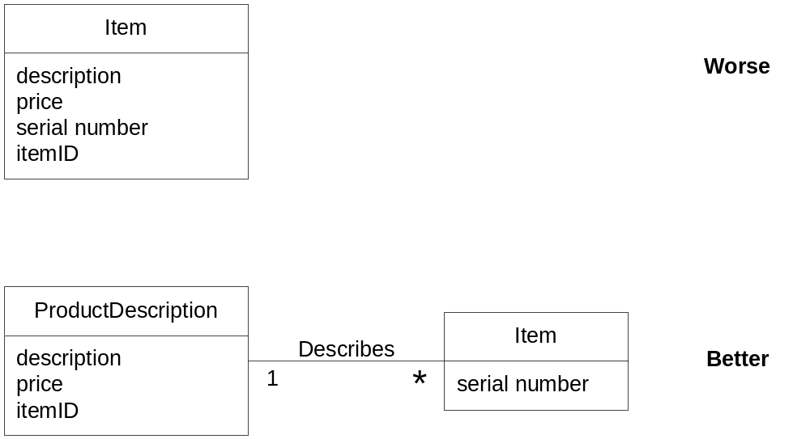
Think about description classes when creating an initial list of conceptual classes (or during refactoring):
  A description class contains information that describes something else;
  E.g.
  Why is it better?

Slide 13
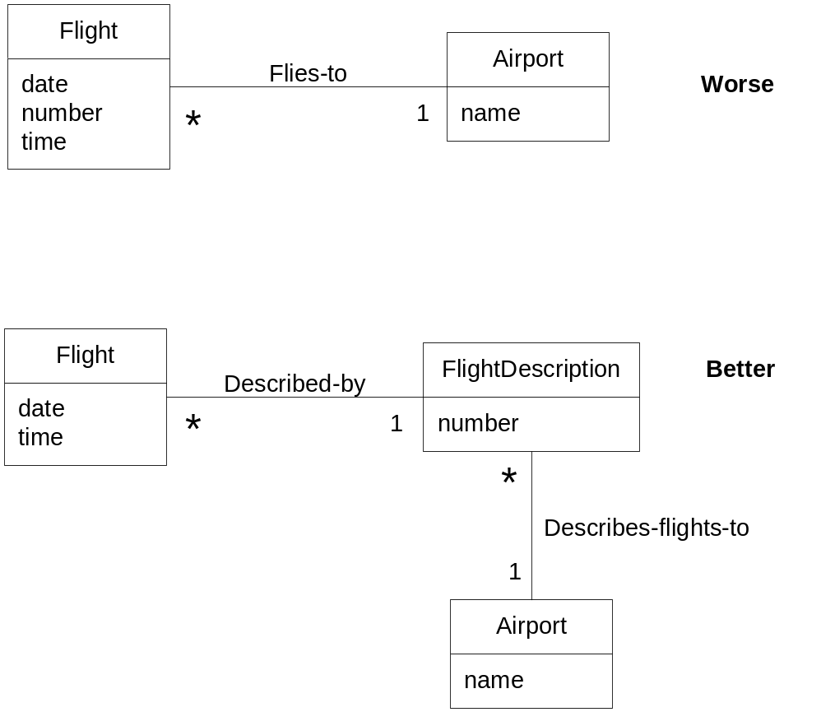
  Add a description class (for example, ProductDescription) when:
    There needs to be a description about an item or service, independent of the current existence of any examples of those items or services.
    Deleting instances of things they describe (for example, Item) results in a loss of information that needs to be maintained, but was incorrectly associated with the deleted thing.
    It reduces redundant or duplicated information.
  Another example:

Slide 14
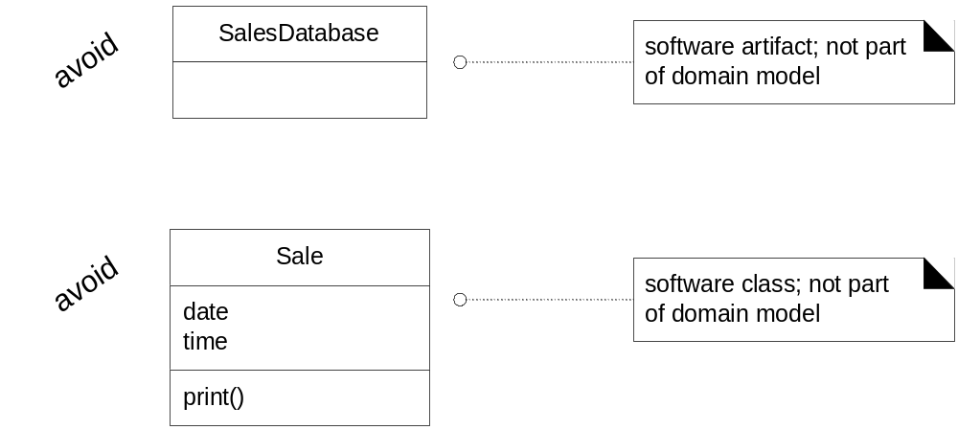
Another common mistake is to include a database concept: whether some of the information will be held in a database is a design decision (it is an implementation detail) : it is wrong to include it in a domain model.

Slide 15
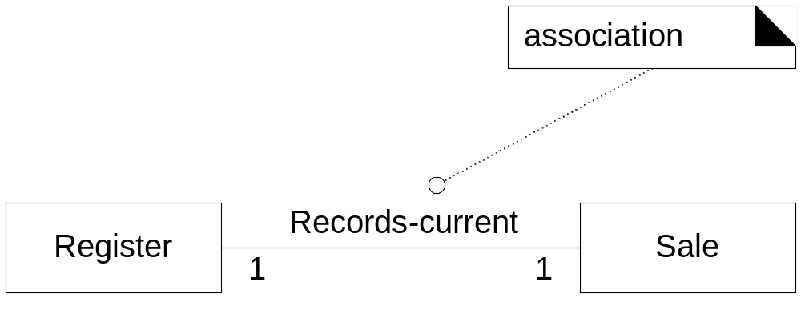
9.4 Associations
An association is a relationship between classes that indicate some meaningful and interesting relationship:
We must discover all associations the application needs to preserve for some duration (even if it is only for a few milliseconds) and discard all other, theoretical, associations (that simply do not make sense) in our domain model.
For example, we do need to remember what SalesLineItem instances are associated with a Sale. For the monopoly domain we need to remember what Square a Piece is on.

Slide 16
On the other hand, while a Cashier may do a product look-up via a POS terminal, the system has no need to remember the fact that a Cashier has looked-up a particular ProductDescription: this is an important remark; associations are not there to record actions that actors may perform; they are there to support the information requirements of the processes that need to be implemented.
We must only focus on the “need to remember” associations to avoid adding too many associations.
Eventually, the associations that we discover will likely end up being implemented as path of navigability between objects (using pointers to objects) : but we should not worry about this during OOA.
See figure 9.5 for association notation in the UML.
The ends of an association may contain a multiplicity expression indicating the numerical relationship between instances of the classes.

Slide 17
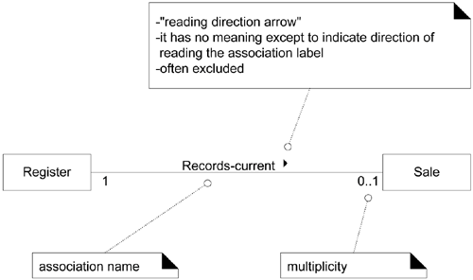
An association is inherently bidirectional, meaning that from instances of either class, logical traversal to the other is possible.
An optional "reading direction arrow" indicates the direction to read the association name; it does not indicate direction of visibility or navigation (if absent, the default reading directions are from left to right or top to bottom).
Figure 9.5 : Associations in UML

Slide 18
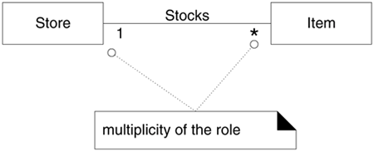
Properly naming associations is important to enhance understanding: name an association based on a ClassName-VerbPhrase-ClassName format where the verb phrase creates a sequence that is readable and meaningful. (e.g. ‘Sale Paid-by CashPayment’)
Each end of an association is called a role. Roles may optionally have:
  multiplicity expression
  name (to clarify meaning)
  navigability (not relevant during OOA)
Multiplicity defines how many instances of a class A can be associated with one instance of a class B:

Slide 19

The multiplicity value communicates how many instances can be validly associated with another, at a particular moment, rather than over a span of time. For example, it is possible that a used car could be repeatedly sold back to used car dealers over time. But at any particular moment, the Car is only Stocked-by one Dealer. No Car can be Stocked-by many Dealers at any particular moment.
See Fig 9.6 for examples of UML multiplicity values.
Adding multiplicity values to the roles of an association helps exploring the problem domain.
Two classes may have multiple associations between them in a UML class diagram; this is not uncommon:

Slide 20
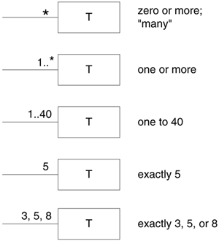
Figure 9.6 Multiplicity Values

Slide 21
9.4.1 How to Find Associations?
Two main ways:
  By reading the current, relevant, requirements and asking ourselves what information is needed to fulfil these requirements: what need to know associations are necessary given our current list of candidate concepts?
  Using a list of association categories.
Association Category | Examples
A is a transaction related to another transaction B | CashPayment-Sale Cancellation-Reservation
A is a line item of a transaction B | SalesLineItem-Sale
A is a product or service for a transaction (or line item) B | Item-SalesLineItem Flight-Reservation
A is a role related to a transaction B | Customer-Payment Passenger-Ticket
A is a physical or logical part of B | Drawer-Register Square-Board Seat-Airplane

Slide 22
Continued …
Association Category | Examples
A is physically or logically contained in/on B | Register-Store Item-Shelf Square-Board Passenger-Airplane
A is a description for B | ProductDescription-Item FlightDescription-Flight
A is known/logged/recorded/reported/captured in B | Sale-Register Piece-Square
A is a member of B | Customer-Payment Passenger-Ticket
A is an organizational subunit of B | Cashier-Store Player-MonopolyGame Pilot-Airline
A is an organizational subunit of B | DepartmentStore MaintenanceAirline

Slide 23
Continued …
Association Category | Examples
A uses or manages or owns B | Cashier-Register Player-Piece Pilot-Airplane
A is next to B | SalesLineItem-SalesLineItem Square-Square City-City
9.4.2 Case Studies
Using the techniques seen we can create a partial domain model for the POS: see Figure 9.7
See Figure 9.8 for the Monopoly case study.

Slide 24
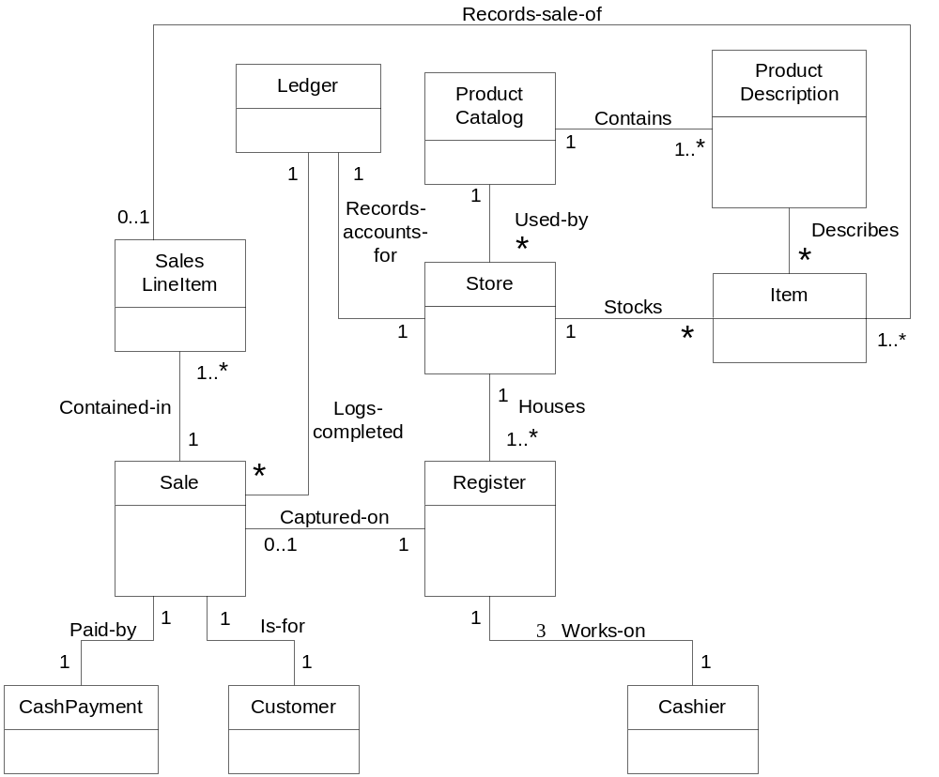
Figure 9.7 : Partial POS Domain Model

Slide 25
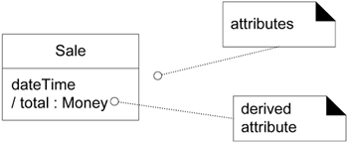
9.5 Attributes
Include attributes that the requirements (for example, use cases) suggest or imply a need to remember information.
For example, a receipt (which reports the information of a sale) in the Process Sale use case normally includes a date and time, the store name and address, and the cashier ID, among many other things. Therefore,
  Sale needs a dateTime attribute.
  Store needs a name and address.
  Cashier needs an ID.
Attributes type and other information may optionally be shown.

Slide 26
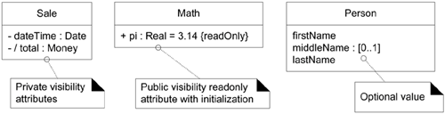
The full syntax for an attribute in the UML is:
visibility name : type multiplicity = default {property-string}
Examples:
{readOnly} is probably the most common property string for attributes. Private visibility (-) is usually implicit.
Attribute multiplicity can be used to indicate the optional presence of a value, or the number of objects that can fill a (collection) attribute.

Slide 27
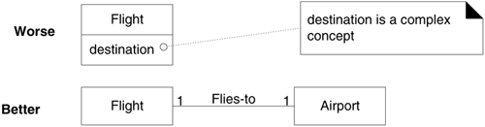
Derived Attributes : The total attribute in the Sale can be calculated or derived from the information in the SalesLineItems. When we want to communicate that 1) this is a noteworthy attribute, but 2) it is derivable, we use the UML convention: a / symbol before the attribute name.
Primitive data types : attribute types should be what are often thought of as "primitive" data types, such as numbers and booleans. The type of an attribute should not normally be a complex domain concept, such as a Sale or Airport. Nor should they be list of objects or other attributes.
A common mistake is to model complex information as an attribute when it should be a conceptual class:

Slide 28
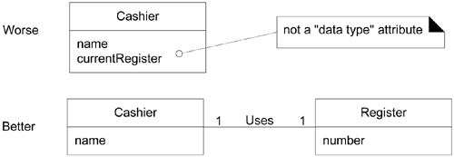
Another mistake is to relate conceptual classes with an attribute rather than with an association (“foreign key” syndrome):
Sometimes what appear as a simple data value (using a primitive type such as a string) is actually more complex:
  We should then create Data Type Classes;
  For example, a Unique Product Code is not just a number : it has subparts (e.g. contains a manufacturer digit), or can have operations performed on it (e.g. a checksum for validation);
  An address has subparts.

Slide 29
Guideline : when should we create new Data Type Classes? Represent what may initially be considered a number or string as a new data type class in the domain model if:
  It is composed of separate sections.
    phone number, name of person
  There are operations associated with it, such as parsing or validation.
    social security number
  It has other attributes.
    promotional price could have a start (effective) date and end date
  It is a quantity with a unit.
    payment amount has a unit of currency
  It is an abstraction of one or more types with some of these qualities.
    item identifier in the sales domain is a generalization of types such as Universal Product Code (UPC) and European Article Number (EAN)
Examples within the POS case study: See Figure 9.9

Slide 30
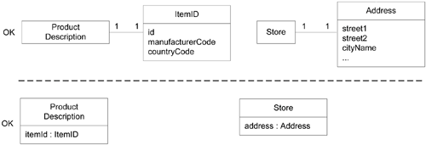
Figure 9.9 : Different Ways to Represent Data Type Classes in the UML
Quantities often also need good modeling : to say that the price is 13 is not very useful …
Figure 9.10 illustrates different ways to model quantities in a domain model.

Slide 31
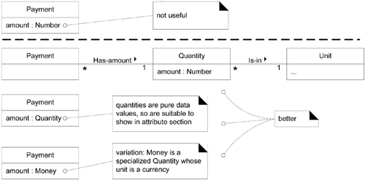
Figure 9.10 Modeling Quantities
9.5.1 Domain Models with Attributes
For the POS most of the attributes can be obtained by analysing the use case under consideration: see figure 9.11

Slide 32
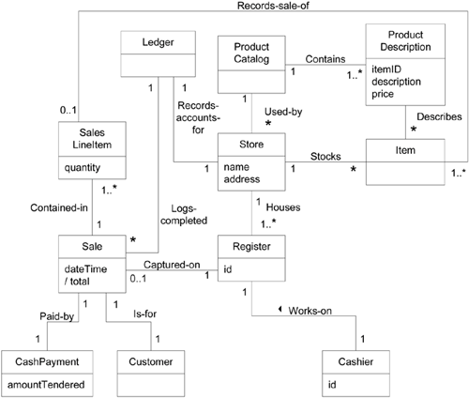
Figure 9.11 POS Partial Domain Model

Slide 33

Note that itemID can thought of as a data type class:

Slide 34
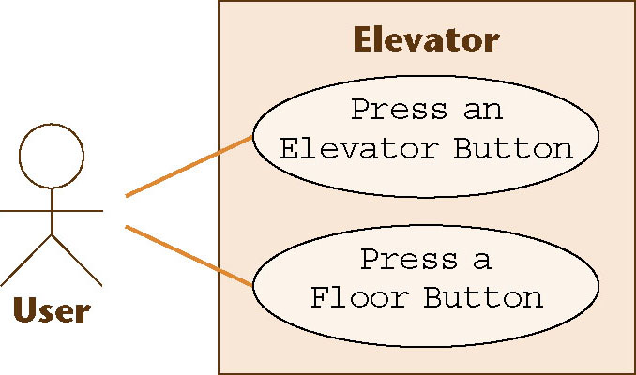
Noun Extraction
A two-stage process
Stage 1. Concise problem definition
  Describe the software product in single paragraph
  Buttons in elevators and on the floors control the movement of n elevators in a building with m floors. Buttons illuminate when pressed to request the elevator to stop at a specific floor; the illumination is canceled when the request has been satisfied. When an elevator has no requests, it remains at its current floor with its doors closed

Slide 35
Noun Extraction (contd)
Stage 2. Identify the nouns
  Identify the nouns in the informal strategy
  Buttons in elevators and on the floors control the movement of n elevators in a building with m floors. Buttons illuminate when pressed to request the elevator to stop at a specific floor; the illumination is canceled when the request has been satisfied. When an elevator has no requests, it remains at its current floor with its doors closed
Use the nouns as candidate classes

Slide 36
Noun Extraction (contd)
Nouns
  button, elevator, floor, movement, building, illumination, request, door
  floor, building, door are outside the problem boundary — exclude
  movement, illumination, request are abstract nouns — exclude (they may become attributes)
Candidate classes:
  Elevator Class and Button Class
Subclasses:
  Elevator Button Class and Floor Button Class

Slide 37
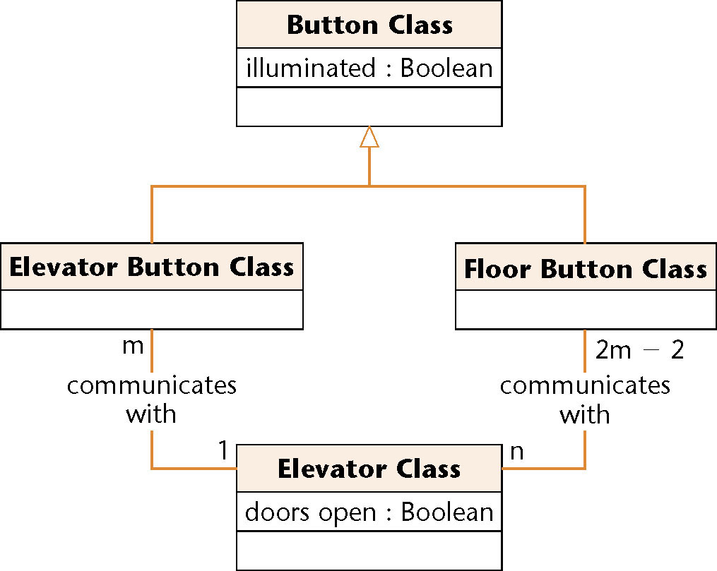
First Iteration of Class Diagram
Figure 12.5
Problem
  Buttons do not communicate directly with elevators
  We need an additional class: Elevator Controller Class

Slide 38
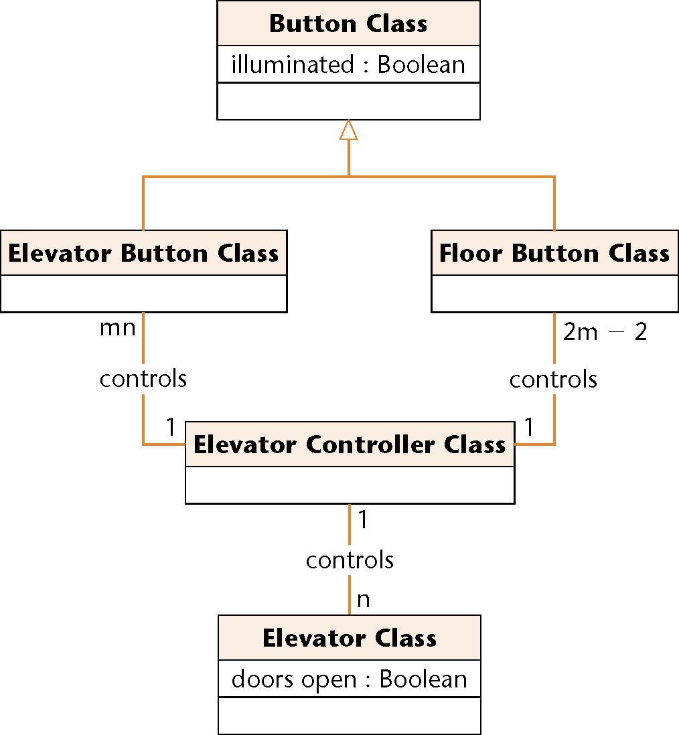
Second Iteration of Class Diagram
All relationships are now 1-to-n
  This makes design and implementation easier
Figure 12.6

Slide 39
9.6 Process: Iterative and Evolutionary Domain Modelling
In iterative development, we incrementally evolve a domain model over several iterations. In each, the domain model is limited to the prior and current scenarios under consideration, rather than expanding to a "big bang" waterfall-style model that early on attempts to capture all possible conceptual classes and relationships. For example, this POS iteration is limited to a simplified cash-only Process Sale scenario; therefore, a partial domain model will be created to reflect just that not more.
See Separate document for details of the Domain Model within the UP.

Slide 40
9.7 Conclusions
Domain modeling is a very important activity in OOA. We must ensure that the model built will be able to withstand the information requirements of the current iteration.
As we will build on this model to obtain the design (and later the code of course) it is obviously an important artefact.
In addition, the model will grow in subsequent iterations are more requirements are examined.
Identifying a rich set of conceptual classes is at the heart of OO analysis: the notation is simple domain modeling isn’t.

