Slide 1

MARKET SEGMENTATION
2
+
2
+
REPORT ON EXPLORATORY DATA ANALYSIS AND MODEL DEVELOPMENT

Slide 2

OUTLINE
2
+
Introduction
Metadata
Objectives
Exploratory Data Analysis
Model Report
Findings
Next steps

Slide 3

INTRODUCTION
2
+
Market segmentation is a marketing strategy that involves dividing a broad target market into subsets of consumers who share common needs, characteristics, behaviors, or demographics. The goal of segmentation is to tailor marketing efforts and products to better meet the specific needs and preferences of each segment, thereby increasing the effectiveness of marketing campaigns.

Slide 4
METADATA
The sample Dataset summarizes the usage behavior of about 9000 active credit cardholders during the last 6 months.
Customer ID: Unique identifier for each customer.
Balance: The outstanding balance amount on the credit card.
Balance Frequency: Frequency of updating the balance.
Purchases: Total amount of purchases made using the credit card.
One-off Purchases: Amount spent on one-time purchases using the credit card.
Installment Purchases: Amount spent on purchases made in installments.
Cash Advance: Total amount of cash advances taken using the credit card.
Purchases Installments Frequency: Frequency of making purchases in installments.
Cash Advance Frequency: Frequency of taking cash advances.
Cash Advance TRX: Number of cash advance transactions.
Purchases TRX: Number of purchase transactions.
Credit Limit: The maximum amount that can be charged on the credit card.
Payments: Total amount of payments made by the customer.
Minimum Payments: The minimum amount required to be paid by the customer.
PRC Full payment: Percentage of the full credit card payment paid by the customer.
Tenure: The duration for which the customer has held the credit card (in months).
Purchases Frequency: Frequency of making purchases using the credit card
One-off Purchases Frequency: Frequency of making one-time purchases.

Slide 5
OBJECTIVE
2
+
This case requires developing a customer segmentation to give recommendations like saving plans, loans, wealth management on target customer groups.

Slide 6
EXPLORATORY DATA ANALYSIS
Insights from Exploratory analysis
Balance for most customers falls between 0 – 2,500 with an average of 1,564
Customers with high balance and high number of purchases tend to have high credit limit.
There is no significant relationship between tenure and credit limit, meaning the duration a customer uses this credit card service doesn’t necessarily affect the credit limit.
Most of the customers have been associated the credit card company for 12 months.

Slide 7
Model report
Several Clustering models were built using Kmeans, Agglomerative Clustering and Mean Shift.
The best model for our objective was Kmeans with 3 clusters.
To ascertain the best number of cluster Elbow method was used as shown in the chart.

Slide 8
FINDINGS
Cluster 0: Customers that makes a lot of purchase and barely take cash advance.
Cluster 1: Customers take a lot of cash advance using their credit cards but make few purchases
Cluster 2: Customers with high number of purchases and take a lot of cash advance using their credit cards.

Slide 9

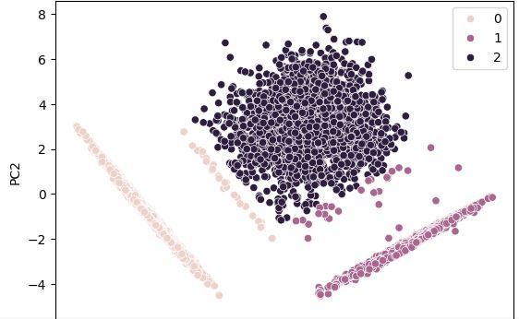
PCA REPRESNTATION OF THE CLUSTERS

Slide 10
NEXT STEPS
Using this segmentation of customers marketing efforts and campaigns can be carried out to better meet the specific needs and preferences of customers in each segment. Recommendations includes saving plans, discounts on purchases, loans and wealth management.

Slide 11
THANK YOU
2
+
2
+

