Slide 1
01 / TRACK 2 — HEALTH AND WELLBEING
A clearer path
to discharge.
ClearPath — AMD-assisted discharge coordination
One reviewable workflow for drafts, approvals, and findings.
Synthetic-data prototype · Human approval remains explicit.
CLEARPATH / DISCHARGE COORDINATION
01 / 07
Notes:
ClearPath — AMD-assisted discharge coordination
One reviewable workflow for drafts, approvals, and findings.
Synthetic-data prototype · Human approval remains explicit.

Slide 2
02 / THE PROBLEM
A change should not
leave approval behind.
Built for the discharge coordinator
Clinical documentation, pharmacy, and billing depend on shared information.
A corrected draft can make earlier approvals and findings outdated.
Coordinators need to see what is current and what still needs review.
CLEARPATH / DISCHARGE COORDINATION
02 / 07
Notes:
Built for the discharge coordinator
Clinical documentation, pharmacy, and billing depend on shared information.
A corrected draft can make earlier approvals and findings outdated.
Coordinators need to see what is current and what still needs review.

Slide 3
03 / THE WORKFLOW
Review once.
Check together.
An explicit sequence with visible outcomes
1 Generate a draft with DeepSeek-V4-Flash through the configured AMD API.
2 Approve the specific revision under review.
3 Run independent pharmacy and billing checks concurrently.
4 Return findings for human review; persist the workflow.
CLEARPATH / DISCHARGE COORDINATION
03 / 07
Notes:
An explicit sequence with visible outcomes
1 Generate a draft with DeepSeek-V4-Flash through the configured AMD API.
2 Approve the specific revision under review.
3 Run independent pharmacy and billing checks concurrently.
4 Return findings for human review; persist the workflow.

Slide 4
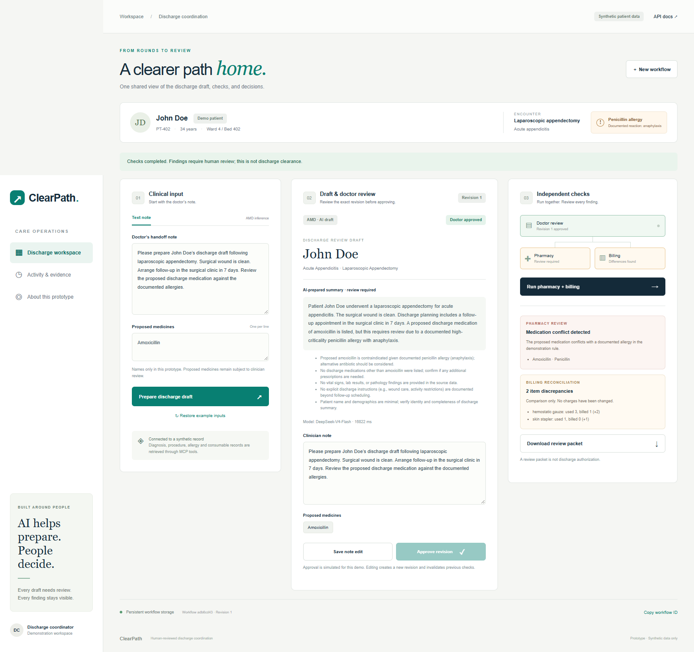
04 / THE DEMO
A real workflow.
Visible findings.
Actual AMD-assisted run · synthetic patient
AMD-assisted draft reviewed before independent checks.
Deterministic MCP tools return pharmacy and billing findings.
Human-review packet. No autonomous discharge clearance.
CLEARPATH / DISCHARGE COORDINATION
04 / 07
Notes:
Actual AMD-assisted run · synthetic patient
AMD-assisted draft reviewed before independent checks.
Deterministic MCP tools return pharmacy and billing findings.
Human-review packet. No autonomous discharge clearance.

Slide 5
05 / THE DESIGN
Every result belongs
to a revision.
Traceable state changes are the core of the prototype
Edits invalidate the previous approval and stored findings.
Revision checks reject results that became stale while workers ran.
SQLite restores saved snapshots after restart.
Interrupted work becomes a visible failure and can be retried.
CLEARPATH / DISCHARGE COORDINATION
05 / 07
Notes:
Traceable state changes are the core of the prototype
Edits invalidate the previous approval and stored findings.
Revision checks reject results that became stale while workers ran.
SQLite restores saved snapshots after restart.
Interrupted work becomes a visible failure and can be retried.

Slide 6
06 / THE BUILD
AMD drafts.
Rules check records.
DeepSeek-V4-Flash → human review → deterministic MCP checks
A live configured AMD endpoint call was verified using synthetic data.
FastAPI + Pydantic: validated requests and structured results.
FastMCP + asyncio: concurrent pharmacy and billing rule checks.
SQLite: persist the latest workflow snapshot and its revision.
CLEARPATH / DISCHARGE COORDINATION
06 / 07
Notes:
DeepSeek-V4-Flash → human review → deterministic MCP checks
A live configured AMD endpoint call was verified using synthetic data.
FastAPI + Pydantic: validated requests and structured results.
FastMCP + asyncio: concurrent pharmacy and billing rule checks.
SQLite: persist the latest workflow snapshot and its revision.
Evidence: submission/amd-execution-evidence.json records one successful configured API response using DeepSeek-V4-Flash. Endpoint: https://developer.amd.com.cn/radeon/api/v1. This is not hardware attestation or a clinical performance evaluation.

Slide 7
07 / THE NEXT STEP
Coordinate first.
Validate before scale.
A working foundation with an honest scope
Today: AMD-assisted drafting, synthetic records, simulated approval.
Next: authenticated reviewers and validated EHR / insurer integrations.
Next: clinical evaluation, multimodal inputs, and a complete audit history.
A successful endpoint call demonstrates integration, not clinical validation.
CLEARPATH / DISCHARGE COORDINATION
07 / 07
Notes:
A working foundation with an honest scope
Today: AMD-assisted drafting, synthetic records, simulated approval.
Next: authenticated reviewers and validated EHR / insurer integrations.
Next: clinical evaluation, multimodal inputs, and a complete audit history.
A successful endpoint call demonstrates integration, not clinical validation.

