Slide 1
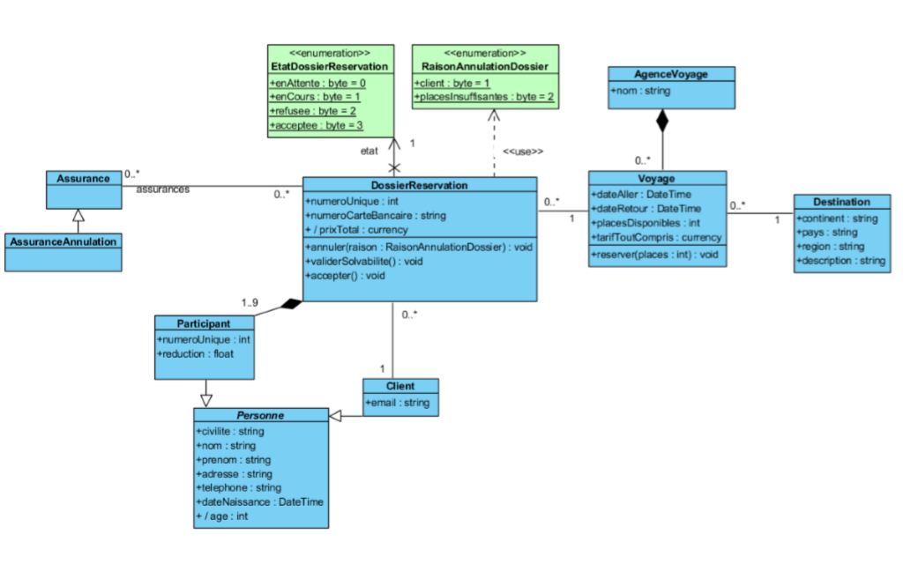
PK
1
1
4
3
PK, FKAnnul
FKAss,
FKDoss
PK
4
PK
2
FKPart,
FKDoss
PK,
FKClient, FKVoya
PK
FKDest, FKAgence
1
PK
1
2
PK
1
IDPart,
IDClient

