Slide 1

How fast things can move

Slide 2



Why do we decide to make it

Slide 3

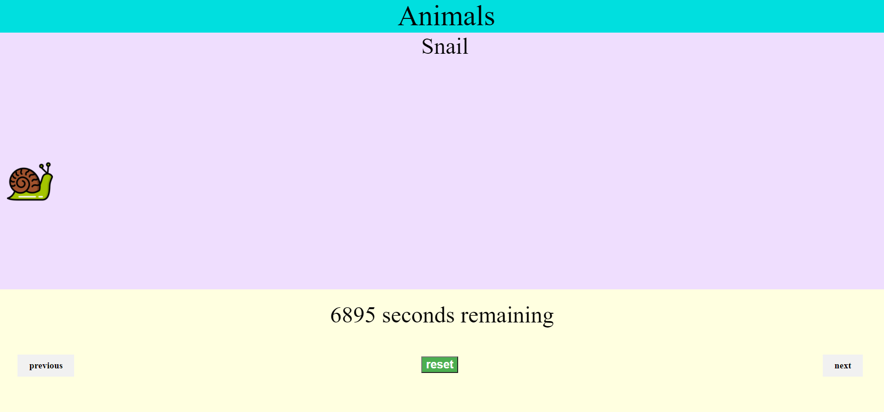
Website Example
1.
2.
3.
4.
6.
5.
7.

Slide 4



Showcase
Snail
Human
Car

Slide 5
Let’s watch our demo

