Slide 1
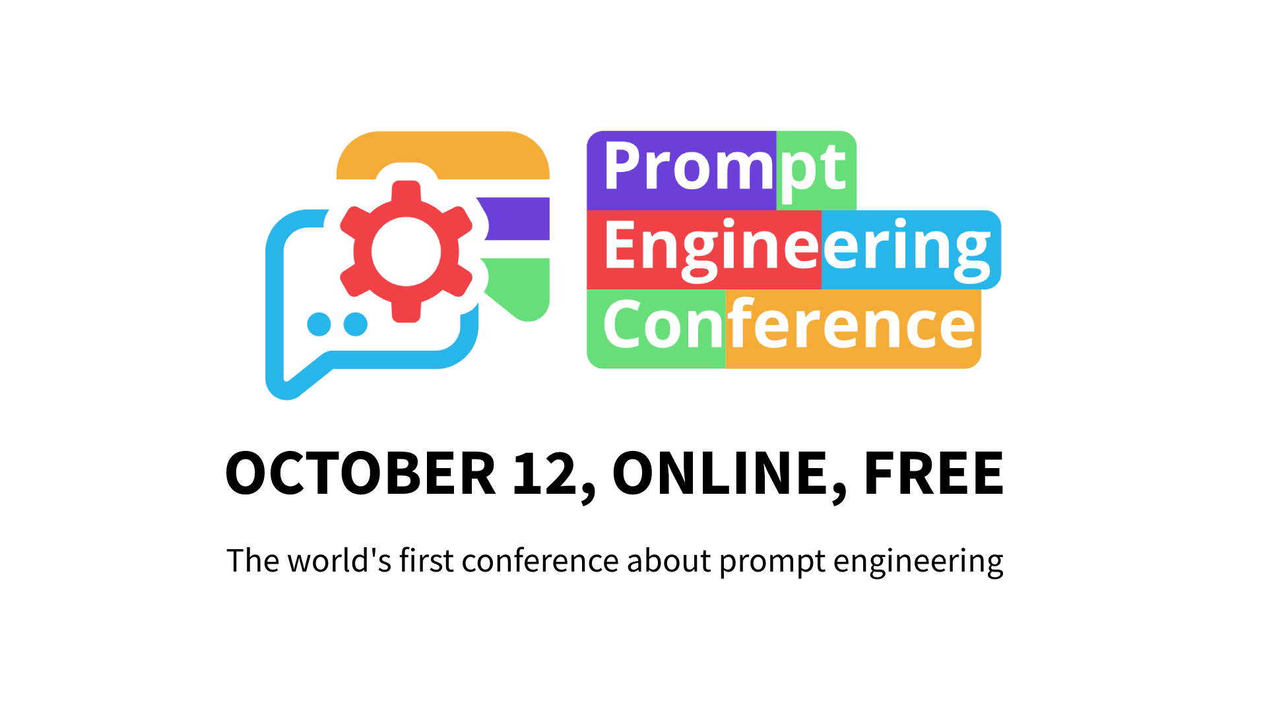
We start in a few moments…

Slide 2

Welcome to the world’s first conference about Prompt Engineering!
Notes:
Maxim

Slide 3




Confirming Prompt Engineering as an emerging discipline and an important skill
Helping you to develop prompts for the production-ready applications
Looking into the future of prompt engineering
Gathering Generative AI community
Notes:
Maxim

Slide 4
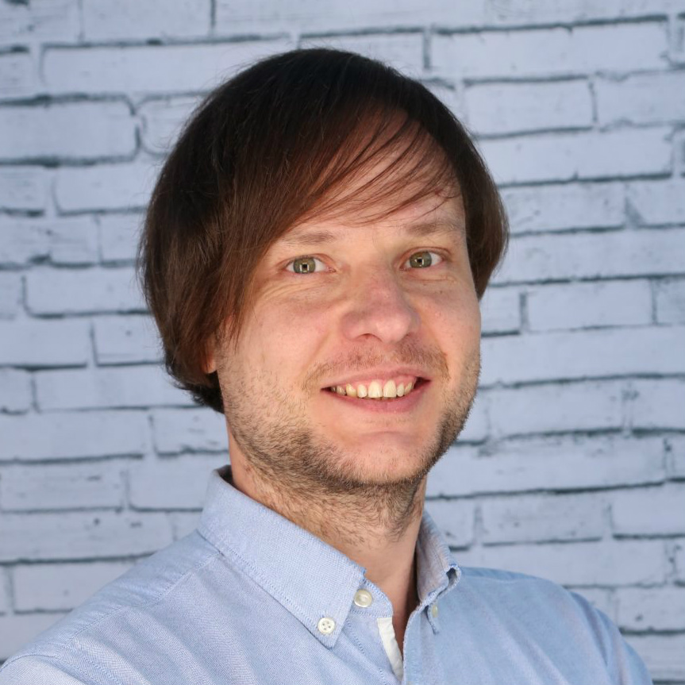
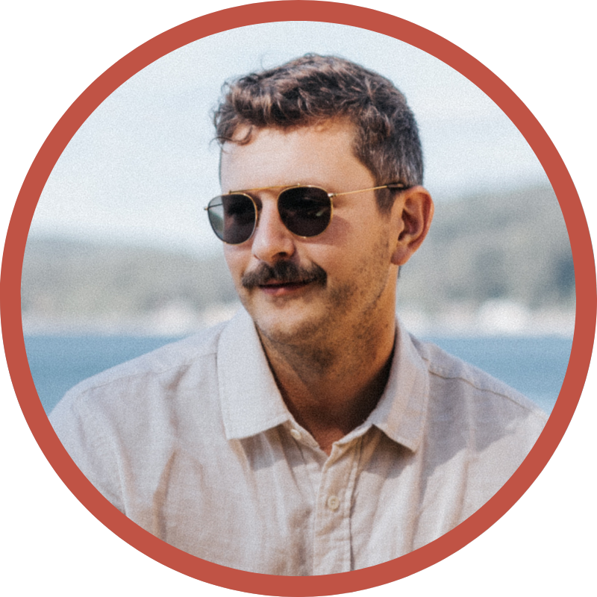

Event organizers
Maxim Salnikov
Developer Productivity @ Microsoft
Erich Hellstrom
Founder @ Prompt Perfect
Dan Cleary
Founder @ Prompt Hub
Notes:
Maxim, Erich, Dan

Slide 5
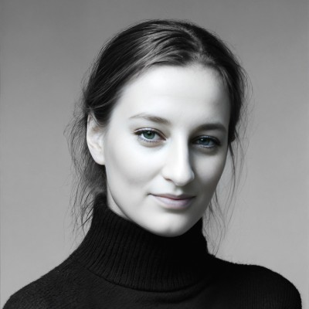
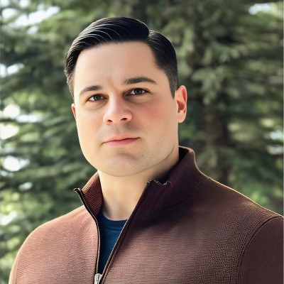
Track hosts & Q&A moderators
Goda Go
Youtuber & Podcast co-host
William (Wes) Shields
MS, MBA, Founder @ Synthminds
Notes:
Maxim

Slide 6
Key resources
Follow program:
Ask speakers:
Be social:
https://promptengineering.rocks
YouTube Chat
Twitter @PromptEngConf #PromptEngConf
Notes:
Maxim

Slide 7
Schedule: think sections
Track 1
Track 2
Section 1: 17:00 CEST, 8:00am PT
Session 1
Session 1
Session 2
Session 2
Session 3
Session 3
Q&A with speakers
Q&A with speakers
Section 2: 18:50 CEST, 9:50am PT
Session 1
Session 1
Session 2
Session 2
Session 3
Session 3
Q&A with speakers
Q&A with speakers
Section 3: 20:30 CEST, 11:30am PT
Session 1
Session 1
Session 2
Session 2
Session 3
Session 3
Q&A with speakers
Q&A with speakers
Notes:
Maxim

Slide 8
Code of Conduct
Prompt Engineering Conference is intended to be an inclusive, welcoming conference for everyone.
Prompt Engineering Conference requires everyone to be respectful to each other. Treat everyone with respect. Participate while acknowledging that everyone deserves to be here — and each of us has the right to enjoy our experience without fear of harassment, discrimination, or condescension, whether blatant or via micro-aggressions.
Report violations:
Direct messaging @PromptEngConf
Mailing hello@promptengineering.rocks
Full version: https://promptengineering.rocks/code-of-conduct
Notes:
Erich

Slide 9

Prompt Perfect optimizes your prompts in ChatGPT to ensure high-quality, relevant responses
https://promptperfect.xyz
Notes:
Erich

Slide 10

Synthminds AI is a full-service AI agency offering consulting, training, and results-driven solutions
https://synthminds.ai
Notes:
Erich

Slide 11

Test, deploy, and manage your prompts with PromptHub, a prompt management tool built for teams
https://prompthub.us
Notes:
Dan

Slide 12
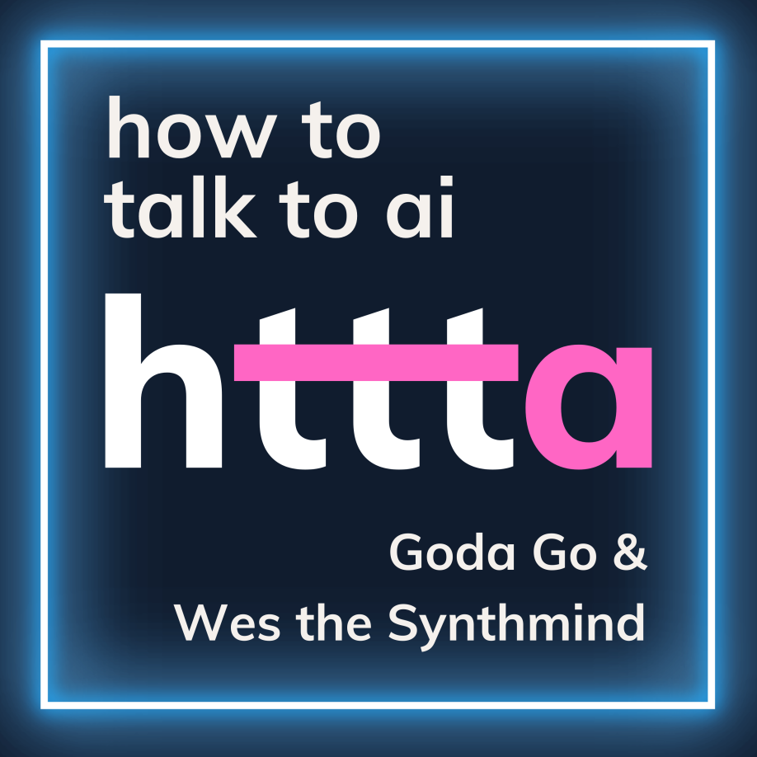
Podcast about unlocking AI’s Revolutionary Potential through Prompt Engineering
@ Spotify
Notes:
Dan

Slide 13
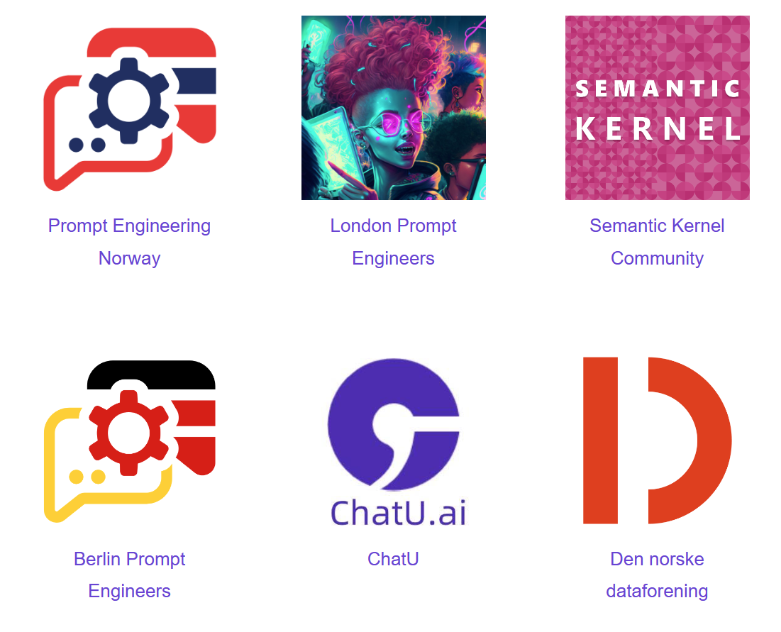
Community partners
Notes:
Dan

Slide 14
What’s next?
Track 1
(starts here)
Prompt Engineering: Democratising learning of AI - experiences from the University of Oxford
by Ajit Jaokar
Track 2
https://bit.ly/prompt-conf-track2
Navigating the Evolution of Prompt Engineering
by Stephen Perin
Notes:
Maxim

