Slide 1

That’s a wrap!
Notes:
Maxim

Slide 2
- Our speakers - Program committee - Sponsors - Community partners - All of you!
Huge thanks to:
Notes:
Maxim, Erich, Dan

Slide 3
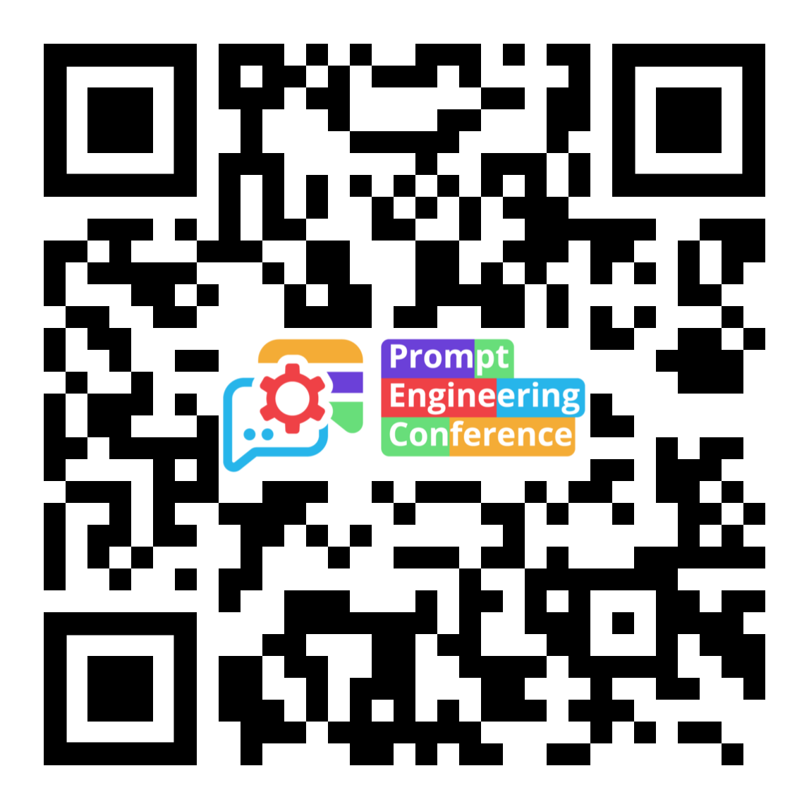
Let’s stay in touch!
Be first to learn about the next event:
Twitter @PromptEngConf
Notes:
Maxim

