Slide 1
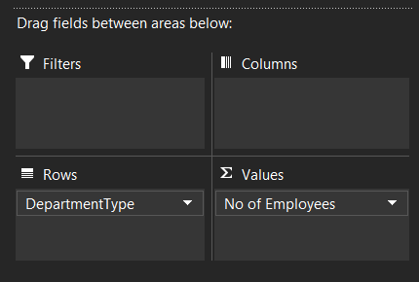
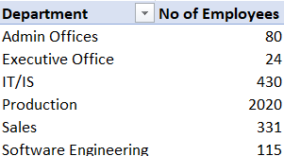
1. Can you create a pivot table to summarize the total number of employees in each department?

Slide 2
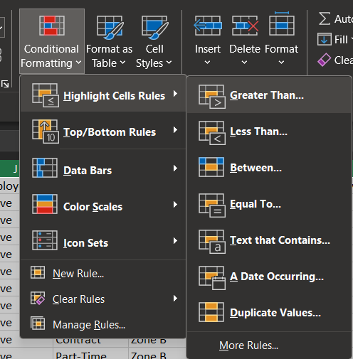
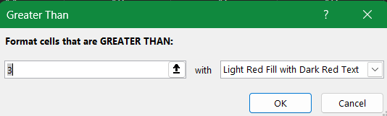
2. Apply conditional formatting to highlight employees with a "Performance Score" below 3 in red.

Slide 3
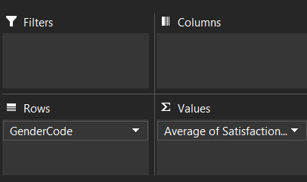

3. Calculate the average "Satisfaction Score" for male and female employees separately using a pivot table.

Slide 4
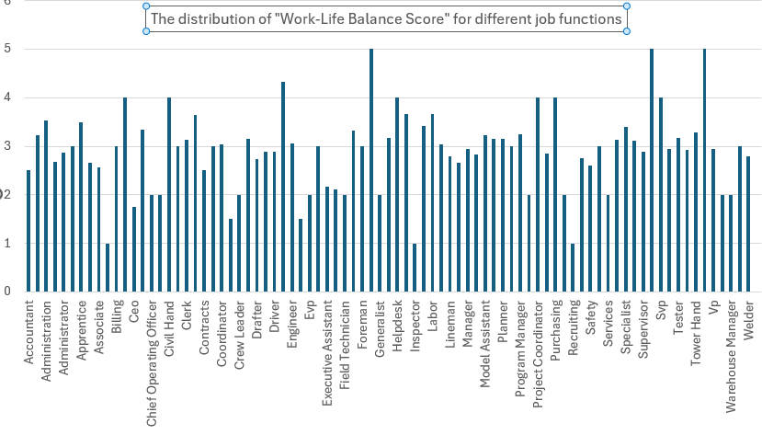
4. Create a chart to visualize the distribution of "Work-Life Balance Score" for different job functions.

Slide 5
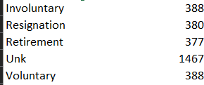
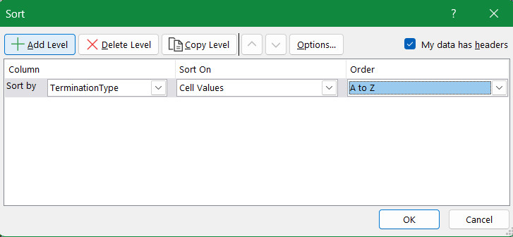
5. Filter the data to display only terminated employees and find out the most common "Termination Type."

Slide 6
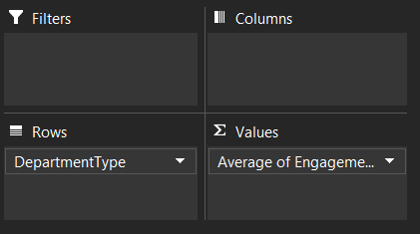
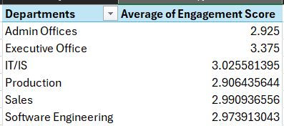
6. Calculate the average "Engagement Score" for each department using a pivot table.

Slide 7
7. Use VLOOKUP to find the supervisor's email address for a specific employee.
=VLOOKUP(G2,A2:Z3001, 8, FALSE)

Slide 8
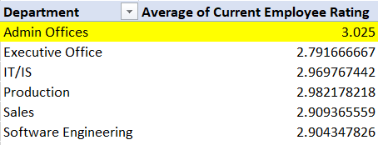
8. Can you identify the department with the highest average "Employee Rating?"

Slide 9
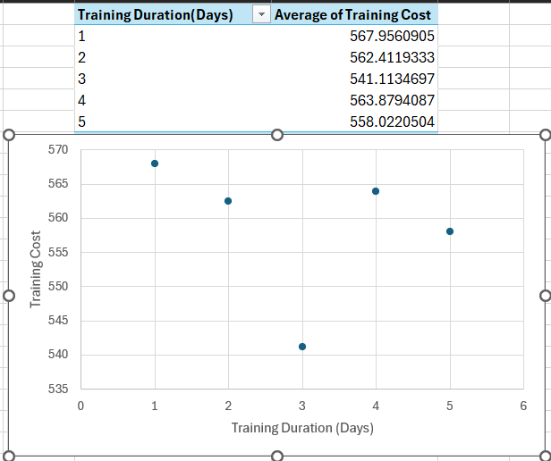
9. Create a scatter plot to explore the relationship between "Training Duration (Days)" and "Training Cost."

Slide 10
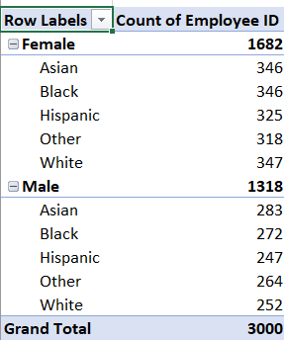
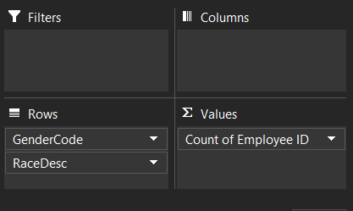
Build a pivot table that shows the count of employees by "RaceDesc" and "GenderCode.

Slide 11
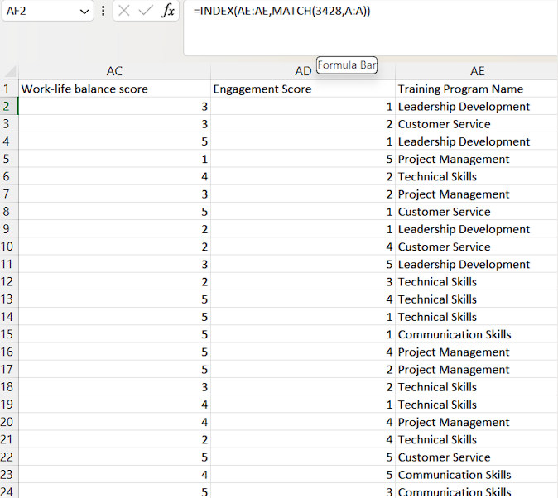
Use INDEX and MATCH functions to find the "Training Program Name" for an employee with a specific ID.
Assuming that we are looking for the training program name for an employee whose ID = 3428, the formula will be as follows: ==INDEX(AE:AE,MATCH(3428,A:A))

Slide 12
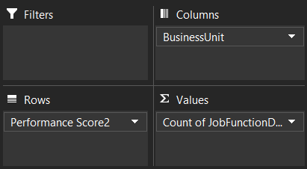
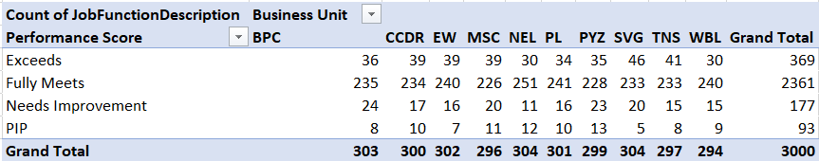
12. Create a multi-level pivot table to analyze the "Performance Score" by "BusinessUnit" and "JobFunctionDescription."

Slide 13
13. Design a dynamic chart that allows users to select and visualize the performance of any employee over time.

