Slide 1
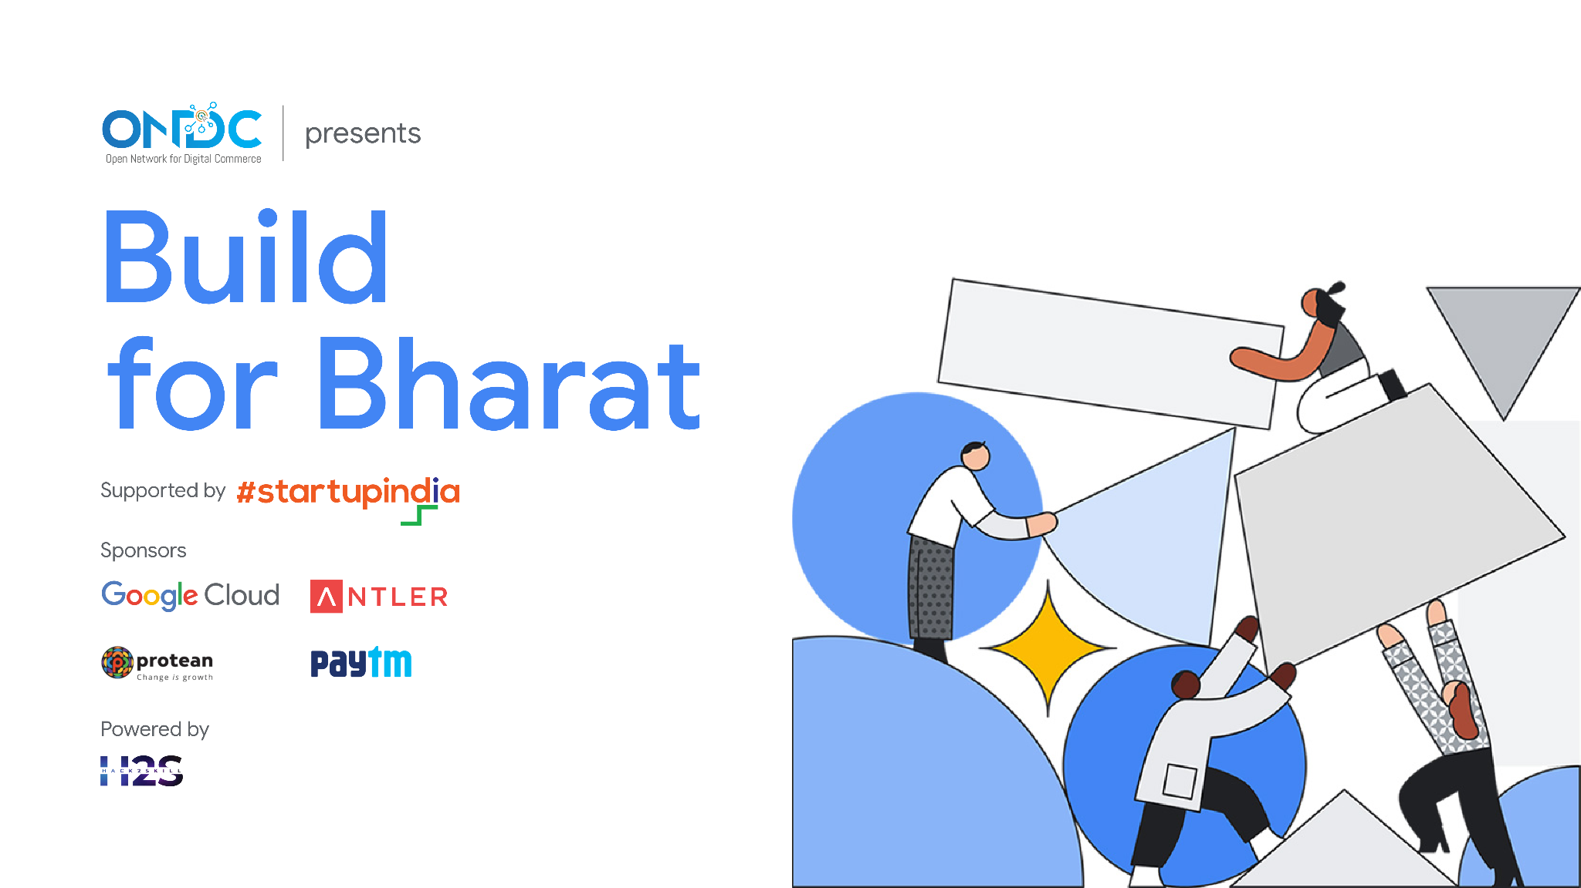

Slide 2
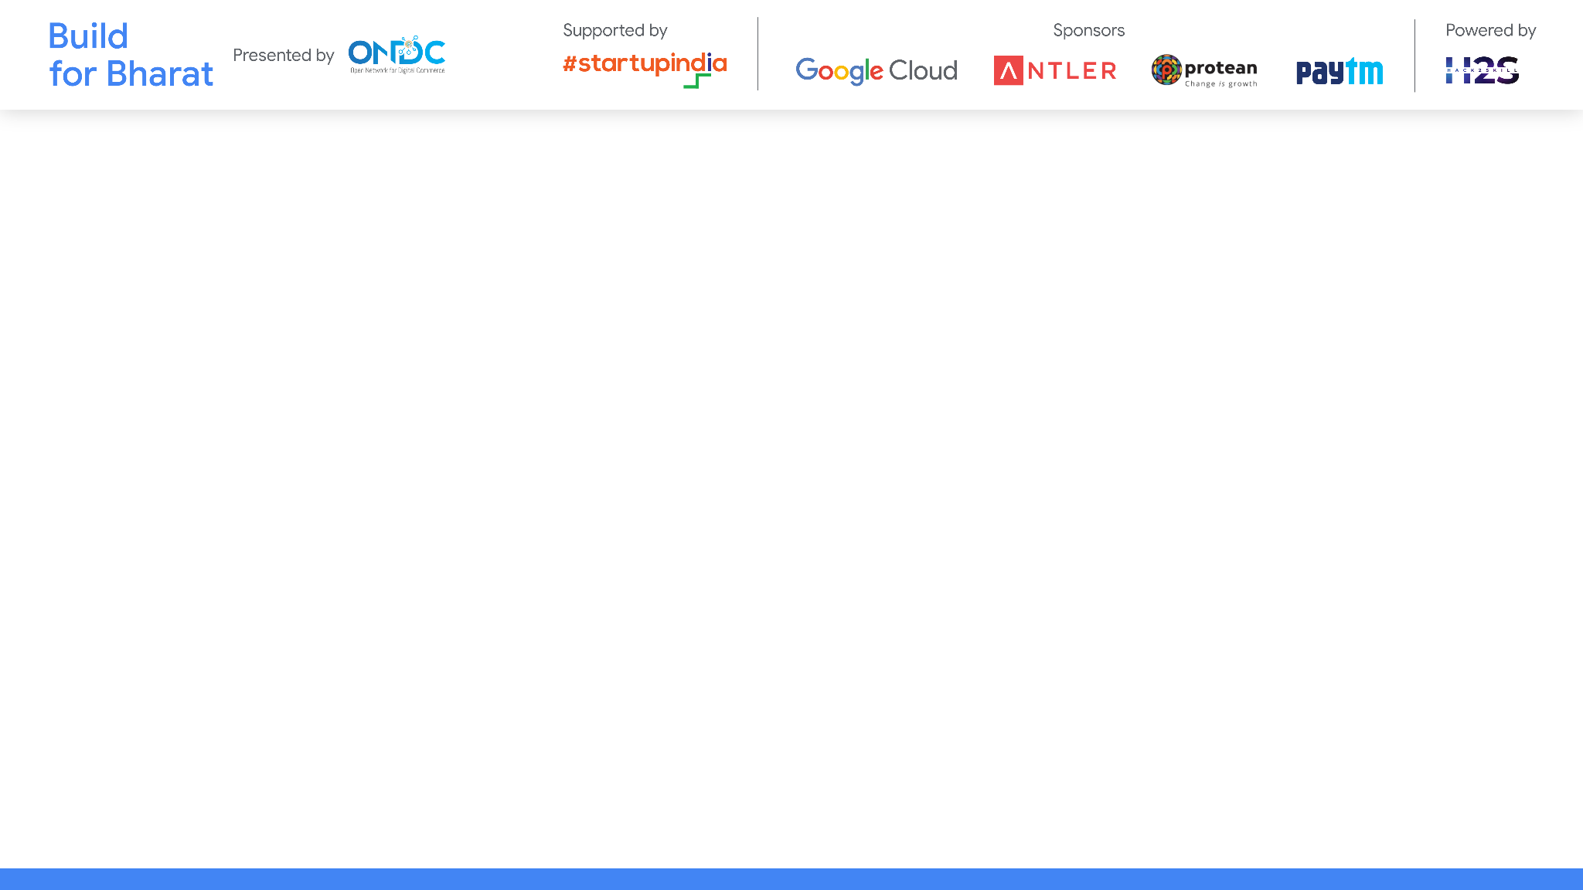
Team Name: Mern
Team Leader Name: Kashni Gulati
Team Member Names: Karan Yadav, Krishna Jain, Himanshi
Problem Statement Category: Foundational
Problem Statement: Conversational Interface

Slide 3
Powered By:
1. Next.js: A popular open-source React framework that is used for building server-side rendered (SSR) and statically generated (SSG) web applications.
2. Tailwind CSS: A popular utility-first CSS framework that provides a set of utility classes to quickly style HTML elements without needing to write custom CSS
3. Gemini: A family of multimodal large language models developed by Google DeepMind, serving as the successor to LaMDA and PaLM 2.
4. Node.js: an open-source, server-side JavaScript runtime environment built on Chrome's V8 JavaScript engine. It allows developers to run JavaScript code outside of a web browser, enabling the development of scalable and efficient server-side applications.

Slide 4
Architecture & Design
1. Frontend Architecture:
Modular structure, all the major code in the app/ directory and assets in the public/ directory, rest all are config files required for the development of the project.
2. Backend Architecture:
Next.js provides method to write backend logic in the same directory (app/api/) which makes is easier to manage and design.
3. Database Considerations:
we use mongodb and fs (node.js module) to store the data of the user and the conversation between user and the bot for analytics.
4.Integration with Gemini:
Used the gemini api key to integrate the gemini to our project.

Slide 5
5. Security Measures:
we are deploying it to the trusted platform and using the best and trusted packages/libraries and external api so that user do not have to compromise with the security.
6. Scalability Strategies:
GCP handle scalability by auto-scaling methods and next.js provides caching mechanisms to provide the fast and uninterrupted user experience. For future we will add cdns also.
7. Deployment and Infrastructure:
Deployed to the Google Cloud using docker and github actions for CI and CD.

Slide 6

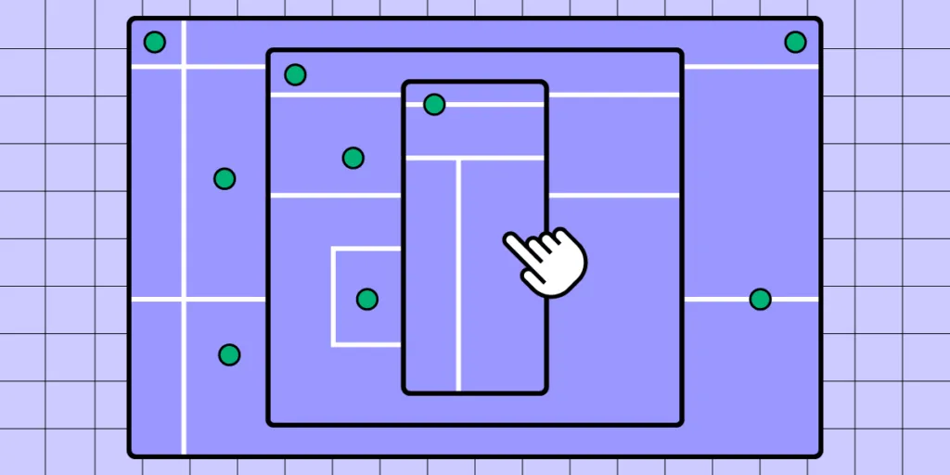

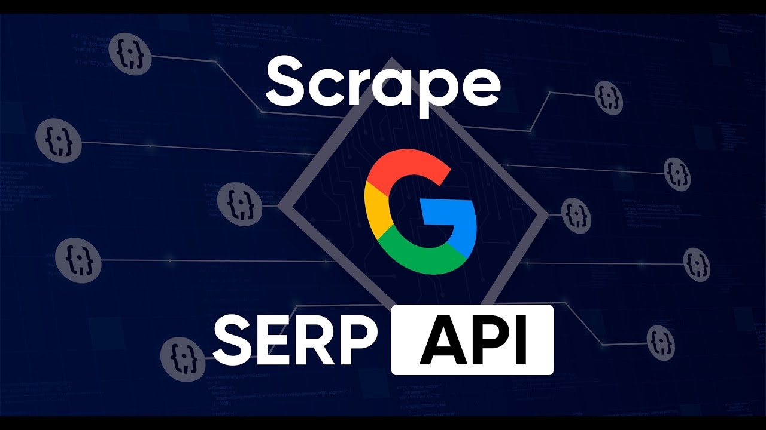
WORKING (How the project works?)

Slide 7
Explanation:
- Our bot application is designed to provide users with an interactive and immersive shopping experience, combining cutting-edge technologies to streamline the process of buying goods. Leveraging Google AI(Gemini), Next.js, Tailwind CSS, Node.js, and SERP API, our platform offers advanced features such as natural language processing, responsive web design, server-side rendering, and integration with external data sources.
- User can come our website then make the request to the server then the server make request to the gemini to understand what user is saying then the response from the gemini is used to do the further tasks such as getting the products online and asking the user to select the type/category/size and other filters to get the product that best fits them then the server send the response to the user.
- User can read the reviews and bot optimized review so that user do not waste time reading the review, in the separate page by clicking on the products and on that page they will get more details about the products, such as links to buy them etc...
- They can see how they look in the by mapping the product to the image provided by them.

Slide 8
Key Features
Conversational Shopping: Users can interact with the bot using natural language, simplifying the process of expressing their shopping needs and preferences.
Responsive Web Design: The application offers a seamless shopping experience across various devices and screen sizes, ensuring accessibility and usability for all users.
Server-side Rendering: Next.js enables server-side rendering for improved performance and SEO, enhancing the overall user experience.

Slide 9
Dynamic Product Visualization: Leveraging SERP API, users can view products in 3D, allowing for a more immersive and engaging shopping experience.
Benefits
Efficiency: By leveraging AI and automation, our application streamlines the shopping process, enabling users to find and purchase goods more efficiently.

Slide 10
Personalization: Through natural language processing, our bot can understand user preferences and tailor product recommendations accordingly, enhancing the relevance of shopping experiences.
Engagement: The integration of 3D product visualization enhances user engagement and satisfaction, providing a visually appealing and immersive shopping environment.

Slide 11
Important Links:-
GitHub Public Repository Link:
https://github.com/Promptilia/User-Interface
Web Link: Visit Promptilia

Slide 12


