Slide 1
ACCENTURE • DATA ANALYTICS CAPSTONE
Cloud Cost Optimization Analysis
Uncovering avoidable cloud spend across AWS, Azure & GCP — and building the roadmap to reclaim it.
$407,980
+38.5%
22.2%
$123K–$188K
FY2023 net spend
Jan → Dec growth
Dev + Staging spend
Annual opportunity
Presented by Breakout Room 4 – Proma Mondal, Yash Chaudhary, Anurag Vyas, Aditya Marathe, Neam Adil
FY2023 Cloud Billing Analysis | Kaggle Cloud Budget Dataset
CLOUD COST OPTIMIZATION
1

Slide 2
01 • PROBLEM & OBJECTIVES
The question is not 'why is cloud expensive?' — it is 'what is avoidable?'
The project focuses on finding measurable waste without cutting operational capability.
BUSINESS PROBLEM
PROJECT OBJECTIVES
Cloud spend increased 38.5% from January to December.
Multi-cloud usage makes cost ownership and optimization harder.
Non-production resources, low commitment coverage and high on-demand exposure may represent avoidable spend.
Leadership needs a way to locate waste and prioritize action.
Analyze FY2023 cloud spending and usage.
Engineer meaningful cost-efficiency KPIs.
Detect anomalies and inefficient utilization.
Identify high-value optimization opportunities.
Build an interactive dashboard for decision-makers.
Translate findings into prioritized recommendations.
Kickoff target: identify ≥15% of annual spend as optimizable.
CLOUD COST OPTIMIZATION
2

Slide 3
02 • WORKFLOW / SYSTEM ARCHITECTURE
How the components work together
An end-to-end flow from source data to an executive decision layer.
SOURCE
PREP
ANALYTICS
INSIGHT
APP
ACTION
Kaggle Cloud Budget Dataset
→
Cleaning & Validation
→
KPI Engineering + EDA
→
Hotspots + Waste Signals
→
Streamlit + Plotly Dashboard
→
Recommendations + Roadmap
FINANCE VIEW
ENGINEERING VIEW
DECISION LAYER
Spend, efficiency, savings opportunity and project prioritization
Resources, environments, exposure, service and region hotspots
Prioritized actions with measurable targets
WORKFLOW / SYSTEM ARCHITECTURE
6

Slide 4
03• TOOL STACK
Technology used across the pipeline
Lightweight, reproducible tools support data preparation, analysis, visualization and delivery.
Python
Core analytical language
Pandas / NumPy
Cleaning, transformation and KPI calculations
Matplotlib
EDA visualizations
Plotly
Interactive dashboard charts
Streamlit
Dashboard application
Jupyter / VS Code
Development and analysis
Git / GitHub
Version control and repository
CSV / Kaggle
Source data
TOOL STACK
7

Slide 5
04 • DATASET OVERVIEW
A full year of daily, resource-level cloud billing data
Source: Kaggle Cloud Budget Dataset • FY2023
54,750
40
365
3
6
billing records
columns
days
providers
regions
COVERAGE
DATA QUALITY
Business units: Finance, Marketing, HR, Engineering, Sales
Departments: Mobile, BI, DataPlatform, Security, WebApps
Environments: Production, Staging, Dev
Services: Serverless, Container, DB, Compute, Storage, Analytics, Networking
9 / 10 overall quality score
0 missing values • 0 duplicates
10 structural issues identified and resolved
CLOUD COST OPTIMIZATION
4

Slide 6
05 • DATA PREPROCESSING
Step 1 — Clean the raw billing data
The goal was to make the source data reliable and analysis-ready before calculating any KPI.
RAW DATA
CLEANING & VALIDATION STEPS
54,750 resource-day records
01
Date normalization
Converted date strings to true datetime values.
02
Tag parsing
Parsed the denormalized tags field into 5 queryable columns and cross-validated against source columns.
→
Initial risks identified during profiling
Denormalized tags
Inactive anomaly flag
Forecast outliers
Invalid daily budget comparison
03
Anomaly repair
Re-engineered a working anomaly flag using the 95th percentile of anomaly_score (>0.58).
04
Forecast outliers
Flagged forecast outliers using the IQR method; records were retained rather than removed.
05
Budget utilization
Recalculated budget utilization at the monthly level because the daily-vs-monthly comparison was not meaningful.
Result: trustworthy, analysis-ready billing data.
DATA PREPROCESSING
5

Slide 7
05• DATA PREPROCESSING
Step 2 — Engineer decision-ready KPIs
The cleaned fields were transformed into metrics that connect billing behavior to optimization decisions.
Cost Efficiency Ratio
Discount Utilization Rate
net_cost / list_cost
How much of list cost becomes net cost?
discount_amount / list_cost
How effectively are available discounts used?
On-Demand Exposure
Idle Resource Indicator
on_demand_cost / net_cost
How much spend remains exposed to on-demand pricing?
1 if exposure > 80%
Proxy for high-exposure / potentially idle usage.
Cost per Usage Unit
net_cost / usage_quantity
Normalizes cost against observed usage.
These KPIs make raw billing data actionable for FinOps decisions.
DATA PREPROCESSING
6

Slide 8
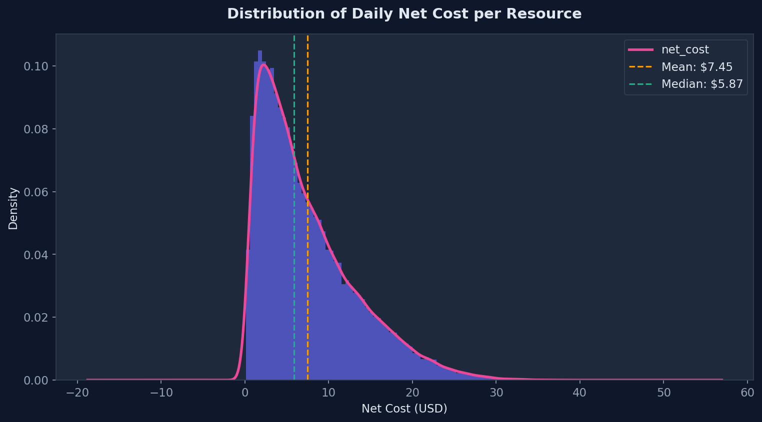
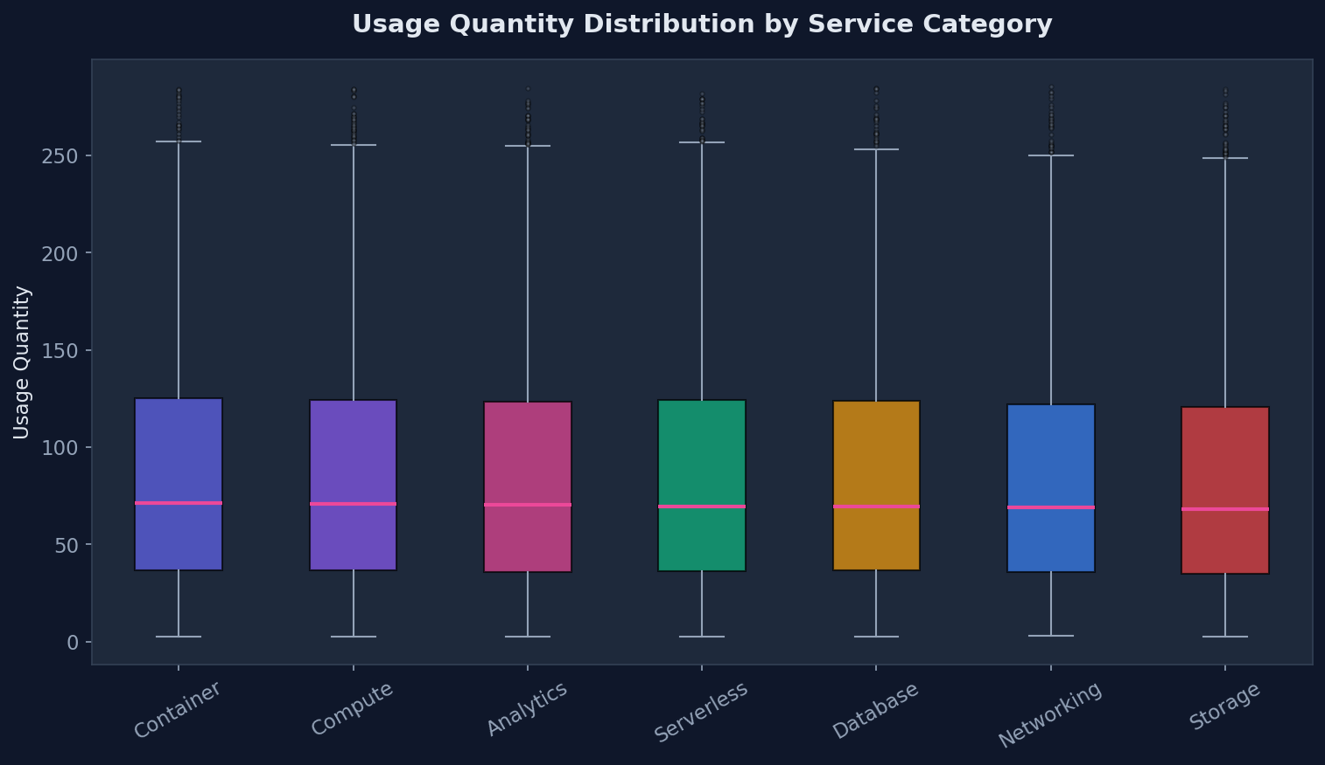
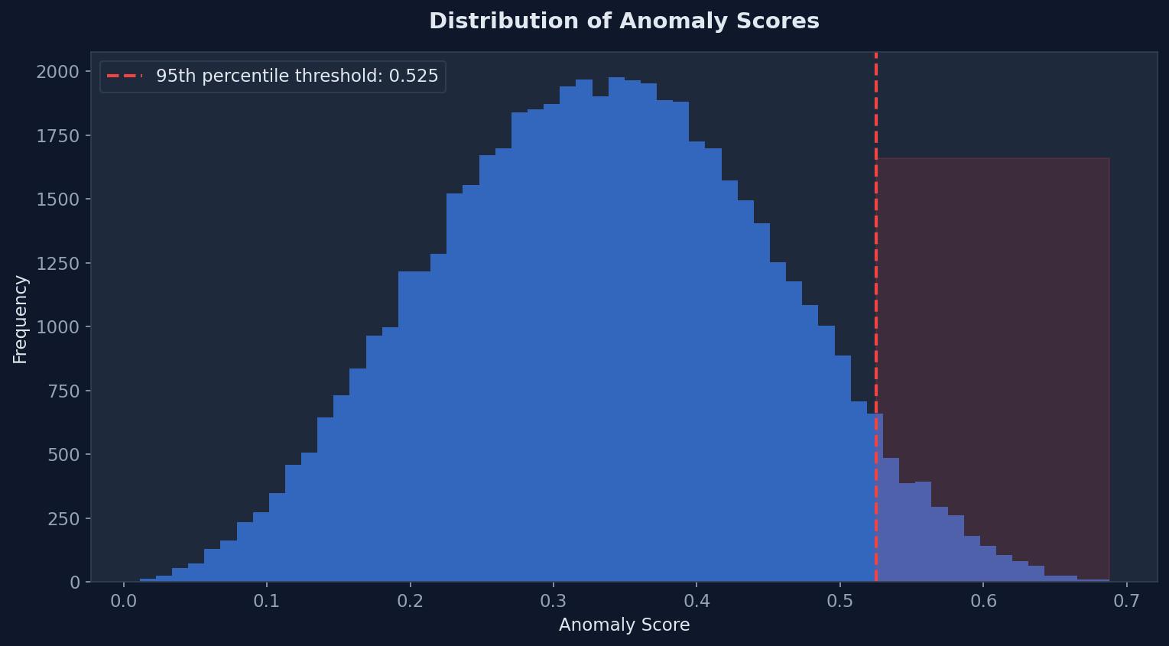
06 • EDA — COST & USAGE
What does cloud spending and usage look like?
KEY EDA TAKEAWAY
Most resources have relatively low daily cost, while a smaller high-cost tail can drive disproportionate spend. Usage varies by service, so optimization must be service-aware. 2,738 records (5%) are above the 95th-percentile anomaly threshold.
EXPLORATORY DATA ANALYSIS
7

Slide 9
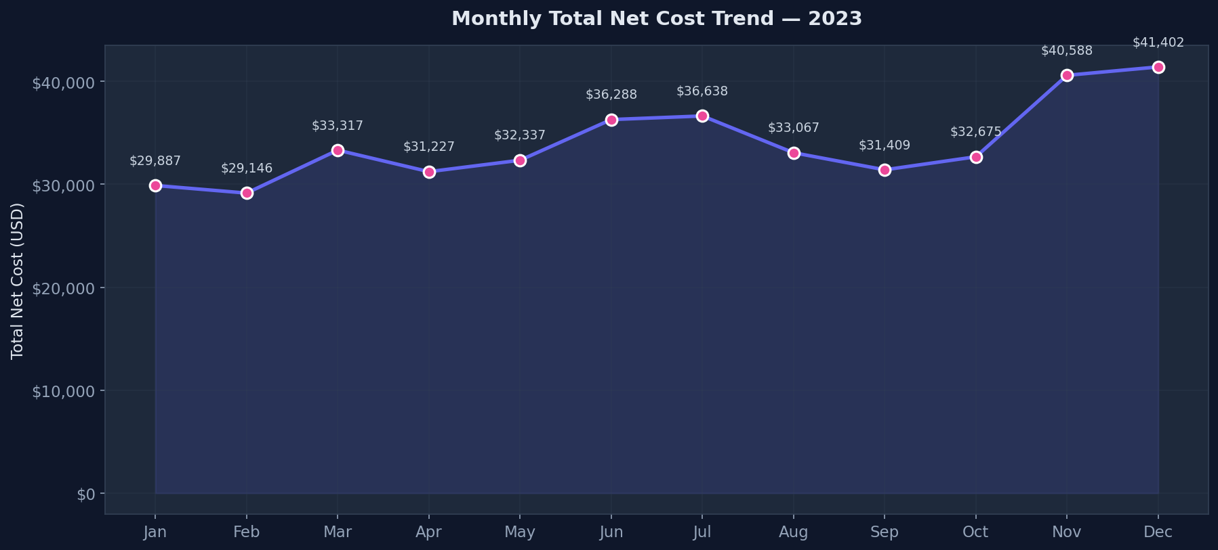
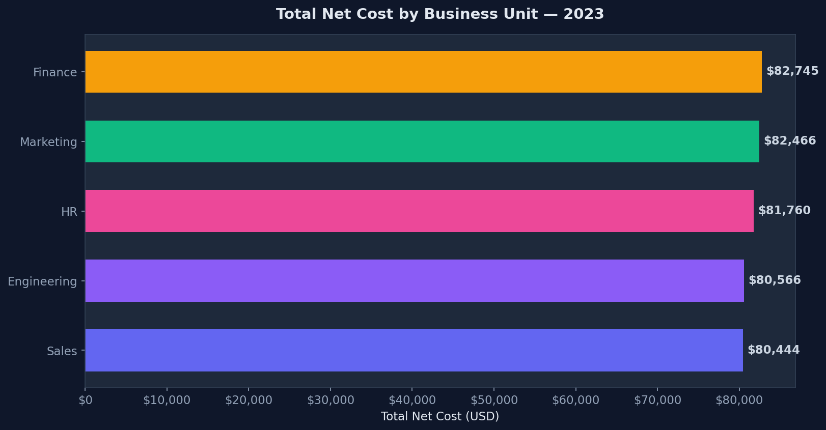
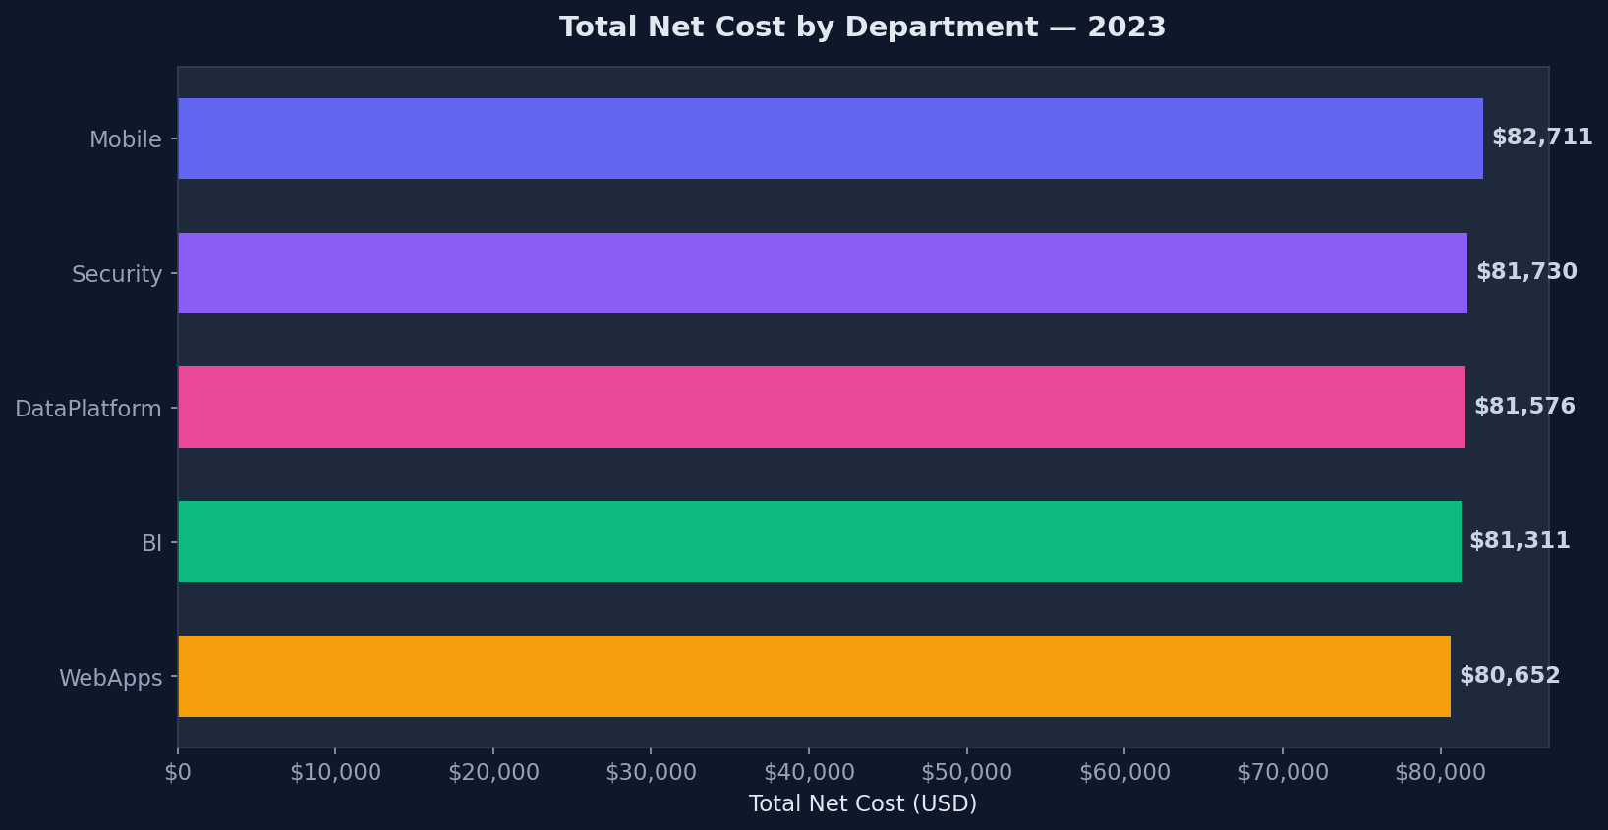
06 • EDA — TREND & OWNERSHIP
Is the cost problem concentrated in one part of the organization?
KEY EDA TAKEAWAY
Spend increased 38.5% from January to December. All five business units sit within a narrow spending band, so the increase is not explained by one department or BU.
EXPLORATORY DATA ANALYSIS
8

Slide 10
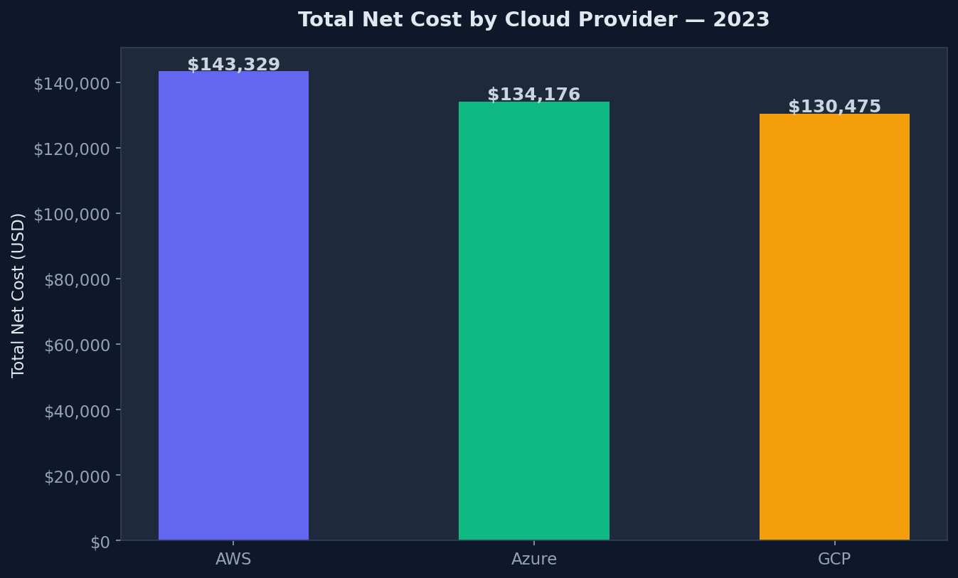
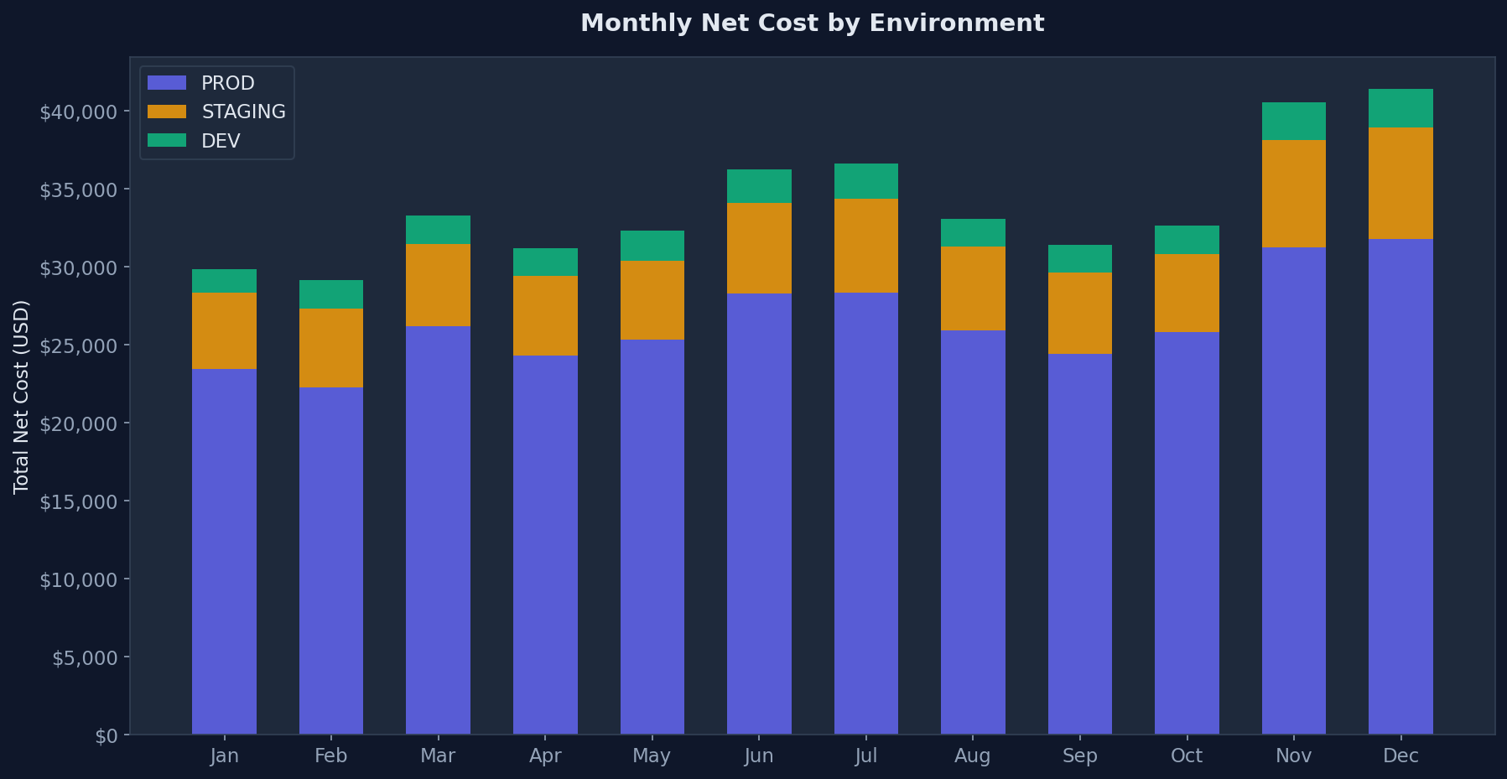
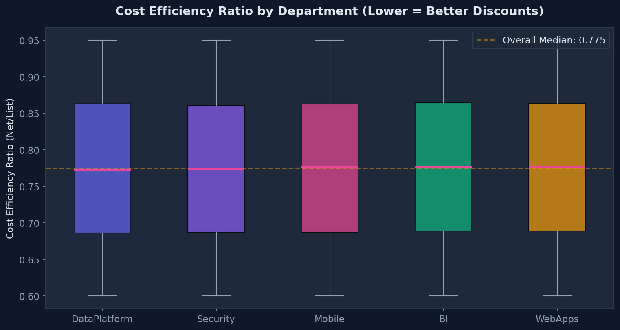
06• EDA — ENVIRONMENT & EFFICIENCY
Where is spend most actionable?
KEY EDA TAKEAWAY
Staging + Dev account for 22.2% of spend ($90,380). Department-level efficiency is comparatively narrow. Non-production is therefore a strong immediate optimization lever.
EXPLORATORY DATA ANALYSIS
9

Slide 11
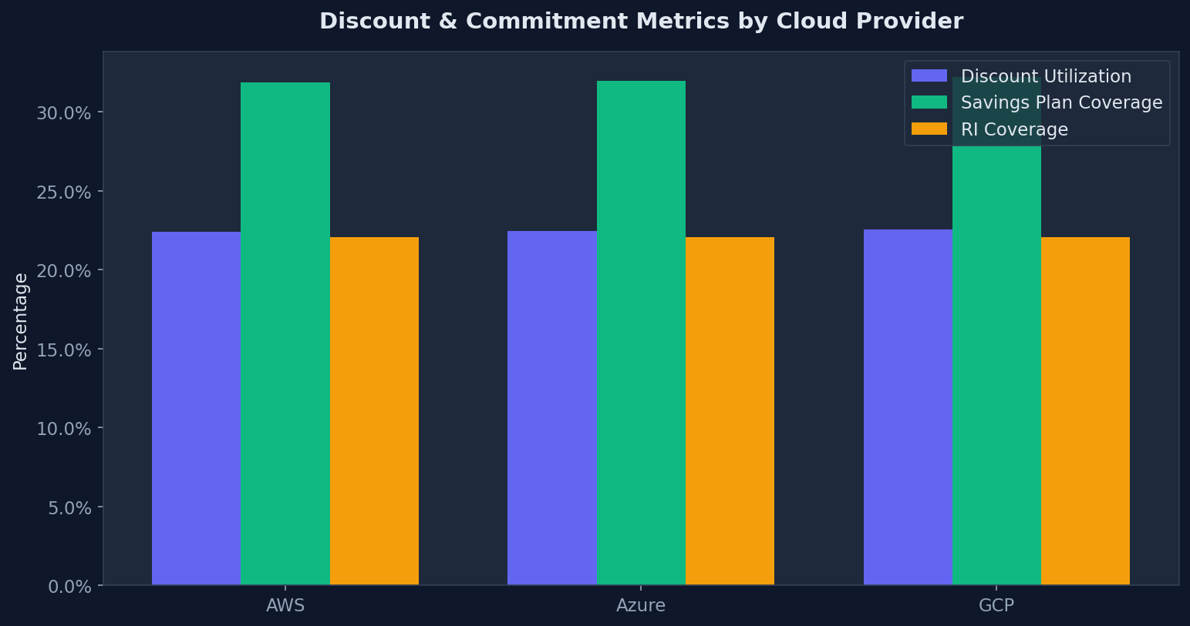
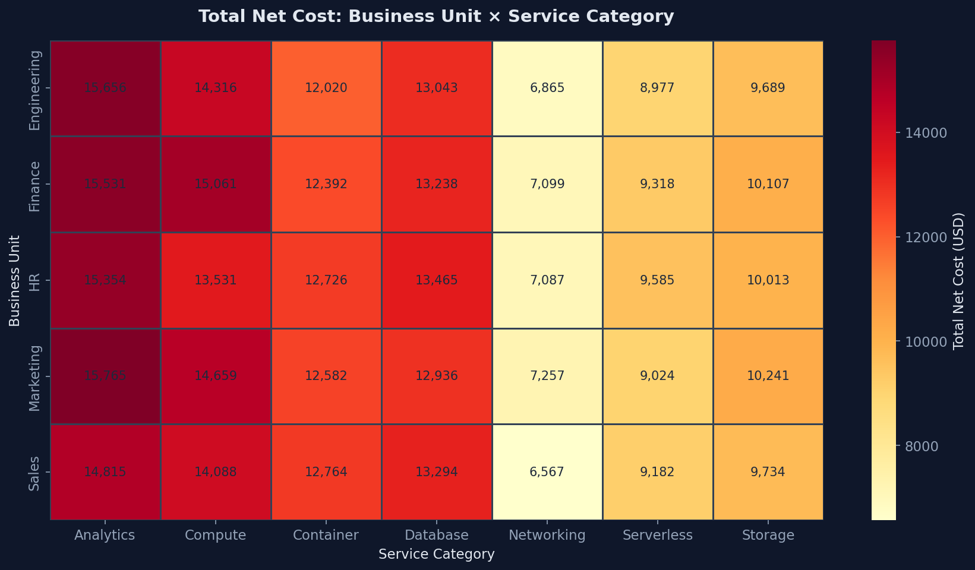
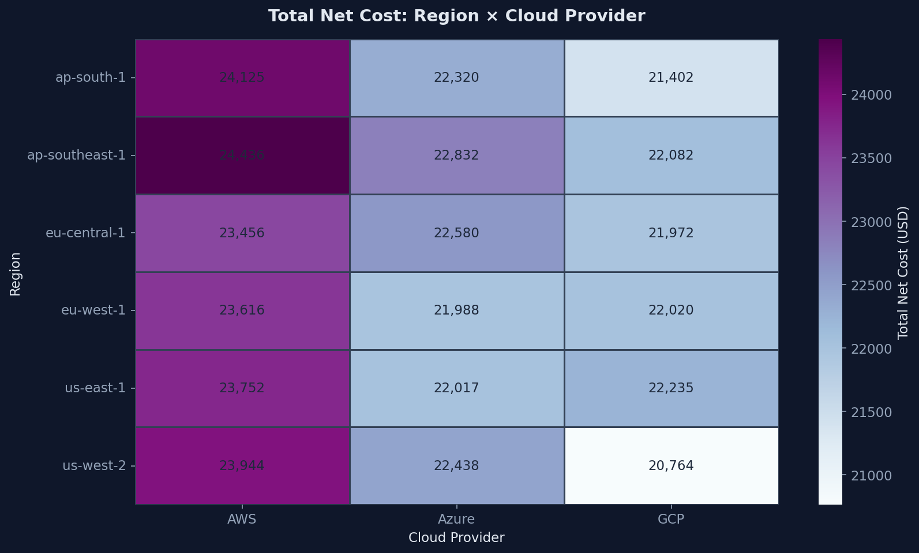
06 • EDA — PRICING & HOTSPOTS
Are we paying efficiently — and where are the hotspots?
KEY EDA TAKEAWAY
Average commitment coverage is 54.1%, leaving 46.5% of spend exposed to on-demand pricing. Cross-dimensional heatmaps identify where spend is concentrated.
EXPLORATORY DATA ANALYSIS
10

Slide 12
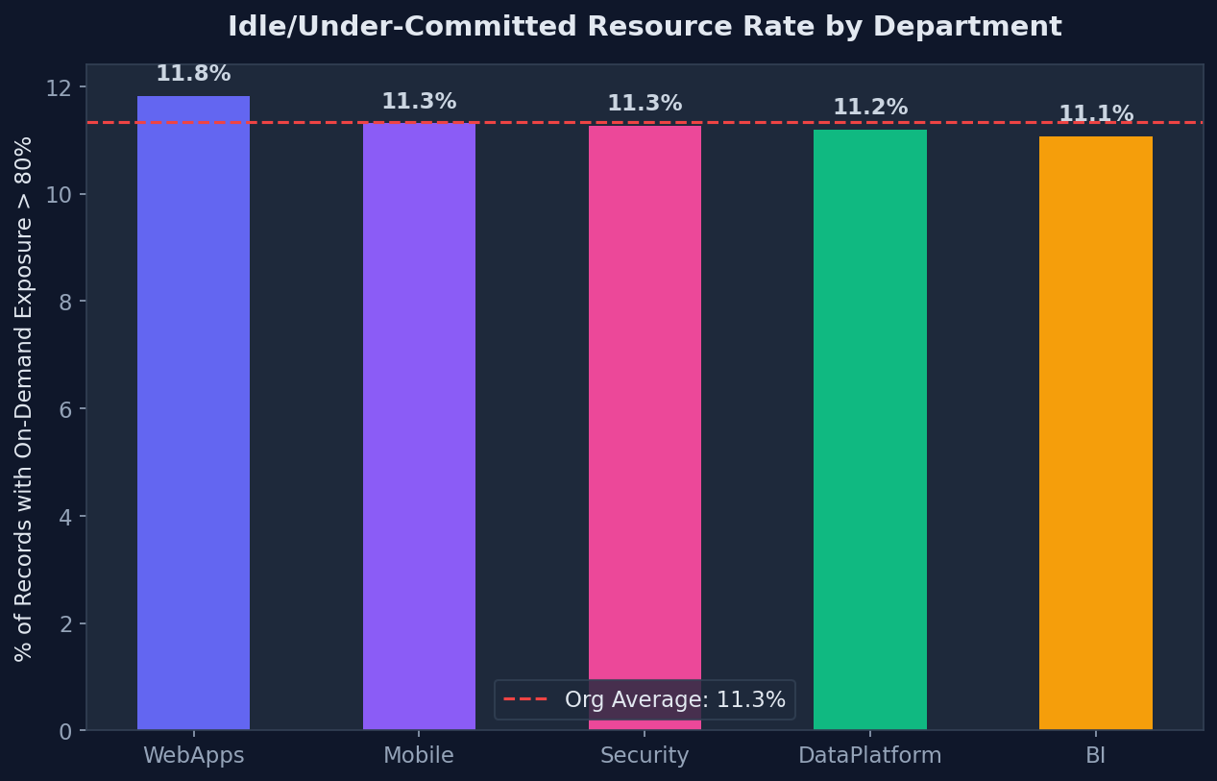
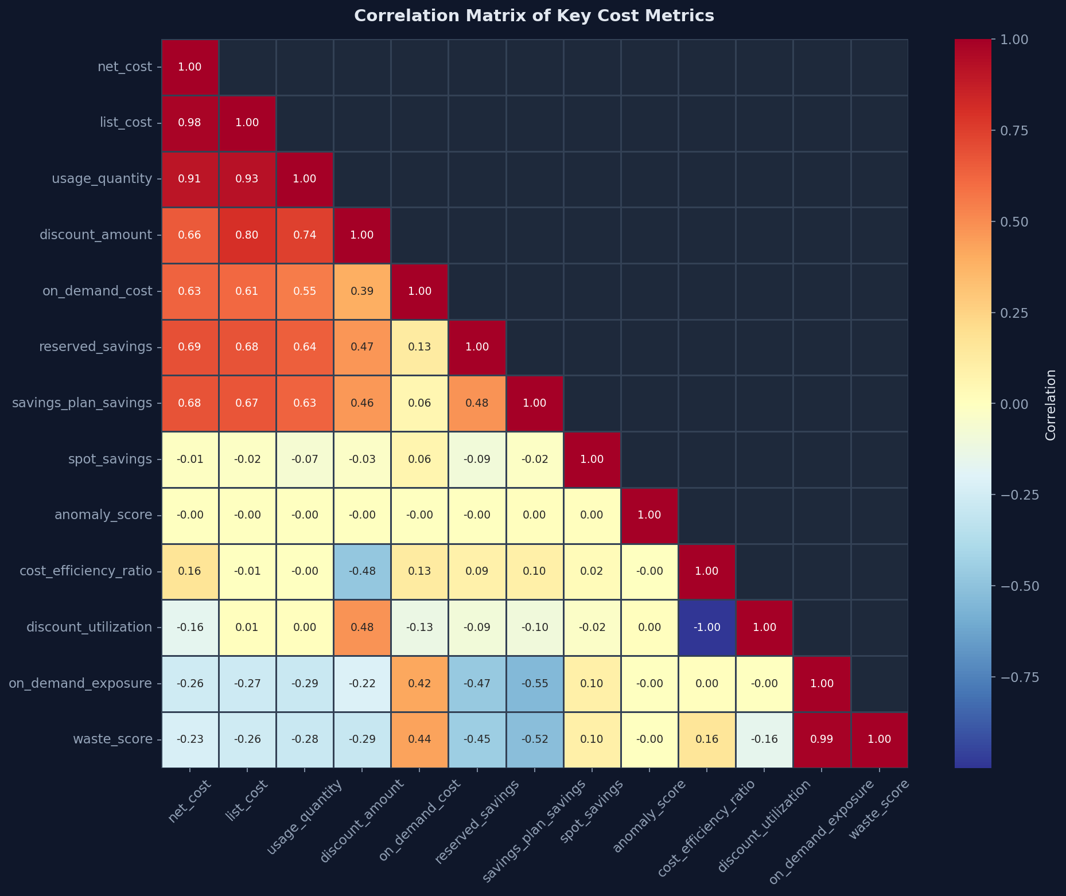
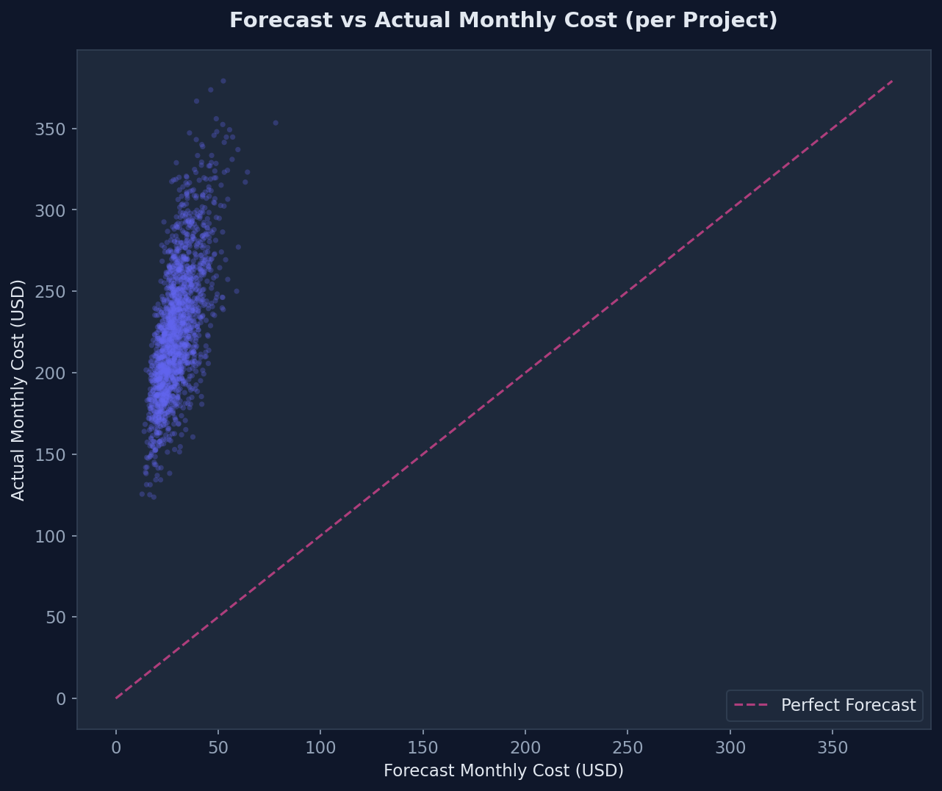
06 • EDA — WASTE & FORECASTING
What else is driving avoidable cost?
KEY EDA TAKEAWAY
11.3% of resource-days meet the >80% on-demand exposure proxy. The engineered waste metrics behave consistently with underlying cost variables, while 10.5% of records are forecast outliers.
EXPLORATORY DATA ANALYSIS
12

Slide 13
07 • KEY INSIGHTS & RECOMMENDATIONS
What the analysis says — and what we should do about it
The strongest findings map directly to operational actions.
38.5% spend growth
Investigate Q4 resource accumulation
Quarterly cleanup + lifecycle governance
22.2% non-prod spend
Reduce unnecessary runtime
Auto-stop Dev/Staging outside business hours
54.1% commitment coverage
Reduce on-demand exposure
Centralize RI / Savings Plan purchasing
11.3% high-exposure rate
Detect inefficient resources earlier
Automated idle-resource alerting
8.4% low SP + RI coverage
Prioritize commitment candidates
90-day usage analysis → 1-year commitments
10.5% forecast outliers
Improve planning accuracy
Rebuild forecasting on historical trends
8 recommendations identified • $123K–$188K annual savings opportunity
INSIGHTS & RECOMMENDATIONS
13

Slide 14
08 • ROADMAP
Six months: quick wins → governance → structural optimization
The roadmap sequences low-risk savings actions before longer-term commitments.
MONTH 1–2
MONTH 3–4
MONTH 5–6
QUICK WINS
STRATEGIC
LONG-TERM
Audit unused Q4 resources
Auto-stop staging/dev 7 PM → 8 AM
Deploy provider-native idle alerts
Use 90-day usage for RIs/SPs
Stand up FinOps team
Rebuild forecast models
Pilot spot instances
Cross-provider TCO analysis
Workload placement guidelines
6-MONTH TARGET
$285K–$330K
annual net cost
70–75%
commitment coverage
4–6%
idle
Identified annual savings opportunity: $123K–$188K • 19–30% six-month cost reduction target
ROADMAP & IMPACT
16

Slide 15
09• PROJECTED IMPACT
Where the organization stands today vs. the 6-month target.
The target state translates the recommendations into measurable operating outcomes.
METRIC
CURRENT
TARGET (6 MO)
Annual Net Cost
$407,980
$285,000–$330,000
19–30%
Non-Prod Spend %
22.2%
10–12%
Commitment Coverage
54.1%
70–75%
TOTAL COST REDUCTION
ACHIEVABLE IN 6 MONTHS
Idle Resource Rate
11.3%
4–6%
Cost Efficiency Ratio
0.775
0.65–0.70
$123,000–$188,000 identified in total annual savings
opportunity across all 8 recommendations.
Spot Instance Adoption
~25%
40–50%
TARGET STATE
Lower cost • higher commitment coverage • less idle capacity • greater spot adoption
CLOUD COST OPTIMIZATION | FY2023 ANALYSIS
15

Slide 16
10 • PROJECT DEMO AND GITHUB
Executive dashboard — from analysis to self-service decision making
Built with Streamlit + Plotly; designed for finance and engineering leaders.
☁ Cloud Cost Optimizer Dashboard
DASHBOARD CAPABILITIES
Interactive 2023 cloud cost analysis
KPI cards: Total Spend, Avg Daily Cost, Discount Rate, Idle %
Interactive filters across 7 dimensions
Monthly cost trends and provider / department comparisons
Top-wasteful-project table & cost-efficiency leaderboard
Anomaly detection view
$407.9K
38.5%
11.3%
54.1%
Total Spend
Growth
Idle / Exposure
Commitment
Monthly Cost Trend
Top Waste Projects
Project 1 $$$
Project 2 $$$
GITHUB REPOSITORY
Project 3 $$$
Source code EDA • preprocessing • dashboard • reports
Filters: Date • Provider • BU • Department • Environment • Region • Service
Repository link: https://github.com/Proms32/Accenture-capstone-project
PROJECT DEMO & GITHUB
17

Slide 17
11 • CHALLENGES,LEARNINGS AND CONCLUSION
From raw billing records to an actionable FinOps story
The project combined data quality work, KPI engineering, EDA, dashboarding and business recommendations.
CHALLENGES
LEARNINGS
FINAL MESSAGE
Interpreting cloud billing terminology
Cleaning denormalized tags and structural issues
Repairing unusable anomaly / budget indicators
Designing meaningful KPIs from billing fields
Turning 18 visualizations into one coherent story
Cloud FinOps and commitment concepts
Data-driven business storytelling
Dashboard design for self-service analysis
Prioritizing recommendations using evidence
Connecting technical metrics to financial outcomes
The data shows a governance problem — not a department problem.
$123K–$188K
identified annual savings opportunity
Future scope: real-time FinOps, ML forecasting, automated recommendations and broader multi-cloud optimization.
CONCLUSION
18

