Slide 1
FRUITBLEND24
From sales data
to operating decisions
CORE SIGNAL
Volume is healthy.
Profit is selective.
Data Analyst Case Study | Sep 2025 - Aug 2026
The opportunity is to scale the right SKUs and kitchens, not simply more cups.
Prepared from the FruitBlend24 case workbook

Slide 2
01 | EXECUTIVE SUMMARY
The business has demand, but not uniform economics
MAPPED CUPS SOLD
NET REVENUE
GROSS PROFIT
WASTE COST
619,932
THB 22,695,760
THB 476,636
THB 855,848
across five core SKUs
after platform commissions
after variable cost + overhead
estimated from daily waste
01 Protect the engine. Watermelon and Pineapple drive 65.9% of cups sold.
02 Fix the drag. BKK kitchens are loss-making after fixed overhead.
03 Spend selectively. Promotions lift volume but dilute contribution margin.
FruitBlend24 | Python data analysis
02

Slide 3
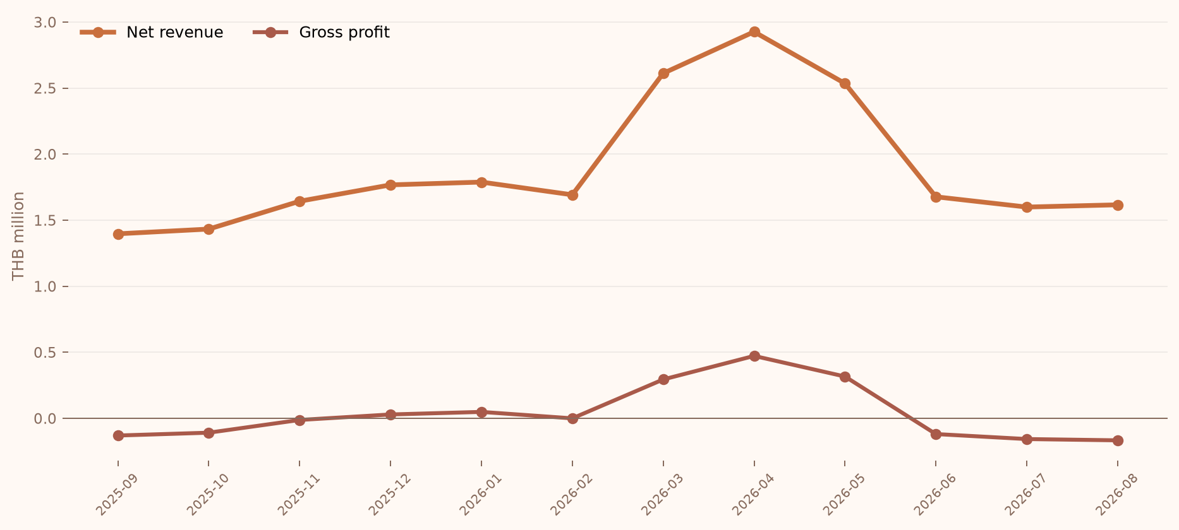
02 | PERFORMANCE
Revenue recovered in spring, then softened again
Monthly net revenue and gross profit, THB millions
READOUT
Peak revenue. Apr 2026 reached THB 2,926,898.
Break-even window. Profit turned positive from Dec through May.
Watch-out. Jun-Aug returned to negative monthly profit.
FruitBlend24 | Python data analysis
03

Slide 4
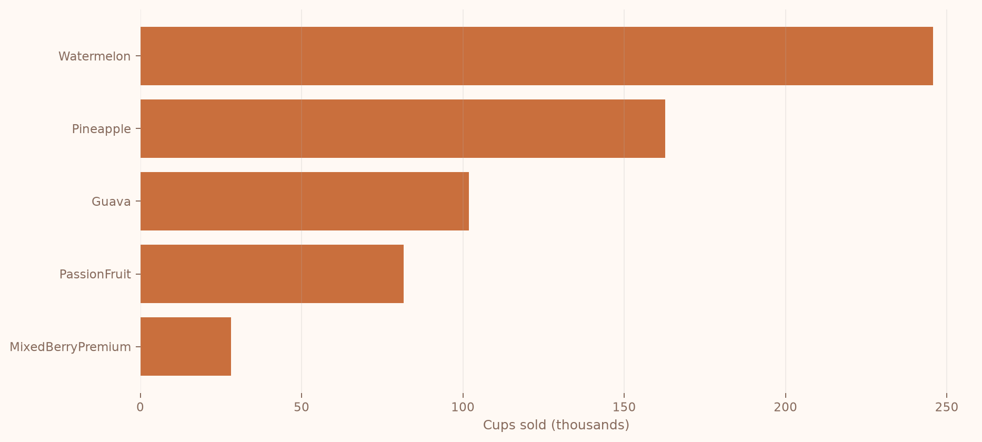
03 | DEMAND MIX
Two core SKUs carry the volume base
Cups sold by core SKU
WHAT IT MEANS
Volume leader. Watermelon represents 39.6% of cups sold.
Premium risk. MixedBerryPremium has the lowest contribution margin at 15.5%.
Action. Use the volume leaders to fund targeted premium mix tests.
FruitBlend24 | Python data analysis
04

Slide 5
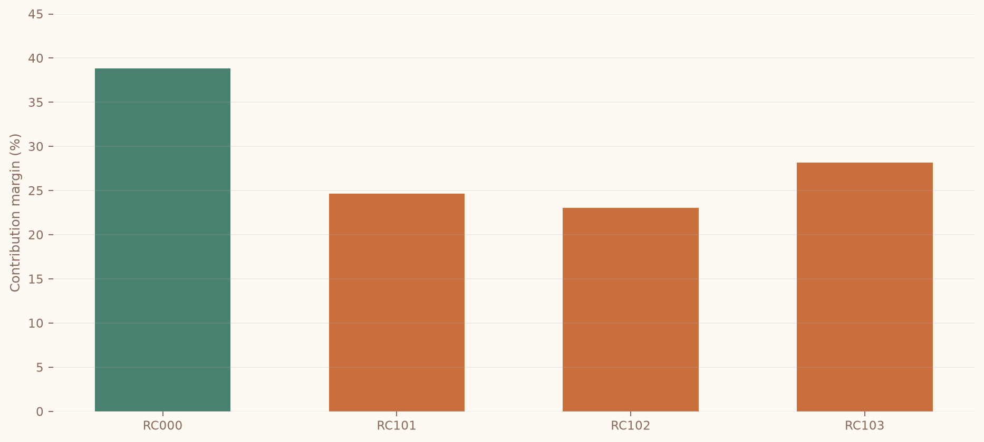
04 | PROMOTIONS
Promotions buy volume at a measurable margin cost
Contribution margin by rate code
DECISION RULE
Keep promotions
that earn repeat
demand, not just
order spikes.
Standard RC000 margin: 38.8%
Lowest promo margin: 23.1%
FruitBlend24 | Python data analysis
05

Slide 6
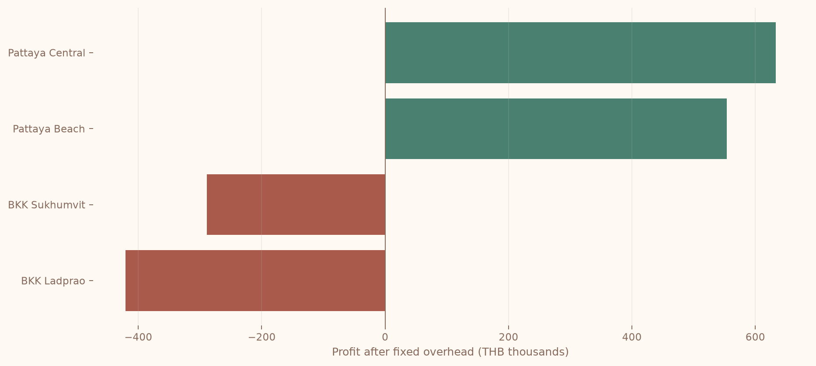
05 | OPERATIONS
Kitchen economics split the network in two
Profit after fixed monthly overhead
OPERATING PRIORITY
Stabilize BKK
before adding
capacity.
Pattaya contributes positive profit. BKK Sukhumvit and BKK Ladprao are negative after fixed overhead.
FruitBlend24 | Python data analysis
06

Slide 7
06 | DATA QUALITY
The core export is reliable enough for decisions
RAW ROWS
MAPPED
REVENUE CHECKS
DUPLICATE SIGNATURES
124,397
124,023
0
372
hourly order export
99.7% of rows
arithmetic mismatches
flagged for review
Method. Non-core or unmapped rows are excluded from P&L and disclosed.
Confidence. Gross revenue reconciles to price x units with zero mismatches.
Next control. Investigate duplicate signatures before production reporting.
FruitBlend24 | Python data analysis
07

Slide 8
07 | RECOMMENDATIONS
Three actions to improve the next quarter
01
Scale profitable demand
Protect availability of Watermelon and Pineapple while testing higher-margin bundles.
02
Repair kitchen economics
Review BKK staffing, fixed-cost allocation, and order routing before adding capacity.
03
Make promotions accountable
Track promotion cohorts and repeat purchase, not only units sold during campaign windows.
Decision principle: grow contribution, not just volume.
FruitBlend24 | Python data analysis
08

