Slide 1
Walmart Sales Data Analysis using SQL
submitted by Pronab Kurmi

Slide 2
Data Cleaning & Preparation
Key steps:
• Convert Date strings to DATE (STR_TO_DATE(Date, '%d-%m-%Y'))
• Created 'sale_date' column and derived month/day
• Calculated profit = gross income - cogs for analysis

Slide 3
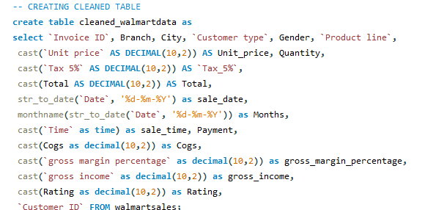

Slide 4
Task 1: Top Branch by Sales Growth Rate
Branch | Growth Rate
A | 1`,66
Key Insight:
Branch with highest growth indicates strong momentum — consider resource allocation.

Slide 5
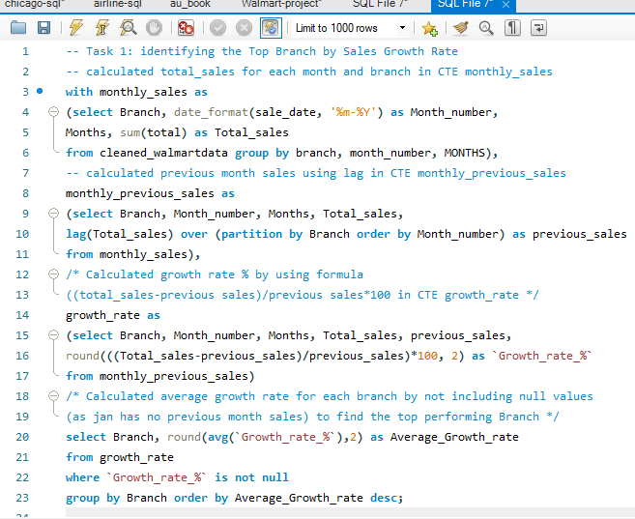


Slide 6
Task 2: Most Profitable Product Line per Branch
Branch | Product Line | Total Profit
A | Health and beauty | 1067.50
B | sports and travel| 951.88
C | food and beverages | 1131.78
Key Insight: Product lines with highest profit per branch should be prioritized for
inventory & promotions.

Slide 7
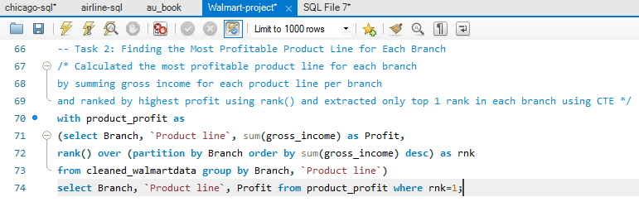
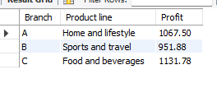

Slide 8
Task 3: Customer Segmentation by Spending
From given data the top 20% of total sales (>=23000) spent customers are segmented as High. Bottom 20% of total sales (<=19999) spent customers are segmented as Low. The other 60% (between 20k and 22999) spent customers are Medium
Recommendations:
High-level customers: Offer VIP loyalty programs and exclusive discounts to retain and upsell.
Medium-level customers: Target with personalized promotions to move them into the high-level category.
Low-level customers: Use entry level offers

Slide 9
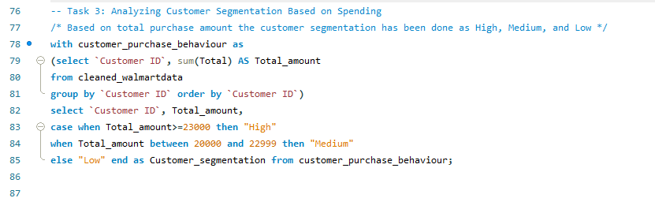
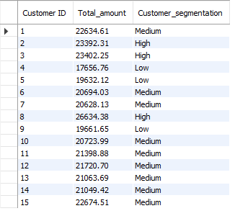

Slide 10
Task 4: Detected Anomalies (sample)
Totally 41.96% of sales are anomalies compared to average
High anomalies are 33.0% and Low anomalies are 8.96%.
Anomalies appear across all product lines.
Recommendations:
Investigate high-invoice anomalies for bulk purchases, special deals, or possible errors.
Key Insight: Flagged transactions should be reviewed for data entry errors or fraud.

Slide 11
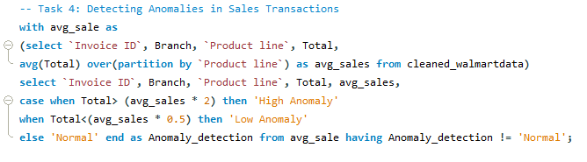
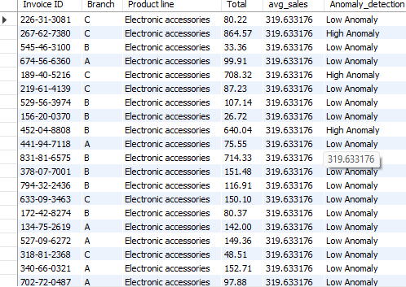

Slide 12
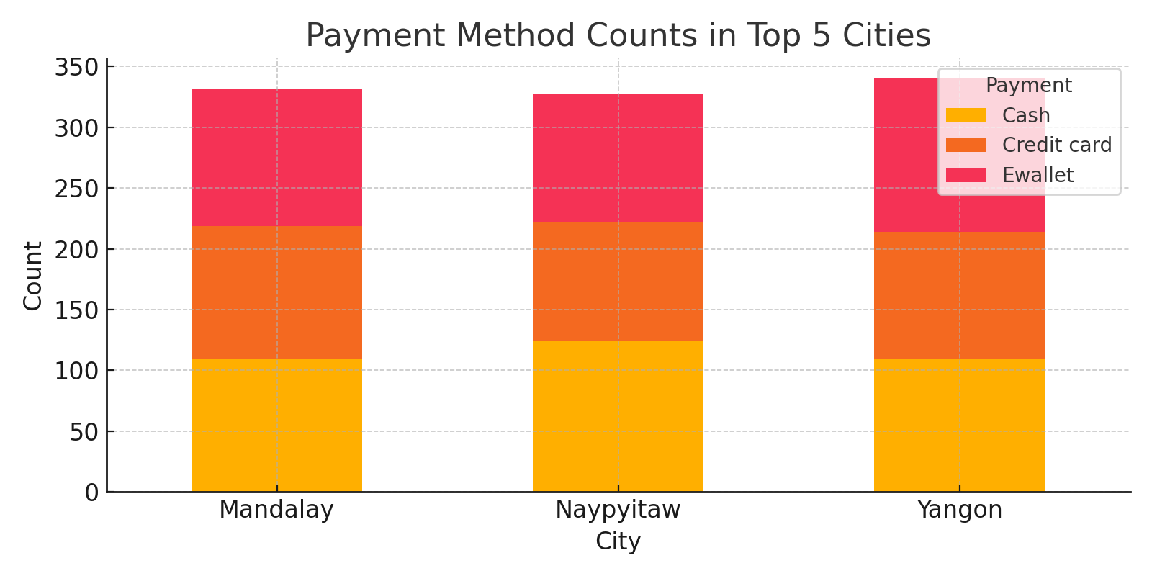
Task 5: Payment Methods by Top Cities
Dataset contains three cities transaction data Mandalay, Naypyitaw, and Yangon.
Results shows more customers from Yangon and Mandalay prefers Ewallet payment method.
Key Insight: Visual shows payment preferences across major cities.

Slide 13
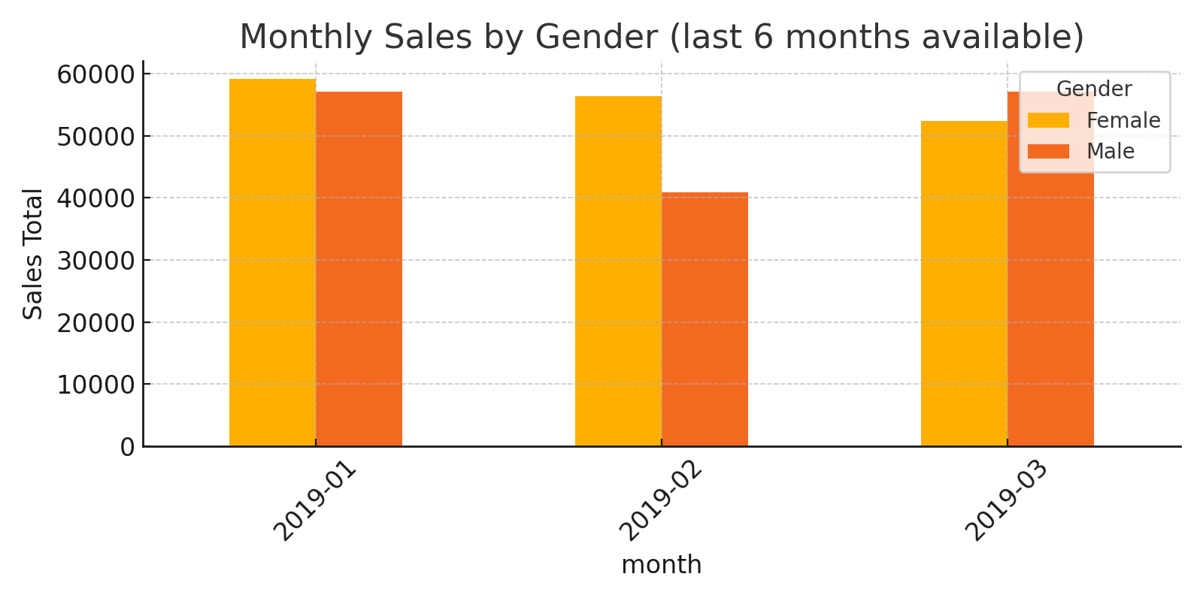
Task 6: Monthly Sales Distribution by Gender (Recent months)
Female customers are contributed more in January(51%) and February(58%) month sales.
Male customers are most contributed in March month sales (52%).
Key Insight: Compare male vs female contributions month-over-month.

Slide 14
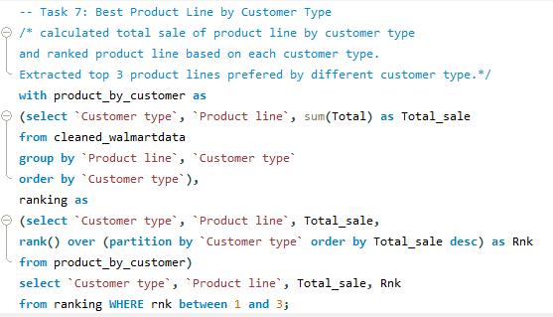
Task 7:- Best Product Line by Customer Type
Data contains two customer types: Membered and Normal.
Membered customers most preferred product line is ‘Food and beverages’ followed by ‘Sports and travels’.
Normal customers preferred ‘Electronics accessories’ product line the most and followed by ‘Fashion accessories’.

Slide 15
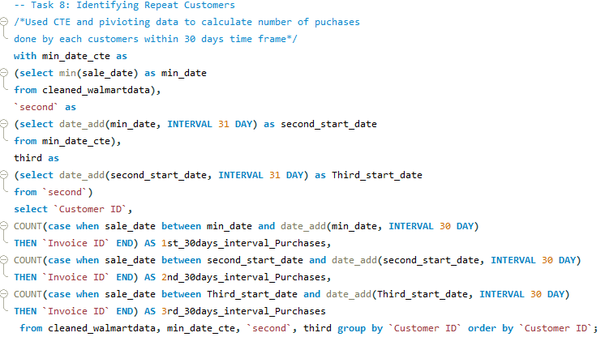
Task 8: Identifying Repeat Customers
Dataset contains 15 customers invoice data over three months.
Each customer made 60+ purchases in overall three months.

Slide 16
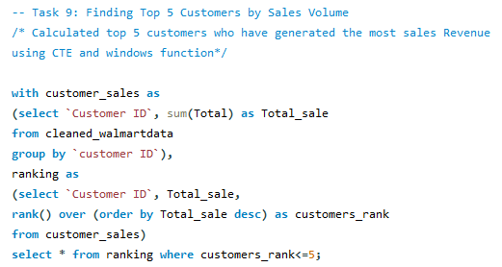
Task 9: Top 5 Customers by Total Sales
Customer ID 8 is the highest contributor with sales of 26634.38.
Customers 3 and 2 ranked as top 2 and 3 with slight difference in total sales.
Followed customers 15 and 1 are in 4th and 5th position.
Key Insight: Consider loyalty rewards for top customers.

Slide 17
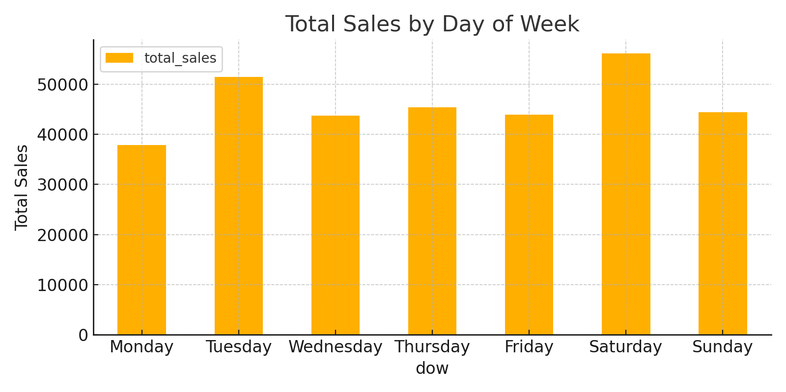
Task 10: Sales Trends by Day of Week
Key Insight: Use to plan staffing & promotions on peak days.

Slide 18
Key Recommendations
• Focus inventory & promotions on profitable product lines per branch
• Target top-tier customers for loyalty programs
• Review flagged anomalies for data quality
• Optimize staffing on weekend peak days

