Slide 1


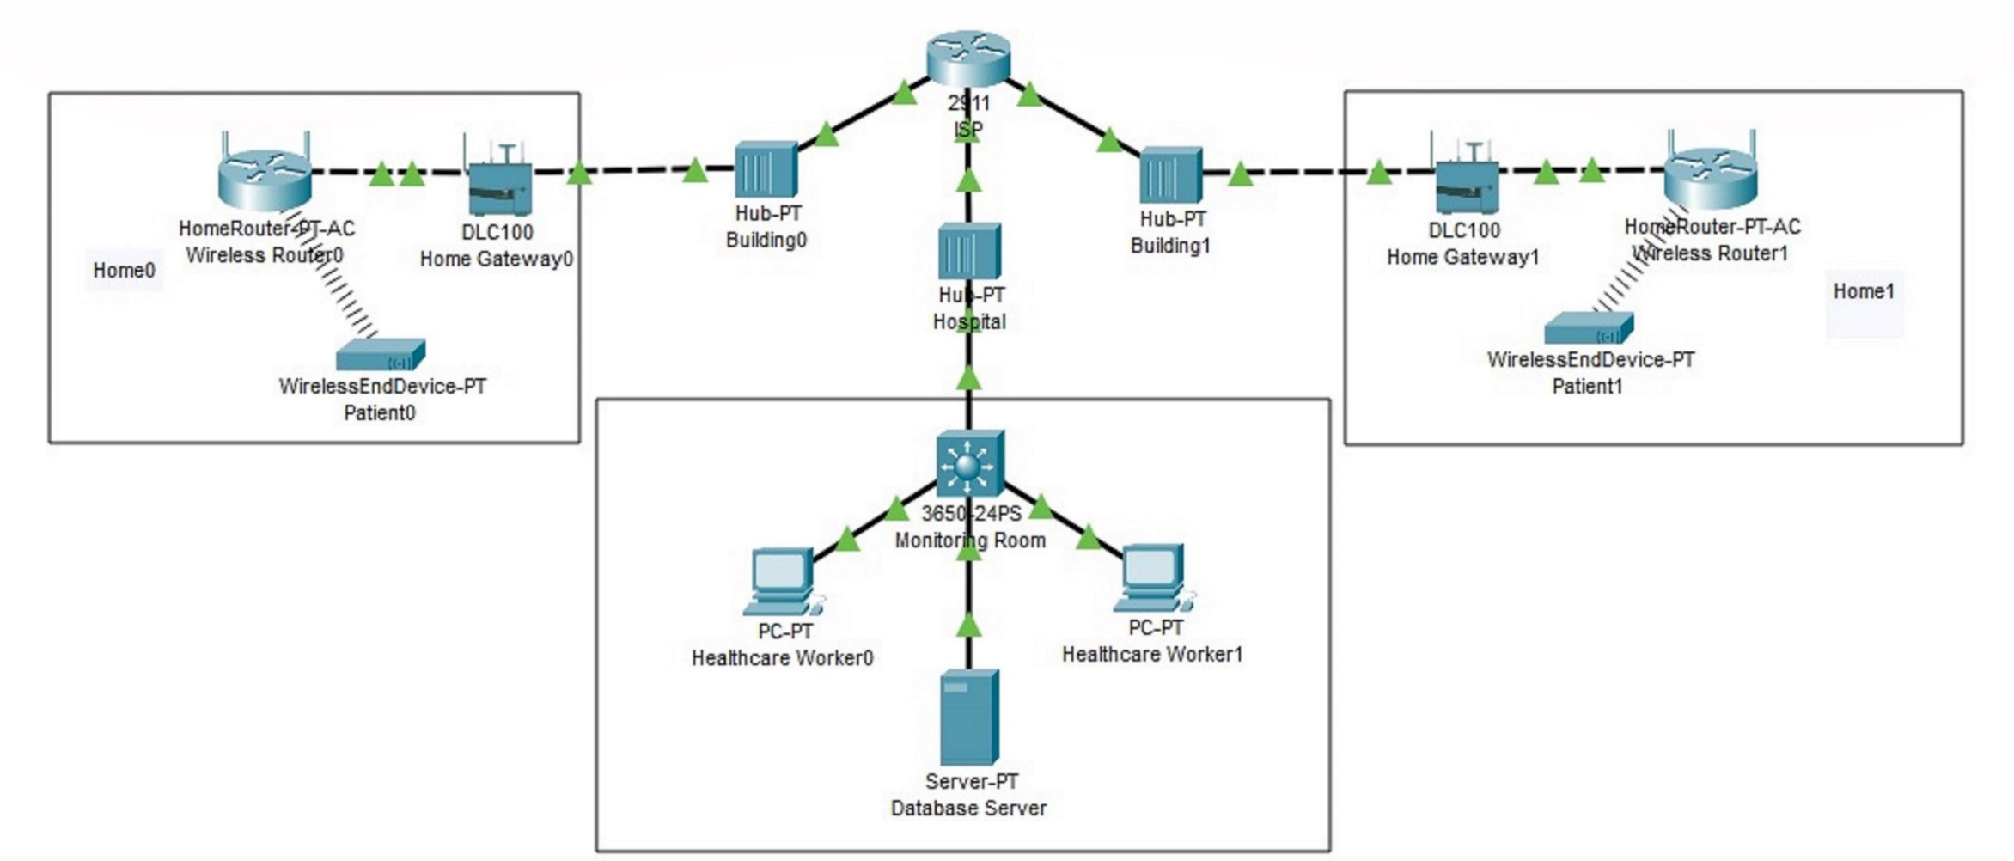
Faculty: Students:
UofG Computing Science
Liew Jun Wei
Gabriel Lau Hian
Ng Jing Yi
Ryan Ong Qi Cheng
Responsiveness Utility Device - Elderly Alertness Detector
Problem Statement
Picture1: Packet Tracer model of the system
As the global population continues to age, there is an increasing demand for technology-based solutions to help care for the elderly.
Proposed Solution
The system conducts daily checks through sensors and alerts which allows caregivers or family members to monitor concerning changes in the elderly person's health status without the use of smartphones which may be confusing to use to these patients.
Our solution is an elderly communication system, which uses sensors and buttons to allow caregivers to conduct daily checks with the elderly.
How to use
Test Sentence
Tools Implemented
CISCO Packet Tracer
Visual Studio Code
MQTT
Features Implemented
Basic LED
Basic Button
Text to Speech (English)
Text to Speech (Chinese)
Future Implementation
Calls Bondulance
Text to Speech (Malay)
Text to Speech (Tamil)
Notes:
D – Content
Heading (Font: Arial Bold, Size: 32)
Body content (Font: Arial Regular, Size: 20pt, Leading: 27pt).
Font Guidelines
• Arial as a default font
• Headings size range: 32 - 34pt; body size range: 20 - 22pt
• No effects (e.g. font outline, font shadow)
• Type in sentence case only
• Bold for headings and sub-headings
Colour guidelines
• Black as a default colour
• Maximum of three colours (including black)
• Invert colours for contrast (e.g. text to be white if based on dark background)
Approved Colours
Primary: Black / Red
Secondary: Blue / Orange / Purple / Green
Margin guidelines
• Ensure spacing of 25mm away from the sides, except title section
• Header dimensions: 594mm X 175mm; Footer dimensions: 594mm x 70mm
Picture guidelines
All photo must be in 300 dpi.
All photo captions to be Italicized and with punctuation. Arial 20 regular.

