Slide 1

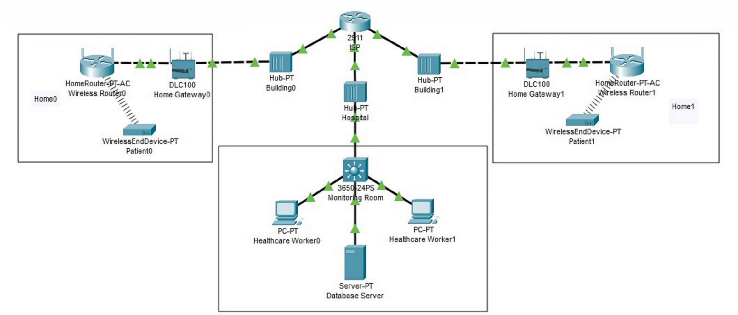








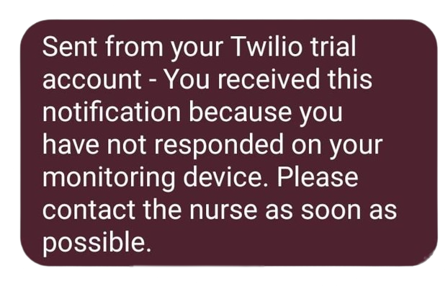
Faculty: Students:
UofG Computing Science
Liew Jun Wei
Gabriel Lau Hian
Ng Jing Yi
Ryan Ong Qi Cheng
Responsiveness Utility Device - Elderly Alertness Detector
Problem Statement
As the global population continues to age, there is an increasing demand for technology-based solutions to help care for the elderly.
Proposed Solution
Device Operations
Network Connection
The system conducts daily checks through sensors and alerts which allows caregivers or family members to monitor concerning changes in the elderly person's health status without the use of smartphones which may be confusing to use to these patients.
Our solution is an elderly communication system, which uses sensors and buttons to allow caregivers to conduct daily checks with the elderly.
Patient’s device would connect to the MQTT server via their home Wi-Fi
Healthcare worker would connect to the MQTT server through their work stations
Both patient and healthcare worker device would communicate through the MQTT server
Patient registers a device and logs their details and preferred check in time, preferably when they wake up, into the hospital database
Upon check in time, patient’s device would light up prompting them to press the button to respond
If the patient did not respond within 3min, an SMS would be sent to their phone prompting them to respond
If the patient did not respond within 3min of the SMS, the healthcare worker device would be notified and the healthcare worker would try and contact the patient
Tools Implemented
Features Implemented
Future Implementation
CISCO Packet Tracer
Visual Studio Code
MQTT
Raspberry Pi 4
Basic LED
Basic Button
Changing of check in time
Text to Speech (English)
Text to Speech (Chinese)
SMS
Calls ambulance
Calls family member
Text to Speech (Malay)
Text to Speech (Tamil)
Notes:
D – Content
Heading (Font: Arial Bold, Size: 32)
Body content (Font: Arial Regular, Size: 20pt, Leading: 27pt).
Font Guidelines
• Arial as a default font
• Headings size range: 32 - 34pt; body size range: 20 - 22pt
• No effects (e.g. font outline, font shadow)
• Type in sentence case only
• Bold for headings and sub-headings
Colour guidelines
• Black as a default colour
• Maximum of three colours (including black)
• Invert colours for contrast (e.g. text to be white if based on dark background)
Approved Colours
Primary: Black / Red
Secondary: Blue / Orange / Purple / Green
Margin guidelines
• Ensure spacing of 25mm away from the sides, except title section
• Header dimensions: 594mm X 175mm; Footer dimensions: 594mm x 70mm
Picture guidelines
All photo must be in 300 dpi.
All photo captions to be Italicized and with punctuation. Arial 20 regular.

