Slide 1
Smart Billing System using object count for departmental store
Team members:
1. Ayon Chandra Das (204096)
2. Apurba Barai (204097)
3. Pronoy Debnath (204098)

Slide 2
Aim and Objectives
1.The aim is to make our shopping easier by using RFID Tags which are attached to each product in the departmental store.
2.To automate the process of tracking items and their associated costs.
3.To save time at the purchase process.
4. Showing total bill in Digital Display.

Slide 3
RFID and why RFID?
RFID:Radio Frequency Identification (RFID) refers to a wireless system comprised of two components: tags and readers. The reader is a device that has one or more antennas that emit radio waves and receive signals back from the RFID tag.
Advantages of RFID over Barcode:
1. Unlike barcode rfid tags can store more information.
2. It eliminates human error.
3. It grants access to Real-Time data.
4. Easy to interface with Arduino.
5. It is cheaper than barcode reader.

Slide 4
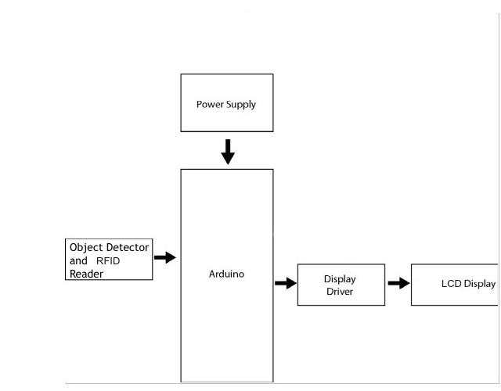
Project Diagram

Slide 5
Used Components, Software and Total Cost
Used Components:
1. Arduino UNO = 1100 tk.
2. LCD (Liquid Crystal Display) = 200 tk.
3. 16 × 2 LCD Module = 150 tk.
4. Power Supply Module = 100 tk.
5. RFID Sensor = 200 tk.
6. Jumper Wire 40 Pcs Set = 100 tk.
7. Others = 200 tk.
Software/Language:
1. Arduino IDE
2. Programming in C/C++
Total = 2050 tk (approx.)

Slide 6
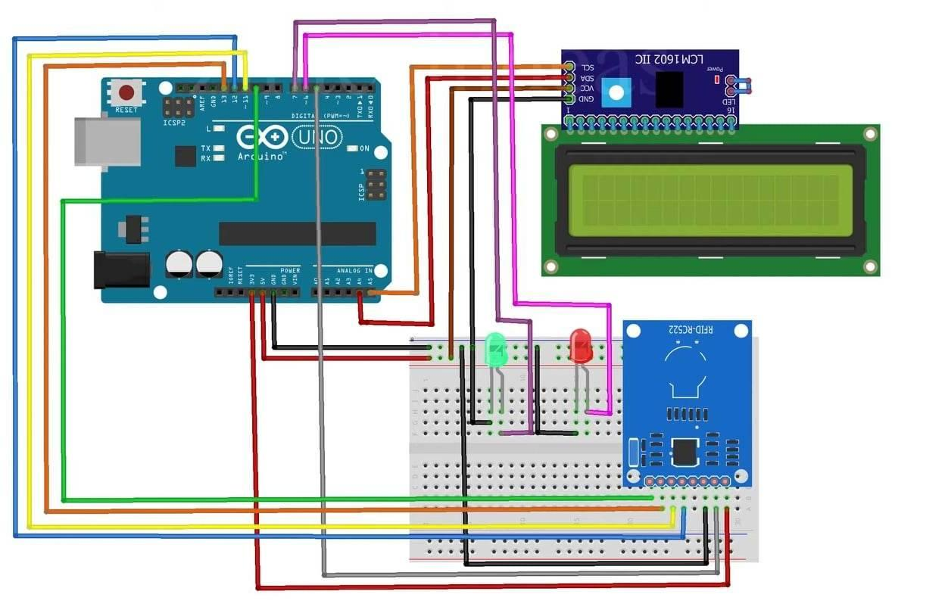
Connection

Slide 7
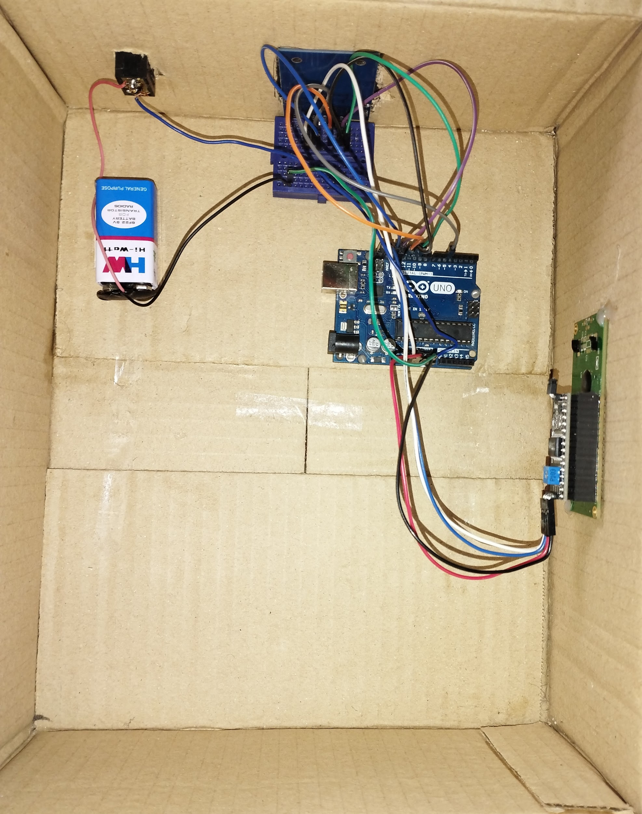
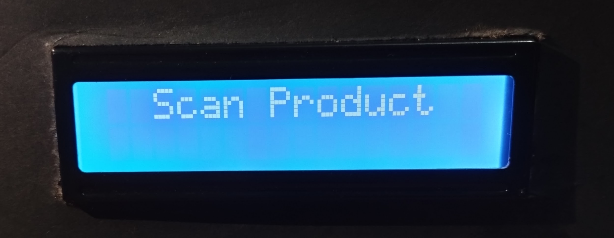
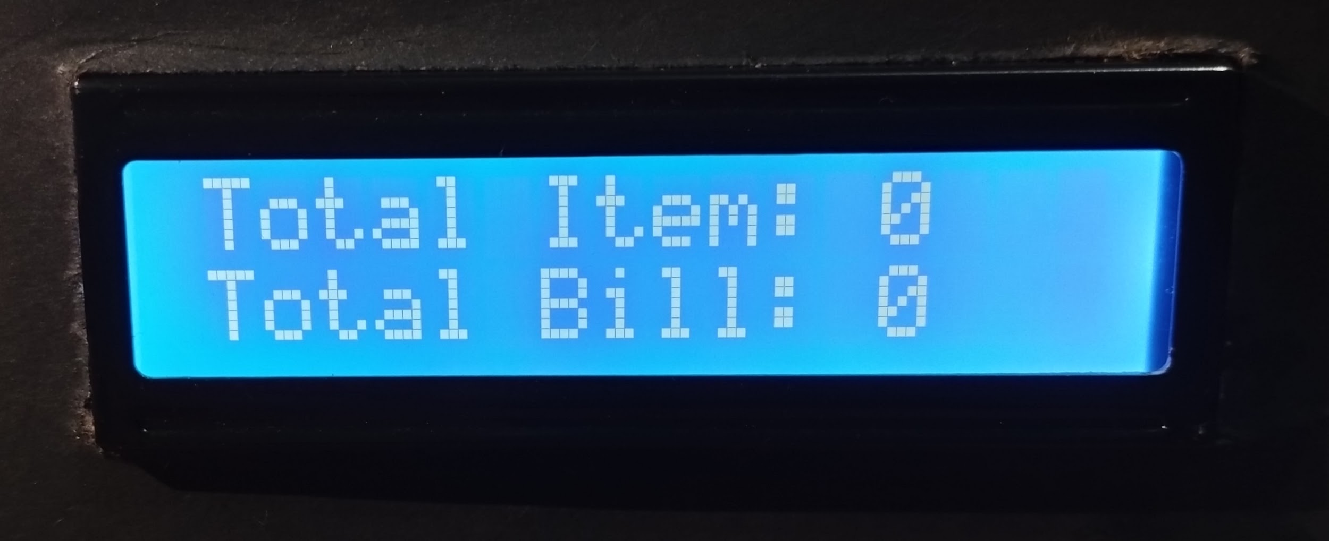
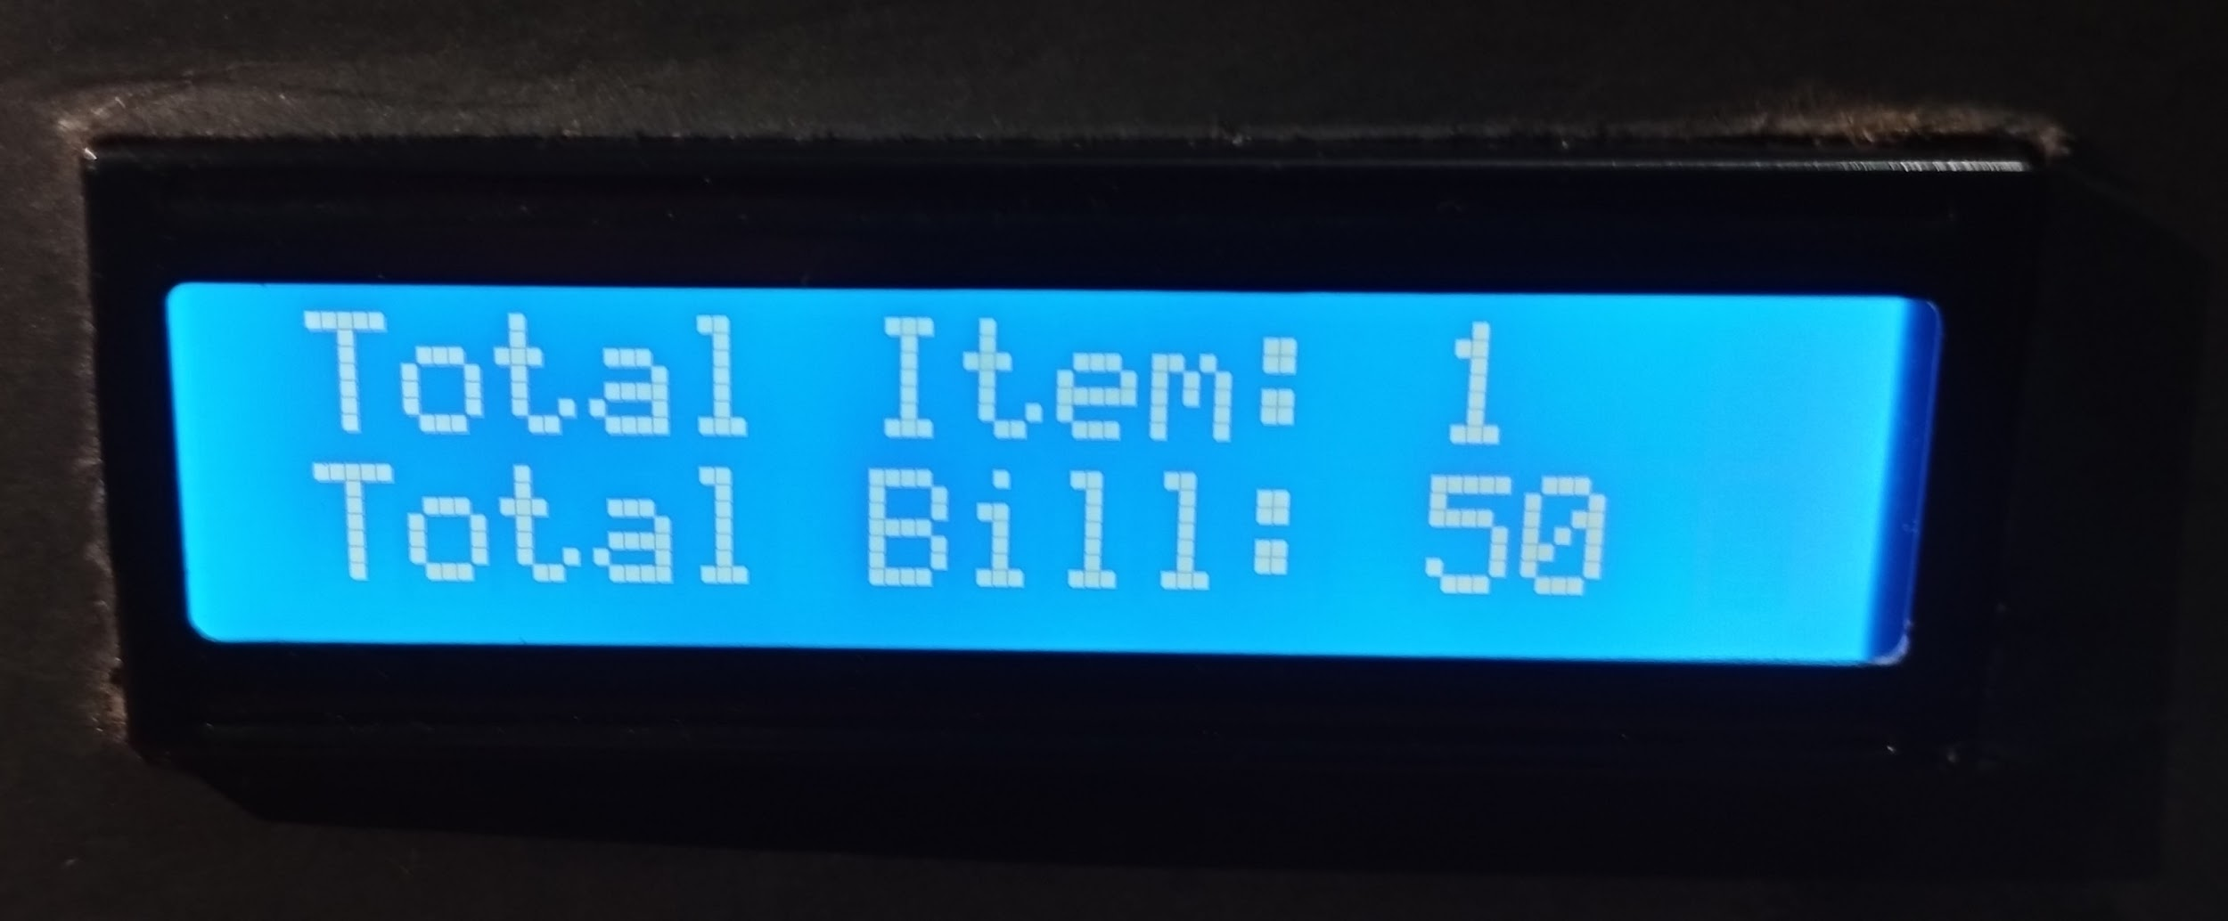
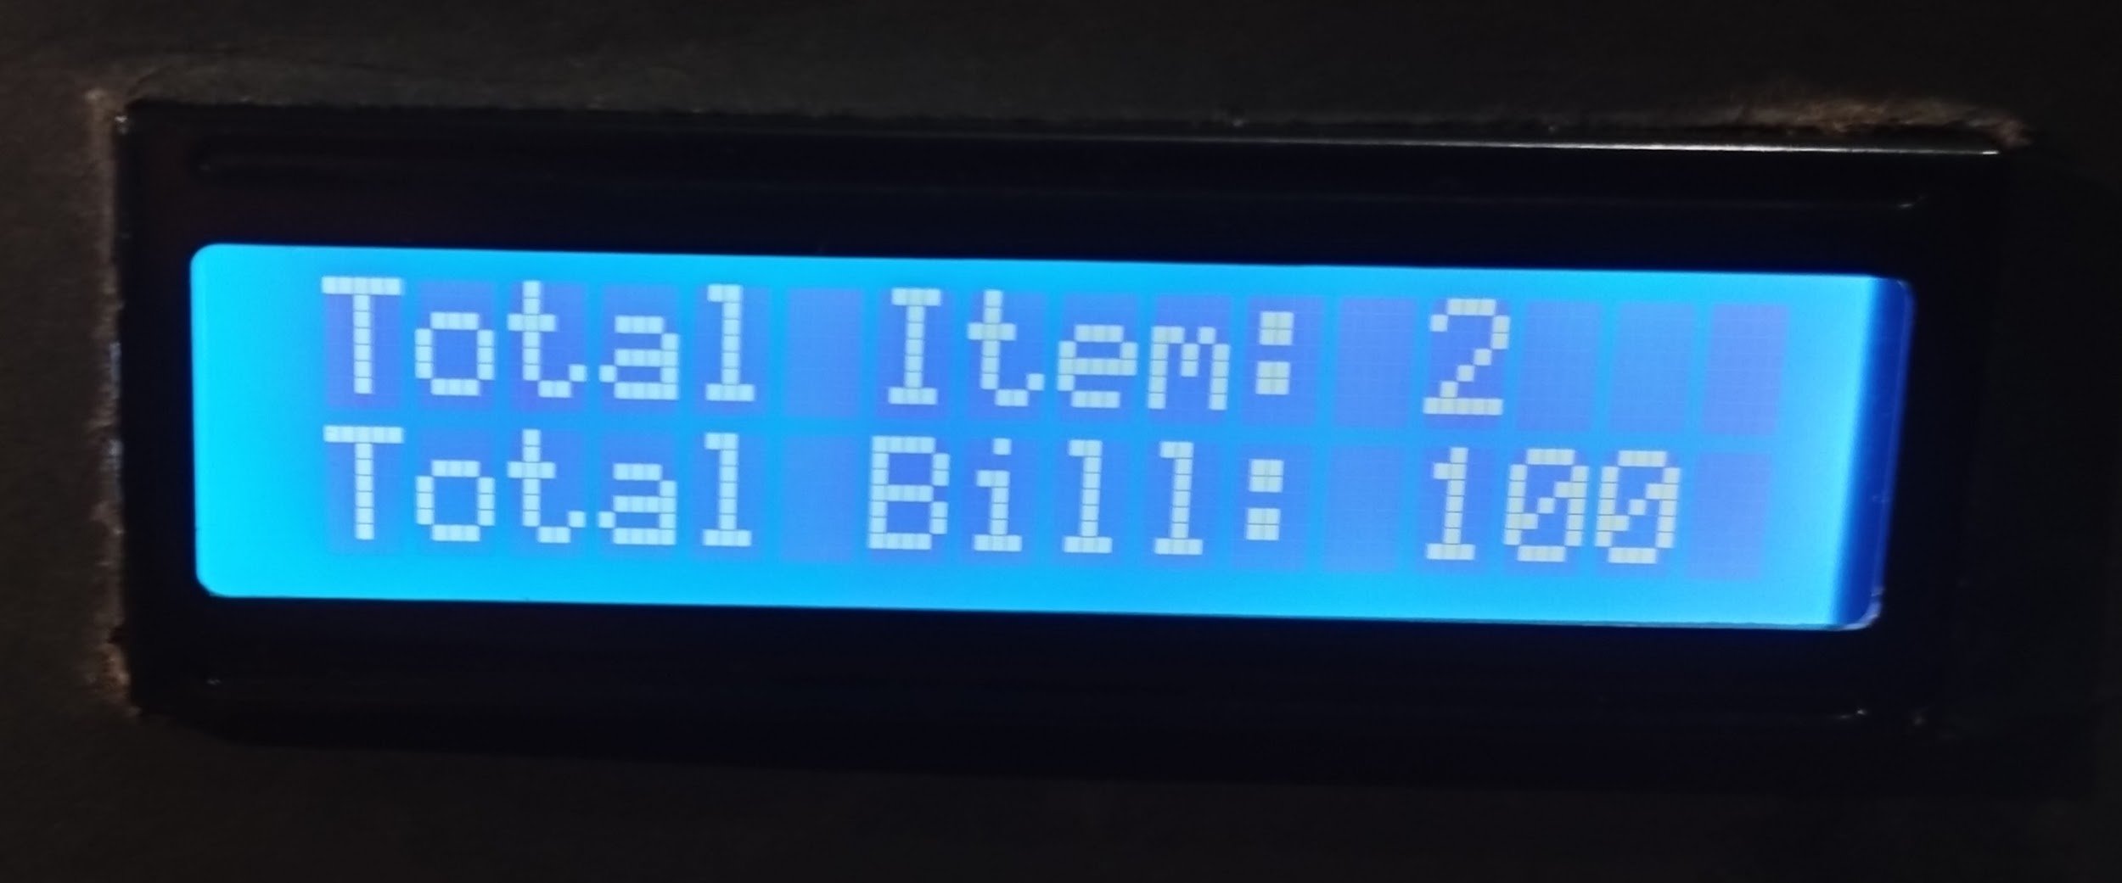
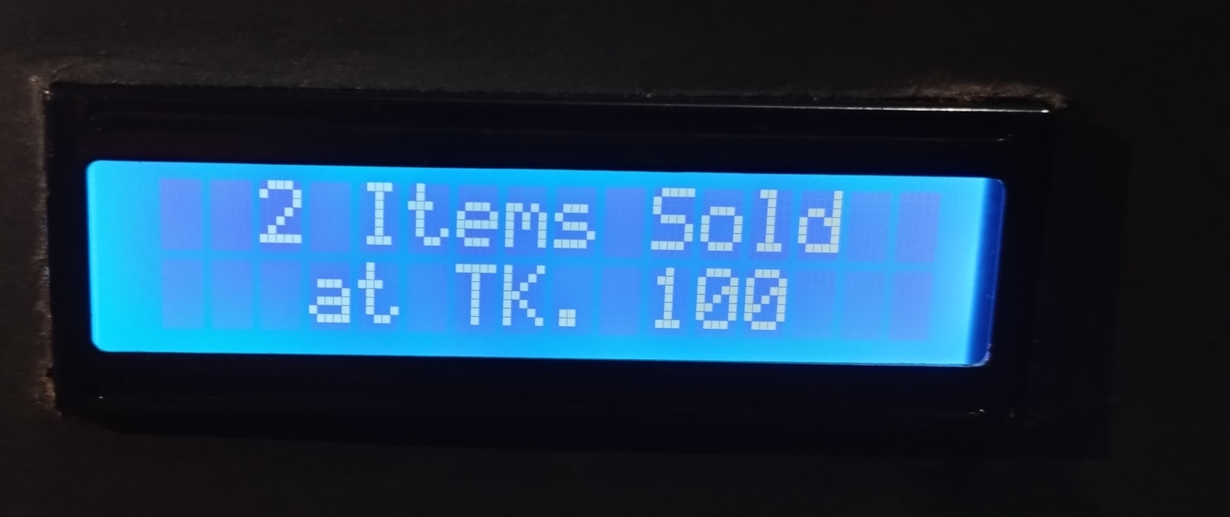
Final Outcome

Slide 8
ADVANTAGES :
1. User interactive system.
2.Time saving.
3. Ensures security.
4. Less Implementation cost.
5. Accurate product counting and bill.
DISADVANTAGES :
1. Can read only single item in this prototype RFID reader can read RFID tag in the order few cm distance.
2. Can read only single item at a time.
APPLICATIONS :
1. Super markets.
2. Shopping centre.
3. In counting objects.

Slide 9
FUTURE SCOPE
1. Development of project can be done in many ways, where RFID tags can be replaced by RFID stickers which are small in size, low cost.
2. Multiple RFID tags can be read using a single RFID reader for more number of products which are added in the cart.
3. Database can be used store details.
4. Online Payment Method can be added.

Slide 10
Thank You

