Slide 1
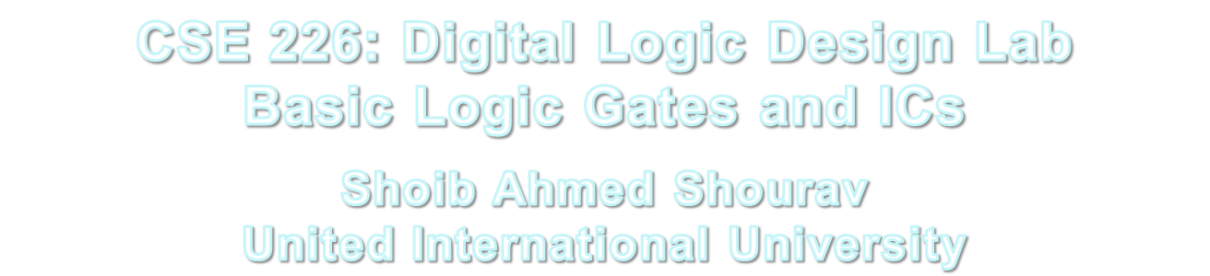

Slide 2
Basic Gates and ICs
74LS00 Quad 2-Input NAND gate
74LS02 Quad 2-Input NOR gate
74LS04 Quad 2-Input NOT gate
74LS08 Quad 2-Input AND gate
74LS32 Quad 2-Input OR gate
74LS86 Quad 2-Input XOR
CSE 226: Digital Logic Design Lab

Slide 3
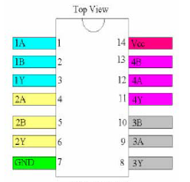
An IC
CSE 226: Digital Logic Design Lab

Slide 4
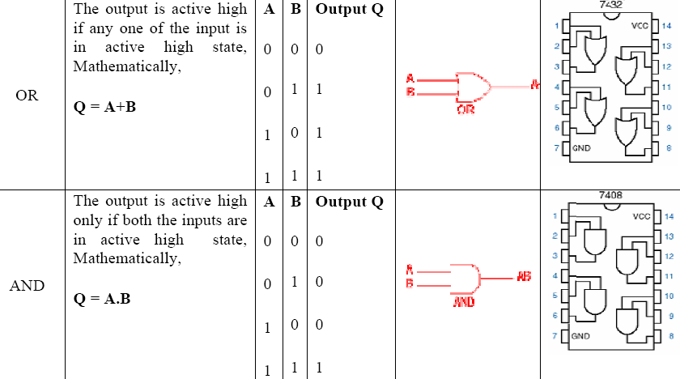
OR, AND
CSE 226: Digital Logic Design Lab

Slide 5
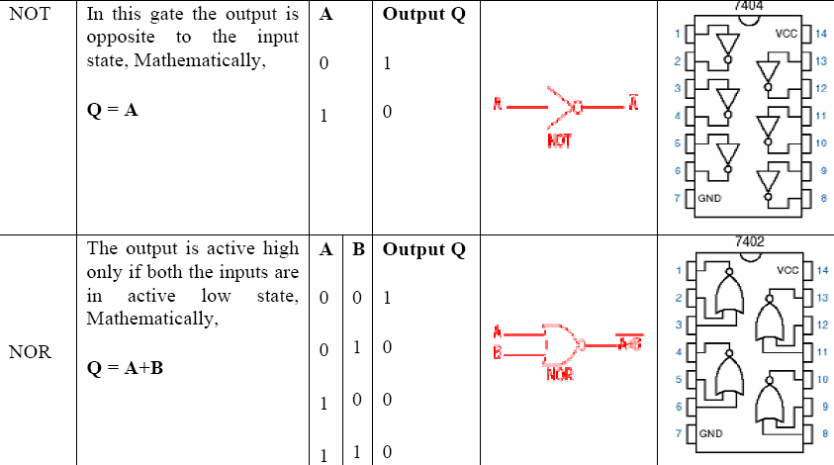
NOT, NOR
CSE 226: Digital Logic Design Lab

Slide 6
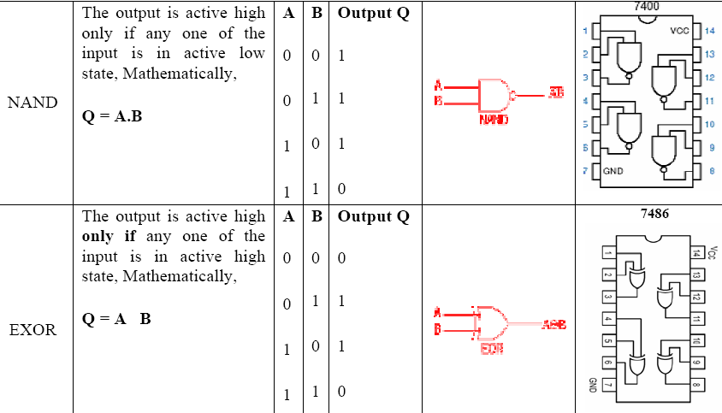
NAND, EXOR
CSE 226: Digital Logic Design Lab

Slide 7
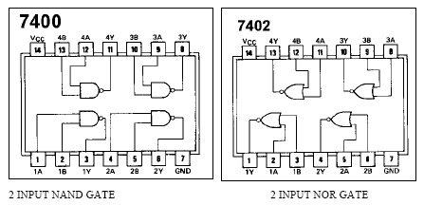
NAND, NOR
CSE 226: Digital Logic Design Lab

Slide 8
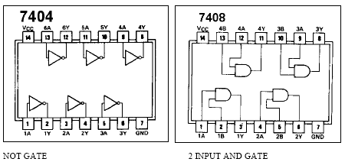
NOT, AND
CSE 226: Digital Logic Design Lab

Slide 9
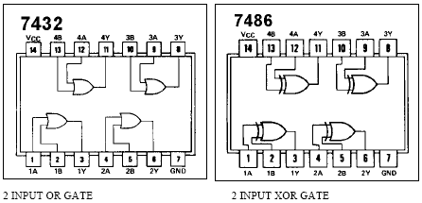
OR, XOR
CSE 226: Digital Logic Design Lab

