Slide 1
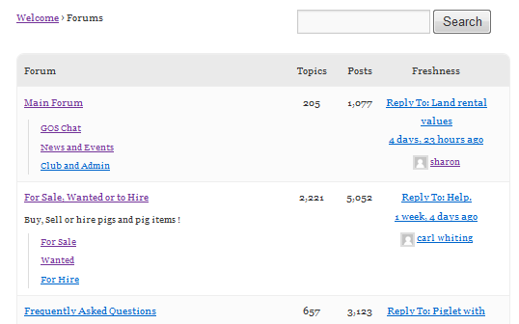
1
5
4
15
3
3
3
2
3
3
5
6
9
13
14
1
7
11
10
8
1
12
2

Slide 2
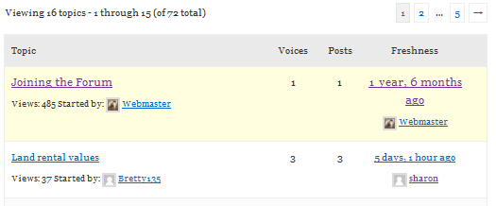


2
21
2
2
2
12
10
11
1
13
13
13
13
15
3
4
9
2
2
20
8
14
17
7
18
19
5
6
7
16
6

Slide 3
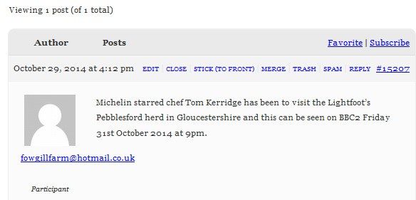


This box is styled in Topics Index 10, 11 & 12
10
10
5
2
11
17
18
8
19
16
6
23
1
7
15
3
9
12
4
13
14
21
22
20

Slide 4


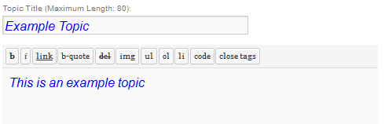
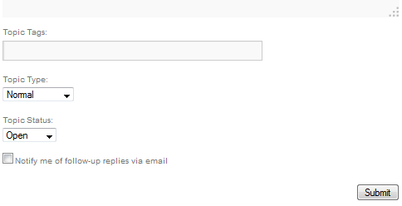
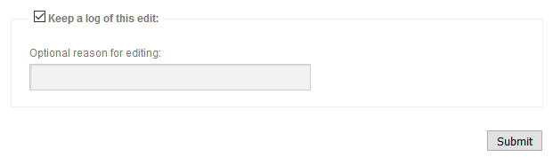
10
12
16
1
3
2
4
2
9
3
2
1
3
18
11
2
1
1
6
1
7
8
5

Slide 5
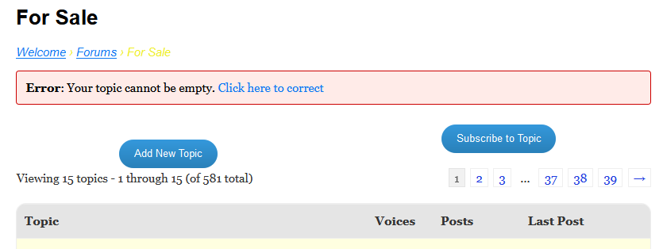
17

Slide 6
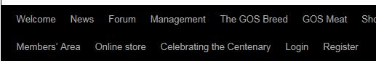


Slide 7
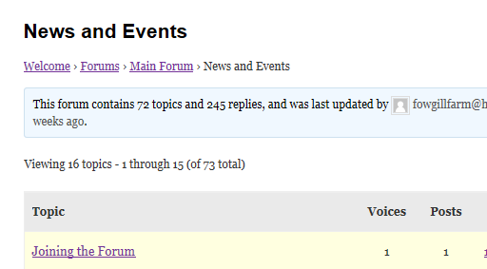
Home
Root
Current
Breadcrumbs

Slide 8
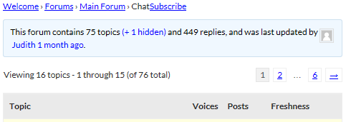
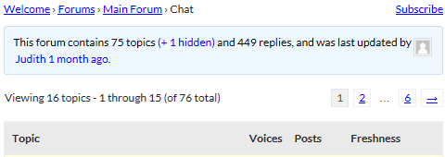

Slide 9
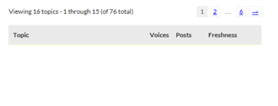

Slide 10

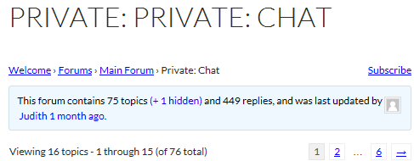


Slide 11

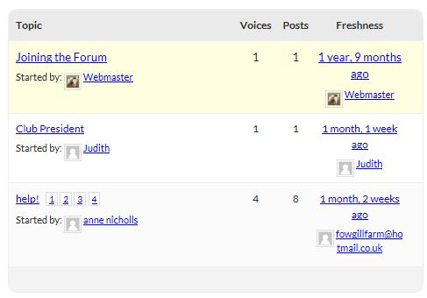

Slide 12
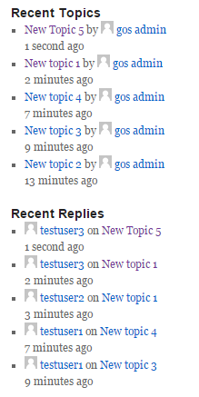
Original topic author always shown
Repeated topics for multiple replies

Slide 13
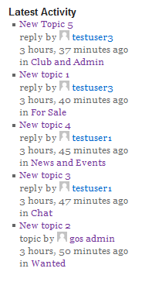

Slide 15
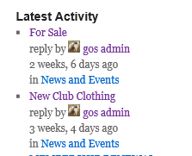
1
2
3
4
5
3
6
7
8

Slide 16
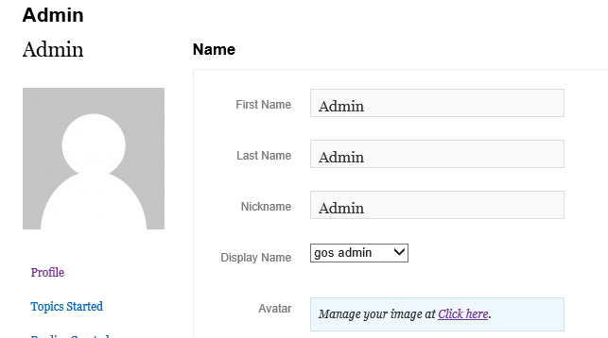
1
2
4
3
The url this links to

Slide 17
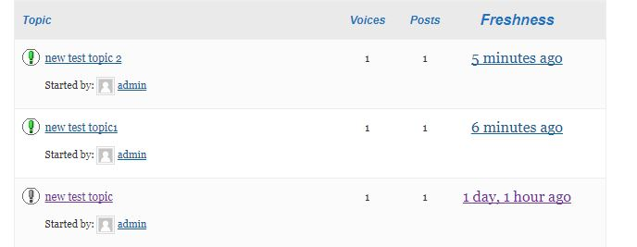
1
2

Slide 18
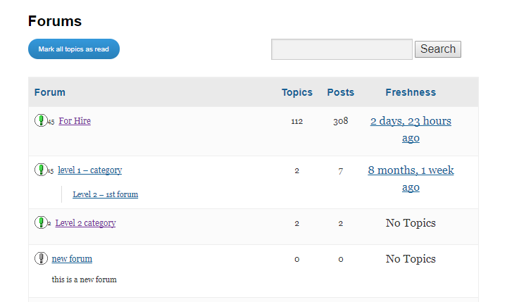
4
3
1
2

Slide 19
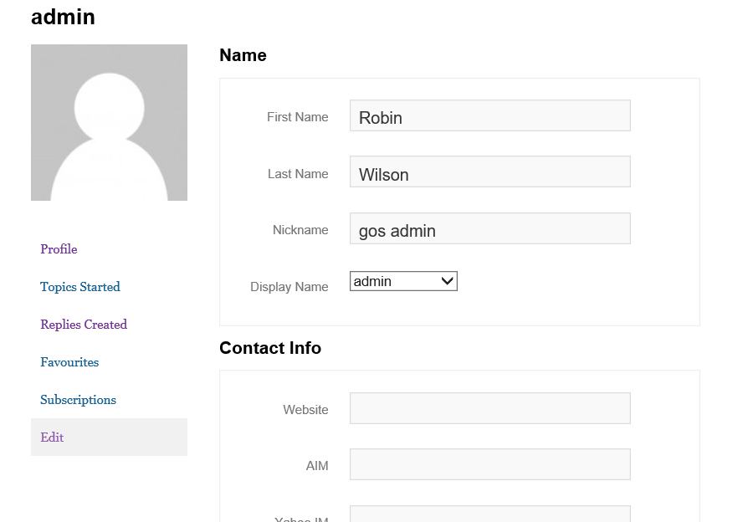
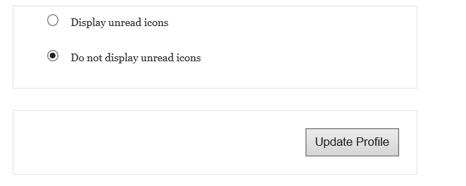
5

Slide 20
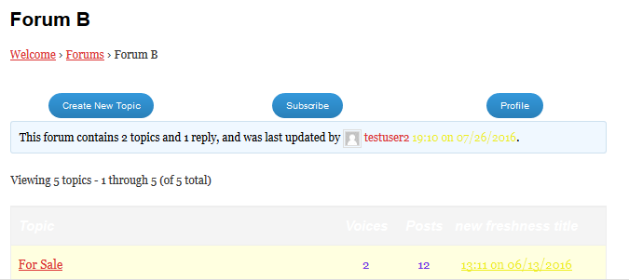

Slide 21
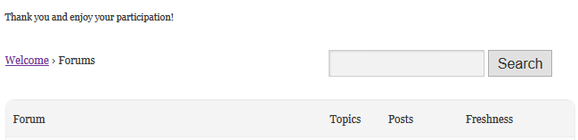
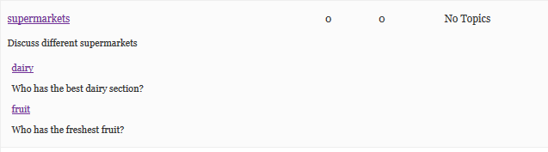

Slide 22


Slide 23


1
2
4
5
3
6
7

Slide 24
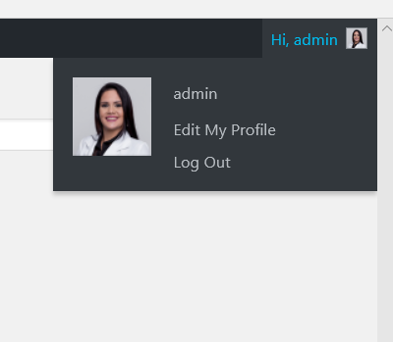
6

Slide 25
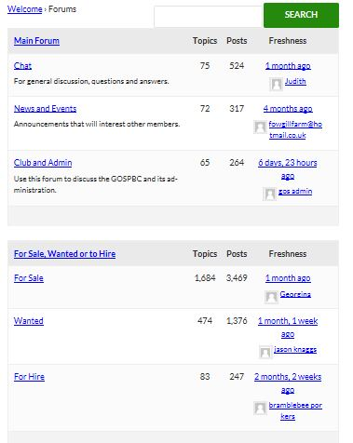
Category
Forums with
above category as parent

Slide 26
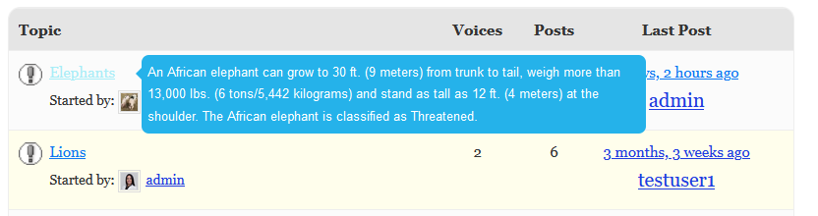
Cursor hover on title
Topic content appears

Slide 27
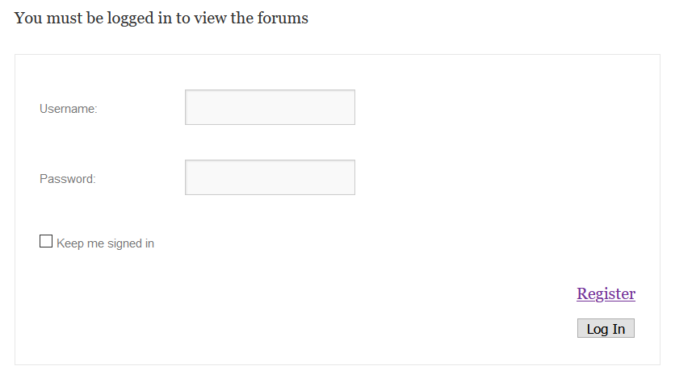
Message
Not Logged in
Logged in

Slide 28
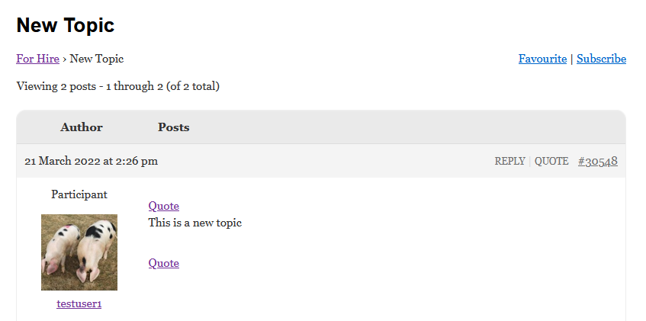
2
2
2

Slide 29

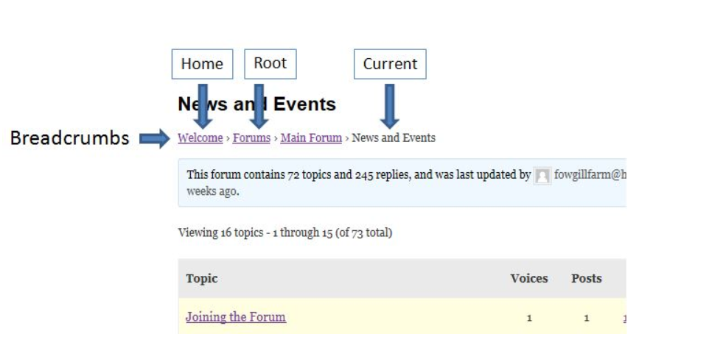
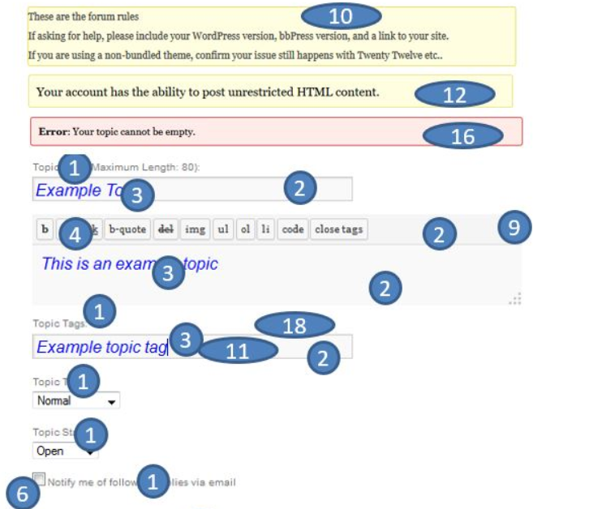
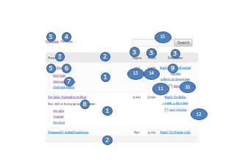
Style bbPress easily
Add lots of useful features
Change the look and feel of bbPress

Slide 30

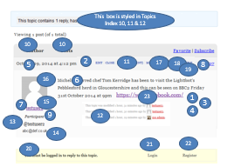
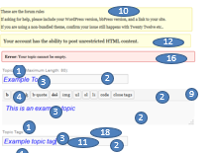

Style bbPress easily
Add lots of useful features
Change the look and feel of bbPress
This is the one for the 722*250 jpg
I’ve also saved it as the bigger one
This is the 128 logo
This is the 256 logo

