Slide 1
Workshop on Web Development with .NET & React
Hosted by: Ali Ahnaf

Slide 2

The Internet
A long piece of wire connecting our computers across the world

Slide 3

The Internet
Some of these computers are online 24/7.
They are called servers
Servers serves files/contents to computers

Slide 4
The Internet
DNS Servers stores the IP address
www.google.com
216.58.210.46
ISP
DNS Server

Slide 5
The Internet
DNS Servers stores the IP address
IP addresses are delivered to the Internet Backbone to point to the specified server
Random Server
216.58.210.46
www.random.com
216.58.210.46
ISP
DNS Server
Internet Backbone

Slide 6
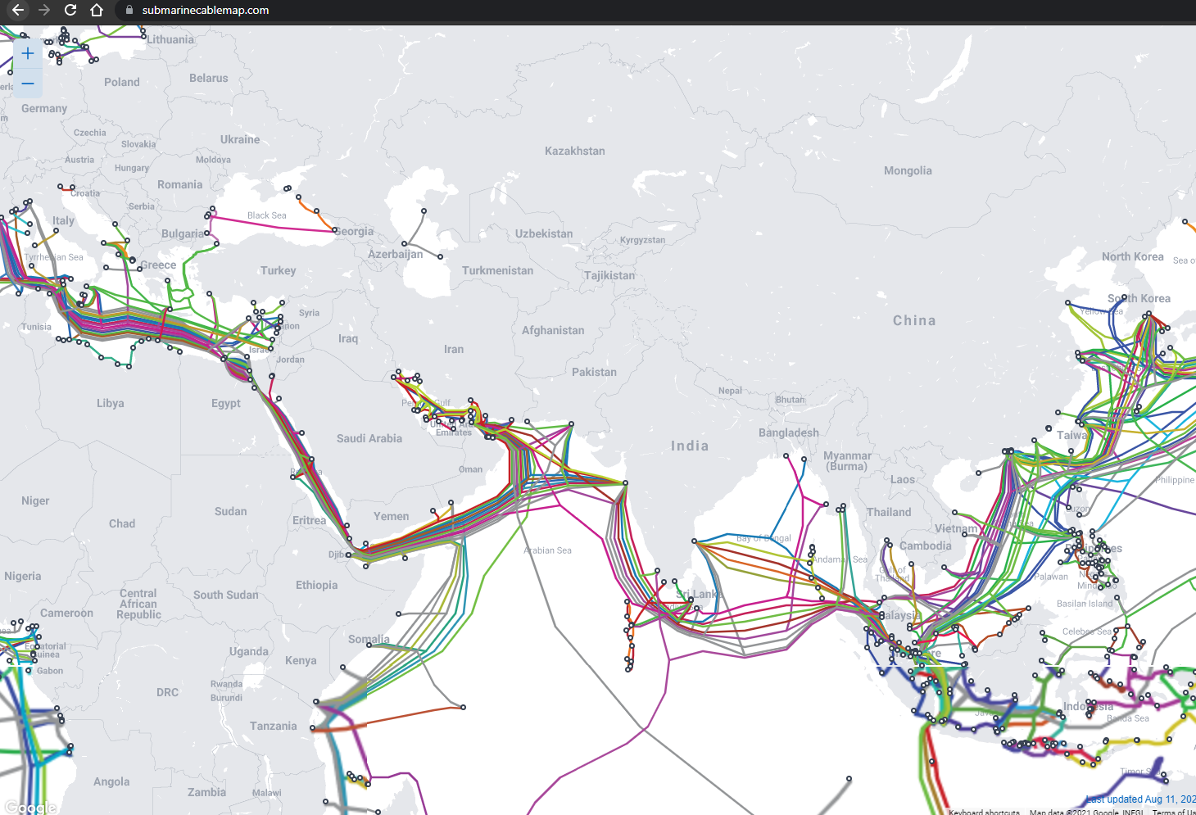
The Internet Backbone
Contains a set of submarine cables

Slide 7
The Internet
The server will serve the client with the following content: HTML, CSS and Javascript
Random Server
www.random.com
216.58.210.46
CONTENT
216.58.210.46
ISP
DNS Server
Internet Backbone

Slide 8




Front End
The front end contains the visual content that the user sees in a website.
They are made using HTML, CSS and Javascript.
Frameworks
Frameworks are libraries that make life easier.
Bootstrap
React
Angular
Vue

Slide 9
Back End
The back end contains the logic behind all the user requests.
For example:
It serves the HTML, CSS, or Javascript contents
It stores user’s information in a database
Manages user accounts

Slide 10
Back End
Some of the popular backend frameworks are:
.NET
Django
Express.js
Laravel
Spring Boot

Slide 11

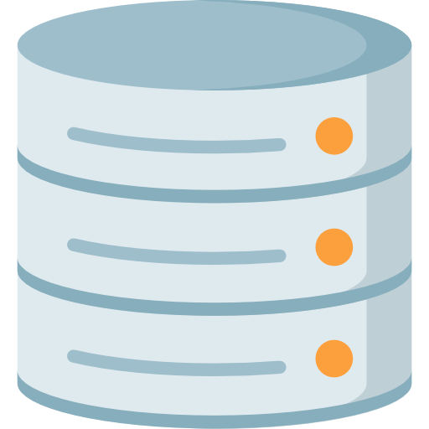
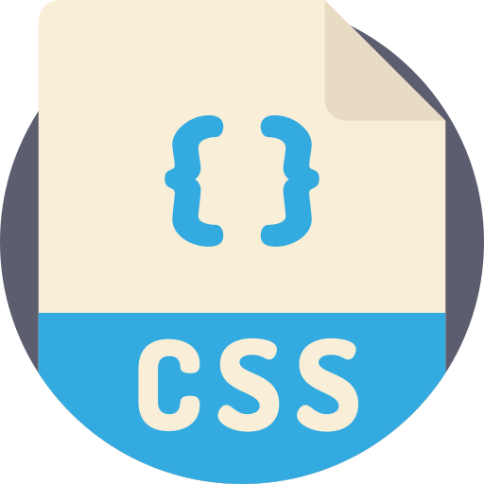

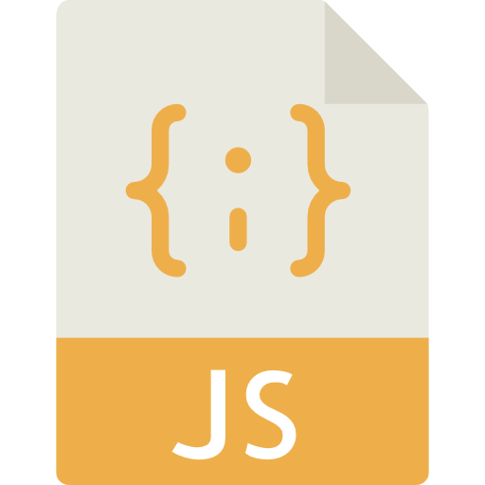
Web Development
The front end and the back end together, makes a website.
Front end
Back end
Notes:
Talk about the restaurant analogy. Restaurant has 3 segments. The diner. The kitchen. And a storage place to keep ingredients.

Slide 12
APIs
Stands for Application Programming Interface
It contains a set of rules that delivers your request to the server and gets back the response from the server back to you
Request
Response
Notes:
Talk about the restaurant analogy. The waiter who takes your order is an API. It simply transfers your request to the server and gets the response from the server to you.

Slide 13
API Architectures
There are several agreed upon rules for designing APIs
Some of them are:
REST
SOAP
RPC
GraphQL
Notes:
Talk about the restaurant analogy. The waiter who takes your order is an API. It simply transfers your request to the server and gets the response from the server to you.

Slide 14
REST API
REST stands for “Representational State Transfer”
Exposes data as resources where each resource is an entity
Uses HTTP methods to represent CRUD (Create, Read, Update, Delete) operations, such as GET, POST, PUT or DELETE
Provides Status Codes within a response to identify whether the operation succeeded or not
Status code | Meaning
2XX | Success
3XX | A resource has been moved
4XX | Error from the client side
5XX | Error from the server side
Notes:
If someone asks: HTTP provides a standard for web browsers that facilitates users to exchange information over internet. HTTP is used by most of the websites to access any file or page. HTTP is a request-response protocol in the client server computing mode

Slide 15
Demonstrating the React Application
We’re going to use a simple Blogging Website as a demonstration
Download the files from https://github.com/Propo41/msa-workshop.git

Slide 16
MVC Pattern
It is a software design pattern that divides a program into 3 elements:
Models: holds the data
Views: renders the visual elements
Controllers: contains the business logic
updates
Model
sees
Manipulates
View
User
Controller
uses

Slide 17
Helpers & Services
Controllers may interact with additional elements, such as:
Helpers: used for keeping boiler plate code, such as converting time from 24hrs to 12hrs
Services: keeps the code for client functionality. For example, a Restaurant Service might contain service methods such as orderFood or payCash
updates
Model
sees
Manipulates
View
User
Controller
uses
Helper
Service
Database

Slide 18
Creating a .NET project from template
$ dotnet new react

Slide 19
Anatomy of a Request
A request is made up of 4 things:
The endpoint
The method
The headers
The data (or body)
Consider the following URL:
https://api.github.com/users/propo41/repos
Here,
https://api.github.com -> this is the root endpoint
/users/propo41/repos -> this is the path
Notes:
If someone asks: HTTP provides a standard for web browsers that facilitates users to exchange information over internet. HTTP is used by most of the websites to access any file or page. HTTP is a request-response protocol in the client server computing mode

Slide 20
Anatomy of a Request
The Method
It is the type of request you send to the server. Some of them are:
GET: used to get a resource from a server
POST: used to create a new resource
PUT: used to update a resource
DELETE: used to delete a resource from a server
Headers
Headers are used to provide information to both the client and server, such as for authorizing a request to a server, or providing information for the body content.
Headers are property-value pairs that are separated by a colon, for example: "Content-Type: application/json"
Notes:
If someone asks: HTTP provides a standard for web browsers that facilitates users to exchange information over internet. HTTP is used by most of the websites to access any file or page. HTTP is a request-response protocol in the client server computing mode

Slide 21
Anatomy of a Request
The Body
The body contains the information you want to send to the server.
This is only used with POST, PUT, PATCH or DELETE requests.
Notes:
If someone asks: HTTP provides a standard for web browsers that facilitates users to exchange information over internet. HTTP is used by most of the websites to access any file or page. HTTP is a request-response protocol in the client server computing mode

Slide 22
Databases
Database is data stored in a computer, typically in a hosted server.
There are different types of databases, with the most common ones be:
SQL Databases
NoSQL Databases
Some popular NoSQL database platforms are:
Firebase
MongoDB
DynamoDB

Slide 23
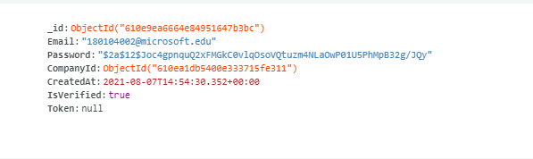
MongoDB
Document oriented database with JSON based structure
Free for limited amount of usage
Easy to set up
This is an example of how the data is stored in mongo DB

Slide 24
Demonstrate API designing

Slide 25
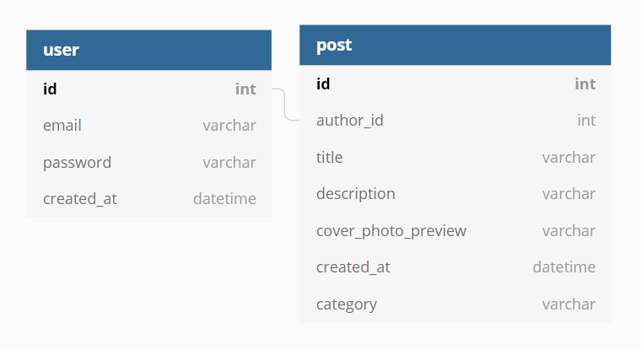
Database design
Notes:
This is not how nosql databases are designed. NoSql databases are not relational but are structured. But to keep things simple, we are using this model

Slide 26
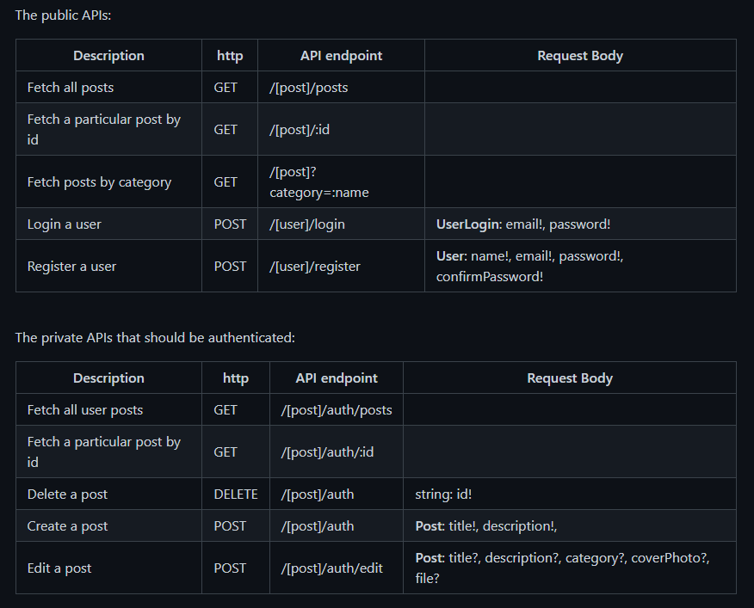
API List

Slide 27
Demonstrating how to create a login endpoint

Slide 28
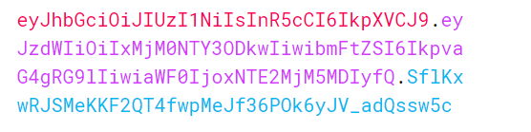
JWT Token
Stands for JSON Web Token.
It is a security validation mechanism used widely
It’s a string of random alphanumeric characters.
Has 3 parts separated by dots:
Header
Payload
Signature
Notes:
Talk about how it’s going to be used. Server creates a token and passes it to the user during log in. Future requests are made from the client by attaching this token to the request header.

Slide 29
Middleware
A middleware is a function which is executed on every request
A web application consists of several built-in middleware functions.
Middleware functions can make changes to the request and response objects.
next() is called to proceed executing the next middleware in the queue
Client
Request
Middleware 1
next()
Middleware 2
next()
Middleware 3
next()
Application Code
Notes:
Talk about how it’s going to be used. Server creates a token and passes it to the user during log in. Future requests are made from the client by attaching this token to the request header.

Slide 30
Thank you

Slide 31
References
https://www.smashingmagazine.com/2018/01/understanding-using-rest-api/
https://www.tutorialsteacher.com/core/aspnet-core-middleware

