Slide 1
Unit 2: CPU Scheduling
Kriti Mathur

Slide 2

Relate!!

Slide 3
Basic Concept
ATC manages aircraft, making decisions about landing and takeoff sequences based on various factors like flight paths, arrival times, and runway availability.

Slide 4
✈️ Air Traffic Control (ATC) as an OS Scheduler
ATC Component | OS Equivalent | Explanation
Aircraft (flights) | Processes | Each flight is like a task/process needing CPU time (runway access).
Runway | CPU | Only one aircraft can use the runway (CPU) at a time.
Flight path, arrival time, urgency | Scheduling Criteria | These are like burst time, arrival time, and priority in OS.
ATC Decision Making | CPU Scheduling Algorithm | ATC chooses based on rules (e.g., emergency landings = high priority).
Position updates & conflict resolution | Interrupt handling & preemptive scheduling | ATC reacts to live updates and may preempt other tasks.

Slide 5
🖥️ What is CPU Scheduling?
CPU Scheduling is the process by which the Operating System (OS) decides which process (program/task) in the ready queue will get to use the CPU next.
📌 Why is CPU Scheduling Important?
⚡Limited CPU resources
✅ Maximizes CPU utilization
🔄 Improving user experience

Slide 6
⚙️ CPU Burst and I/O Burst in OS Scheduling
CPU Burst
A CPU burst occurs when a process is actively executing instructions using the CPU.
This is the part where the CPU is doing the actual work for the process (calculations, logic, etc.).
CPU Burst Time
CPU burst time refers to the amount of time a process needs to utilize the CPU to complete a specific task
I/O Burst:
An I/O burst happens when a process is waiting for input/output operations to complete (like reading from a file or waiting for user input).
During this time, the CPU is idle for that process and can be given to another one.

Slide 7
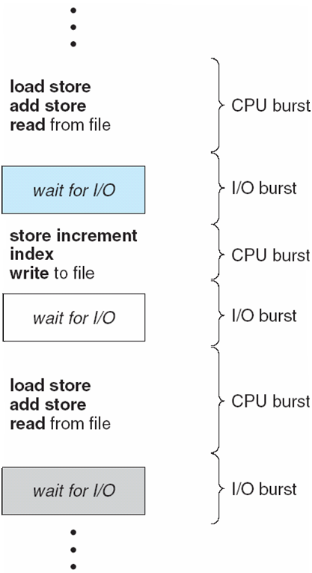
Sequence of CPU and I/O Bursts

Slide 8
🖥️ CPU Scheduling Decisions in Operating Systems
📌 When Does the OS Make Scheduling Decisions?
# | Condition | State Transition | Type of Scheduling
1 | I/O request or wait | Running → Waiting | Non-preemptive(CPU automatically released)
2 | Interrupt occurs | Running → Ready | Preemptive(OS may take CPU from current process)
3 | I/O completes | Waiting → Ready | Preemptive(newly ready process might preempt current one)
4 | Process terminates | Running → Exit | Non-preemptive(CPU becomes free; next process is scheduled)

Slide 9
✅ Key Concepts:
Preemptive Scheduling: The OS forcibly takes back the CPU from a running process (e.g., due to an interrupt or time slice expiry).
Non-preemptive Scheduling: The OS waits until the process releases the CPU voluntarily (e.g., via I/O or termination).

Slide 10

Time for Some MCQs
Notes:
C

Slide 11
Which of the following process state transitions is/are NOT possible?
A Running to Ready
B Waiting to Running
C Ready to Waiting
D Running to Terminated

Slide 12
Transitions NOT possible: B (Waiting to Running), C (Ready to Waiting)

Slide 13
Which transitions are involved in process creation and termination?
New → Ready
Running → Terminated
Ready → Waiting
Waiting → Ready

Slide 14
A) New → Ready B) Running → Terminated

Slide 15
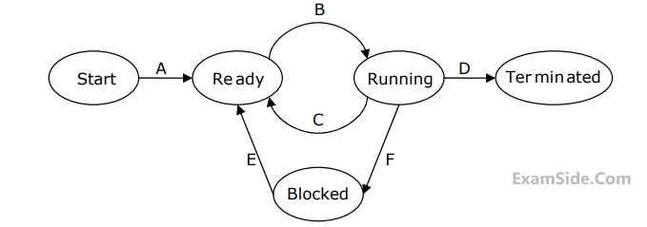
In the following process state transition diagram for a uniprocessor system, assume that there are always some processes in the ready state:
Now consider the following statements: 1. If a process makes a transition D, it would result in another process making transition A immediately. 2. A process P2 in blocked state can make transition E while another process P1 is in running state. 3. The OS uses preemptive scheduling. 4. The OS uses non-preemptive scheduling. Which of the above statements are TRUE?
A 1 and 2
B 1 and 3
C 2 and 3
D 2 and 4

Slide 16
Correct Answer 2 and 3

Slide 17
Types of CPU Scheduling
1️⃣ Non-Preemptive Scheduling
Once a process starts execution on the CPU, it runs to completion or voluntarily yields (e.g., for I/O).
The OS does not interrupt the process.
✅ Examples:
First Come First Serve (FCFS)
Shortest Job First (SJF)
Priority Scheduling (non-preemptive variant)
📌 Real-life analogy: A person at a doctor's clinic gets full time with the doctor until they leave — no interruptions.

Slide 18
2️⃣ Preemptive Scheduling
The OS can interrupt and suspend a running process to assign the CPU to another process (e.g., one with higher priority).
Used in multitasking systems for fairness and responsiveness.
✅ Examples:
Round Robin (RR)
Preemptive Priority Scheduling
Shortest Remaining Time First (SRTF)
📌 Real-life analogy: A manager may interrupt an ongoing meeting if a high-priority issue arises.

Slide 19
Scheduler
Function: Picks which process should run next from the ready queue, using defined algorithms.
Types:
Long‑term scheduler (Job scheduler) – admits new processes, controlling multi-programming level.
Medium‑term scheduler – swaps processes in and out to manage memory and I/O blocking.
Short‑term scheduler (CPU scheduler) – selects the next process for CPU execution.

Slide 20
Dispatcher
Function: Executes how the chosen process actually starts running on the CPU.
Responsibilities (upon scheduler’s selection):
Save current process context and load next process context.
Switch processor from kernel mode to user mode.
Jump to the next instruction of the selected process.
Latency: This context‐switching delay is known as dispatch latency.
Dependency: Cannot act without scheduler’s decision—only dispatches processes ordered by the scheduler.

Slide 21
Key CPU scheduling criteria
Which algorithm to use in a particular situation
✔️ 1. CPU Utilization
Definition: The percentage (%) of time the CPU is actually doing work (not idle).
Goal: Maximize — systems aim for high CPU activity (typically 40–90% utilization in real environments)
✔️ 2. Throughput
Definition: Number of processes completed per unit time (e.g., jobs/sec).
Goal : Maximize — the more processes finished, the more efficient the system.
✔️ 3. Turnaround Time (TAT)
Definition: The total time from the moment a process is submitted to the time it completes.
TAT = Completion Time – Arrival Time

Slide 22
✔️ 4. Waiting Time:
Definition:The total time a process spends in the ready queue waiting to be assigned to the CPU.
Waiting Time = Turnaround Time - Burst Time
✔️ 5. Response Time:
Definition: The time from the submission of a request (or process) until the first response is produced (i.e., the process starts execution), not when it finishes.
Response Time = First CPU Allocation Time - Arrival Time
✔️ 6. Load Average:The average number of processes in the ready queue (waiting to use the CPU) over a specific period of time.

Slide 23
Scheduling Algorithm Optimization Criteria
CPU Utilization
Throughput
Turnaround Time
Waiting Time
Response Time
Fairness

Slide 24
🔹 First Come First Serve (FCFS)
✅ Definition: FCFS is the simplest CPU scheduling algorithm where the process that arrives first is executed first.
🕒 Scheduling Order: Based on the arrival time of processes — the earliest arriving process gets the CPU first.
🚫 Non-Preemptive: Once a process starts execution, it runs to completion without interruption.
📊 Queue-based: Processes are maintained in a FIFO (First-In-First-Out) queue.
📉 Easy to implement: Simple and straightforward, requiring minimal overhead.
⏳ High waiting time possible: If a long process arrives first, shorter processes have to wait longer
(known as the convoy effect).
⚠️ Not ideal for interactive systems, where quick response time is important.

Slide 25
📘 Example: Assume we have the following processes:
Process | Arrival Time | Burst Time
P1 | 0 | 2
P2 | 1 | 2
P3 | 5 | 3
P4 | 6 | 4
Draw the Gantt Chart and compute average Completion Time, Turnaround Time, and Waiting Time .

Slide 26
Execution Order: P1 → P2 → P3 → P4
🔹 Gantt Chart:
| P1 | P2 | P3 | P4 |
0 2 4 8 12
Calculations:
Process | Completion Time | TAT = CT - AT | WT = TAT - BT
P1 | 2 | 2 - 0 = 2 | 2- 2= 0
P2 | 4 | 4- 1 = 3 | 3 - 2 = 1
P3 | 8 | 8 - 2 = 6 | 6 - 3 = 3
P4 | 12 | 12 - 3 = 9 | 9 - 4 = 5

Slide 27
🔷 FCFS Scheduling Pseudocode
Input:
n ← number of processes
arrival[] ← array of arrival times
burst[] ← array of burst times
Output:
completion[] ← completion time for each process
turnaround[] ← turnaround time for each process
waiting[] ← waiting time for each process
Step 1: Sort all processes by arrival time (if not already sorted)
Step 2: Initialize:
time ← 0
for i ← 0 to n-1:
if time < arrival[i]:
time ← arrival[i] // CPU is idle till the process arrives
completion[i] ← time + burst[i]
time ← completion[i]
turnaround[i] ← completion[i] - arrival[i]
waiting[i] ← turnaround[i] - burst[i]
Step 3: Print or return completion[], turnaround[], waiting[]

Slide 28
Practice Problem

Slide 29
Shortest Job First (SJF)
✅ Definition: SJF is a non-preemptive CPU scheduling algorithm that selects the process with the shortest burst time
from the set of available processes.
🕒 Scheduling Basis: Among all arrived processes, the one with the smallest CPU burst time is selected next.
🚫 Non-Preemptive: Once a process starts executing, it cannot be interrupted until it finishes.
📉 Goal: Minimizes the average waiting time and turnaround time, making it more efficient than FCFS in many cases.
🧠 Requires knowledge of burst times in advance, which is not always possible in real systems.
🕳️ Starvation possible: Long processes may have to wait a long time if many short jobs keep arriving.
📋 Decision criteria:
If two processes have the same burst time, tie is broken by arrival time.
If no process has arrived yet, the CPU remains idle

Slide 30
📘 Example: Assume we have the following processes:
Process | Arrival Time | Burst Time
P1 | 1 | 3
P2 | 2 | 4
P3 | 1 | 2
P4 | 4 | 4

Slide 31
Execution Order : P1 → P4 → P3 → P2
📊 Gantt Chart:
| | P3 | P1 | P2 | P4 |
0 1 3 6 10 14
Calculations:
Process | Arrival | Burst | Completion | Turnaround | Waiting
P1 | 0 | 6 | 6 | 5 | 2
P2 | 1 | 8 | 10 | 8 | 4
P3 | 2 | 7 | 3 | 2 | 0
P4 | 3 | 3 | 14 | 10 | 6

Slide 32
🔷 Pseudocode: Shortest Job First (SJF – Non-Preemptive)
Input:
n ← number of processes
arrival[] ← array of arrival times
burst[] ← array of burst times
Initialize:
time ← 0
completed ← 0
mark[] ← array of size n, initialized to false
Repeat until completed = n:
Find process i such that:
- arrival[i] ≤ time
- mark[i] == false
- burst[i] is minimum among such processes
If such a process exists:
completion[i] ← time + burst[i]
time ← completion[i]
turnaround[i] ← completion[i] - arrival[i]
waiting[i] ← turnaround[i] - burst[i]
mark[i] ← true
completed ← completed + 1
Else:
time ← time + 1 // CPU idle

Slide 33
Practice Problem
Consider the set of 5 processes whose arrival time and burst time are given below-
Process | Arrival Time | Burst Time
P1 | 3 | 1
P2 | 1 | 4
P3 | 4 | 2
P4 | 0 | 6
P5 | 2 | 3
If the CPU scheduling policy is SJF non-preemptive, calculate the average waiting time and average turnaround time.

Slide 34
🔹 Shortest Remaining Time First (SRTF)
✅ Definition: SRTF is the preemptive version of the Shortest Job First (SJF) algorithm. The process with the shortest remaining burst time is selected to run next.
🔁 Preemptive nature: If a new process arrives with a shorter burst time than the remaining time of the currently running process, the CPU is preempted and assigned to the new process.
🕒 Dynamic decision-making: The scheduler constantly checks for new arrivals and remaining times to choose the next process.
🕳️ Risk of starvation: Long processes may be indefinitely postponed if short processes keep arriving.
📉 Minimizes average waiting and turnaround time.
⚠️ Requires knowledge of remaining burst times (often estimated in real systems).
📋 Ready queue is updated at every unit of time, selecting the process with the least remaining time.
🧠 More complex to implement due to frequent context switches and time tracking.

Slide 35
Example:
Consider the set of 4 processes whose arrival time and burst time are given below Process Id Arrival time Burst time
Process | Arrival Time | Burst Time
P1 | 0 | 5
P2 | 1 | 3
P3 | 2 | 4
P4 | 4 | 1
If the CPU scheduling policy is SRTF, calculate the average waiting time and average turn around time

Slide 36
📊 Gantt Chart
| P1 | P2 | P2 | P2 |P4|P1|P1|P1|P1|P3|
0 1 2 3 4 5 6 7 8 9 13
📋 Completion Table
Process | AT | BT | CT | TAT = CT - AT | WT = TAT - BT
P1 | 0 | 5 | 9 | 9 | 4
P2 | 1 | 3 | 4 | 3 | 0
P3 | 2 | 4 | 13 | 11 | 7
P4 | 4 | 1 | 5 | 1 | 0

Slide 37
🔹 SRTF Scheduling – Pseudocode
Input: List of processes with Arrival Time (AT) and Burst Time (BT)
Initialize:
time = 0
completed = 0
n = total number of processes
remaining_time[i] = BT[i] for each process i
is_completed[i] = false for all i
While completed != n:
Find process with minimum remaining_time among processes that have arrived (AT <= time) and are not completed
If no such process exists:
time = time + 1
continue
Execute that process for 1 unit of time
remaining_time[process] = remaining_time[process] - 1
time = time + 1
If remaining_time[process] == 0:
is_completed[process] = true
completed = completed + 1
Completion Time = current time
Turnaround Time = Completion Time - Arrival Time
Waiting Time = Turnaround Time - Burst Time
End While
Output: Completion Time, Turnaround Time, Waiting Time for all processes

Slide 38
Practice Problems
To calculate the Average Waiting Time (AWT) and Average Turnaround Time (ATAT) for the given 6 processes using the Shortest Remaining Time First (SRTF) scheduling algorithm (i.e., preemptive version of SJF)
Process | Arrival Time | Burst Time
P1 | 0 | 7
P2 | 1 | 5
P3 | 2 | 3
P4 | 3 | 1
P5 | 4 | 2
P6 | 5 | 1

Slide 39
🔷 Priority Scheduling
✅ Each process is assigned a priority number (lower number = higher priority or vice versa, based on convention).
🕒 The CPU is allocated to the process with the highest priority among the ready processes.
🔁 Can be: Preemptive – A higher-priority process can preempt the running process.
⚠️ Starvation can occur if lower-priority processes keep getting postponed (can be avoided using aging).
🔄 Aging is a technique that gradually increases the priority of waiting processes to prevent starvation in priority scheduling.

Slide 40
🧾 Example
Process | Arrival Time | Burst Time | Priority
P1 | 0 | 5 | 10
P2 | 1 | 4 | 20
P3 | 2 | 2 | 30
P4 | 4 | 1 | 40
Note: Higher number = higher priority

Slide 41
📋 Completion Table
Process | Arrival | Burst | Priority | Completion | Turnaround (CT - AT) | Waiting (TAT - BT)
P1 | 0 | 5 | 10 | 12 | 12 - 0 = 12 | 12 - 5 = 7
P2 | 1 | 4 | 20 | 8 | 8 - 1 = 7 | 7 - 4 = 3
P3 | 2 | 2 | 30 | 4 | 4 - 2 = 2 | 2 - 2 = 0
P4 | 4 | 1 | 40 | 5 | 5 - 4 = 1 | 1 - 1 = 0

Slide 42
🧠 Pseudocode: Preemptive Priority Scheduling
Input:
n ← number of processes
arrival[] ← array of arrival times
burst[] ← array of burst times
priority[] ← array of priorities (lower value = higher priority)
Initialize:
remaining[] ← burst[] // Track remaining time for each process
completion[] ← [0] * n
waiting[] ← [0] * n
turnaround[] ← [0] * n
is_completed[] ← [false] * n
time ← 0
completed ← 0
current_process ← -1

Slide 43
While completed < n:
Find process i such that:
- arrival[i] ≤ time
- remaining[i] > 0
- priority[i] is smallest among available (higher priority)
If such process i exists:
If current_process ≠ i:
current_process ← i // context switch
remaining[i] ← remaining[i] - 1
If remaining[i] == 0:
completion[i] ← time + 1
turnaround[i] ← completion[i] - arrival[i]
waiting[i] ← turnaround[i] - burst[i]
is_completed[i] ← true
completed ← completed + 1
Else:
time ← time + 1 // CPU is idle
time ← time + 1

Slide 44
Practice Problem
Consider the set of 5 processes whose arrival time and burst time are given below-
Process | Arrival Time | Burst Time | Priority
P1 | 0 | 4 | 2
P2 | 1 | 3 | 3
P3 | 2 | 1 | 4
P4 | 3 | 5 | 5
P5 | 4 | 2 | 5
If the CPU scheduling policy is priority non-preemptive, calculate the average waiting time and average turnaround time. (Higher number represents higher priority)

Slide 45
🔹 Round Robin Scheduling
🔁 Round Robin (RR) is a preemptive CPU scheduling algorithm.
⏱️ Each process is given a fixed time slot called a time quantum.
🕒 If a process doesn’t finish within its time quantum, it is preempted and placed at the end of the ready queue.
✅ It is always preemptive due to the fixed time quantum.
🔄 Ensures fair sharing of CPU time among all processes.
⚖️ Good for time-sharing systems and interactive environments.
🚫 Avoids starvation, but average turnaround time may be higher than SJF.
📥 Handles arriving processes dynamically – new arrivals can enter the ready queue at any time.

Slide 46
Let's solve this Round Robin Scheduling example
Process | Arrival Time | Burst Time
P1 | 0 | 5
P2 | 1 | 4
P3 | 2 | 2
P4 | 4 | 1
🕒 Assume Time Quantum = 2

Slide 47
📋 Completion Table
Process | Arrival | Burst | Completion | Turnaround Time (CT - AT) | Waiting Time (TAT - BT)
P1 | 0 | 5 | 12 | 12 - 0 = 12 | 12 - 5 = 7
P2 | 1 | 4 | 11 | 11 - 1 = 10 | 10 - 4 = 6
P3 | 2 | 2 | 6 | 6 - 2 = 4 | 4 - 2 = 2
P4 | 4 | 1 | 9 | 9 - 4 = 5 | 5 - 1 = 4

Slide 48
📄 Pseudocode: Round Robin Scheduling
Input:
n ← number of processes
arrival[] ← array of arrival times
burst[] ← array of burst times
time_quantum ← fixed time slice
Initialize:
remaining[] ← burst[] // Remaining burst time
completion[] ← [0] * n
turnaround[] ← [0] * n
waiting[] ← [0] * n
queue ← empty list
time ← 0
mark all processes as not added to queue yet
Add first arrived processes to queue
While any process has remaining time:
If queue is empty:
time ← time + 1
Add newly arrived processes
continue
process ← queue.pop_front()

Slide 49
Contd…
If remaining[process] > time_quantum:
time ← time + time_quantum
remaining[process] ← remaining[process] - time_quantum
Add new arrivals to queue
queue.append(process)
Else:
time ← time + remaining[process]
remaining[process] ← 0
completion[process] ← time
turnaround[process] ← time - arrival[process]
waiting[process] ← turnaround[process] - burst[process]
Add new arrivals to queue (if any)
Output:
completion[], turnaround[], waiting[]

Slide 50
Practice Problem
Consider the set of 5 processes whose arrival time and burst time are given below-
Process | Arrival Time | Burst Time
P1 | 0 | 5
P2 | 1 | 3
P3 | 2 | 1
P4 | 3 | 2
P5 | 4 | 3
If the CPU scheduling policy is Round Robin with time quantum = 2 unit, calculate the average waiting time and average turnaround time.

Slide 51
Time for Some MCQs
Notes:
C

Slide 52
Which one or more of the following CPU scheduling algorithms can potentially cause starvation?
A First-in First-out
B Round Robin
C Priority Scheduling
D Shortest Job First

Slide 53
C. Priority Scheduling
D. Shortest Job First

Slide 54
Which of the following statement(s) is/are correct in the context of CPU scheduling?
A Implementing preemptive scheduling needs hardware support.
B Turnaround time includes waiting time.
C Round-robin policy can be used even when the CPU time required by each of the processes is not known apriori.
D The goal is to only maximize CPU utilization and minimize throughput.

Slide 55
Correct statements: A, B, and C

Slide 56
🔹 Multilevel Queue Scheduling
Divides the ready queue into multiple separate queues.
Each queue is designed for a specific type of process (e.g., system, user, batch).
Each queue has its own scheduling algorithm (e.g., Round Robin, FCFS, Priority).
Processes are permanently assigned to one queue based on:
Process type (system/user)
Memory size
Priority level
CPU burst characteristics
No movement of processes between queues.
Queues are scheduled based on priority levels:
Higher-priority queues are served first.
Lower-priority queues may experience starvation.
Used when system needs strict separation of process types (e.g., OS vs user tasks).

Slide 57
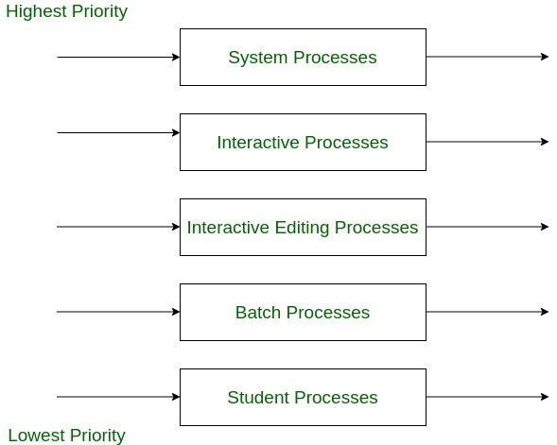
🔢 Multilevel Queue Scheduling – 5 Queue Explanation
Each queue is designed to handle a specific type of process based on its behavior, importance, or resource needs. These queues are prioritized from top (highest) to bottom (lowest):

Slide 58
🟥 System Processes (Highest Priority)
What it includes: Operating system tasks, interrupt handling, device drivers.
Reason for high priority: These are essential for the system’s core functions. Delays can cause crashes or instability.
Scheduling Algorithm: Round Robin (small time quantum like 2 ms).
Example: Keyboard/mouse input handling, memory management.
🟧 Interactive Processes
What it includes: Real-time user applications that require quick responses.
Scheduling goal: Fast response time to maintain smooth user experience.
Scheduling Algorithm: Round Robin (larger time quantum like 4 ms).
Example: Web browsers, video players, or GUI-based applications.

Slide 59
🟨 Interactive Editing Processes
What it includes: Tools used for content creation and editing.
Balance between responsiveness and workload.
Scheduling Algorithm: Priority Scheduling (based on importance of task or user).
Example: Text editors, IDEs, design tools.
🟩 Batch Processes
What it includes: Long-running jobs submitted without direct user interaction.
Scheduled only when higher queues are empty.
Scheduling Algorithm: FCFS (First-Come, First-Served).
Example: Compiling a large project, backups, report generation.

Slide 60
🟦 Student Processes (Lowest Priority)
What it includes: User-initiated or lab processes by students in academic environments.
Lowest priority to avoid interfering with system/admin tasks.
Scheduling Algorithm: FCFS or Low-Priority Round Robin.
Example: Running code, simulations, non-critical applications.

Slide 61
🧭 Foreground and Background Processes
In operating systems and CPU scheduling (including multilevel queue scheduling), processes are often classified as foreground or background based on their interaction with the user and urgency of execution.
1. Foreground Processes : Initiated by the user (e.g., opening apps, typing, browsing). Short CPU bursts, frequent I/O.
Cannot be delayed for long. They require immediate attention and quick response times.
Example: Word processors
2. Background Processes: These are non-interactive processes that run without direct user interaction. Often used for maintenance, logging, or low-priority tasks. Run in the background silently. Usually have long CPU bursts. Can tolerate delay or being preempted.
Example: Software updates

Slide 62
✅ Advantage:
Can apply separate scheduling algorithm for each queue
This is a key feature of MLQ scheduling: Each queue can use a different scheduling algorithm (e.g., Round Robin for one queue, FCFS for another), based on the process type.
❌ Disadvantages:
Until high priority queue is not empty, no process from lower priority queues will be selected
This describes strict priority scheduling used between queues in MLQ.
Lower-priority queues must wait until all higher ones are empty.
Starvation for lower priority processes
A common problem in MLQ: If high-priority queues are always busy, low-priority processes (like background or student processes) may never get CPU time.

Slide 63
Multilevel Feedback Queue (MLFQ) Scheduling
Key Concept: Unlike Multilevel Queue Scheduling (which assigns processes permanently to a queue), Multilevel Feedback Queue allows processes to move between queues based on their CPU usage pattern.
How It Works:
Multiple queues with different priority levels.
Each queue can have a different scheduling algorithm (usually Round Robin for higher priority queues, FCFS for lower).
New processes start in the highest priority queue.
If a process uses too much CPU time, it's moved to a lower-priority queue.
If a process waits too long, it may be promoted to prevent starvation.

Slide 64
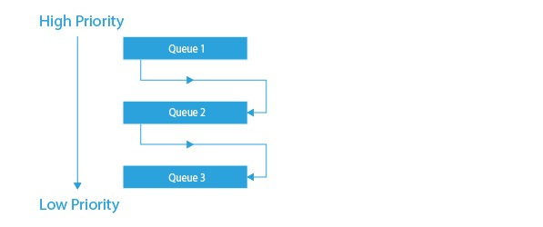
Multilevel Feedback Queue

Slide 65
🌐 Why Aging is Needed in MLFQ:
In MLFQ, high-priority queues are served first.
If many short or interactive processes keep arriving, long processes in lower queues might never get scheduled.
This leads to starvation. Aging solves this by promoting long-waiting processes up the queue hierarchy.
🛠️ How Aging Works in MLFQ:
Each process has a wait time counter. If a process stays in a lower-priority queue for longer than a defined threshold, its priority is increased. It gets moved to a higher-priority queue, making it more likely to be scheduled. This ensures fair CPU access for all processes.

Slide 66
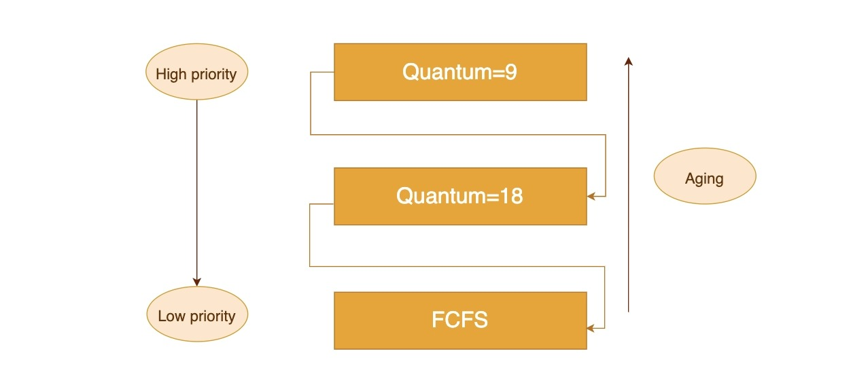
This diagram shows a Multilevel Feedback Queue (MLFQ) with:
3 priority levels:
Q1 (High): Round Robin, Quantum = 9
Q2 (Medium): Round Robin, Quantum = 18
Q3 (Low): FCFS (no time quantum)
New processes start in Q1. If they don’t finish, they move down.
Aging (right side): Long-waiting processes in lower queues are promoted upward to prevent starvation.
This balances speed for short tasks and fairness for long ones.

Slide 67
Multiprocessing Scheduling
Multiprocessing scheduling is the method used by an operating system to manage multiple CPUs working in parallel.
Types of Multiprocessing Systems:
Symmetric Multiprocessing (SMP)
All processors are equal and share scheduling duties.
Each CPU has access to the shared ready queue or its own queue.
Example: Morden operating systems(windows,Linux,Mac OS)

Slide 68
Asymmetric Multiprocessing (AMP)
One CPU is the master, others are slaves.
Master handles all scheduling and assigns tasks to slave processors.
Slaves only execute what’s assigned.
✅ Simple to implement
❌ Underutilizes other processors
Example: Early multiprocessor systems and some embedded systems.

Slide 69
Processor Affinity
Processor affinity (also called CPU pinning) is a scheduling technique where a process is "bound" or prefers to run on a specific CPU core.
Improve cache performance (data remains in local CPU cache).
Reduce context switching and memory latency.
Enhance predictability for real-time or performance-sensitive tasks.
Faster execution due to better cache locality.
May cause load imbalance in the system.
Can lead to CPU underutilization if pinned processes block one core while others are idle.
Types of Affinity:
Soft Affinity: The OS prefers to schedule the process on the same CPU it ran on before, but may change if needed.
Hard Affinity: The process is strictly restricted to run only on a specific CPU or set of CPUs (set manually or by user).

Slide 70
Load Balancing
On SMP systems, workload balance is important.
All processors should be fully utilized efficiently.
Load balancing prevents some processors from idling.
High workloads may burden specific processors excessively.
Idle processors waste system resources and efficiency.
Balanced workloads maximize the system's overall performance.

Slide 71
Two approaches to load balancing: push migration and pull migration.
1. Push migration: a specific task periodically checks the
load on each processor and—if it finds an imbalance—evenly distributes the load by moving (or pushing) processes from overloaded to idle or less-busy processors.
2. Pull migration: occurs when an idle processor pulls a waiting task from a busy processor.

Slide 72
Multicore Processors
A multi-core processor has independent cores.
It reads and executes program instructions.
A CPU may contain multiple cores.
A core includes registers and cache.
A core handles a portion of the processor's tasks, not the entire workload.
Better performance in parallel applications (e.g., video editing, simulations)
Lower power consumption than using multiple separate processors.
Enables high responsiveness in modern OS and software.

Slide 73
⚙️ Types of Multicore Processors:
Dual-Core – 2 cores
Quad-Core – 4 cores
Hexa-Core – 6 cores
Octa-Core – 8 cores
Many-Core – 16+ cores (e.g., used in servers, GPUs)

Slide 74
Memory Stall in Multicore Processors
Multiple cores share memory resources (like main memory, cache, or buses). When many cores try to access memory at once, it can lead to delays.
What is a Memory Stall?
A memory stall occurs when a processor waits (stalls) because the data it needs is not yet available from memory — especially main memory (RAM).
Memory Stall may occur due to a cache miss (accessing data that are not in cache memory).
Example:
1. LOAD R1, [X] ; Load value from memory address X
2. ADD R2, R1, #10 ; Use value loaded into R1
If the data at [X] is not in cache, the processor must stall after instruction 1 until the value is fetched from main memory,
delaying instruction 2

Slide 75
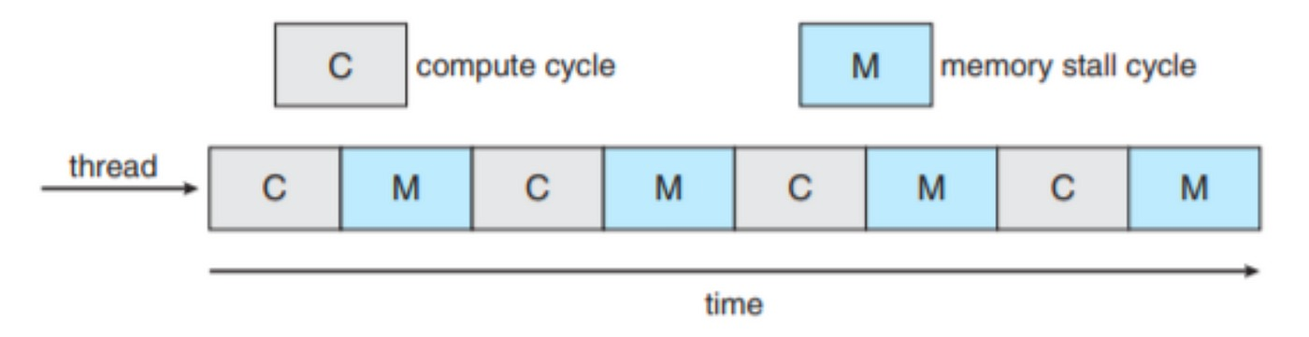
The image illustrates a sequence of compute and memory stall cycles for a single thread over time.

Slide 76
⏱️ Real-Time Scheduling
Real-time scheduling is a type of CPU scheduling designed for real-time systems, where correctness depends not only on logical results, but also on timing — tasks must be completed within a specific deadline.
Types of Real-Time Systems:
✅ Hard Real-Time Systems
Missing a deadline = system failure
Example: Airbag system, pacemaker, aircraft control
⚠️ Soft Real-Time Systems
Occasional deadline misses are acceptable
Example: Video streaming, online gaming

Slide 77
Rate Monotonic Scheduling (RMS)
✅ Static priority real-time scheduling algorithm
📉 Priority is based on the period: → Shorter period = Higher priority
🕒 Designed for periodic tasks with known execution times and periods
🔁 Preemptive: Higher priority tasks can interrupt lower ones
✅ Optimal for fixed-priority scheduling (if deadlines = periods)
❌ Not suitable for aperiodic or sporadic tasks
❌ Less flexible than dynamic algorithms like EDF
📈 Widely used in embedded, automotive, and control systems

Slide 78
Example: Let's calculate the CPU utilization for each process and the total CPU utilization using the Rate Monotonic Scheduling (RMS) model
📝 Given:
Process | Period (T) | Burst Time (C)
P1 | 50 | 20
P2 | 100 | 35
CPU Utilization Formula: U=∑(Ci​/Ti​)
Step-by-Step Calculation:
For P1: U1​=20/50​=0.4 or 40%
For P2: U2​=35/100​=0.35 or 35%
Total CPU Utilization: Utotal​=U1​+U2​=0.4+0.35=0.75 or 75%

Slide 79
⏳ Earliest Deadline First (EDF) Scheduling
Earliest Deadline First (EDF) is a dynamic priority real-time scheduling algorithm that always runs the task with the closest (earliest) deadline.
Dynamic priority: Priorities change at runtime based on deadlines.
Task with earliest absolute deadline gets the highest priority.
Preemptive: A new task with an earlier deadline can preempt the current task.
Under the EDF policy, when a process becomes runnable, it must announce its deadline requirements to the system.

Slide 80
References
1. Operating System Concepts :Authors: Abraham Silberschatz, Peter B. Galvin, Greg Gagne
2. Modern Operating Systems: Author: Andrew S. Tanenbaum
3. Operating Systems: Internals and Design Principles by William Stallings
4. GeeksforGeeks – CPU Scheduling 🔗 https://www.geeksforgeeks.org/cpu-scheduling-in-operating-systems/
5. TutorialsPoint – Operating System Scheduling
🔗 https://www.tutorialspoint.com/operating_system/os_process_scheduling_algorithms.htm

