Slide 1
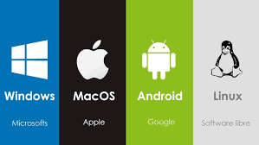
Operating Systems
The Foundation of Modern Computing

Slide 2
Table of Contents
1
Definition
7
File Systems
2
Goals
8
Process Management
3
Components
9
Security
4 Types
10 Popular OS
5
Functions
11
Conclusion
6
Memory Management
2/20
Notes:
2/20

Slide 3
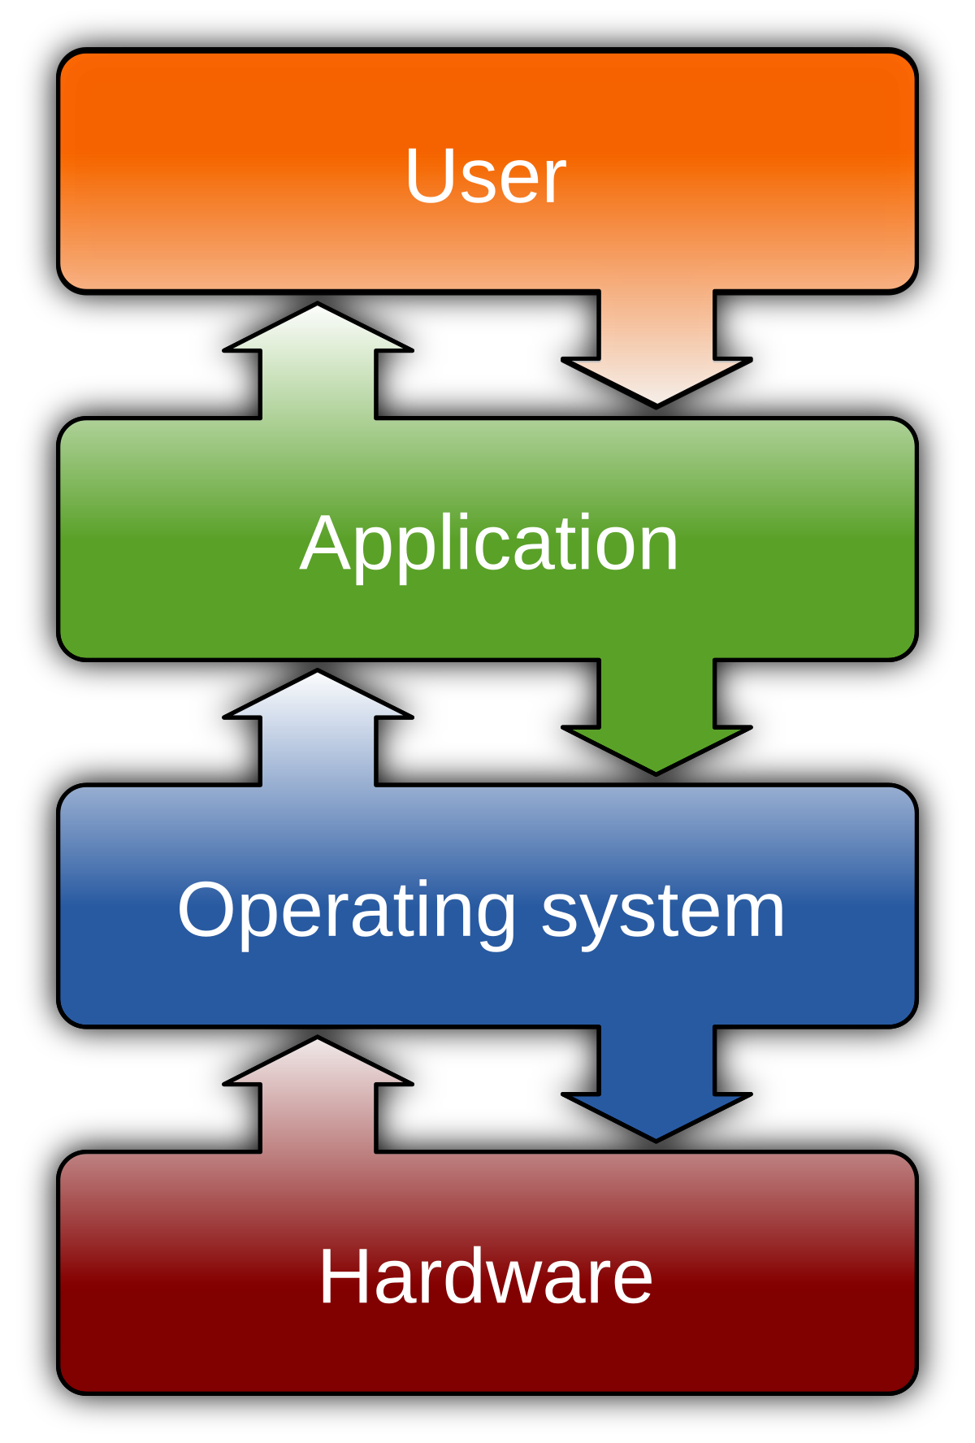
What is an Operating System?
✅ It is essential software that runs the computer.
⚙️ Controls and coordinates the use of hardware like CPU, memory, disk drives, etc.
📦 Provides a platform for software programs to run (e.g., browsers, games, word processors).
👤 Lets users interact with the computer (e.g., using a desktop, icons, command line).
🔄 Sits between the user and hardware to simplify complex tasks.
🧠 Allocates system resources (CPU time, memory, input/output) to different programs efficiently.
🧩 Offers common functions (like saving files or printing) that programs can use.
3/20
Notes:
3/20

Slide 4
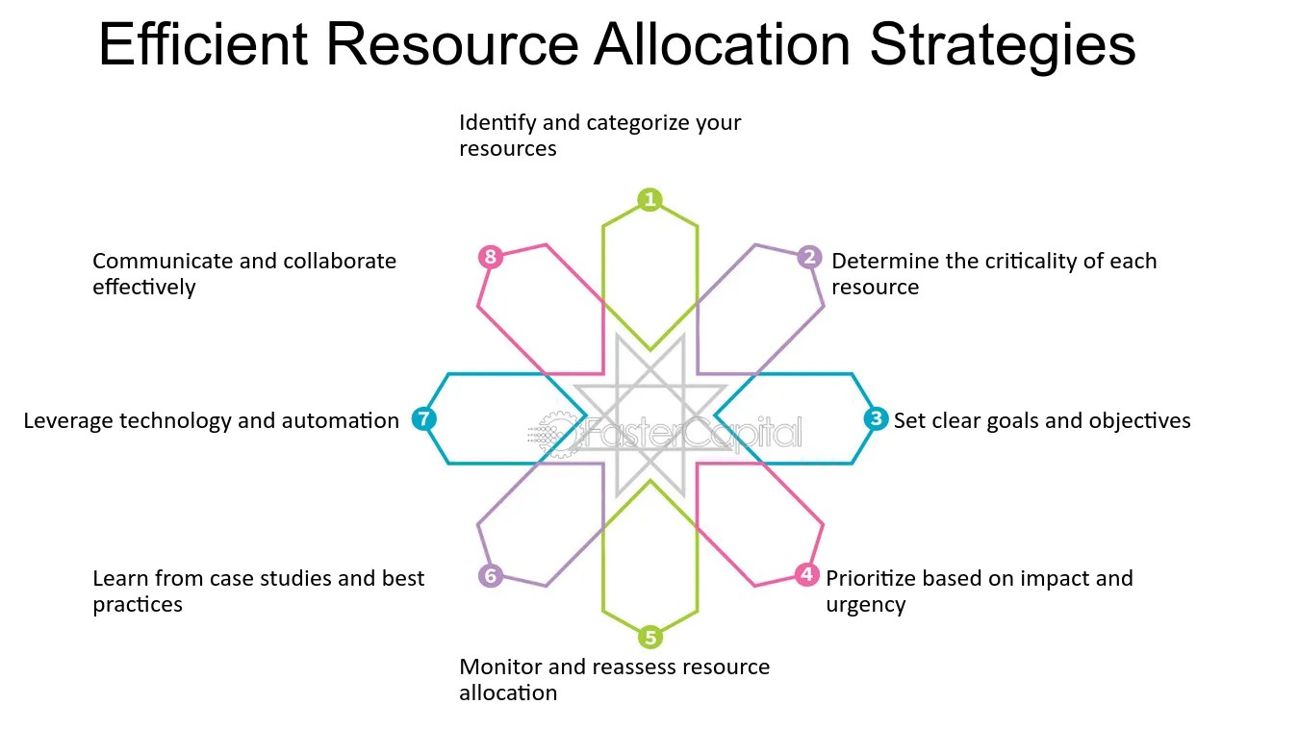
Goals of Operating Systems
Execute user programs efficiently
Allocate resources among applications Maximize convenience, efficiency, security Ensure reliability and stability
Provide user-friendly environment Balance competing needs of applications
4/20

Slide 5
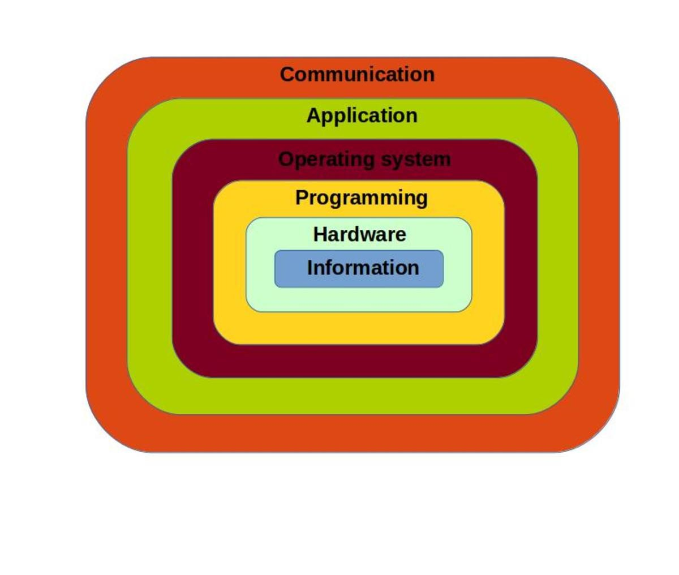
Components of a Computer System
Hardware (CPU, memory, I/O devices)
Operating system (kernel, system software) Application software (programs and utilities) Users (interacting with the system)
Network components (interfaces, protocols, connections)
Peripheral devices (printers, scanners, cameras)
5/20

Slide 6
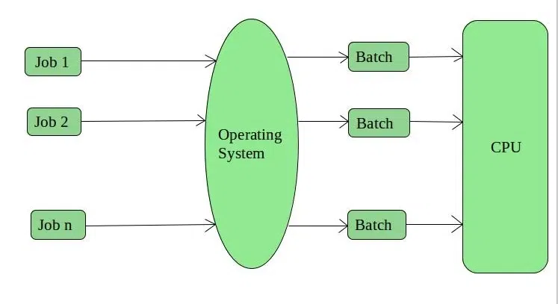
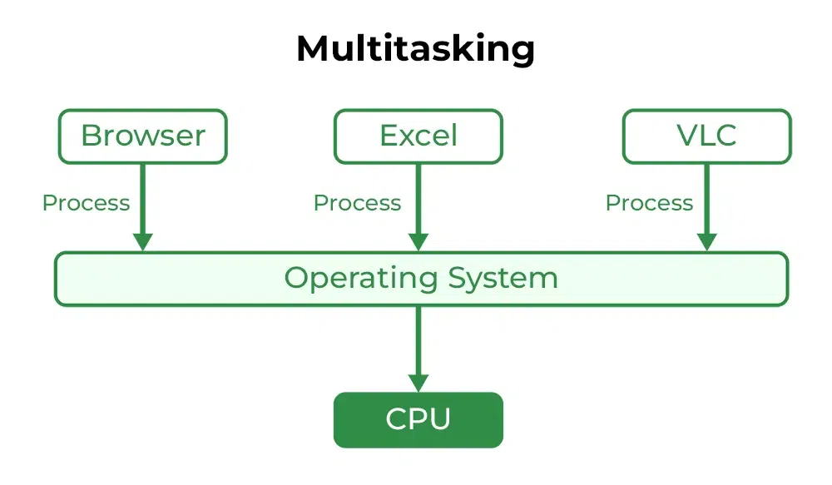
Types of Operating Systems
Batch processing systems (job queuing)
Time-sharing systems (multiple concurrent users)
6/20

Slide 7
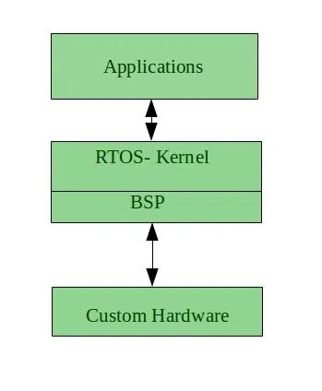
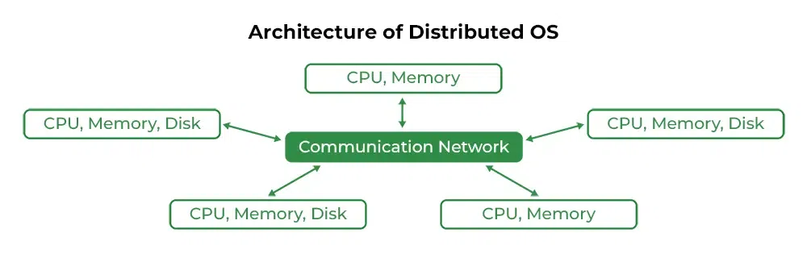
Types of Operating Systems
Real-time operating systems (instant responses)
Distributed operating systems (networked computers)
7/20

Slide 8
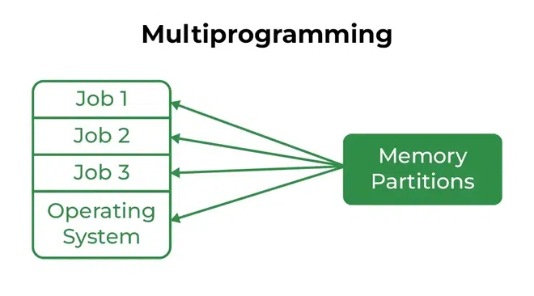
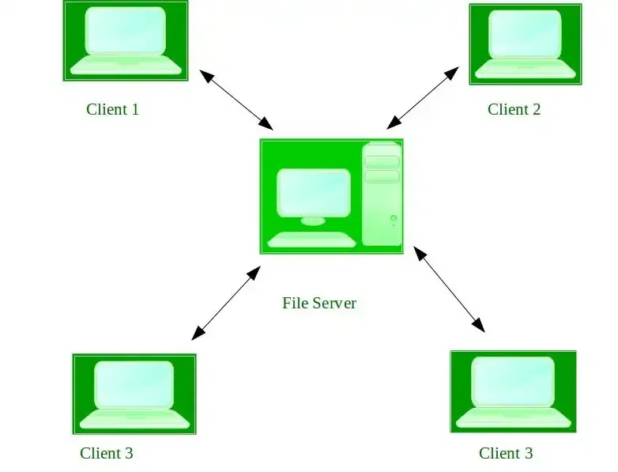
Types of Operating Systems
Multiprogramming operating system
Network operating systems (network resources)
8/20

Slide 9
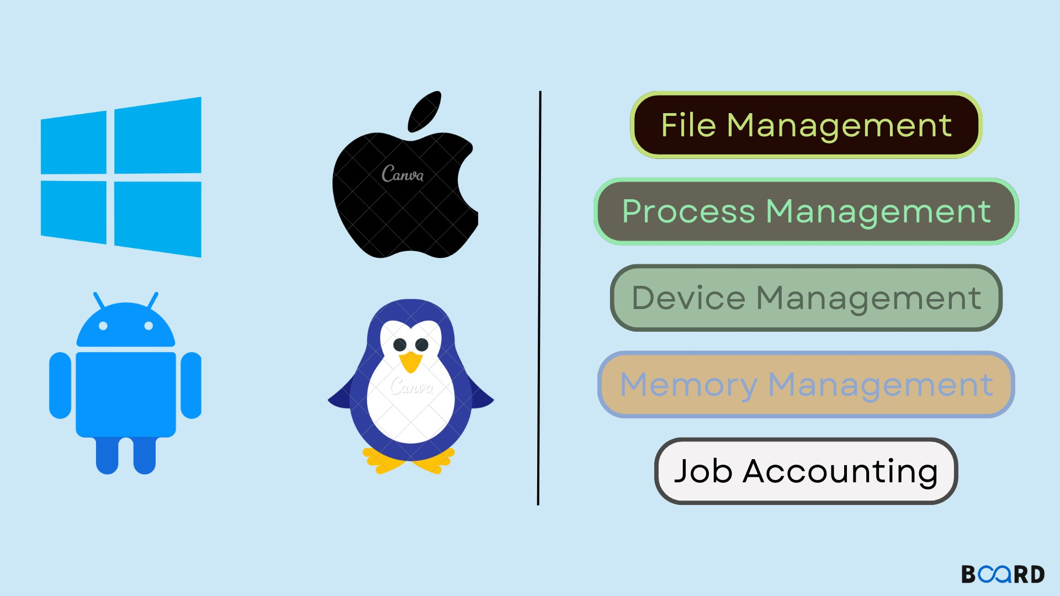
Functions of Operating Systems
Process management (running tasks efficiently)
Memory management (allocating RAM resources) File system management (storing data)
Device management (printers, storage, peripherals) Security and access control systems
User interface for human interaction
9/20

Slide 10










Memory Management
Allocates memory space to programs
Virtual memory (per process)
Physical memory
Tracks which memory is in use
Swaps data between RAM and disk
Another process's memory
Prevents processes from accessing others' memory
Implements virtual memory address translation
RAM
Optimizes limited physical memory resources
Disk
10/20

Slide 11
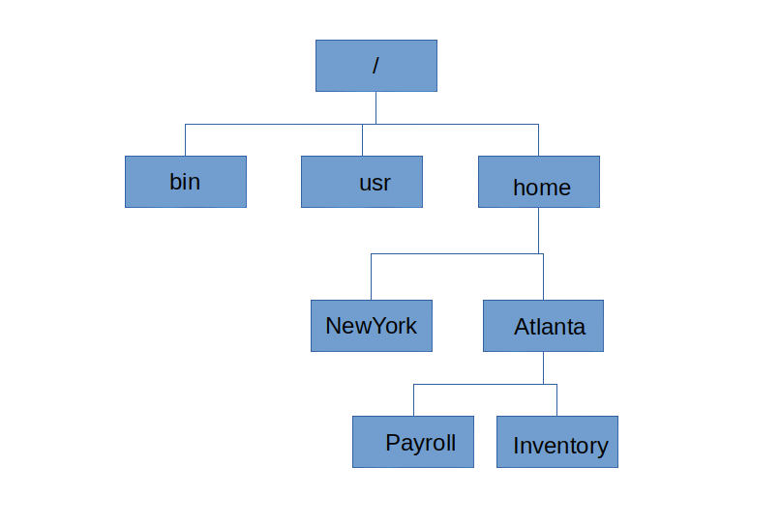
File System Management
Organizes files into hierarchical directories
Manages file access and permissions Stores, retrieves, and updates data Allocates space for file storage
Implements security and protection features Provides efficient search and navigation
11/20

Slide 12
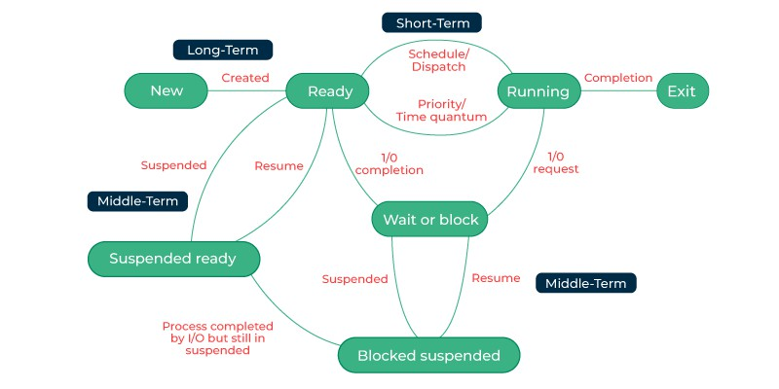
Process Management
Create, schedule, and terminate processes
Manage multitasking between different programs
Coordinate process communication and synchronization
Prevent deadlocks and resource conflicts Allocate CPU time efficiently
Control process states and transitions
12/20

Slide 13

Operating System Security
Authentication verifies user identity credentials
Authorization controls access to resources Encryption protects sensitive data storage Firewalls monitor and filter traffic
Virus protection prevents malicious attacks Regular updates patch security vulnerabilities
13/20

Slide 14
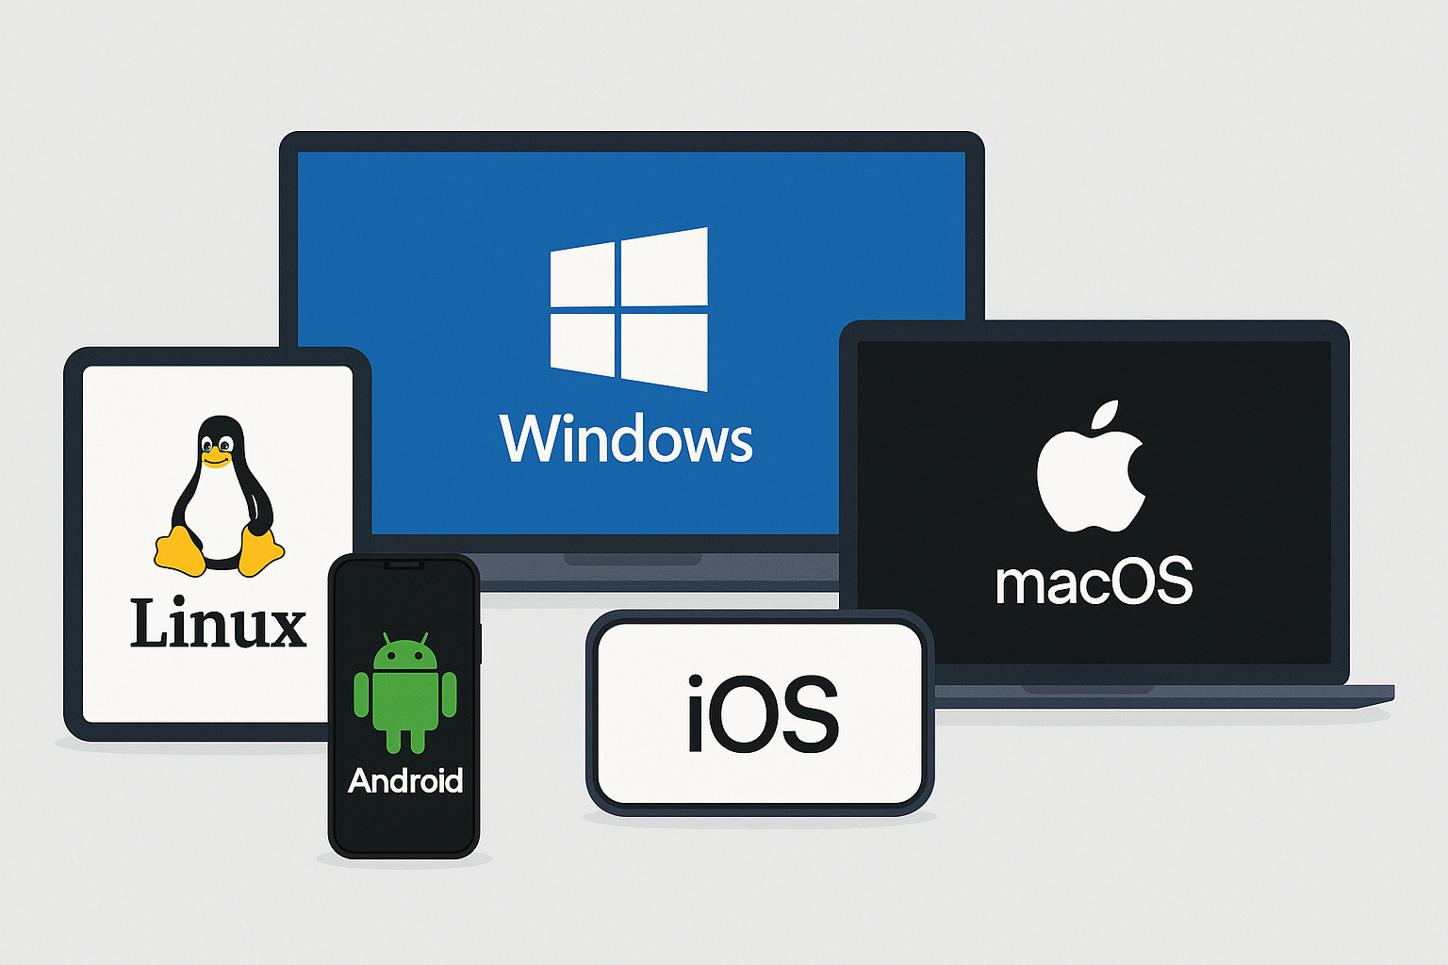
Popular Operating System Examples
Microsoft Windows - desktop market leader
macOS - Apple's desktop operating system Linux - open-source Unix-like OS
Android - mobile OS by Google iOS - mobile OS by Apple
Chrome OS - web-centric OS by Google
14/20

Slide 15

Conclusion
Operating systems are computing foundations
They manage hardware and software resources Various types serve different computing needs Security and efficiency remain key priorities Rapidly evolving with new technologies Essential for all modern computing systems
15/20

Slide 16

Time for Some MCQs
16/20
Notes:
C

Slide 17
Which operating system executes tasks within a specified time limit and is used in critical systems like pacemakers and flight control?
a) Distributed OS
b) Time-sharing OS
c) Real-time OS
d) Multiprogramming OS
Which operating system executes tasks within a specified time limit and is used in critical systems like pacemakers and flight control?
a) Distributed OS
b) Time-sharing OS
c) Real-time OS
d) Multiprogramming OS
17/20

Slide 18
Which type of operating system allows multiple users to use the computer system interactively at the same time? a) Real-time OS b) Time-sharing OS c) Batch OS d) Distributed OS
Which type of operating system allows multiple users to use the computer system interactively at the same time? a) Real-time OS b) Time-sharing OS c) Batch OS d) Distributed OS
18/20

Slide 19
Which of the following functions is responsible for allocating and deallocating memory to processes? a) Processor management b) File management c) Memory management d) I/O management
Which of the following functions is responsible for allocating and deallocating memory to processes? a) Processor management b) File management c) Memory management d) I/O management
19/20

Slide 20
The OS function that keeps track of the status of each I/O device is called: a) I/O traffic control b) Spooling c) Device management d) Buffering
v
20/20

Slide 21
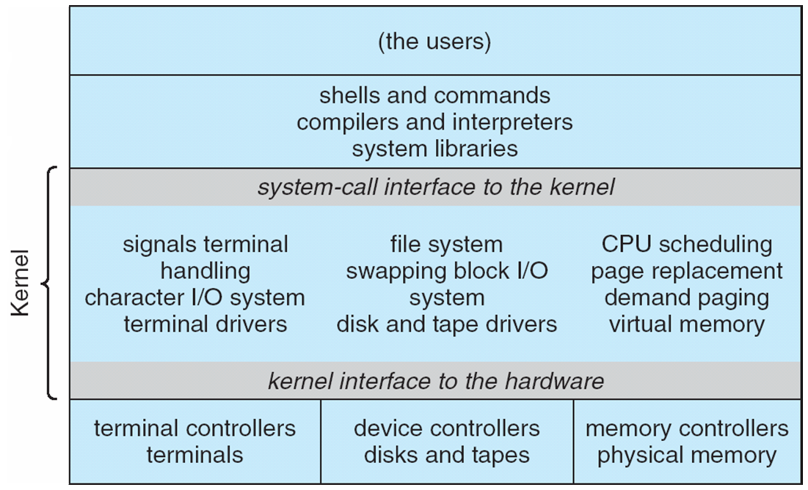
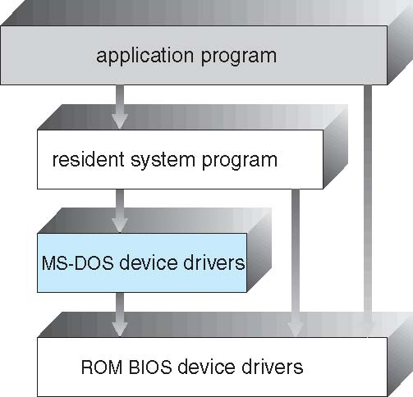
Operating Systems Structure
Simple Structure -- MS-DOS
Traditional UNIX System Structure
Provide most functionality in least space
Not divided into modules
Levels of functionality are not separated

Slide 22
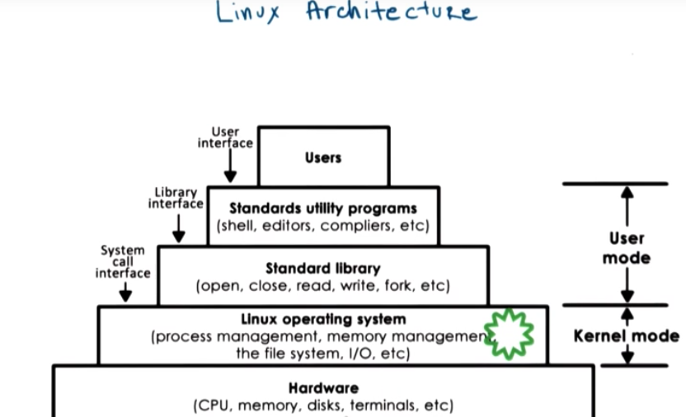
Traditional LINUX System Structure

Slide 23
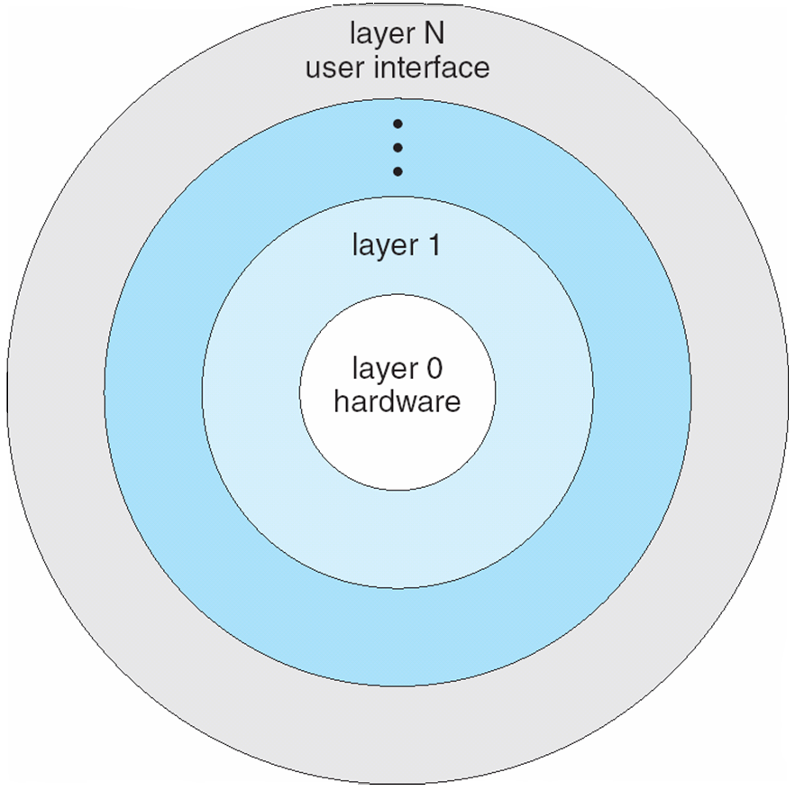
Layered Approach
The Operating System (OS) is divided into layers (levels), where each layer builds on the services of the layer below it.
Layer 0 (Bottom Layer): Hardware (CPU, memory, I/O devices).
Layer N (Top Layer): User interface (where users interact with the system).
Each layer only interacts with the immediately lower layer, ensuring modularity.
This makes the system easier to design, debug, and maintain, since changes in one layer don’t directly affect others.

Slide 24
Kernel
Kernel
The kernel is the central part of an OS.
Role:
It acts as a bridge between user applications (software) and hardware (CPU, memory, devices).
The main goal is to manage communication between applications and hardware.
Main Tasks of the Kernel:
Main Tasks of the Kernel:
Process Management
Device Management
Memory Management
Interrupt Handling
I/O communication
File System …etc

Slide 25
Kernel
A kernel is the lowest level of software that interfaces with the hardware in your computer.
It is responsible for interfacing all applications that are running in “user mode” down to the physical hardware, and allowing processes, to get information from each other using inter-process communication (IPC).

Slide 26
Types of Kernels
Kernels fall into 3 main types:
1. Monolithic Kernel
Entire OS runs in kernel space (single large process).
All services like device drivers, file system, memory management, and process scheduling are inside the kernel.
Advantages:
Fast execution (no context switching between kernel/user for services).
High performance.
Disadvantages:
Large size, less secure (a bug in one module can crash the whole system).
Examples: Linux, UNIX, MS-DOS.

Slide 27
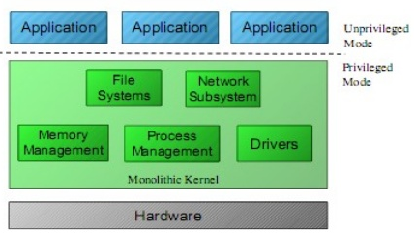
Monolithic Kernel

Slide 28
Types Of Kernel
2. Microkernel
Only the essential services (CPU scheduling, memory management, IPC) run in kernel space.
Other services like device drivers, file system, etc. run in user space.
Advantages:
More secure and stable (fault isolation).
Easier to extend (new services can be added in user space).
Disadvantages:
Slower due to frequent user-kernel context switching.
Examples: QNX, Minix, Mach.
22M

Slide 29
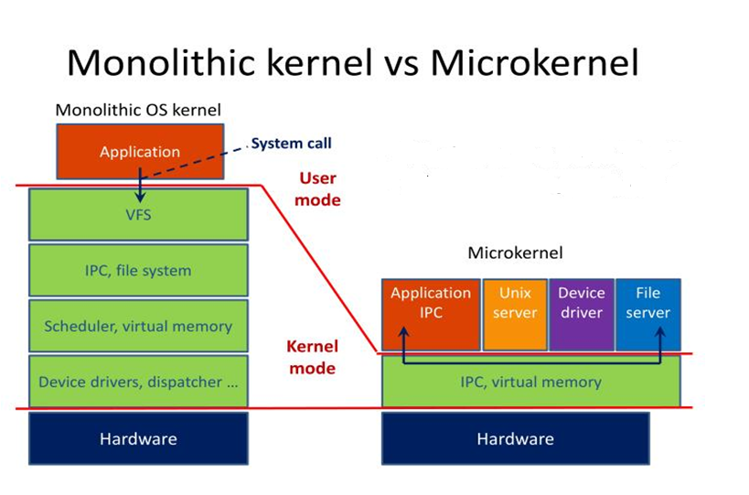
Types of Kernel

Slide 30
Hybrid Kernel
A combination of Monolithic and Microkernel.
Hybrid kernels have the ability to pick and choose what they want to run in user mode and what they want to run in supervisor mode.
Some non-essential services (like drivers) run in kernel mode for speed, while others may run in user mode for stability.
Advantages:
Good balance between performance and security.
Smaller install than monolithic kernel
More flexible than other models
Disadvantages:
More complex design.
Processes have to wait in a queue to get information
Processes can’t get access to other processes without waiting
Device drivers need to be managed by user
Examples: Windows NT, macOS (XNU Kernel).

Slide 31
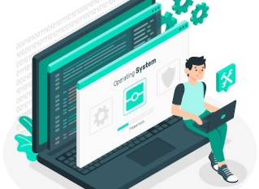

Operating System Views
User Viewpoint
System Viewpoint
Aims to maximize productivity by simplifying interactions
Emphasizes the OS's role as a resource manager and control program.

Slide 32
Dual-Mode Operation
To protect the Operating System (OS) and resources, modern computers work in two modes:
User Mode (mode bit = 1)
Normal programs run here (e.g., MS Word, browsers, games).
Limited access: cannot directly access hardware.
Prevents user programs from accidentally damaging the system.
Kernel Mode (mode bit = 0)
OS runs here with full privileges.
Can directly access hardware (CPU, memory, I/O devices).
Executes system calls on behalf of user programs.
✔️ A Mode Bit (stored in CPU hardware) keeps track of whether the system is in user mode or kernel mode.

Slide 33
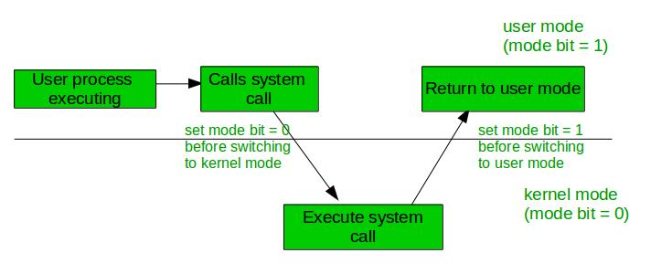
Operating Systems Operations

Slide 34
Dual-Mode Operation
Transition Mechanism
Switching to kernel mode happens during
System calls or interrupts, enabling tasks
User Mode vs. Kernel Mode
User mode:
Applications operate with limited privileges
Kernel mode:
Offers full access to system resources.

Slide 35
Which OS structure runs the entire OS in kernel space as one large process? a) Microkernel b) Monolithic Kernel c) Hybrid Kernel d) Layered Kernel

Slide 36
Answer: b) Monolithic Kernel ✅

Slide 37
Which type of kernel is considered more secure and stable due to fault isolation? a) Monolithic Kernel b) Microkernel c) Hybrid Kernel d) None of the above

Slide 38
Answer: b) Microkernel ✅

Slide 39
In dual-mode operation, the mode bit is 1 when the system is in: a) Kernel mode b) User mode c) Supervisor mode d) Debug mode

Slide 40
Answer: b) User mode ✅ (Mode bit = 0 → Kernel mode, Mode bit = 1 → User mode.)

Slide 41
In a layered OS structure, each layer: a) Can interact with any other layer b) Interacts only with the layer immediately below it c) Is independent of all other layers d) Runs in both user and kernel mode simultaneously

Slide 42
Answer: b) Interacts only with the layer immediately below it ✅

Slide 43
Which of the following is an example of a Hybrid Kernel? a) MS-DOS b) Linux c) Windows NT d) Minix

Slide 44
Answer: c) Windows NT ✅

