Slide 1
Memory Management

Slide 2
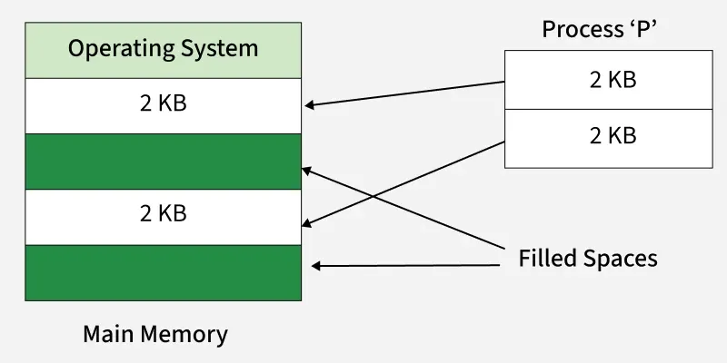
Non-contiguous Memory Allocation
A process does not need to occupy a single continuous block of physical memory.
The process is divided into parts (segments or pages) that can be stored in different locations in main memory.
Increases flexibility and reduces external fragmentation.

Slide 3
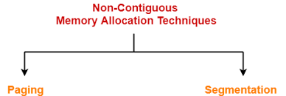
Non-Contiguous memory allocation

Slide 4
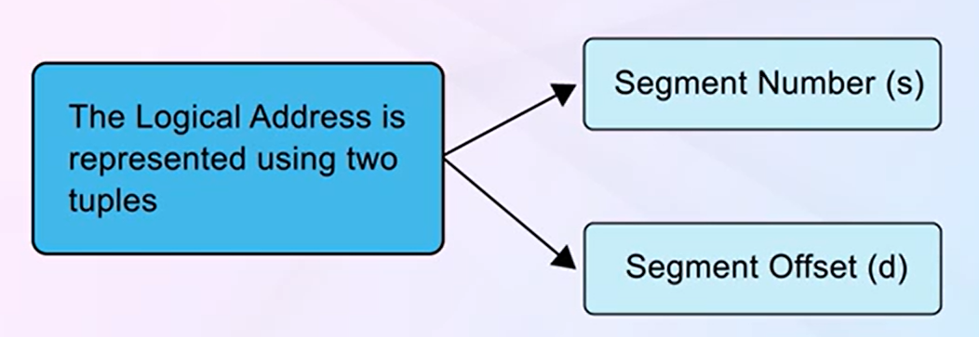
Segmentation
Segmentation divides a user process into several segments of variable size, unlike paging, which uses equal-sized pages.
Segments correspond to logical structures in programs, such as main programs, functions, and variables.
Segment Table and Address Translation
A segment table is used to manage segments, containing base addresses and limit values for each segment.
Logical addresses are represented as tuples of segment number and offset, with conversion to physical addresses involving checks against limit values.

Slide 5
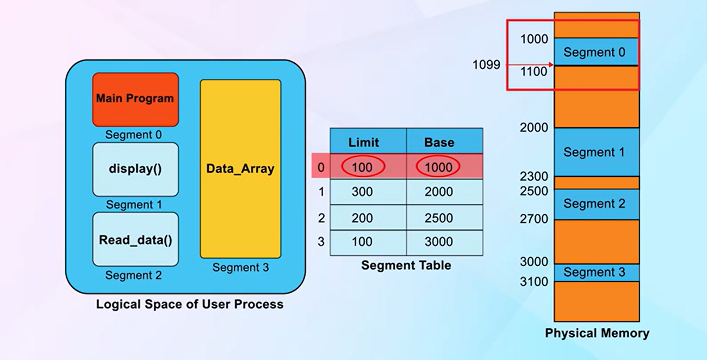

Slide 6
Segmentation Architecture
Each segment has a name and its length.
Logical address consists of a two tuple:
<segment-number, offset>,
Segment table – maps physical addresses; each table entry has:
base – contains the starting physical address where the segments reside in memory
limit – specifies the length of the segment
Segment-table base register (STBR) points to the segment table’s location in memory
Segment-table length register (STLR) indicates number of segments used by a program;
segment number s is legal if s < STLR
Notes:
6

Slide 7
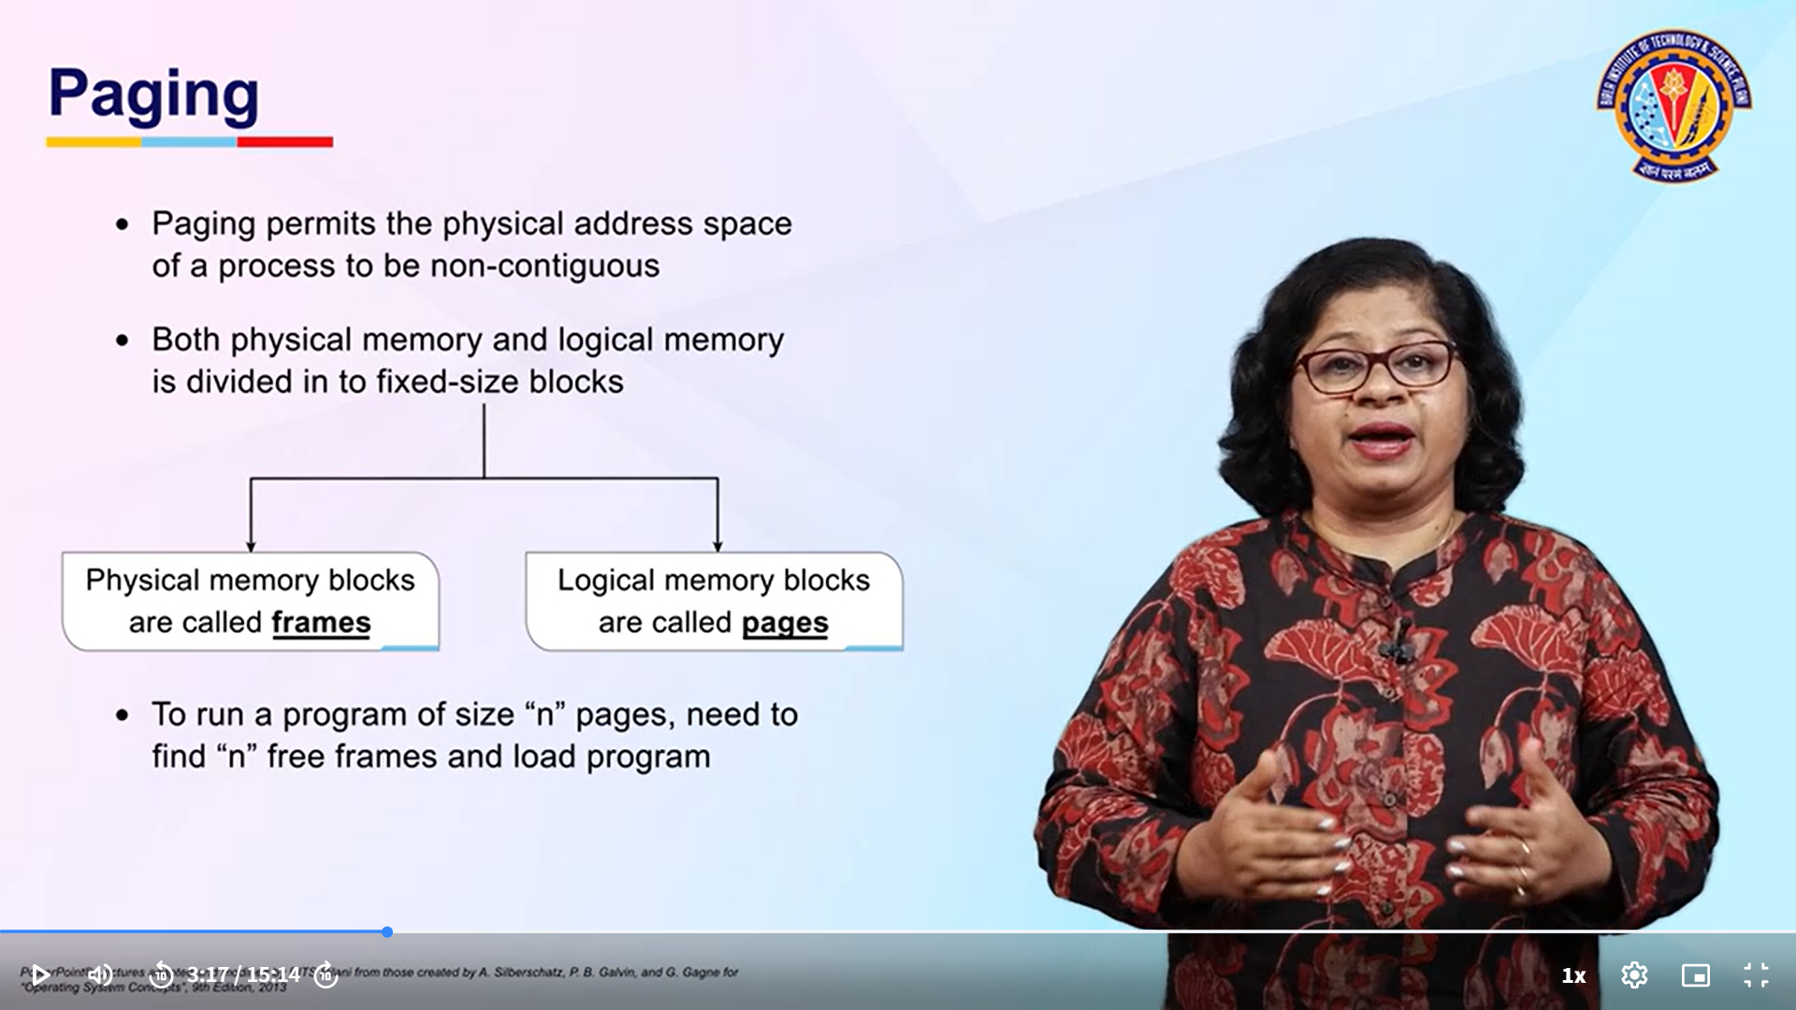
Paging
Paging is a memory management scheme that eliminates the need for contiguous allocation of physical memory. It allows a process’s logical address space to be non-contiguous, thus avoiding external fragmentation and efficiently using memory.

Slide 8
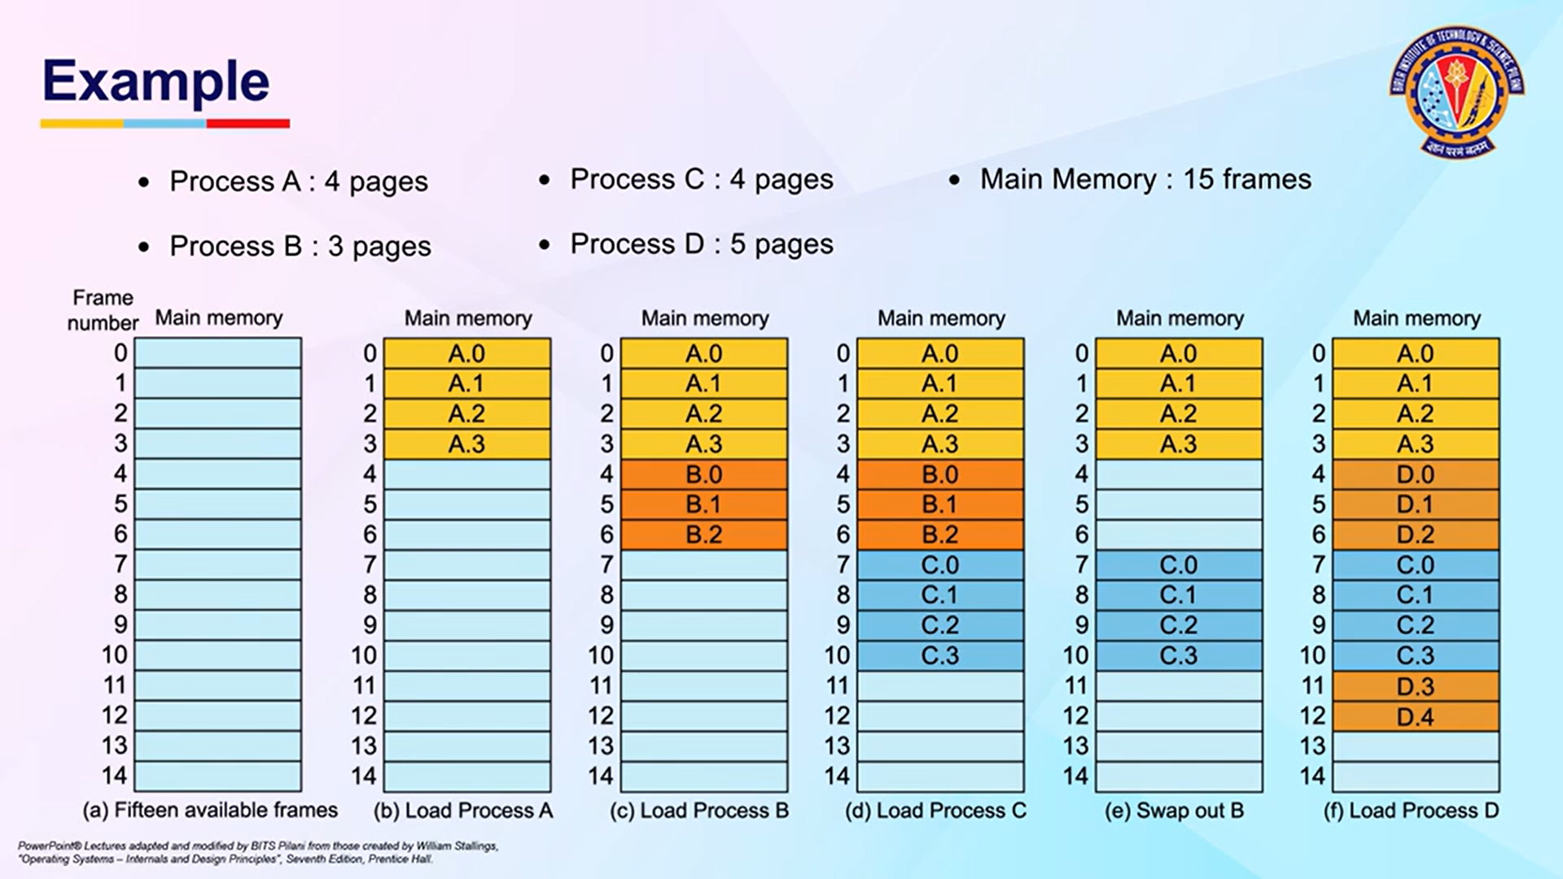
Notes:
in paging, the page size = frame size.

Slide 9


Slide 10


Slide 11
Paging Scheme
The final physical address is formed by combining the frame number (f) (from the page table)with the displacement (d) (from the logical address).
This results in a physical address in RAM that the CPU can use to access the correct data.
Paging helps eliminate external fragmentation and reduces internal fragmentation by allowing non-contiguous physical address spaces.
Memory is divided into fixed size pages (logical memory) and frames (physical memory), with a page table that maps logical pages to physical frames.
Address Translation and Page Size
Logical addresses consist of a page number and an offset, which are used to find the corresponding physical address through the page table.
Notes:
It maps the page number (p) of the logical address to a corresponding frame number (f) in physical memory.
Each entry in the page table points to a frame in physical memory where the actual data is stored.

Slide 12
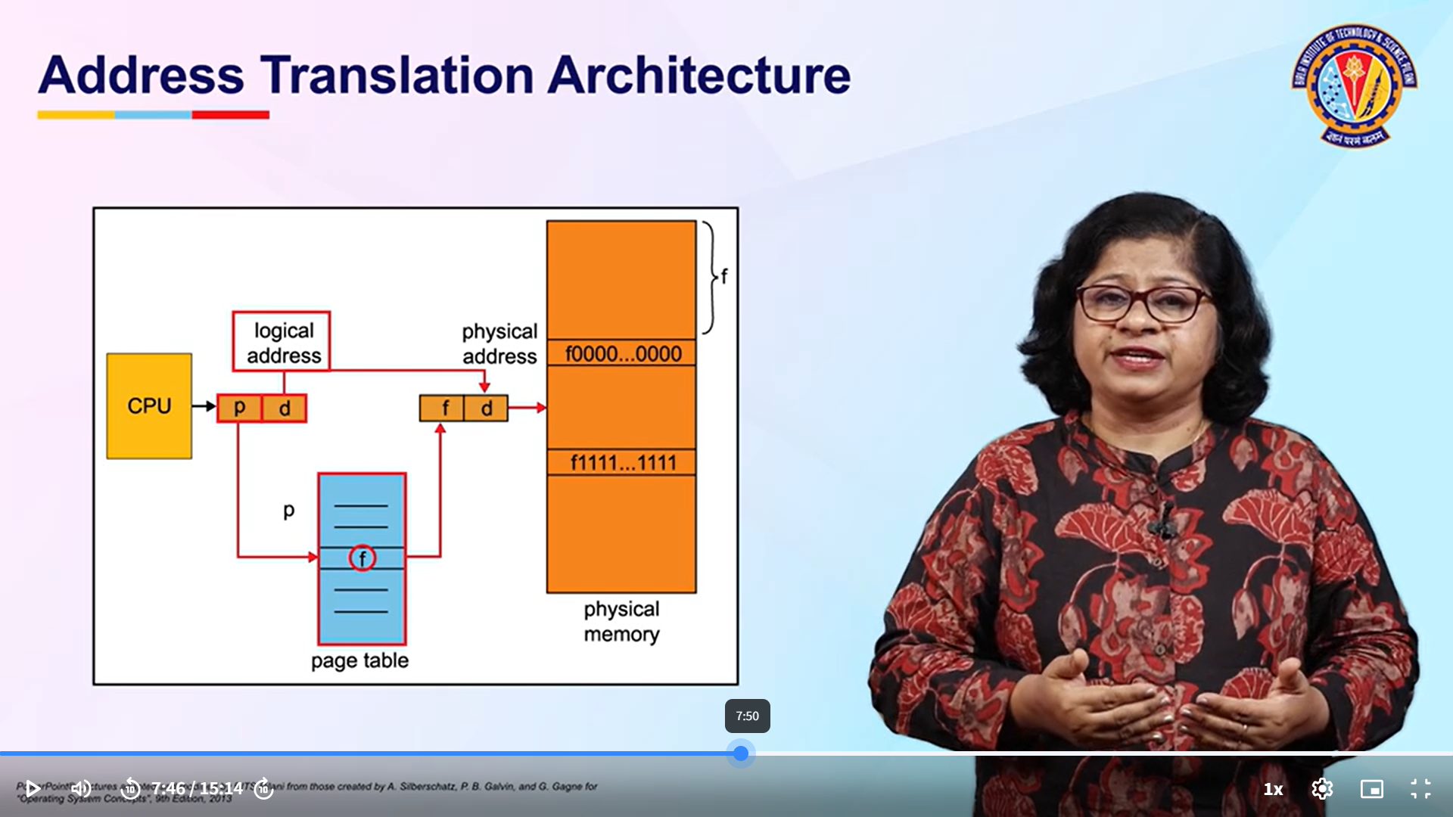

Slide 13
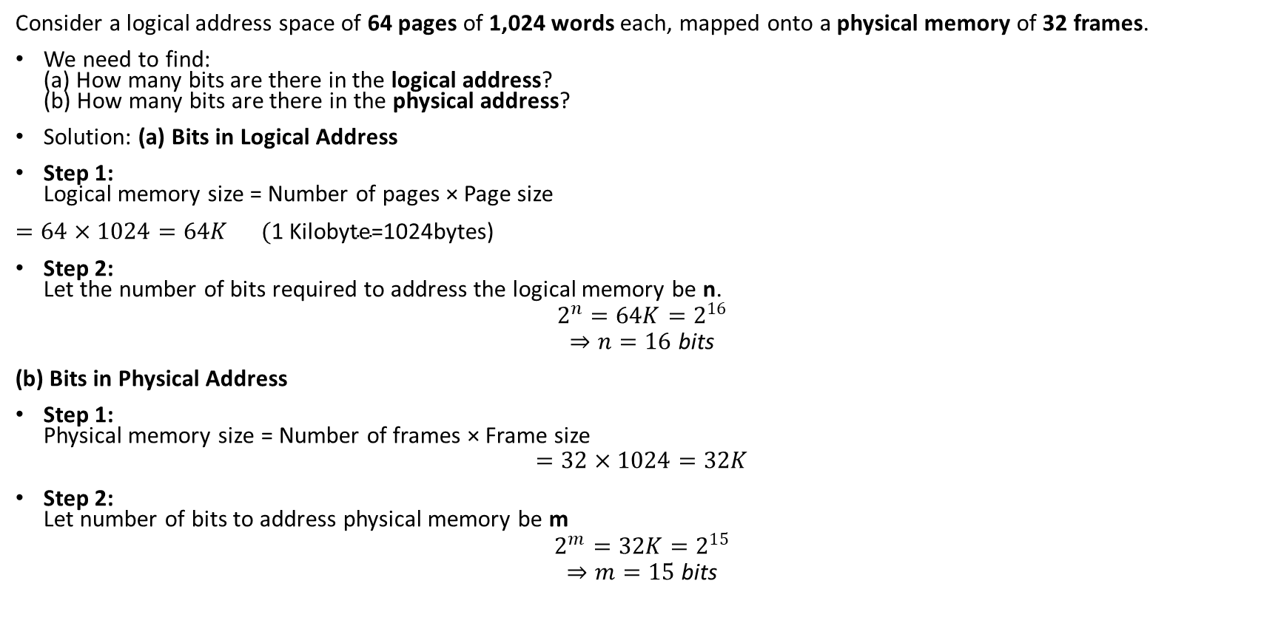
Example Question:
Consider a logical address space of 64 pages of 1,024 words each, mapped onto a physical memory of 32 frames.
We need to find: (a) How many bits are there in the logical address? (b) How many bits are there in the physical address?
Solution: (a) Bits in Logical Address
Step 1: Logical memory size = Number of pages × Page size
$=64×1024=64K (\text{1 }\text{Kilobyte}\text{=}\text{1024}$bytes)
Step 2: Let the number of bits required to address the logical memory be n.
$$2^{n}=64K=2^{16}$$
$$⇒n=16 \text{bits}$$
(b) Bits in Physical Address
Step 1: Physical memory size = Number of frames × Frame size
$$=32×1024=32K$$
Step 2: Let number of bits to address physical memory be m
$$2^{m}=32K=2^{15}$$
$$⇒m=15 \text{bits}$$
Notes:
64=2power6and1024=2power10
So 64k=2power6x2power10
2power 6+10=2power16

Slide 14
Page Table
The Page Table is kept in main memory (RAM).
Every process has its own page table.
The CPU needs to know where the page table starts — so there is a special register called:
Page Table Base Register (PTBR)
The PTBR stores the starting address (base address) of the page table in memory.
Whenever the CPU generates a logical address, it uses the PTBR to find the correct page table and look up the frame number.
The Performance Issue: "Two Memory Accesses"
The CPU generates a logical address (page number + offset).
It must first access the page table in memory (using PTBR) to find the frame number.
Then, it accesses the actual data in physical memory using that frame number.
That means:
🔹 One memory access for the page table 🔹 One memory access for the actual data
So total = 2 memory accesses per instruction.
❌ This makes memory access slower — because everything takes twice as long.

Slide 15
Solution: Use a Translation Lookaside Buffer (TLB) A TLB is a special cache (high-speed memory) inside the CPU that stores recently used page table entries.
How It Works:
When the CPU generates a logical address:
It first checks the TLB to see if the page number is already there.
If found (TLB hit) →
The corresponding frame number is fetched instantly from the TLB.
Only 1 memory access is needed (for the data).
If not found (TLB miss) →
The CPU accesses the page table in main memory (2 memory accesses).
Then it adds that entry to the TLB for future use.

Slide 16
Question :In a paged memory, the page hit ratio is 0.35. The time required to access a page in secondary memory is equal to 100 ns. The time required to access a page in primary memory is 10 ns. The average time required to access a page is? a) 3.0 ns b) 68.0 ns c) 68.5 ns d) 78.5 ns
Solution: Page hit ratio: 0.35
Page Miss :1-0.35 =0.65
Secondary memory access time= 100ns
Primary memory access time =10ns
Average time to access page=(Hit ratio×Primary access time)+(Miss ratio×(Primary+Secondary access time))
(0.35×10)+(0.65×(10+100))=75.0 ns (close to 78.5ns)
Note:Because on a miss, you must first access the secondary memory and then bring it to primary memory.

Slide 17
VIRTUAL MEMORY
Virtual Memory is a memory management technique that gives an illusion of a very large main memory (RAM) by temporarily using a part of the hard disk as an extension of RAM.
It allows programs that are larger than physical memory to execute efficiently.
How It Works
When a process is executed, it is divided into pages.
Only a few of these pages are kept in RAM at a time.
The rest of the pages are kept on the hard disk (secondary storage) in a space called the swap area or page file.
When the CPU needs a page that’s not in memory, a page fault occurs:
The OS swaps out an unused page from RAM (if necessary),
And loads the required page from disk into RAM.
This process is called paging in and paging out.
Less I/O would be needed to load or swap each user program into memory, Virtual memory can be implemented via:
Demand paging

Slide 18
Demand Paging
Bring a page into memory only when it is needed
Less I/O needed
Less memory needed
Faster response
More users
Page is needed ⇒ reference to it
not-in-memory ⇒ bring to memory
Notes:
18

Slide 19
Valid-Invalid Bit
With each page table entry a valid–invalid bit is associated (v ⇒ in-memory, i ⇒ not-in-memory)
Initially valid–invalid bit is set to i on all entries
Example of a page table snapshot: During address translation, if valid–invalid bit in page table entry
is I ⇒ page fault
Frame #
valid-invalid bit
v
v
v
v
i
….
i
i
page table
Notes:
19

Slide 20
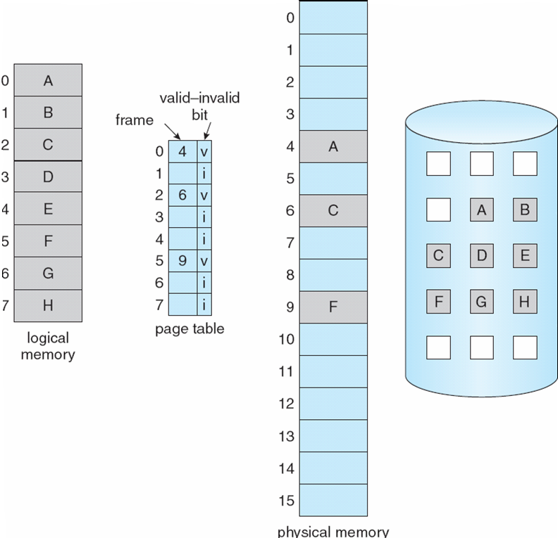
Page Table When Some Pages Are Not in Main Memory
Notes:
20

Slide 21
Page Fault
If the required page is not available in Physical Memory: Page Fault
A page reference is a request made by the CPU to access data or instructions from a specific page.
Get empty frame
Swap page into frame
Reset tables
Set validation bit = v
Restart the instruction that caused the page fault
Suppose a program accesses Page 7, but Page 7 is not in memory.
➡️ Page Fault occurs ➡️ OS finds a free frame (say Frame 3) ➡️ Page 7 is loaded from disk into Frame 3 ➡️ Page Table updated: Page 7 → Frame 3, Valid = 1 ➡️ CPU restarts the instruction successfully
Notes:
21

Slide 22
What happens if there is no free frame?
If all frames in physical memory are already occupied, the OS cannot directly load the new page.
So the OS must free up a frame by removing (replacing) one of the pages currently in memory.
Solution: Page Replacement
Step1:The OS must select a victim frame using a Page Replacement Algorithm, such as:
Algorithm | Description
FIFO (First-In-First-Out) | Replace the oldest loaded page.(Disadvantage: Can remove frequently used pages → leads to Belady’s Anomaly (more frames cause more page faults).
LRU (Least Recently Used) | Replace the page that has not been used for the longest time.
Optimal | Replace the page that will not be used for the longest time in the future (Called OPT or MIN,used in theory).
Notes:
the victim page is the memory page that gets swapped out to make room for the new page being brought into main memory during page replacement.

Slide 23
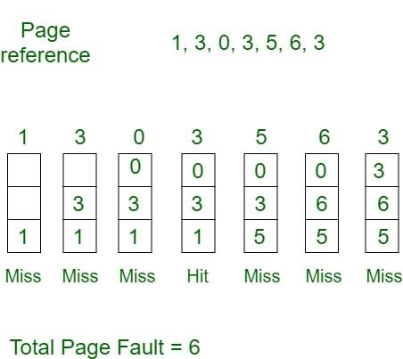
Example Question:
Consider page reference string 1, 3, 0, 3, 5, 6, 3 with 3-page frames. Find the number of page faults using FIFO Page Replacement Algorithm.
Notes:
A reference string is a sequence of memory page numbers that a process requests over time.
Each number in the reference string represents a page that the CPU needs to access.

Slide 24
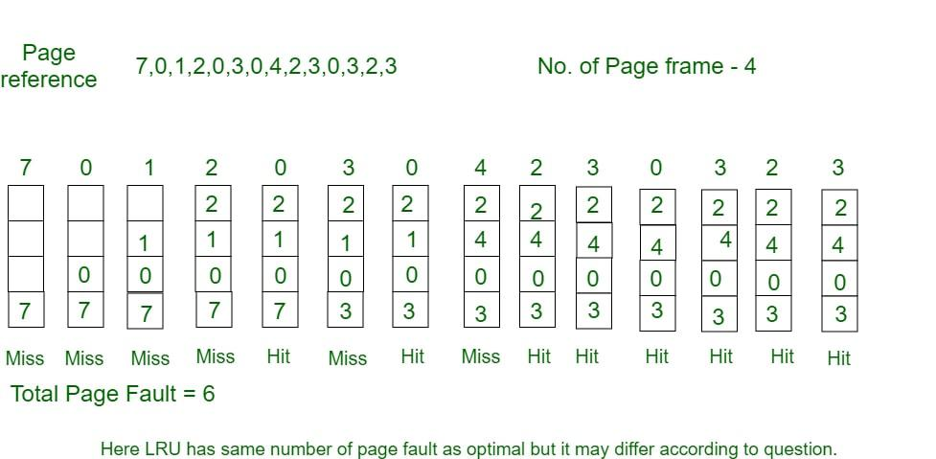
Example Consider the page reference string 7, 0, 1, 2, 0, 3, 0, 4, 2, 3, 0, 3, 2, 3 with 4-page frames. Find number of page faults using LRU Page Replacement Algorithm.

Slide 25
Step 2:Check if the Page Is Modified (Dirty Bit)
Each page has a dirty bit:
Dirty bit = 1: Page has been modified → must be written back to disk before replacement.
Dirty bit = 0: Page unchanged → can be directly replaced.
Step 3: Swap In the New Page
The OS brings the required page from disk.
Places it into the newly freed frame.
Step 4: Update the Page Table enteries.
Step 5: Restart the Instruction

Slide 26
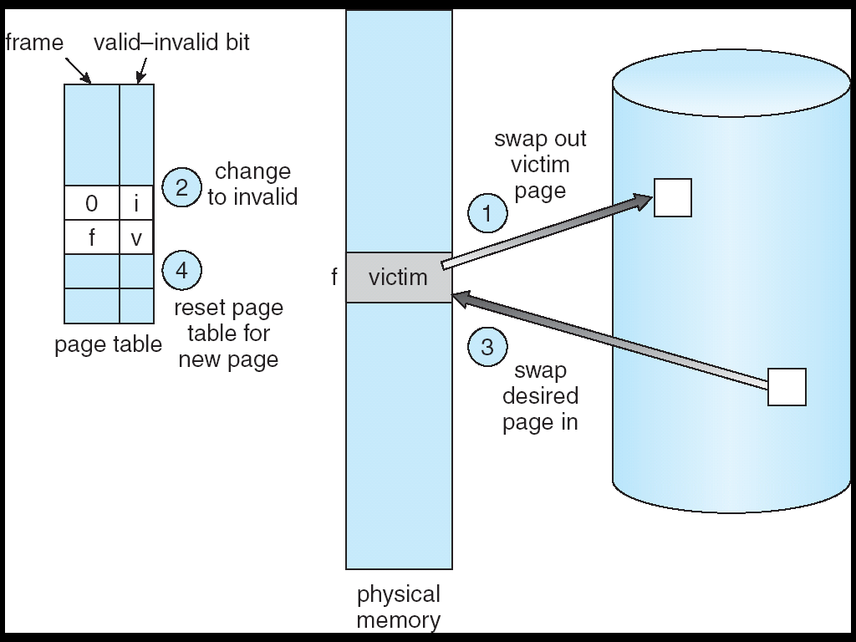

Slide 27
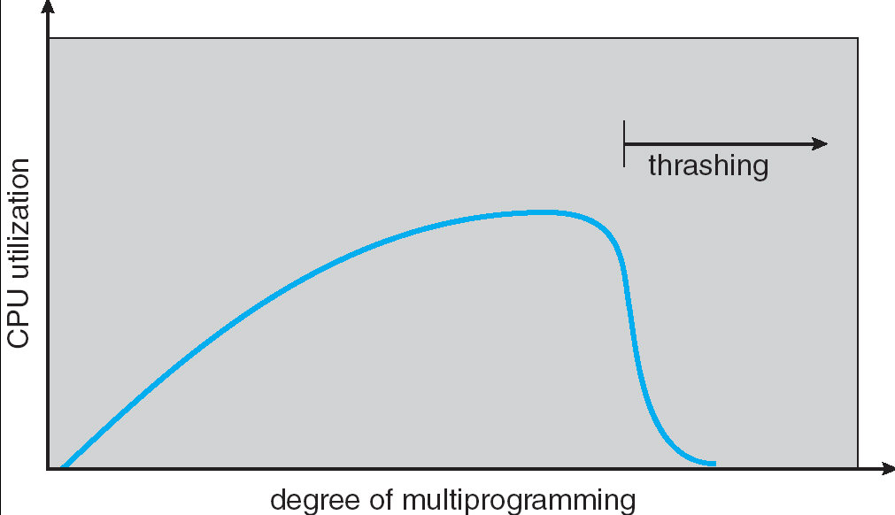
What is Thrashing?
Thrashing occurs when a process (or multiple processes) spends more time swapping pages in and out of memory than executing actual instructions.
Thrashing is a condition where the CPU utilization drops drastically because the operating system is constantly busy handling page faults (loading and removing pages) instead of running useful programs.

Slide 28
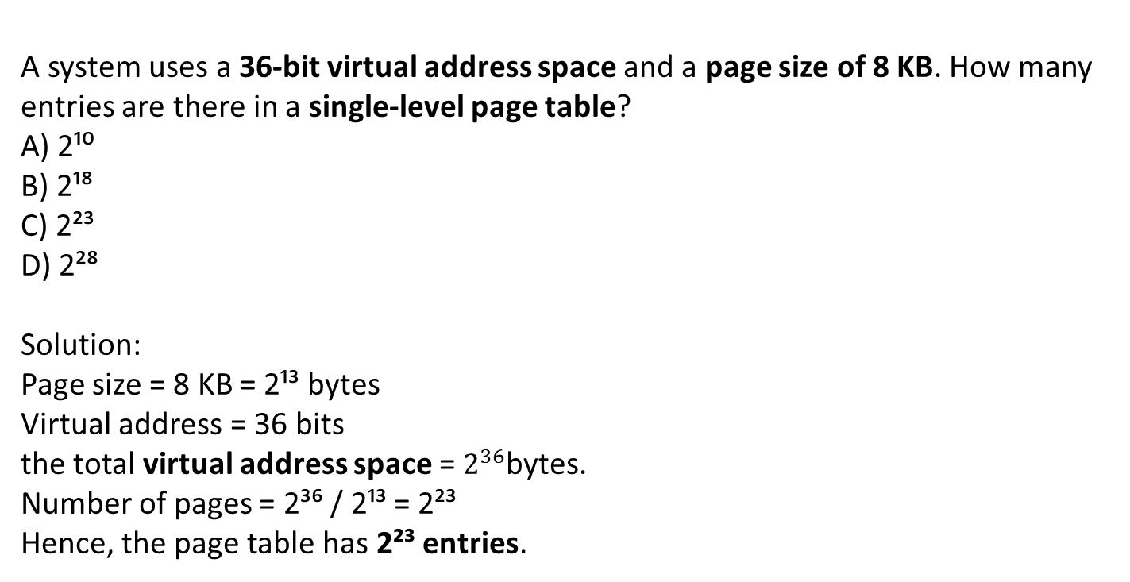
Sample Question
A system uses a 36-bit virtual address space and a page size of 8 KB. How many entries are there in a single-level page table?
A) 2¹⁰ B) 2¹⁸ C) 2²³ D) 2²⁸
Solution:
Page size = 8 KB = 2¹³ bytes
Virtual address = 36 bits
the total virtual address space = $2^{36}$bytes.
Number of pages = 2³⁶ / 2¹³ = 2²³
Hence, the page table has 2²³ entries.

