Slide 1
Pinakidion
A Scripture Text Editor Powered By Proskomma
by Mark Howe
August 2021

Slide 2
Pinakidion
“Diminutive of pinax – little (wooden) tablet - especially of a writing tablet for notes (Lk 1.63)”

Slide 3
Pinakidion
Proskomma Scripture Runtime Engine
Electronite App Framework
  Chaliki Framework for Proskomma
SlateJS
https://github.com/Proskomma/pinakidion

Slide 4
<Demo Goes Here>

Slide 5
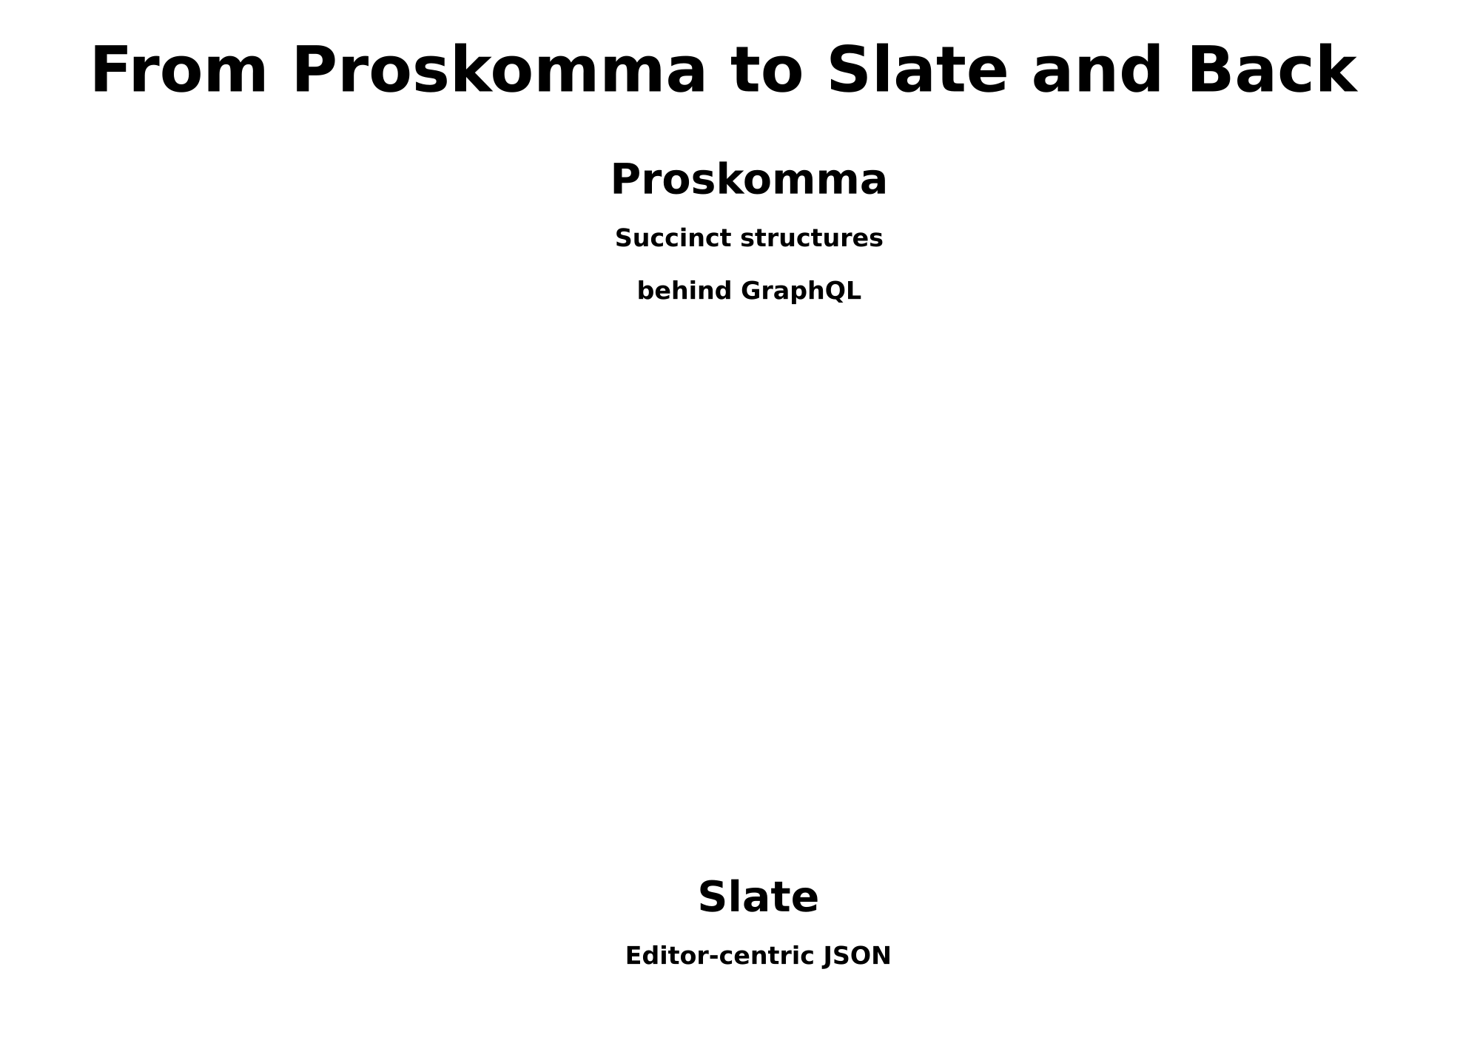

Slide 6
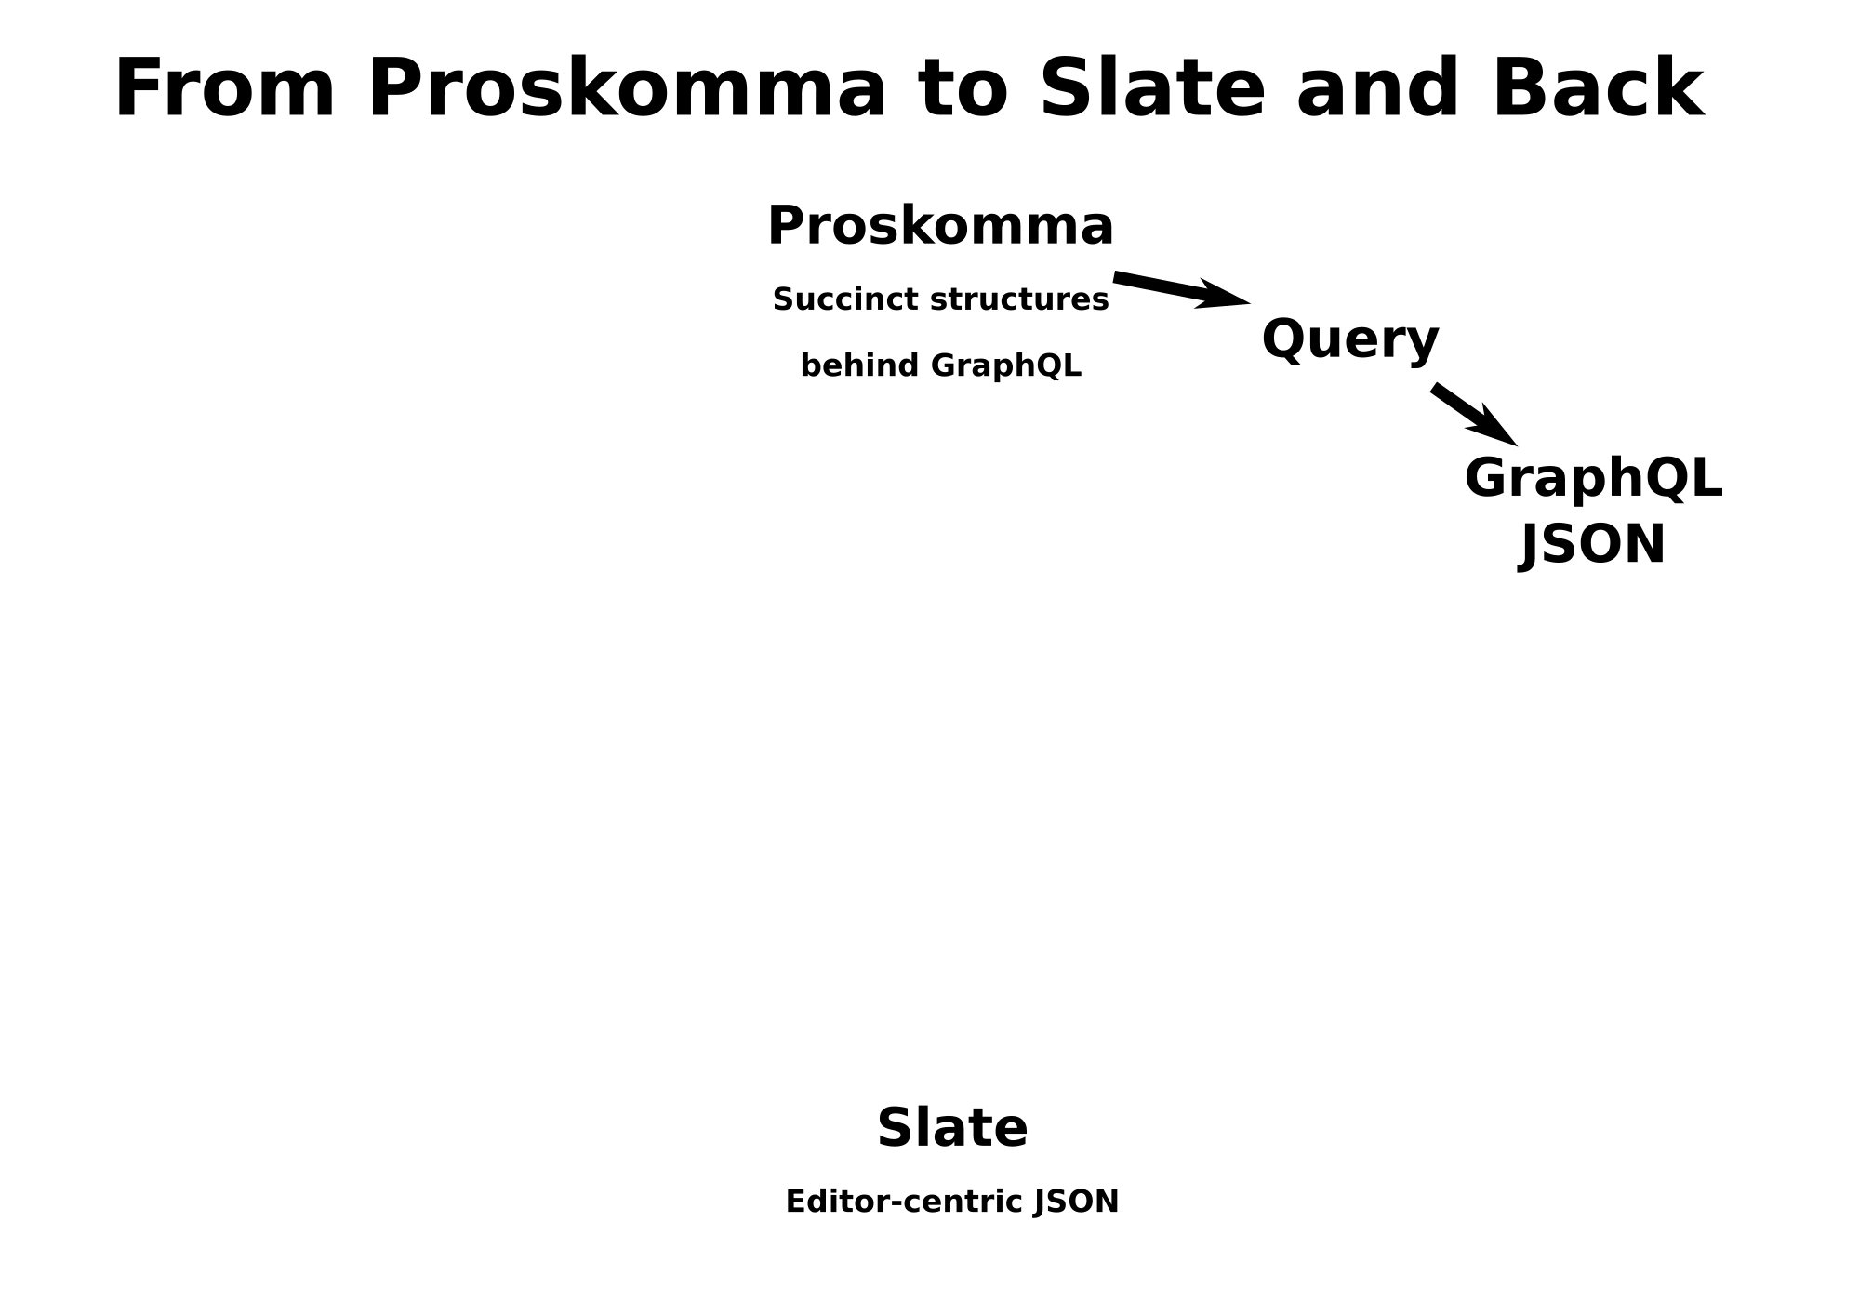

Slide 7
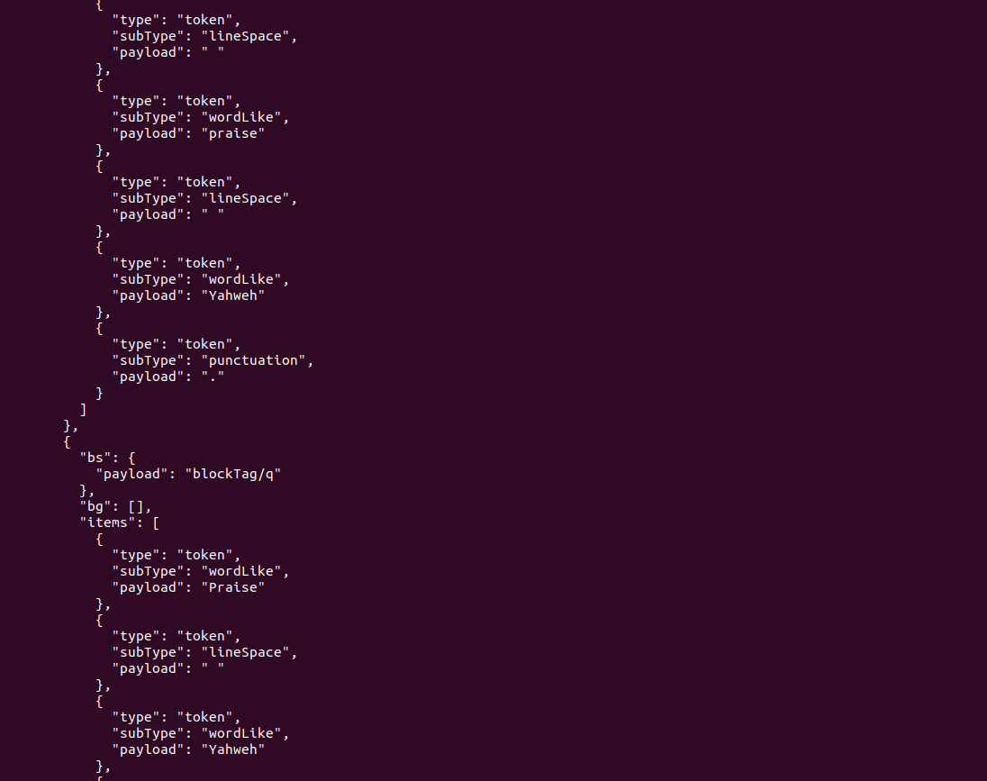

Slide 8
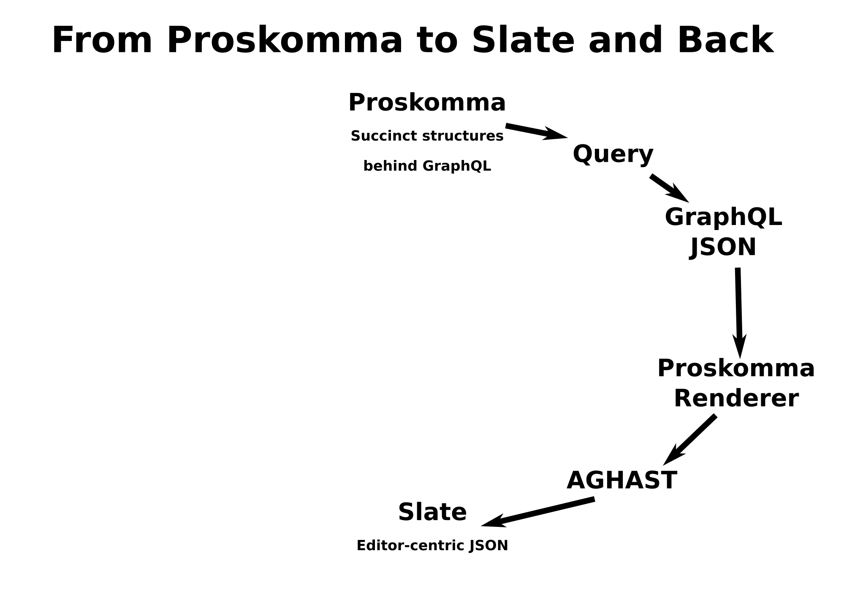

Slide 9
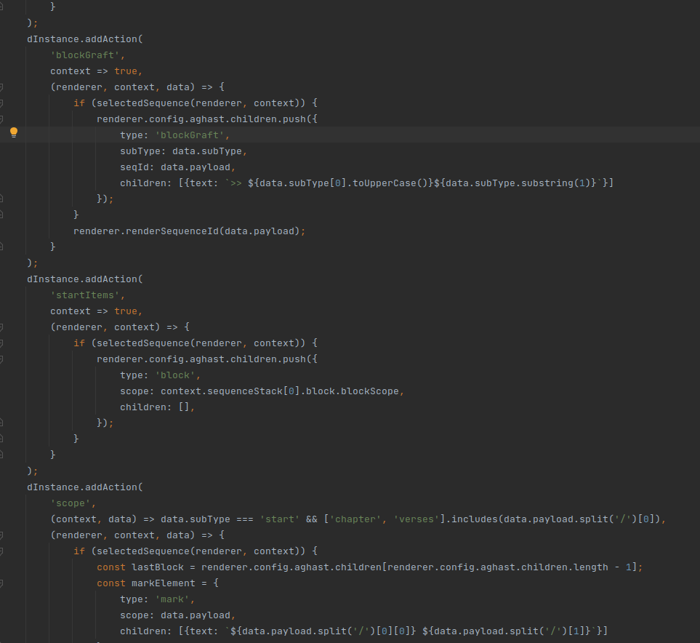

Slide 10
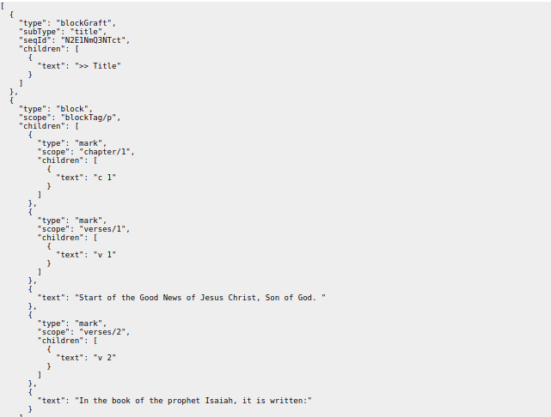

Slide 11
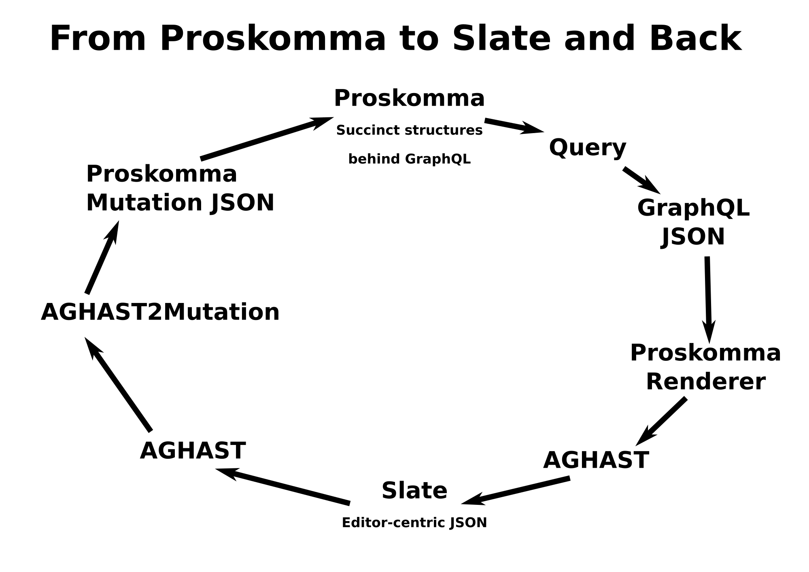

Slide 12
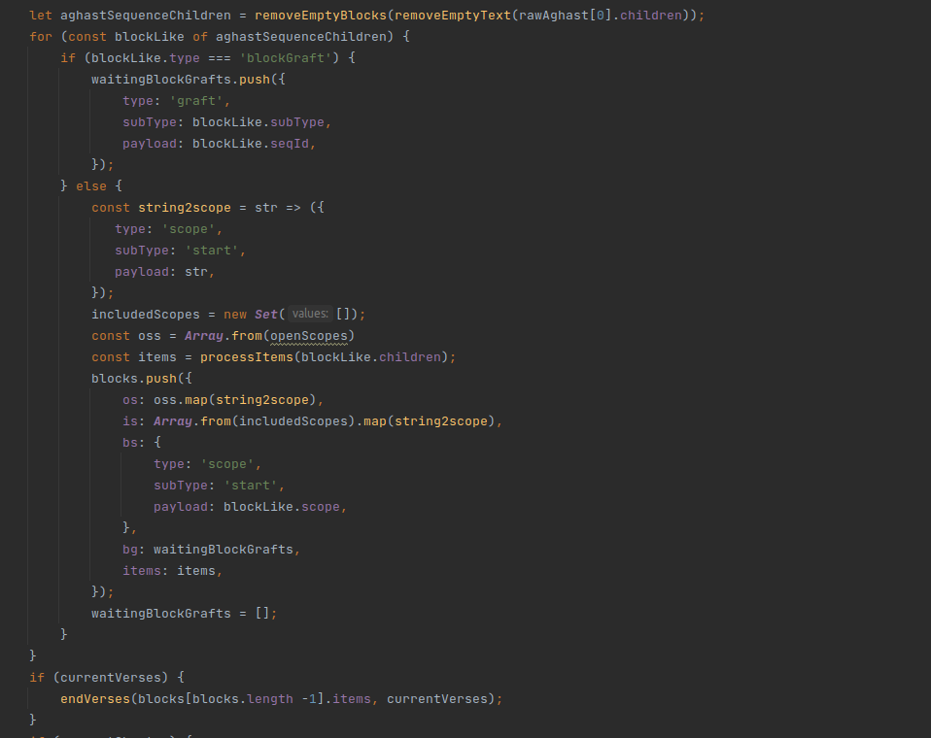

Slide 13
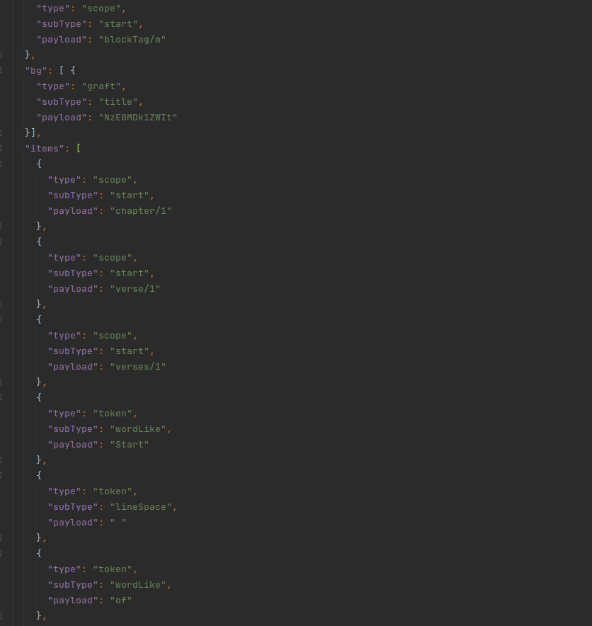

Slide 14
What Next?
More tags
USFM Export
Agree editing API (sequence? block? Character?)
Proskomma-aghast interface layer
Schemas
Proskomma does checking and normalization

